Slide 1
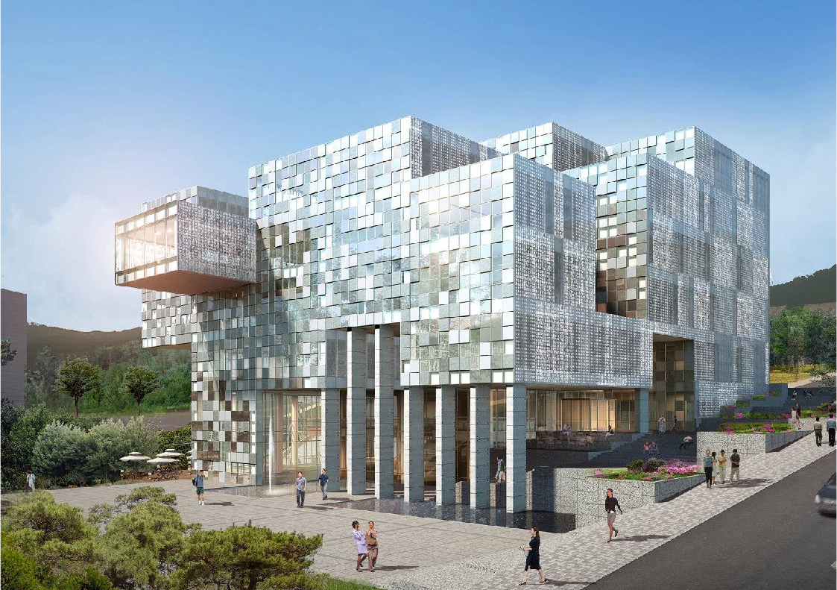

Study on high-k
material zirconium Oxide
HOSEO University Student
Undergraduate 3_{rd} grade Lee Ji Won
Notes:
안녕하세요. 저는 호서대학교 학생 이지원입니다.
Hello. I am Lee Ji Won, a student at Hoseo University.
발표를 시작하겠습니다.
I will start the presentation.

Slide 2
High - K material
INDEX
Investigation on Zirconium Oxide
Description of the solution process
1) Compare deposition process with solution process
2) Zirconium Oxide solution process
ZrO2 solution spin coating on silicon wafer
1) Metal - Insulator - Metal structure device process
2) C - V Measurement of device
3) ZrO2 Microscopy
4) Dielectric constant find
Notes:
목차는 세 가지 주요 내용입니다.
The table of contents is three main categories.
첫 번째는 하이케이 물질인 지르코늄 옥사이드에 대한 설명입니다.
The first is a description of the High-K material, Zirconium oxide.
두 번째는 용액공정에 대한 설명입니다.
The second is a description of the solution process.
세 번째는 ZrO2 solution spin coating on silicon wafer 에 대한 설명입니다.
- The third is the description of the Zirconium oxide solution spin coating
on silicon wafer.

Slide 3
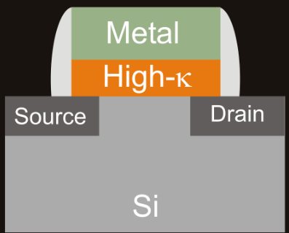
High - K material
Investigation on Zirconium Oxide
The Hi-K material must have a specific inductive capacity than Silicon oxide.
the Hi-K material should have large bandgaps and high energy barriers.
Zirconium oxide is capable of a solution process.
Notes:
최근에는 SiO2를 대체할 물질은 high-k 물질이 가장 많이 연구되어 왔습니다.
Recently, high-k materials have been studied the most frequently to replace Silicon oxide.
하이케이 물질은 SiO2보다 큰 비유전율 값을 가지는 물질이어야 합니다.
the Hi-K material must have a specific inductive capacity than Silicon oxide.
즉, 소자의 누설전류가 SiO2를 사용하였을 경우와 동일한 정전용량값을 유지해야 합니다.
In other words, it is required to maintain the same capacitance value as when SiO2 is used for leakage current of the device.
두 번째로 하이케이 물질은 큰 에너지 간격과 높은 에너지 장벽을 가져야 합니다.
Second, the Hi-K material should have large bandgaps and high energy barriers.
ZrO2는 SiO2를 대체할 물질로 최근 많이 연구되고 있습니다.
ZrO2 has recently been studied as an alternative to SiO2.

Slide 4
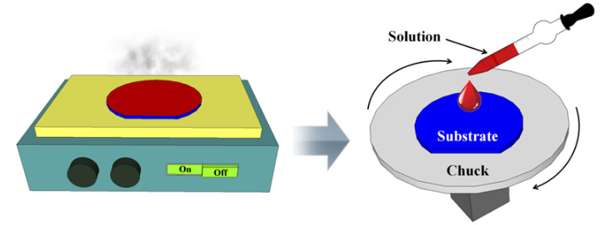
Description of the solution process
1) Compare deposition process with solution process
The solution process has lower facility investment.
Smaller equipment enables faster processes.
The solution process can make electronic devices cheaply and quickly.
Notes:
용액공정이란 사용재료를 유기용매에 녹여 액체화해 스핀코팅, 잉크젯 프린팅 등과 같은 방법으로 기판위에 증착하는 방식을 말합니다.
Solution process refers to the method of dissolving materials into organic solvents and liquidating them on substrate, such as spin coating and inkjet printing.
저는 ZrO2 Solution을 만들어 용액 공정을 진행하고 있습니다.
- I'm making a Zirconium oxide solution and working on the solution process.

Slide 5
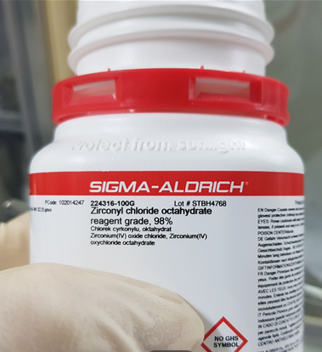
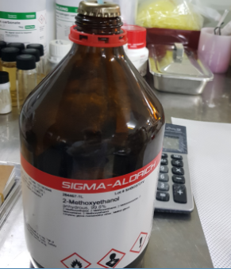
Description of the solution process
2) Zirconium Oxide solution process ( 0.5M, 0.6M )
Materials
Solvent : 2-Methoxy ethanol ( 0.965 g / mol )
Solute : Zirconium(IV) chloride octahydrate ( 322.25 g / mol )
Notes:
(5 페이지)
Solvent와 Solute는 각각 2-methoxy ethanol와 Zirconium chloride octahydrate 를 사용합니다.
2-methoxy ethanol and Zirconium chloride octahydrate are used as solvents and solute, respectively.

Slide 6
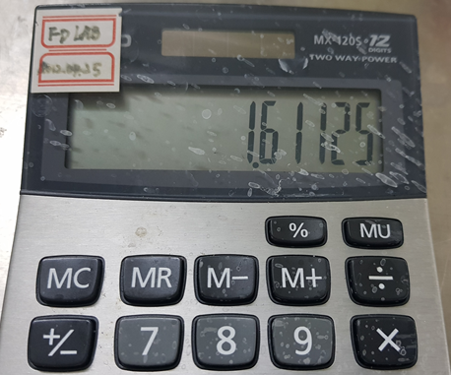
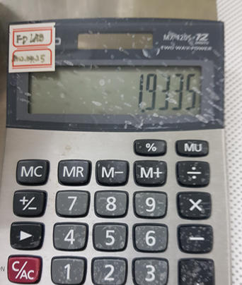
Description of the solution process
2) Zirconium Oxide solution process ( 0.5M, 0.6M )
Materials
Solvent : 2-Methoxy ethanol ( 0.965 g / mol )
Solute : Zirconium(IV) chloride octahydrate ( 322.25 g / mol )
In case of ZrO2 0.5M
In case of ZrO2 0.6M
Notes:
(6,페이지)
Solution은 용해포화점을 찾기 위해 0.2~0.6M까지 만들었습니다.
The Solution made zero point tow to zero point six molarity to find the saturation point.

Slide 7
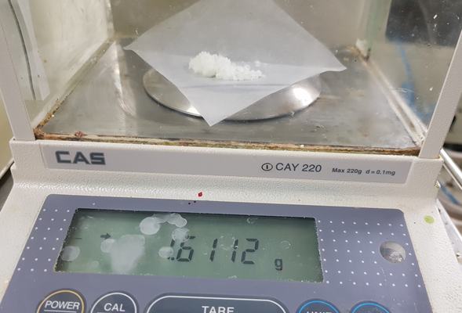
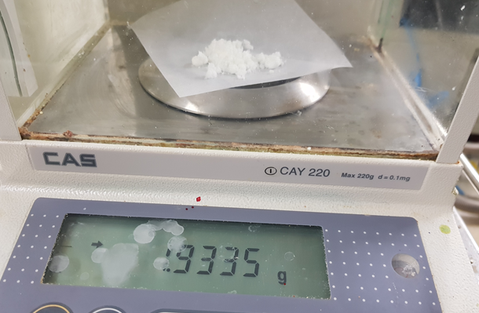
Description of the solution process
2) Zirconium Oxide solution process ( 0.5M, 0.6M )
Materials
Solvent : 2-Methoxy ethanol ( 0.965 g / mol )
Solute : Zirconium(IV) chloride octahydrate ( 322.25 g / mol )
In case of ZrO2 0.5M
In case of ZrO2 0.6M
Notes:
(6,7,8,9 페이지)
솔벤트가 10ml일 때, 0.5몰,0.6몰의 Zirconium chloride octahydrate의 질량을 섞고 교반을 합니다.
- When the solvent is 10 ml, mix and stir the amount of the Zirconium chloride octahydrate at 0.5 molarity and 0.6 molarity.

Slide 8
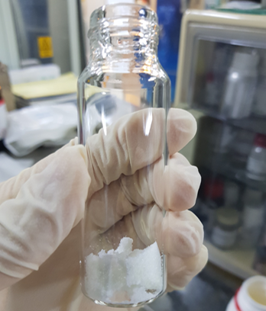
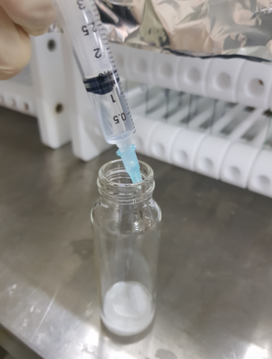
Description of the solution process
2) Zirconium Oxide solution process ( 0.5M, 0.6M )
Put the solution in the beaker and add 10mL of the solution
Notes:
(6,7,8,9 페이지)
솔벤트가 10ml일 때, 0.5몰,0.6몰의 Zirconium chloride octahydrate의 질량을 섞고 교반을 합니다.
- When the solvent is 10 ml, mix and stir the amount of the Zirconium chloride octahydrate at 0.5 molarity and 0.6 molarity.

Slide 9
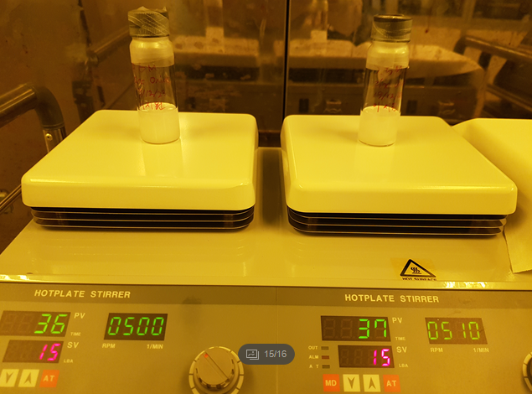
Description of the solution process
2) Zirconium Oxide solution process ( 0.5M, 0.6M )
Place the solution on the hot plate stirrer
Notes:
(6,7,8,9 페이지)
솔벤트가 10ml일 때, 0.5몰,0.6몰의 Zirconium chloride octahydrate의 질량을 섞고 교반을 합니다.
- When the solvent is 10 ml, mix and stir the amount of the Zirconium chloride octahydrate at 0.5 molarity and 0.6 molarity.

Slide 10
ZrO2 solution spin coating on silicon
1) Metal – Insulator – Metal structure device process
Process
ZrO₂ solution fabrication, cleaning bare Silicon wafer
ZrO₂ solution spin coating(3000rpm, 30s)
soft bake(200 ℃, 5min)
annealing(350℃ 30min) and this process repeat 5 times
Cr deposition(sputter)
process | factor
ZrO₂ solution fabrication | Solute : 10mL Solvent : 1.61125g(0.5M), 1.9335g(0.6M)
Cleaning bare Silicon wafer | DI Water -> Aceton -> IPA (Sonification cleaning)
ZrO₂ solution spin coating | Spin : 3000rpm Time : 30 sec
soft bake | Tmp : 200℃ Time : 5 min
annealing | Tmp : 350℃ Time : 30 min
Spin coating, soft bake and annealing repeat 5 times
Cr deposition | sputter Ar : 20sccm power : 125W Pre : 300s main : 500s Thickness : 100nm
Notes:
(10 페이지)
절연 특성을 분석하기 위해 민낯 실리콘 웨이퍼를 위에 MIM 구조 소자를 제작하였습니다.
To analyze insulation properties, bare silicon wafers were manufactured on top of MIM structural elements.
ZrO2 용액 스핀 코팅은 3000rpm, 30 sec
- Zirconium oxide solution spin coating is 3thousand rpm, Thirty sec.
소프트 베이크는 200도에서 5분
- Soft bake at 2hundred degrees for 5 minutes.
열처리는 350도에서 30분
- Heat treatment at 3hundred fifty degrees for Thirty minutes.
그리고 이 과정을 5번 반복합니다.
and this process repeat 5 times.
Cr 증착은 스퍼터로 수행합니다.
chromium deposition perform with a sputter.

Slide 11
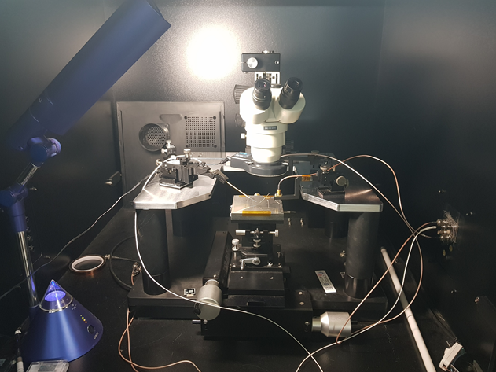
ZrO2 solution spin coating on silicon
2) C – V Measurement of device
Probe Station ( Check insulation characteristics )
Notes:
(11 페이지)
ZrO2의 절연특성을 분석하기 위해 프로브 스테이션으로 C-V curve를 측정 하였습니다.
- To analyze the insulation characteristics of ZrO2, a C-V curve was measured with the probe station.

Slide 12
ZrO2 solution spin coating on silicon
2) C – V Measurement of device
3000RPM Spin coating ( One time )
Notes:
(12,13,14 페이지)
스핀 코터 1, 2, 3회 증착 후 측정한 MIM구조의 ZrO2 C-V curve입니다.
ZrO2 C-V curve of the MIM structure measured after depositing the spin coater 1, 2 or 3 times.
- first curve is one times.
- next curve is two times.
- last curve is three times.

Slide 13
ZrO2 solution spin coating on silicon
2) C – V Measurement of device
3000RPM Spin coating ( Two time )
Notes:
(12,13,14 페이지)
스핀 코터 1, 2, 3회 증착 후 측정한 MIM구조의 ZrO2 C-V curve입니다.
ZrO2 C-V curve of the MIM structure measured after depositing the spin coater 1, 2 or 3 times.
- first curve is one times.
- next curve is two times.
- last curve is three times.

Slide 14
ZrO2 solution spin coating on silicon
2) C – V Measurement of device
3000RPM Spin coating ( Three time )
Notes:
(12,13,14 페이지)
스핀 코터 1, 2, 3회 증착 후 측정한 MIM구조의 ZrO2 C-V curve입니다.
ZrO2 C-V curve of the MIM structure measured after depositing the spin coater 1, 2 or 3 times.
- first curve is one times.
- next curve is two times.
- last curve is three times.

Slide 15
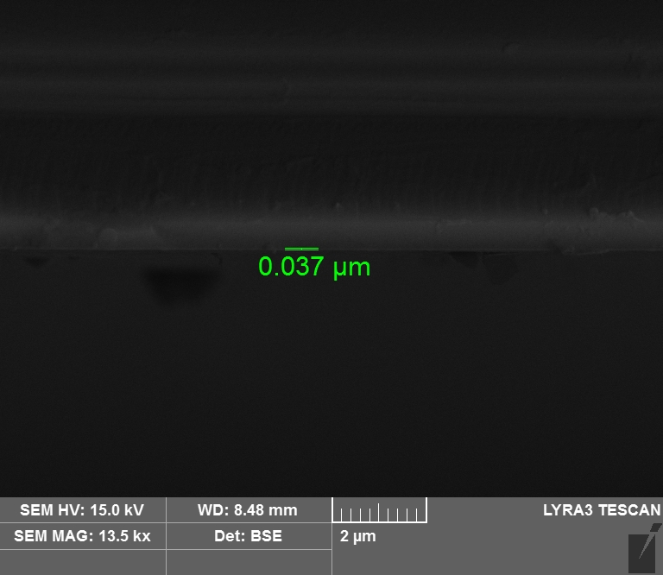
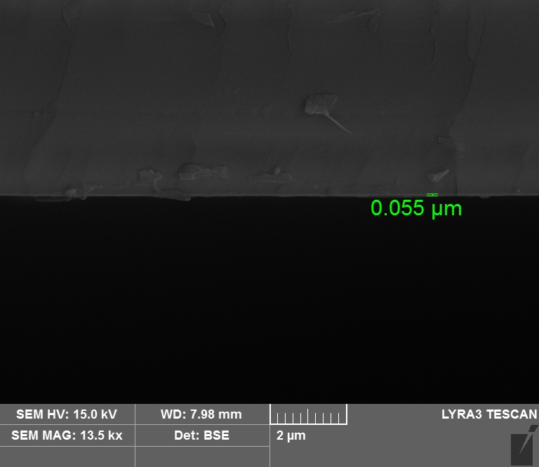
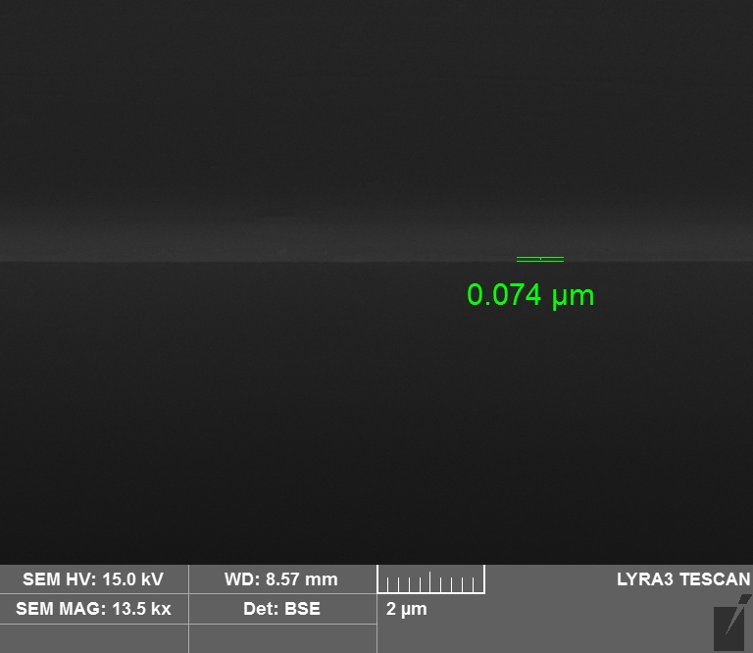
ZrO2 solution spin coating on silicon
3) SEM image of ZrO2
One time(37nm)
Two time(55nm)
Three time(74nm)
Notes:
(15 페이지)
이것은 박막 두께를 확인한 SEM image입니다.
- This is a SEM image that checks thin film thickness.
각각의 두께는 37nm, 55nm, 74nm입니다.
- Each thickness is 37nm, 55nm, and 74nm.

Slide 16
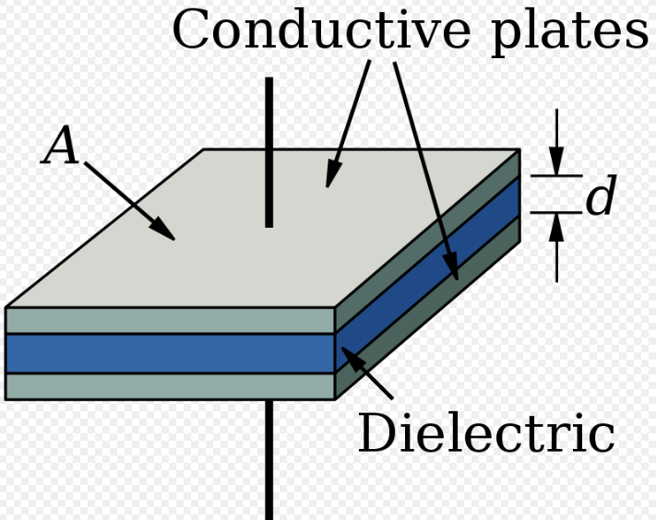

ZrO2 solution spin coating on silicon
4) Dielectric constant of ZrO₂
( One time ) K = 5.174
( Two time ) K = 7.692
( Three time ) K = 7.666
Normally, ZrO2 has a dielectric constant between 20 and 40.
Notes:
(16 페이지)
지르코늄 옥사이드 유전 상수를 값을 유도하여 계산했습니다.
Zirconium oxide dielectric constant was calculated by inducing a value.
통상적으로 ZrO2의 유전 상수는 20~40사이입니다.
Normally, ZrO2 has a dielectric constant between 20 and 40.

Slide 17
Future work
ZrO2's dielectric constant calculation value showed a relatively low value compared to the existing ZrO2 genetic constant value.
I will optimize the concentration of the ZrO2 solution molarity
and the number of multi-coatings and increase the ZrO2
thickness.
several insulator characteristics, such as breakdown voltages
that have not yet been measured, will be measured.
Notes:
(17 페이지)
ZrO2의 유전상수 계산 값은 기존의 ZrO2의 유전 상수 값과 비교 하였을때 비교적 낮은 값을 보여 주었습니다.
- ZrO2's dielectric constant calculation value showed a relatively low value compared to the existing ZrO2 genetic constant value.
왜냐하면 ZrO2의 얇은 두께로 때문에 K값이 낮은 것 같습니다.
- Because of the thinness of ZrO2, K value seems to be low.
따라서 앞으로의 실험에서 저는 ZrO2 솔루션의 몰농도와 멀티 코팅 횟수를 최적화 하고, ZrO2의 두께를 증가 시킬 것입니다.
- Thus, in future experiments, I will optimize the concentration of the ZrO2 solution molarity and the number of multi-coatings and increase the ZrO2 thickness.
또한 아직 측정 하지 못한 breakdown voltage와 같은 여러 절연체 특성을 측정 진행 예정입니다.
In addition, several insulator characteristics, such as breakdown voltages that have not yet been measured, will be measured.

Slide 18
Thank you.
Notes:
(예상 질문)
장치의 다른 특성을 확인하려면 새 장치를 만들어야 합니다.
To identify other characteristics of the device, you must create a new device.
아직 하나의 장치만 만들었기 때문에 CV만 측정되었습니다.
Only CV was measured because only one device was still created.
아직 연구생이 된지 얼마되지 않아, 잘 모르는 부분이 많습니다.
- Not long after I became a researcher, I don’t know many things.

