Slide 1


Liquid crystal fresnel lens with variable refractive index (2)
▷Hoseo University
▷Electron Devices Laboratory
▷Undergraduate Student 1st
▷YOUNG JIN KIM
1

Slide 2
Table of contents
1. Introduction
2. Explain about the diopter
3. Sample pictures
4. Measurement equipment
5. Lens Measurement Method
6. Blow molding fresnel lens : ON/OFF state
7. Blow molding fresnel lens : video
8. Pattern fresnel lens : ON/OFF state
9. Pattern fresnel lens : video
10. Result
2

Slide 3
Introduction
1. Purpose
▷ According to voltage, measure the diopter value.
▷ Take a picture of the change in diopter.
2. Measurement method
▷ Apply AC voltage to signal generator
▷ Measure the diopter using a dioptermeter.
▷ Take a picture operation.
3

Slide 4
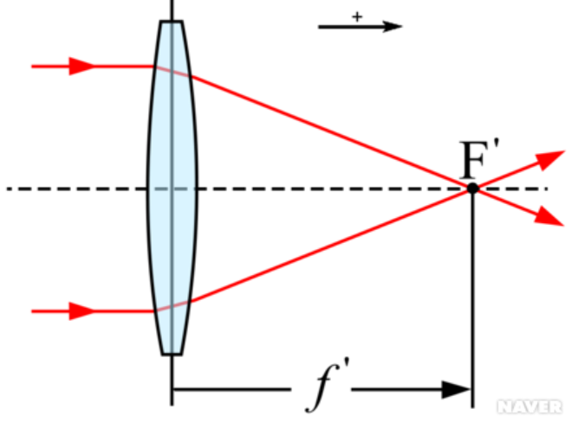
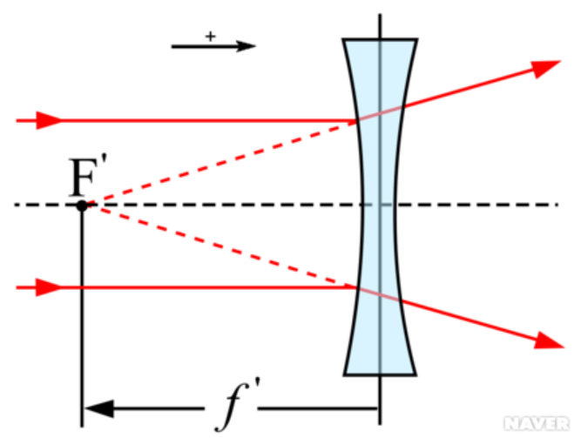
Explain about the diopter
0.5(meter)
-0.25(meter)
1/0.5(m)= 2(D) 1/-0.25(m)= -4(D)
Diopter
▷ Diopter is the unit of refractive index of the lens
▷ Diopter (unit: D)= 1/f’(f’= focal distance)
▷ Convex lens = D value: +
▷ Concave lens = D value: -
4

Slide 5
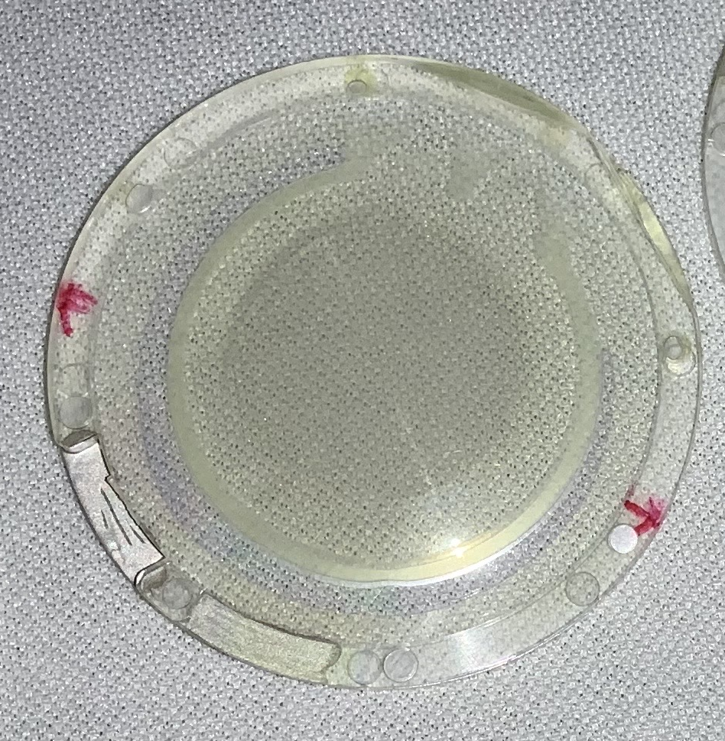
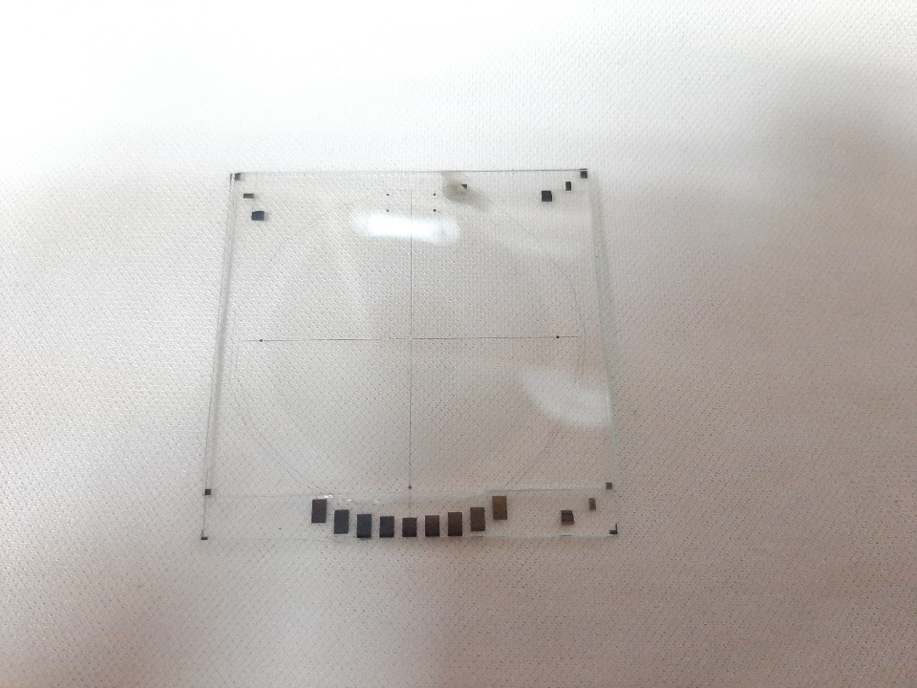
Sample pictures
Blow molding fresnel lens
Pattern fresnel lens
5

Slide 6
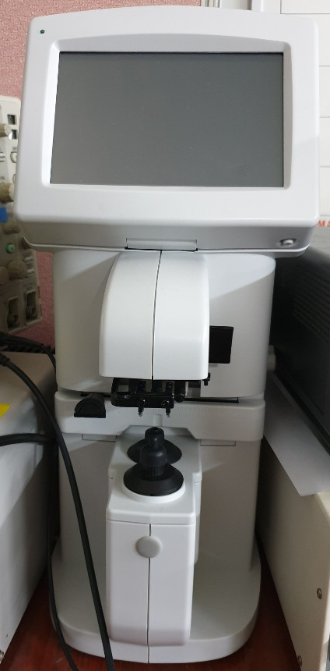
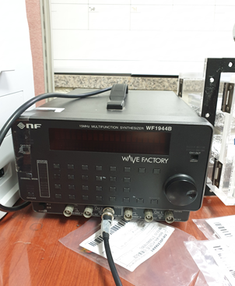
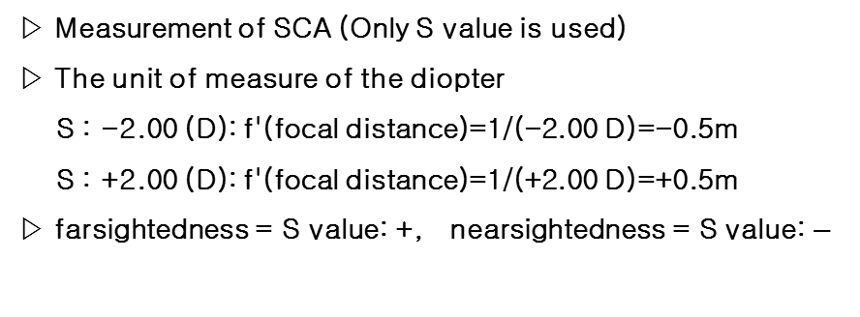
Measurement equipment
Dioptometer
Signal generator
▷ Measurement of SCA (Only S value is used)
▷ The unit of measure of the diopter
S : -2.00 (D): f'(focal distance)=1/(-2.00 D)=-0.5m
S : +2.00 (D): f'(focal distance)=1/(+2.00 D)=+0.5m
▷ farsightedness = S value: +, nearsightedness = S value: $−$
▷ Generating an driving voltage
6

Slide 7
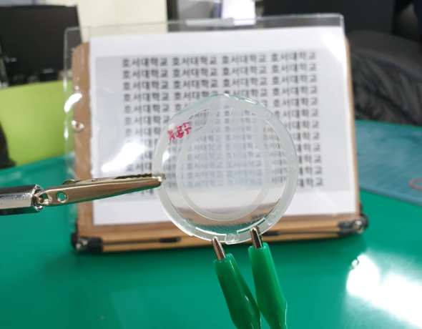
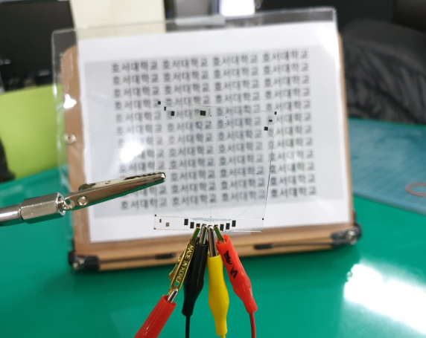
Lens Measurement Method (1)
Blow molding fresnel lens
Pattern fresnel lens
7

Slide 8
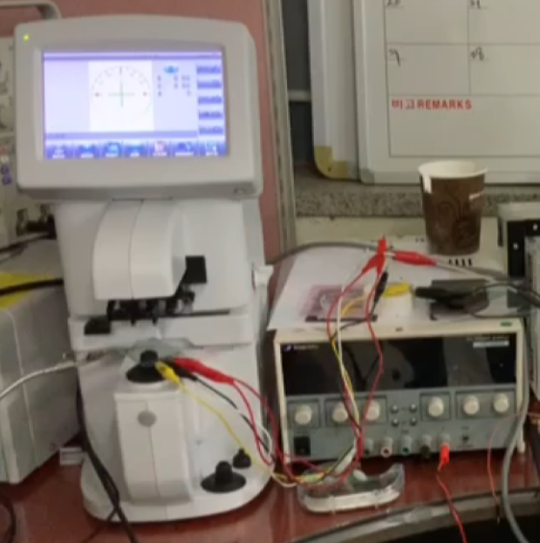
Lens Measurement Method (2)
Measure diopter using Dioptometer
8

Slide 9
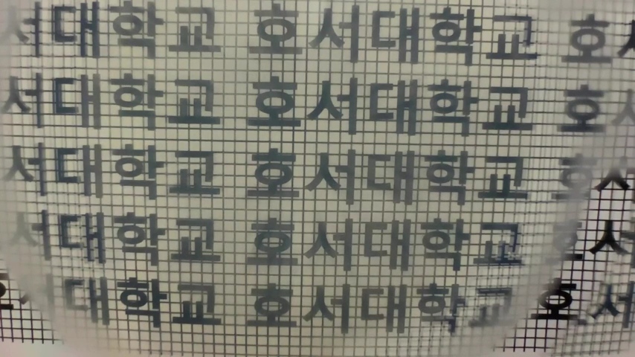
Blow molding fresnel lens: video
The driving voltage is 15V on/off
9

Slide 10
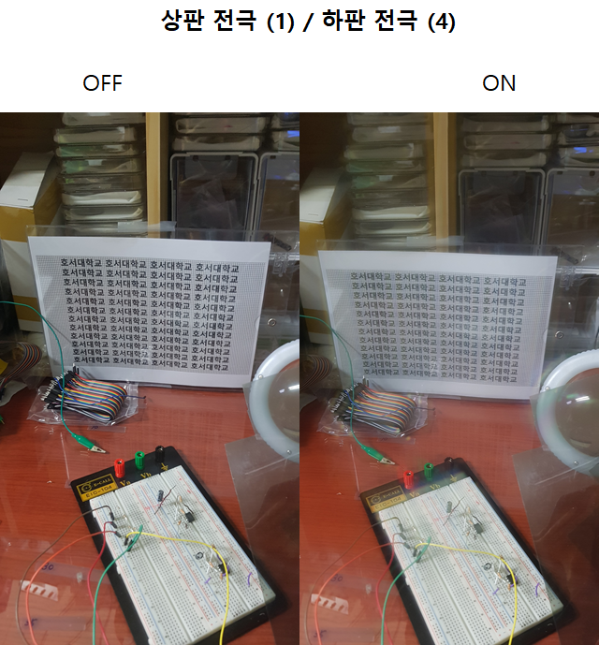
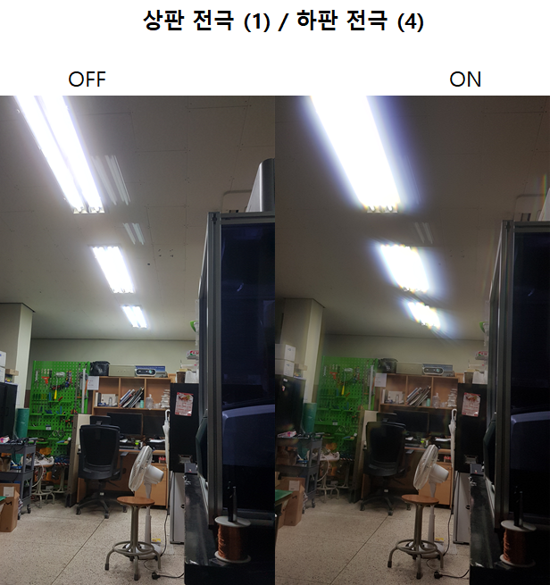
Pattern fresnel lens : ON/OFF state
10

Slide 11
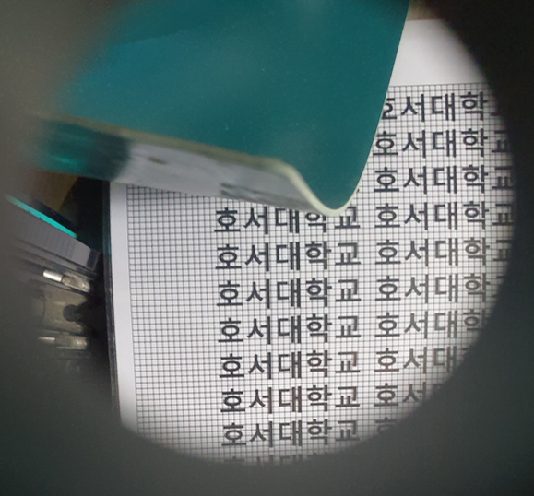
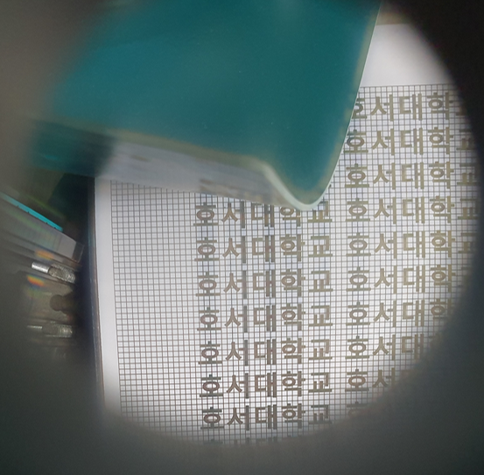
Pattern fresnel lens: ON/OFF state (1)
Voltage off
Voltage on(15V)
11

Slide 12
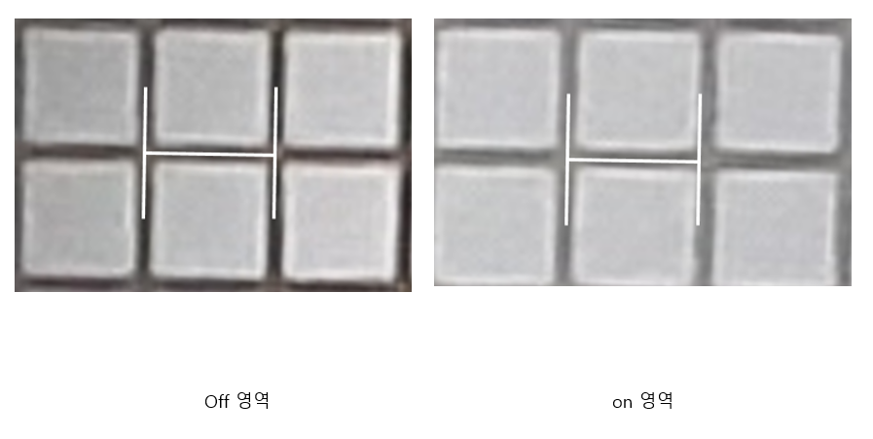
Pattern fresnel lens : ON/OFF state (2)
Voltage off
Voltage on(15V)
12

Slide 13
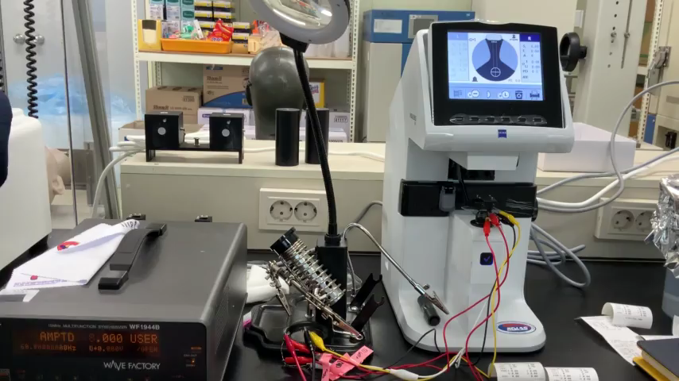
Pattern fresnel lens : video
A video that measures the lens using Dioptometer.
13

Slide 14
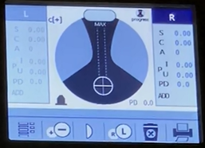

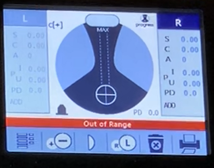

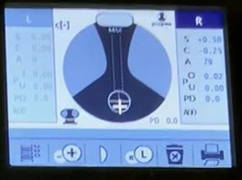

Pattern fresnel lens : ON/OFF state(2)
8V = 0.00
9V = 0.00
out of range
10V = 0.50
14

Slide 15
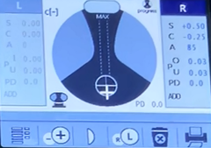

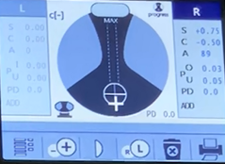

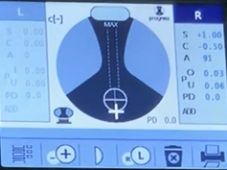

Pattern fresnel lens : ON/OFF state(2)
11V = 0.50
12V = 0.75
13V = 1.00
15

Slide 16
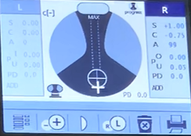

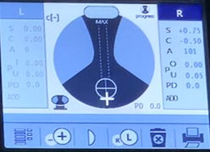


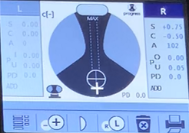
Pattern fresnel lens : ON/OFF state(2)
14V = 1.00
15V = 0.75
16V~20V = 0.75
16

Slide 17
Result
1. Blow molding fresnel lens
- According to driving ON/OFF voltage, measure diopter
- diopter is changed
2. Pattern fresnel lens
- According to driving ON/OFF voltage, measure diopter
- diopter is changed
17

Slide 18
Thank You
18

