Slide 1
The 20th Collaboration Meeting​
The Characteristics of ​
a-IGZO Thin-Film Transistors ​
on Polyimide Substrates​
2020. 01. 07
Hoseo Univiersity
Kang, In Hye (姜 仁 惠)​
Notes:
Hello.
My name is In Hye Kang.
My topic is the characteristics of a-IGZO Thin-film transistors on polyimide substrates.

Slide 2
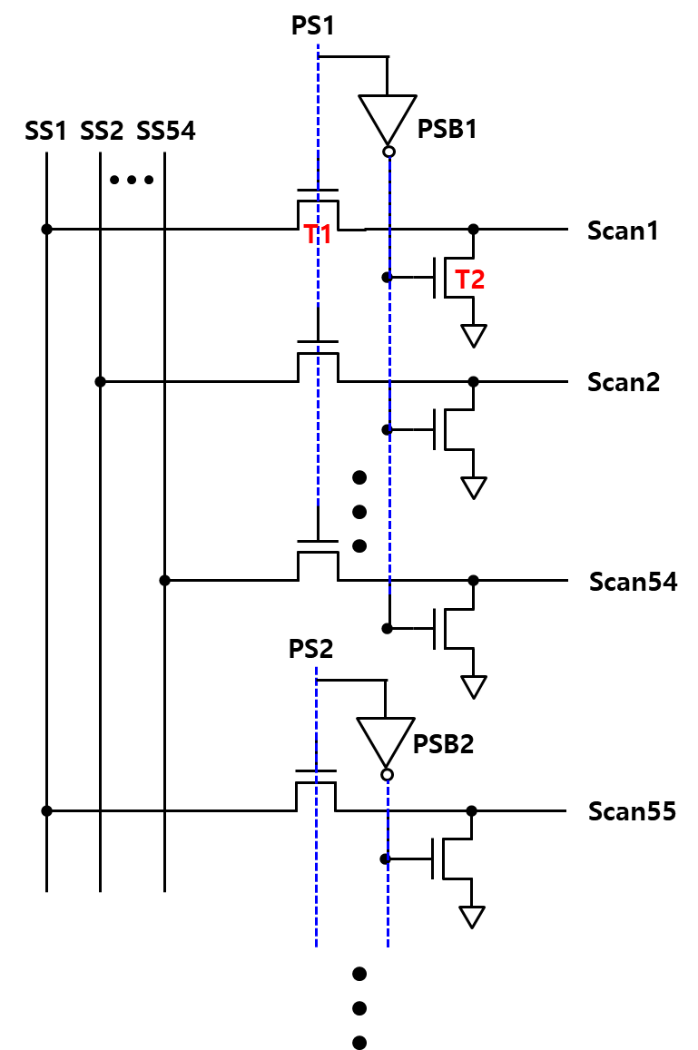
The 16th Collaboration Meeting​
Gate Drive Circuit for Stretchable Display
1
2
3
4
5
6
1
2
3
4
5
6
1
(a)
(b)
Figure. 1 — (a) A circuit diagram of the proposed gate drive circuit, (b) The simulation result of the proposed gate drive circuit.
Notes:
When the 16th collaboration meeting​, I gave a presentation of the gate drive circuit with a-IGZO TFTs for stretchable display.
It was shown in figure 1 and composed of only two a-IGZO TFTs in a stage.
Because the size of the stretchable display changes, there may arise problems such as a change in the characteristics of the electrodes and TFTs.
Therefore, When the AMOLED panel is strained, the proposed circuit prevents loss or distortion of an output signal even if the characteristics of TFTs and bus lines change.

Slide 3
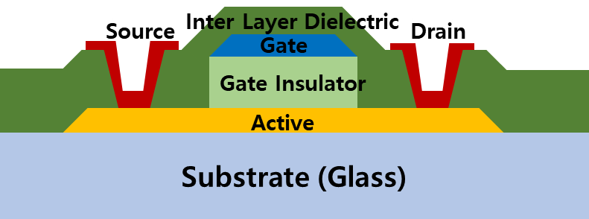
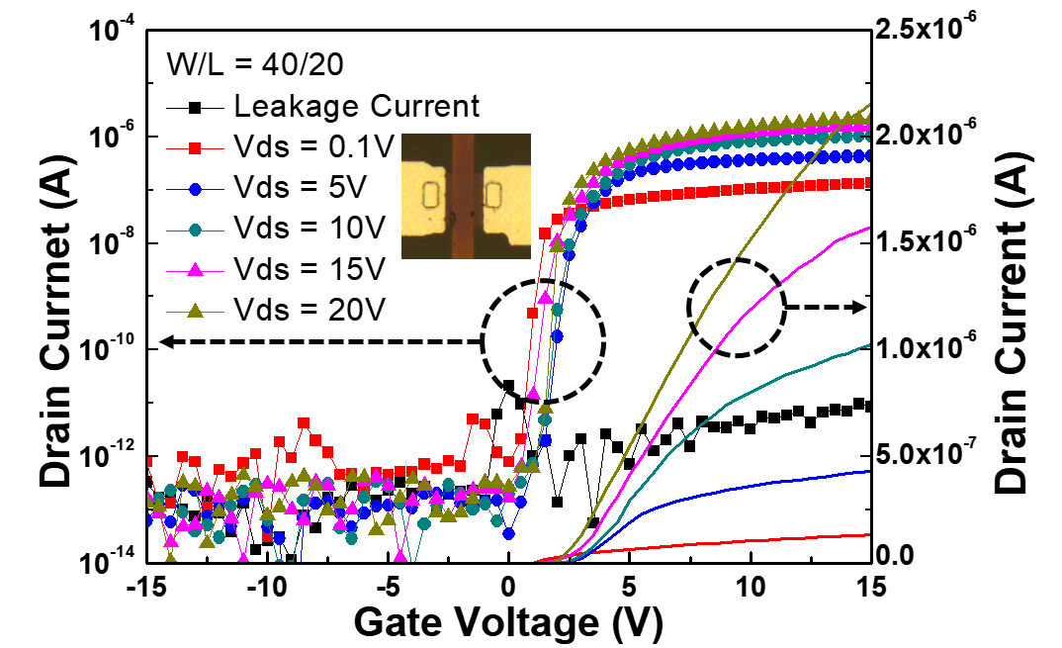
The 16th Collaboration Meeting​
Gate Drive Circuit for Stretchable Display
Active (a-IGZO) / 50 nm / RF sputtering
O₂ post annealing
Gate insulator (SOG) / 350 nm / Spin coating
Gate (Cr) / 150 nm / DC sputtering
Gate insulator patterning / Dry etching
Inter layer dielectric (SOG) / 350 nm / Spin coating
Contact hole / Dry etching
Source/Drain (Al) / 150 nm / DC sputtering
(a)
On/off ratio​ | Mobility​ | Thresholdvoltage​ | S.S.​
3.3x10⁷​ | 7.1 cm²/Vs​ | -0.5 V​ | 0.1 V/dec​
Figure. 2 — (a) A cross-sectional structure of the top-gate a-IGZO TFT, (b) Transfer characteristic and microscope image of the a-IGZO TFT
(b)
Notes:
We made a-IGZO TFT on glass substrates shown in figure 2.
We used the SOG solution for Insulator at that time.

Slide 4
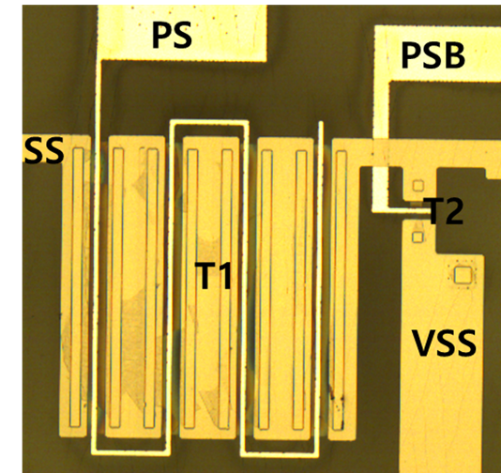
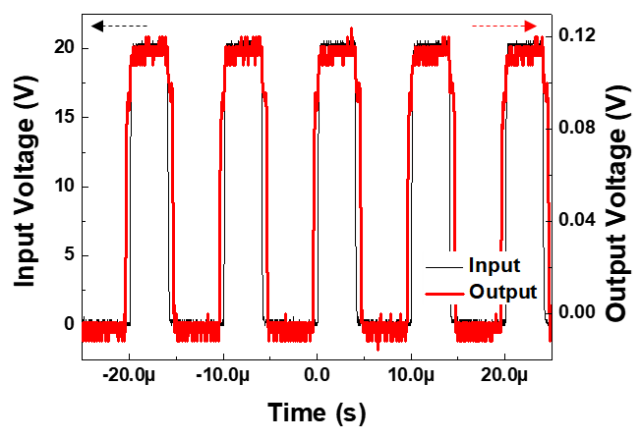
The 16th Collaboration Meeting​
Gate Drive Circuit for Stretchable Display
(a)
(b)
Figure 3. — (a) The microscope image of the proposed gate drive circuit,
(b) The Measurement result of the proposed gate drive circuit.
Notes:
When an SS signal of 20 V with the pulse width of 10 μs was inputted, as shown in Figure 6, measured the output voltage was about 0.12 V, which equivalented to 20 V.
Since the on-resistance of the a-IGZO TFT is much larger than the input impedance of the oscilloscope, the output waveform was measured to be small.
Therefore, the output voltage of 0.12 V corresponds to 20 V.

Slide 5
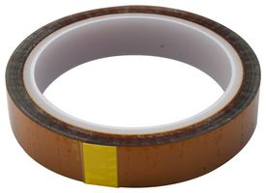
The 20th Collaboration Meeting​
Gate Drive Circuit for Stretchable Display
Mask: Shadow mask
Structure: bottom gate TFT
Substrate: PI film / glass
Substrate: Glass위에 Kapton tape 부착
Buffer: SiO₂ (2500s / 약 1250Å) 증착
Annealing: Air, 250℃, 1h 30m
Gate: Ta (300s / 약 750Å) 증착
GI: SiO₂ (5000s / 약 2500Å) 증착
Annealing: Air, 250℃, 1h 30m
Active: IGZO (15m, 약 500Å) 증착
Annealing: O₂, 250℃, 1h
S/D: Ta (600s / 약 1500Å) 증착
Ta
IGZO
SiO₂
Ta
SiO₂
PI
Glass
Figure 4. — (a) The microscope image of the proposed gate drive circuit,
(b) The Measurement result of the proposed gate drive circuit.
Notes:
We should make to TFT on a PI substrate to operate the proposed circuit on the stretchable display.
So, I made a-IGZO TFT using shadow masks on the PI substrate.
Unlike a-IGZO TFT had made on the glass substrate, I used SiO2 for insulator by sputtering.

Slide 6
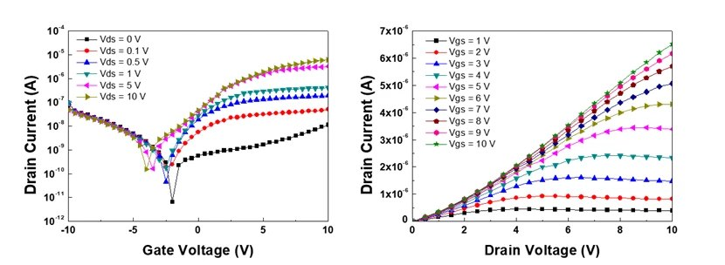
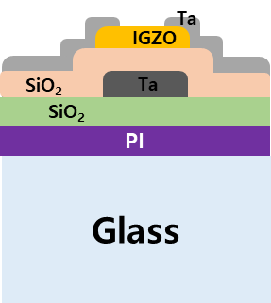
The 20th Collaboration Meeting​
Gate Drive Circuit for Stretchable Display
Figure 5. — (a) The microscope image of the proposed gate drive circuit,
(b) The Measurement result of the proposed gate drive circuit.
Notes:
Figure 5 is shown the characteristics of the a-IGZO TFT on the PI/Glass substrate.
It is not excellent performance despite not removing the glass substrate.
We take comfort in the fact that I found some possibility in the result.
However, we will try to make good characteristics of the a-IGZO TFT on the PI substrate.
Here, we need technology to detach PI and Glass.

Slide 7
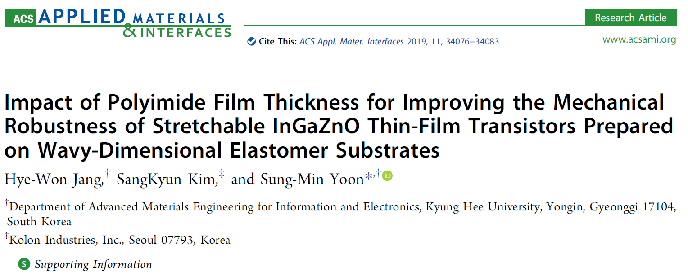
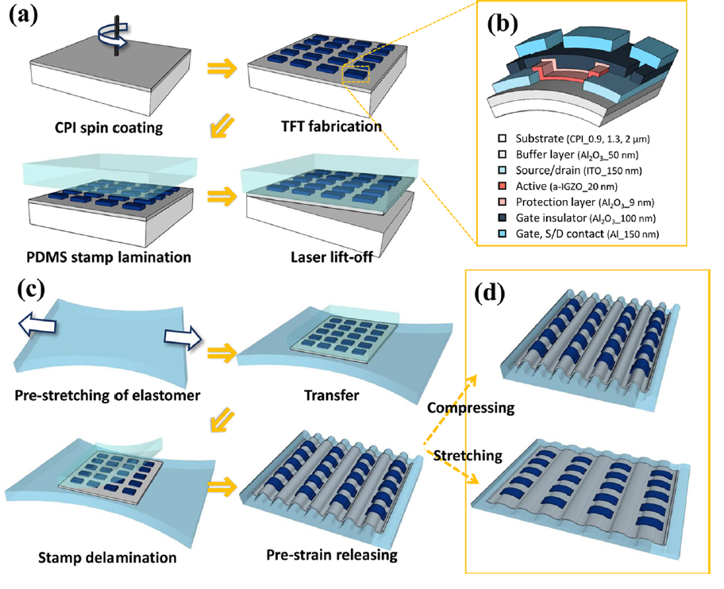
The 20th Collaboration Meeting​
Future Work
Notes:
This paper is to stretchable IGZO TFT on a wavy-dimensional elastomer substrate.
In the paper, TFTs were lift-offed by laser after it was made on CPI and Glass substrate.
And then, TFT on the PI substrate was transferred to the pre-stretched elastomer.
However, we don't equip with a laser machine for lift-off.
So, we need different ways to detach PI and glass.
Anyway, I will make IGZO TFT in reference to the methods of this paper.
I also need to try many new things.

Slide 8
☺
Thank for your attention

