Slide 1



The 20th Technical Collaboration Meeting
Introduction to EDLAB
2020.01.07
-1-
Notes:
Good afternoon everyone.
Today, I would like to talk about our ED Lab

Slide 2

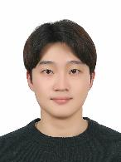
The 20th Technical Collaboration Meeting
Introduction
Name : WonJun Kang
Age : 27 (Undergraduate)
Major: Electronic Display Engineering
-2-
Technical Collaboration Meeeting 2020, January, WBF Hotel, Okinawa, Japan
Notes:
Fisrt let me introduce myself.
My name is WonJun Kang who is a member of the ED lab.
I am Electronic Display Engineering of Hoseo University.
I am 27 years old and a 4th grade in university.
I became a member to this laboratory in November, and I'm learning a lot from this laboratory.

Slide 3
The 20th Technical Collaboration Meeting
Contents
1
LAB MEMBER
3
ED Lab Research
- Stretchable Display
2
Clean room
- Presbyopia glasses
- Touch sensor & Taste sensor
- Interfacial oxidation
-3-
Notes:
This is a table of contents.
The list here is what we're doing in our lab.
I will show my lab members and what they are working on.

Slide 4
The 20th Technical Collaboration Meeting
Part 1
LAB MEMBER
-4-
Technical Collaboration Meeeting 2020, January, WBF Hotel, Okinawa, Japan
Notes:
First, Before introducing the task, introduce the researchers.

Slide 5
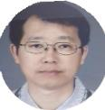



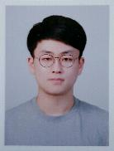

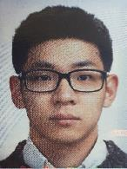
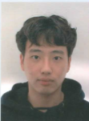
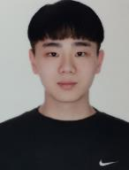
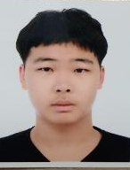
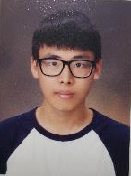
LAB MEMBER
Part 1
LAB MEMBER
Professor
ByungSeoung Bae
Doctor’s course
JongMo Lee
SeungJae Moon
InHye Kang
Master’s course
JaeGeun Woo
SeokJun Kang
SeoGwon Kim
Undergraduate
EunSeong Yu
YoungJin Kim
HyuckSoo Lee
WonJun Kang
JiWon Lee
-5-
Technical Collaboration Meeeting 2020, January, WBF Hotel, Okinawa, Japan
Notes:
Let me introduce the Electronic Device Laboratory members.
First, Professor ByungSeoung Bae.
Second, In the doctor’s course, there are jongmo Lee, SeungJae Moon and InHye Kang, there are three people.
Third, master’s course, there are JaeGeun Woo, SeokJun Kang, SeoGwon Kim there are three people.
Finally, EunSeong Yu, YoungJin Kim, HyuckSoo Lee, WonJun Kang, Jiwon Lee There are five undergraduates composed.
First of all, I am learning about the process in the lab.
I am learning how to handle process equipment and how to operate it.

Slide 6
The 20th Technical Collaboration Meeting
Part 2
Clean room
-6-
Technical Collaboration Meeeting 2020, January, WBF Hotel, Okinawa, Japan
Notes:
The second part is about the clean room

Slide 7
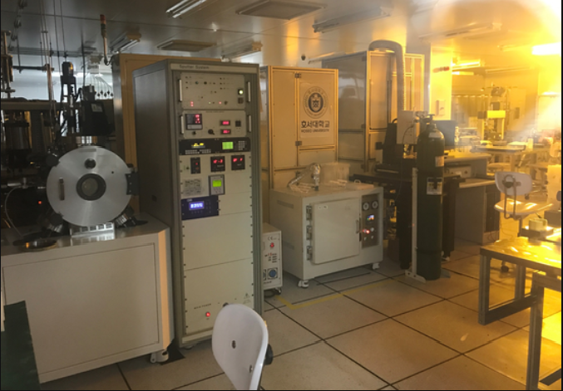
Part 2
Clean room
The inside of clean room
-7-
Technical Collaboration Meeeting 2020, January, WBF Hotel, Okinawa, Japan
Notes:
In this slide introduce the clean room we are using.
The picture shows the inside of the clean room.
The import condition for making a TFT should be that there is no such thing as a particle.
Therefore, we proceed with all the processes here.

Slide 8
The 20th Technical Collaboration Meeting
Part 3
ED Lab Research
-8-
Technical Collaboration Meeeting 2020, January, WBF Hotel, Okinawa, Japan
Notes:
The third part is about the lab project.

Slide 9
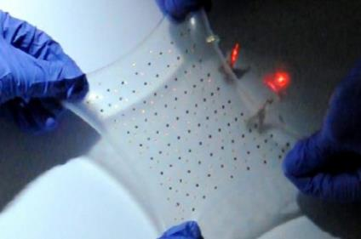
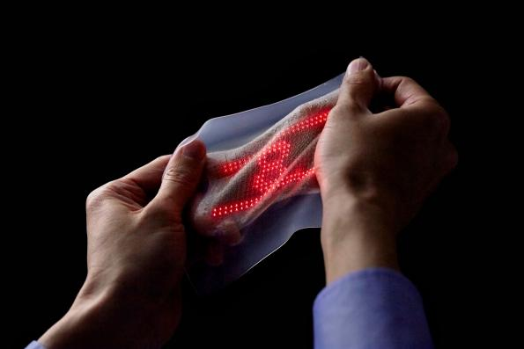
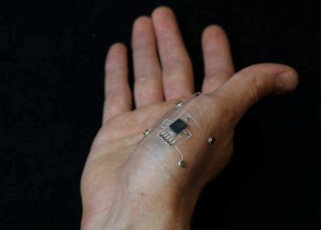
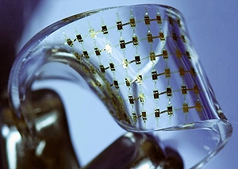
Part 3
Stretchable Display
Studying a flexible circuit.
-9-
Technical Collaboration Meeeting 2020, January, WBF Hotel, Okinawa, Japan
Notes:
In this slide introduce my laboratory research.
First research is Stretchable.
This research is under study to design a stretch and flexible circuit as shown above.
It is a futuristic display that is expected to be used in a wide variety of industries because the brightness does not change.

Slide 10
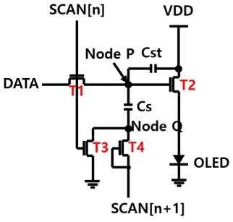
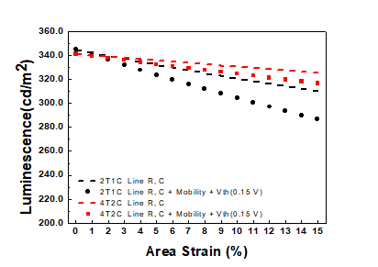
Part 3
Stretchable Display
Stretchable OLED circuit.
Luminance depending on elongation
-10-
Technical Collaboration Meeeting 2020, January, WBF Hotel, Okinawa, Japan
Notes:
We made a stretchable oled circuit.
As can be seen from the figure on the right, the brightness is lowered with increase of the strain, and it is under study to minimize this change.
Elongation - 연장(늘어남)에 따른 휘도

Slide 11
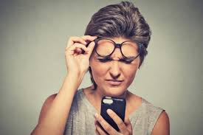
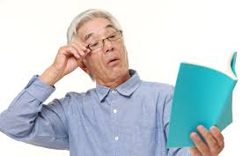
Part 3
Presbyopia glasses
Presbyopia glasses by changing the refractive index using liquid crystal.
-11-
Technical Collaboration Meeeting 2020, January, WBF Hotel, Okinawa, Japan
Notes:
The second research is Presbyopia glasses.
The research is to inject liquid crystals between glasses to change refractive
index making it easier to see.

Slide 12
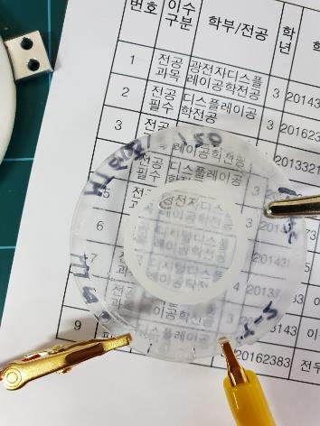
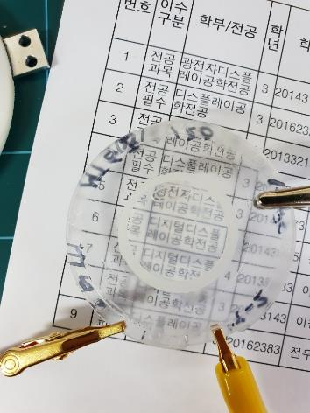
Part 3
Presbyopia glasses
Off state
On state
-12-
Technical Collaboration Meeeting 2020, January, WBF Hotel, Okinawa, Japan
Notes:
We could change the refractive index according to the voltage applied to the cholesteric liquid crystal.
When the voltage is turned off, the transmittance is lowered, and when the voltage is applied, the transmittance is increased.
Due to the high drive voltage, we are focusing on decreasing the drive voltage.

Slide 13



Part 3
Touch Sensor & Taste Sensor
Figure 1. Optical type
Figure 2. Capacitance type
-13-
Technical Collaboration Meeeting 2020, January, WBF Hotel, Okinawa, Japan
Notes:
The third research is touch sensor.
Figure 1 is a optical type touch sensor. This can use light sources or image sensors to recognize fingerprints.
Figure 2 is a capacitance type. This can detect changes in the capacitance of the area that the fingerprintcontacts.
A device that is needed to implement fingerprint recognition function with integral display is a TFT.
We study the sensor circuit using oxide TFT.
모바일에 집적 가능한 소형화된 디스플레이 일체형 지문인식-터치 센서를 구현하는데 필요한 소자는 박막 트랜지스터입니다.
산화물 TFT를 기반으로 지문인식-터치 센서 회로를 연구하였습니다.

Slide 14
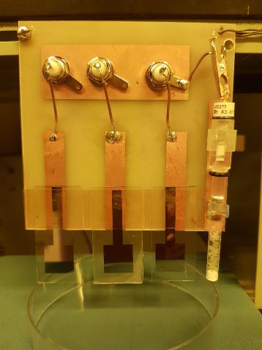
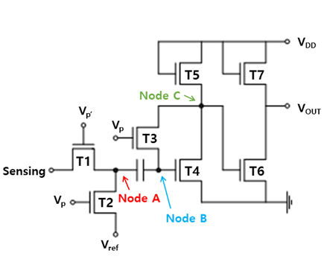
Part 3
Touch Sensor & Taste Sensor
Taste sensor using TFT
Circuit of the amplifier
-14-
Technical Collaboration Meeeting 2020, January, WBF Hotel, Okinawa, Japan
Notes:
The photo on the left is a taste sensor made by our TFT, and the right picture is a circuit made to amplify the weak signal.
Such sensor membrane fabrication and amplification circuit technology is expected to be applicable to portable portable taste sensor applications.
왼쪽 사진은 우리가 만든 TFT로 만든 미각 센서이고, 오른쪽사진은 신호가 약해서 이를 증폭하기 위해 만든 회로이다.
이러한 센서막의 제작과 증폭회로 기술은 휴대가 가능한 소형 미각센서 어플리케이션에 적용 가능할 것이라고 예상한다.

Slide 15
Part 3
Interfacial oxidation
Metal
Interfacial Oxidation
IGZO
Glass
Interfacial oxidation research.
-15-
Technical Collaboration Meeeting 2020, January, WBF Hotel, Okinawa, Japan
Notes:
The Finally, Interfacial oxidation.
Reducing the Interfacial oxide between IGZO and metal is important to reduce the contact resistance.

Slide 16
The 20th Technical Collaboration Meeting
EDLAB
Thank you for attention
-16-
Technical Collaboration Meeeting 2020, January, WBF Hotel, Okinawa, Japan
Notes:
Thank you for listening to my presentation.

