Slide 1
The Characterization of Insulators by Reactive Sputtering.
Electronic Device LAB. Hoseo University
The master’s course
Kang Seok Jun

Slide 2
Contents
Introduction
Experiment & Measurement
Result
Conclusion
C-V Measurement Sample Characterization

Slide 3
Introduction
An insulator layer can be deposited by reactive sputtering.
This research is to study the formation of insulators by reactive sputtering.
Control the oxygen flow rate to get the high quality insulator.
The breakdown voltage and C-V curves were measured for insulator characteristics.

Slide 4
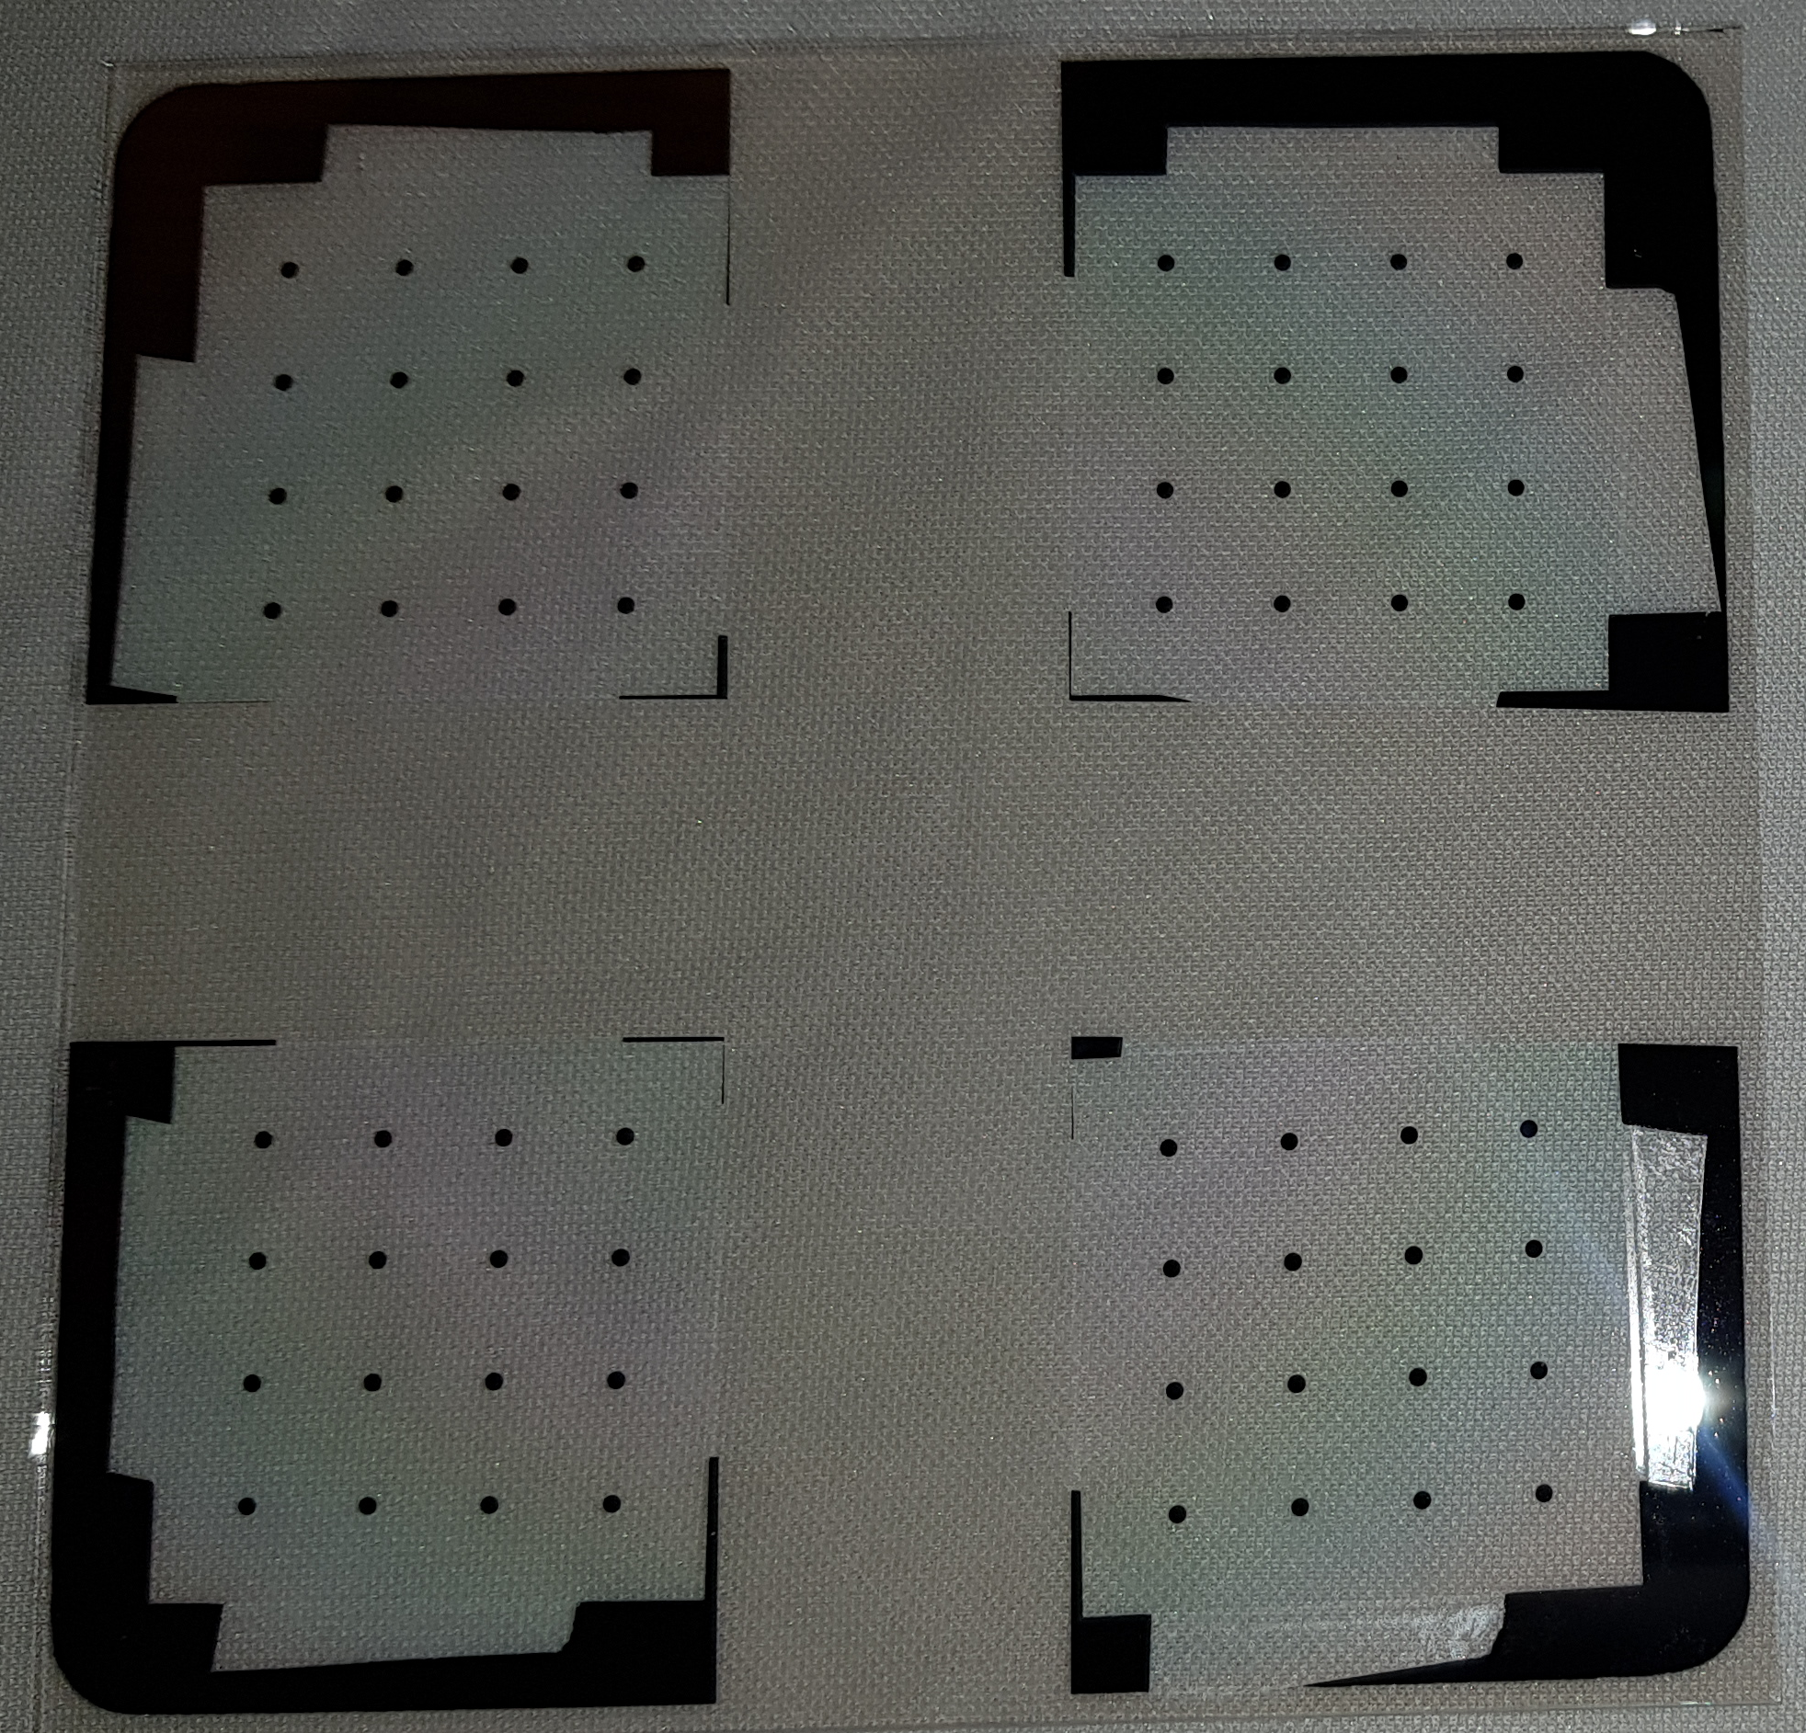
Experiment & Measurement
Conditions of Ta Reactive Sputtering
Ar : 18 Sccm
O₂ : 2 Sccm
Gas flow : 5mtorr
Power : 125W
Depo. : pre – 600 s, main – 1000, 2000s
Ta
TaOx
ITO
Conditions of Ta Deposition
Ar : 20 Sccm
Gas flow : 5mtorr
Power : 125W
Depo. : pre – 300 s, main -1000s
Measurement
Breakdown voltage
C-V

Slide 5
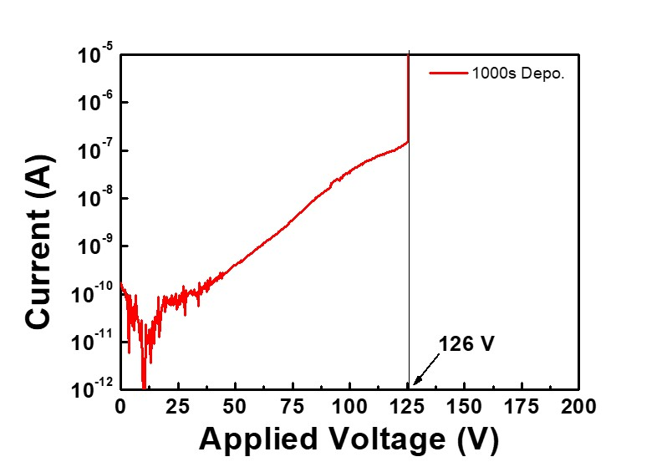
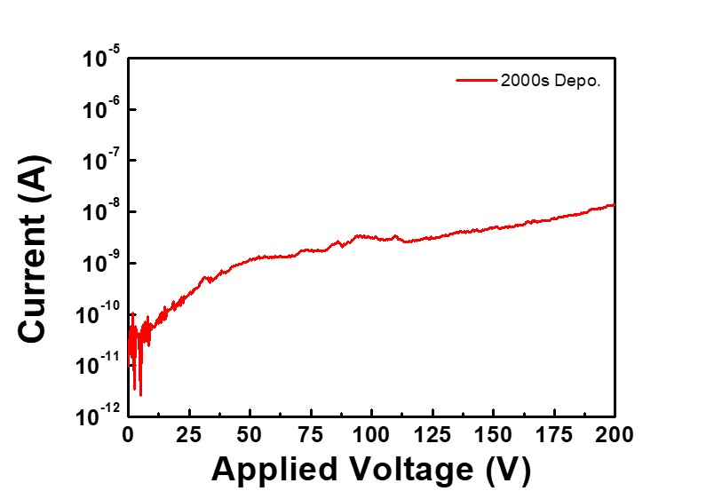
Result ( Breakdown voltage )
1000 s Deposition
2000 s Deposition

Slide 6
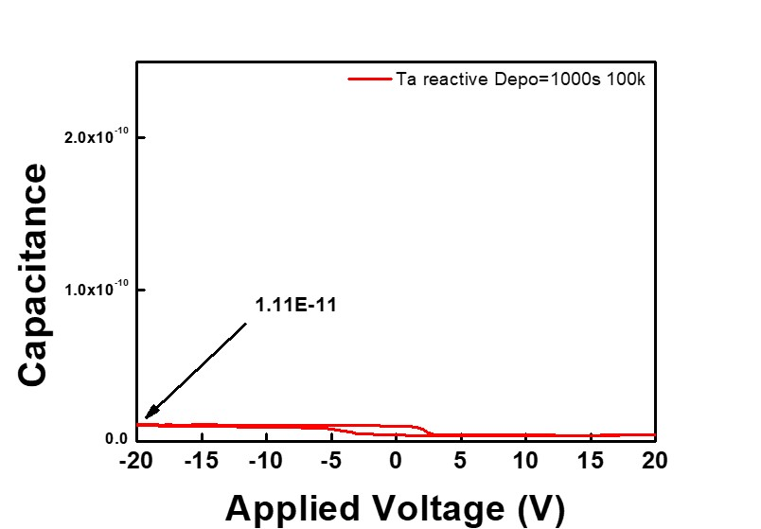
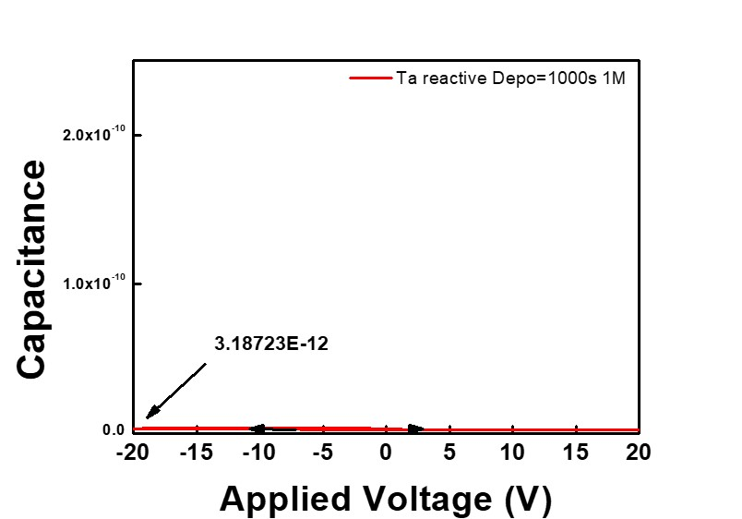
Result ( C-V curve )
1000 s Deposition
1000 s Deposition

Slide 7
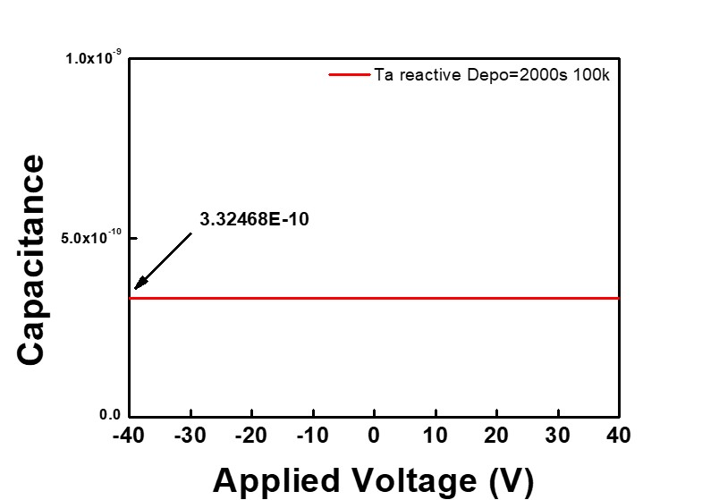
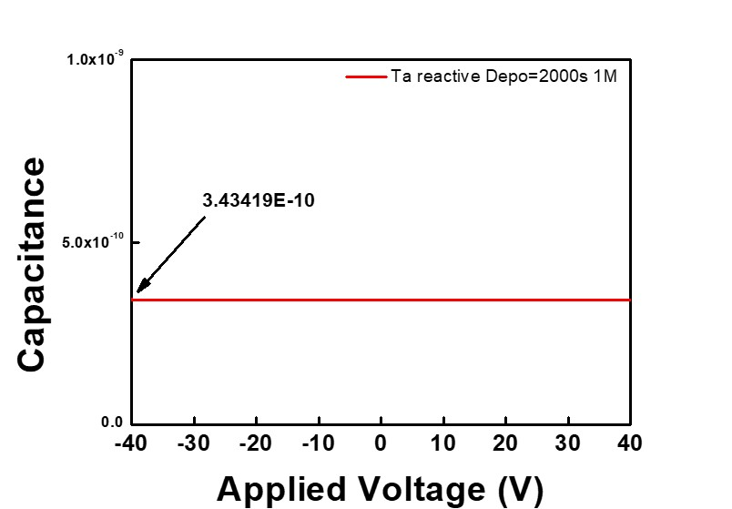
Result ( C-V curve )
2000 s Deposition
2000 s Deposition

Slide 8
Conclusion
The deposition rate varies depending on the oxygen flow rate.
Gas flow rate were Ar: 18 Sccm, and O₂: 2 Sccm. And deposition times were 1000s and 2000s.
The breakdown voltage was 126 V for 1000s reactive sputtered TaOx.
Future work
Improving the insulator characteristics.
Process optimization for TFT fabrication.

Slide 9
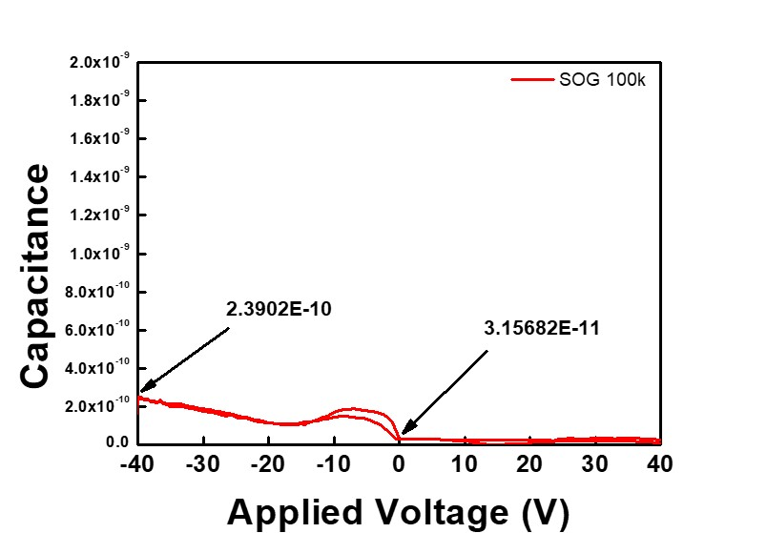
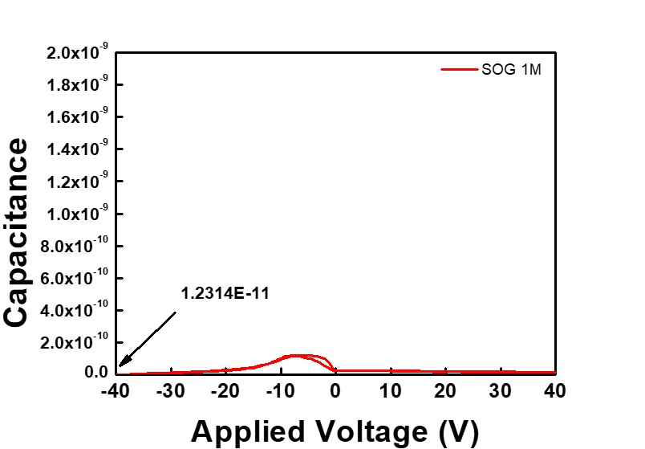
C-V Measurement Sample Characterization
SOG

Slide 10
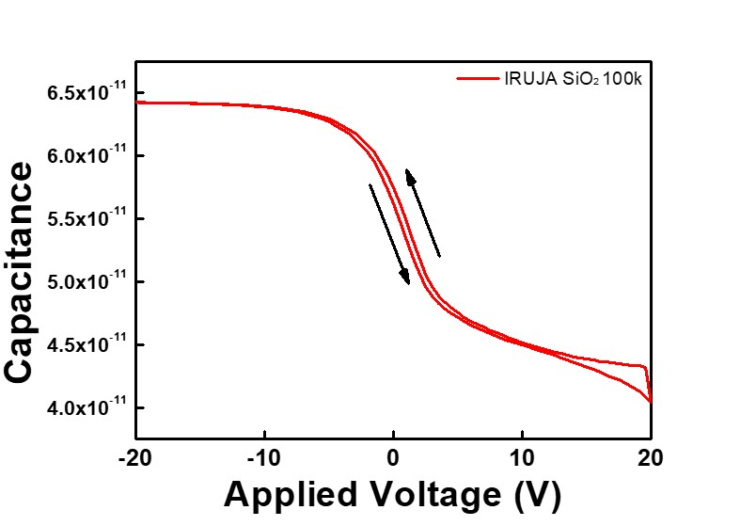
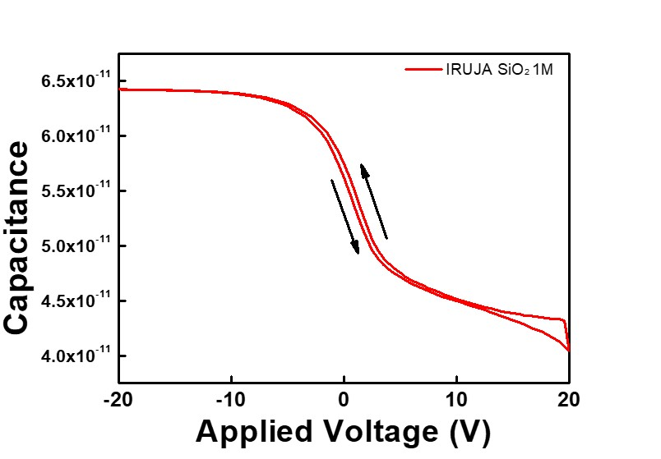
C-V Measurement Sample Characterization
IRUJA - SiO₂

Slide 11
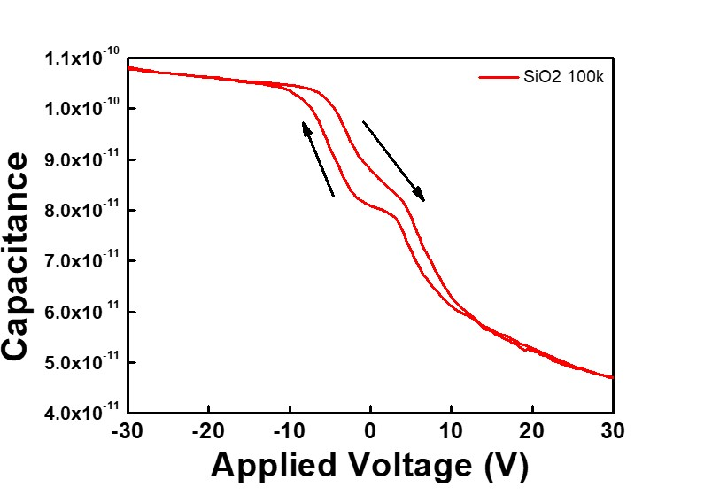
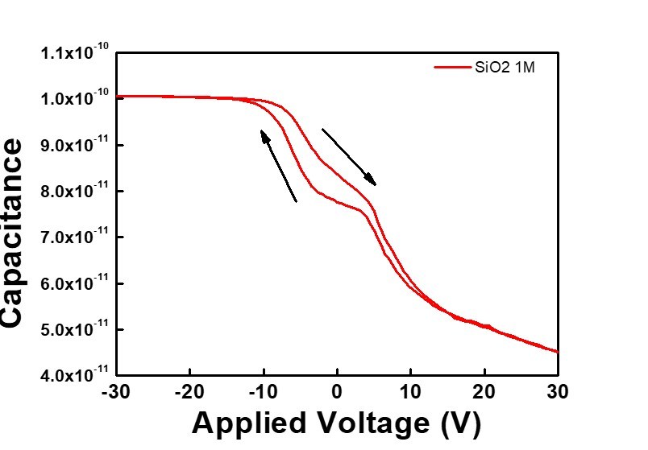
C-V Measurement Sample Characterization
SiO₂

Slide 12
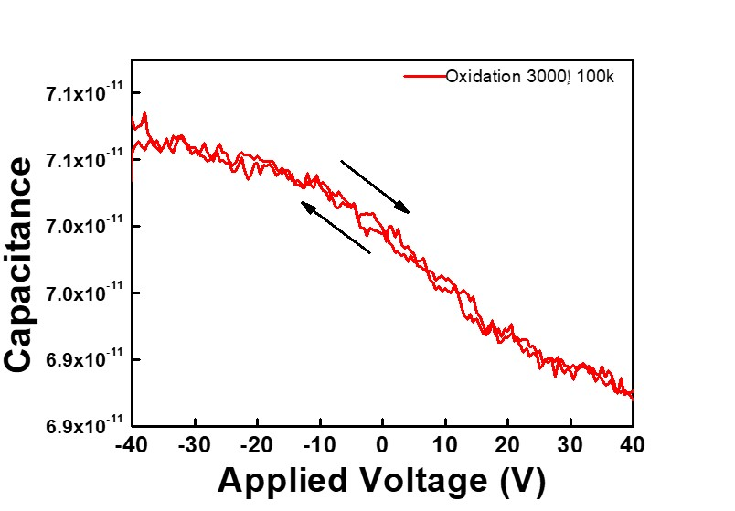
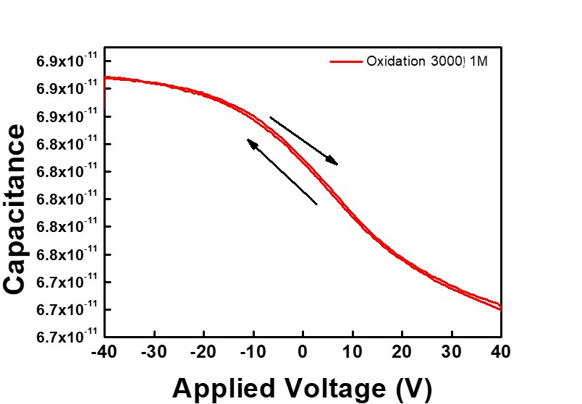
C-V Measurement Sample Characterization
Oxidation 3000Å

Slide 13
Thank you for your attention!
Notes:
Thank you for your attention!

