Slide 1
Annealing Effect on IGZO-Metal Interface
Electronic Device LAB. Hoseo University
Undergraduate Student
Yu Eun Seong
Notes:
i will introduce annealing effect on IGZO-Metal Interface
This presentation, I introduce now is my first research
Many trials and errors have been made to produce results in the course of the study.
I will show you how the experiment was conducted.

Slide 2
Contents
1. Introduction
2. Experiment
3. Result
4. Conclusion
Notes:
The table of contents consists of introductions, experiments, results, and conclusions.

Slide 3
Introduction
Several studies have shown that oxidation is formed on the metal and IGZO interfaces through heat treatment
This interfacial oxide can be used to replace the insulator deposition process
Notes:
Several studies have shown that heat treatment creates oxidation in the metal and IGZO interfaces.
I used this result to do it as a way to replace the insulator

Slide 4
Experiment
The Oxidation formation by annealing at the furnace under various gas conditions (Air, N₂, O₂)
An oxide was formed between IGZO and metal after high temperature anneal under oxygen ambient.
Heat
Heat
O₂
O₂
IGZO
Ta₂O₅
Ta
Notes:
If IGZO and metal are annealed under oxygen ambient, it shows that ta2o5 is produced
The characteristics and strength of insulator are shown according to the thickness of Ta2O5.
First , I tried to make a sample

Slide 5
Result
Conditions of ITO Deposition
Ar : 20 sccm
Gas flow : 5 mtorr
Power : 125 W
Depo. : pre – 300 s, main – 600s
Heat
O₂
ITO
ITO
ITO
Conditions of IGZO Deposition
Ar : 30 sccm
Gas flow : 5 mtorr
Power : 50 W
Depo. : pre – 600 s, main – 600s , 250℃
IGZO
Ta
ITO
IGZO
Drain
Ta
ILD
Source
Sample Structure for interfacial oxdiation
Conditions of Ta Deposition
Ar : 20 Sccm
Gas flow : 5mtorr
Power : 125W
Depo. : pre – 300 s, main -1200s
Glass
Bottom Gate Structure
Measurement
Breakdown voltage
Notes:
The deposition conditions are as follows, and the conditions for the manufacture of TFTs are as follows.
First of all, we deposited ITO on a Glass for the bottom electrodes.
Ta and IGZO were sequentially deposited and ITO was deposited for top electrode using shadow mask.
Breakdown voltages were measured.

Slide 6
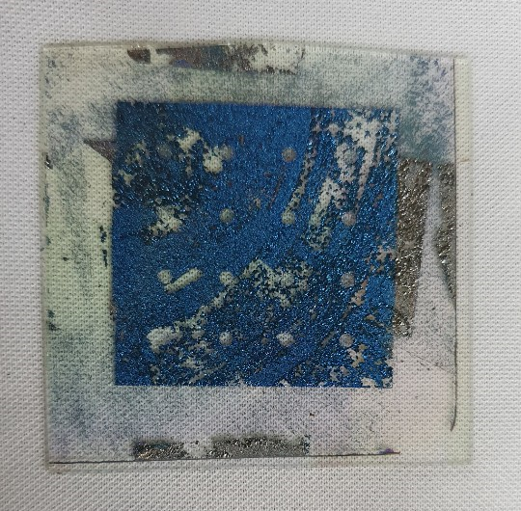
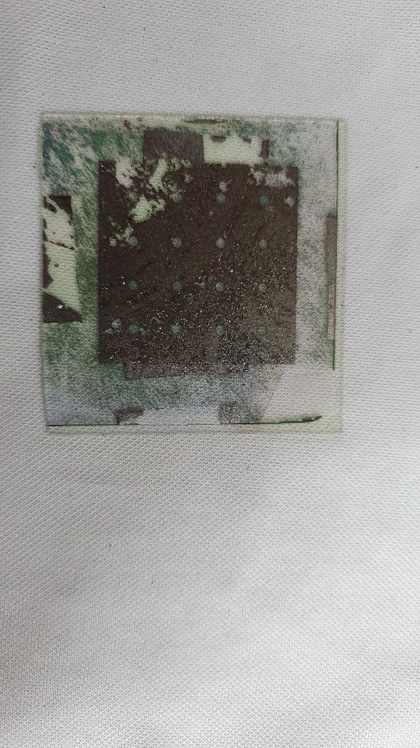
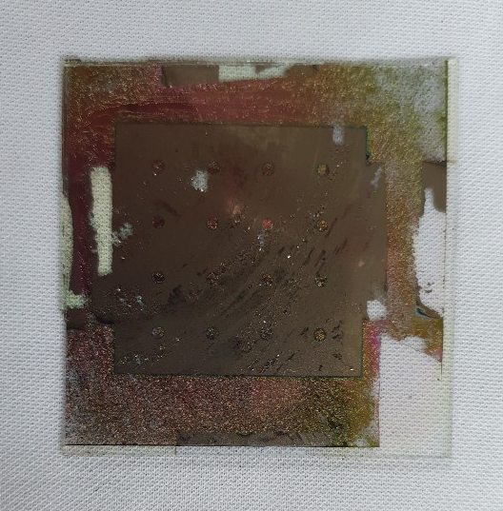
O₂
No | Process
1 | Bottom ITO
2 | ITO annealing
3 | Ta
4 | IGZO
5 | Top ITO depo
6 | Annealing
Heat
ITO
ITO
ITO
IGZO
Ta
ITO
450℃
400℃
350℃
Notes:
The two kind of samples were produced in reverse order of annealing and top ITO Deposition.
This is because if annealing of oxygen atmosphere is carried out when top ITO is present,
it may not be possible for oxygen to penetrate into the Ta interface properly.
If you look at the picture of the sample, you can see that there is a lot of peel off.
These pictures show a high temperature heat treatment of 450 degrees, 400 degrees, and 350 degrees from the left.

Slide 7
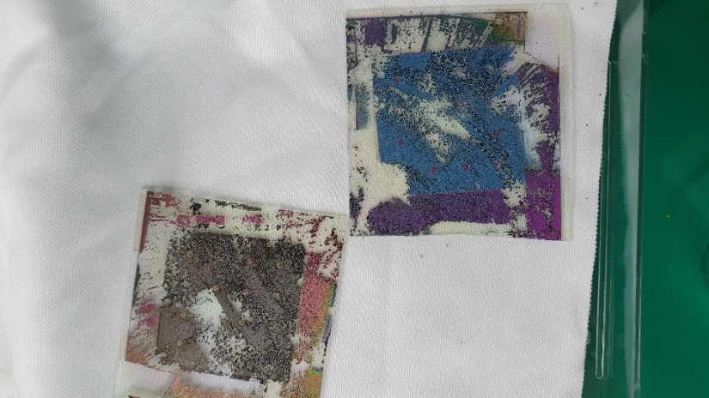
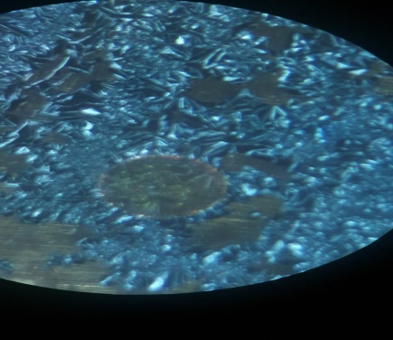
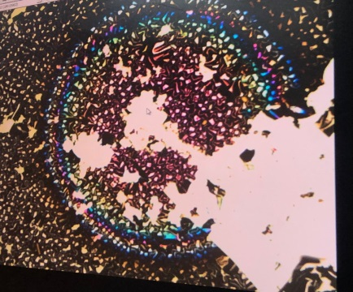
O₂
No | Process
1 | Bottom ITO
2 | ITO annealing
3 | Ta
4 | IGZO
5 | Annealing
6 | Top ITO depo
Heat
ITO
ITO
ITO
IGZO
Ta
ITO
400℃
450℃
Tantalum and ITO's adhesion were bad
Notes:
Although it was manufactured under different conditions, there were a lot of peel off to the extent that it could not be measured.
This is assumed to be resulted from bad adhesion between the lower ITO and Tantalum

Slide 8
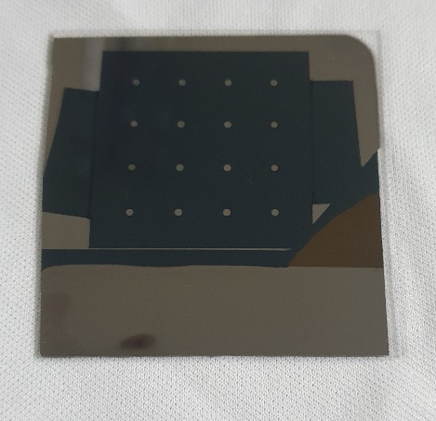
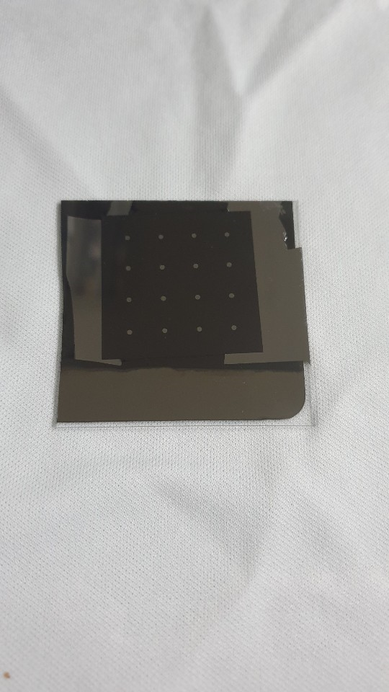
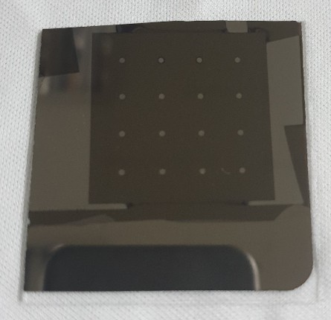
New process
Process
Bottom Ta
IGZO
Annealing
Top Ta depo
Ta
Ta
Ta
IGZO
Ta
Glass
Annealing and Top Ta Deposition
450℃
400℃
350℃
Notes:
To solve the problem, we have created a new process that uses Ta as an electrode, without the ITO.
Ta and IGZO were deposited on Glass and IGZO was removed on the side using BOE after annealing
Then, the TOP Ta was deposited using a mask after a sample was annealed.
I could see that the adhesion is very good compared to the previous sample

Slide 9
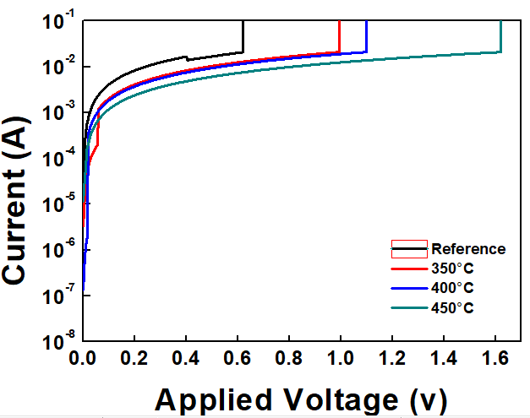
1.09V
1.62V
0.62V
0.99V
Result ( Breakdown voltage )
Notes:
As the annealing temperature rose from room temperature to 450 C, the breakdown voltages increased to 0.62V, 0.99V, 1.09V and 1.62V.

Slide 10
Conclusion
Through the annealing, an oxide was formed between the IGZO and the metal.
As the annealing temperature rose from room temperature to 450 C, the breakdown voltage increased to 0.62V, 0.99V, 1.09V and 1.62V.
Tantalum adhesion on the ITO was bad.
Future work
Improving the insulator characteristics.
Analysis for various annealing atmospheres is required.
Notes:
Conclusion Through annealing, an oxide formed between IGZO and metal. As the annealing temperature increased from room temperature to 450C, the breakdown voltage increased to 0.62V, 0.99V, 1.09V and 1.62V. Tantalum adhesion on the ITO was bad.
In Future work
Improving the insulator characteristics and Analysis for various annealing atmospheres is required

Slide 11
ありがとうございます Thank you for your attention

