Slide 1


LTPO TFT Technology for AMOLEDs
Lee, Hyuck Su
Undergraduate Student of Electronic Device LAB
The 20th Technical Collaboration Meeting
Technical Collaboration Meeting 2020, January, University of the Ryukyus, Okinawa, Japan
Notes:
I am Hyuk Soo Lee, a student at Hoseo University.
The topic of the presentation is LTPO TFT Technology for AMOLEDs.

Slide 2
Contents
What is the LTPO?
LTPO Section Plot
LTPO Pixel Circuit
The 20th Technical Collaboration Meeting
Technical Collaboration Meeting 2020, January, University of the Ryukyus, Okinawa, Japan
Notes:
I prepared 3 contents.
I'll start my presentation.

Slide 3

What is the LTPO?
Apple Watch Series 4 of Apple
The 20th Technical Collaboration Meeting
Technical Collaboration Meeting 2020, January, University of the Ryukyus, Okinawa, Japan
Notes:
What is LTPO?
LTPO was used as AMOLED backplane for the first time at Apple Watch 4.
LTPO combines both LTPS TFTs and Oxide TFTs.

Slide 4
What is the LTPO?
 | LTPS | Oxide TFT
Advantage | Relatively Larger mobility (~100cm² /Vs) | Low off state leak current
Weakness | Large off-state leak current A frame not capable of exceeding 60hertz | Relatively lower mobility (~30cm² /Vs) Larger Gate Integrated Peripheral (GIP) Circuit size
The 20th Technical Collaboration Meeting
Technical Collaboration Meeting 2020, January, University of the Ryukyus, Okinawa, Japan
Notes:
LTPS has superior mobility.
So LTPS has been widely used as backplane technology in mobile and wearable displays.
However, since off-state leakage currents are inherently high, visible artifacts often occur.
And the frame cannot exceed 60 hertz to prevent artifacts from occurring.
Oxide TFTs such as IGZO have low leakage current.
Low leakage current can reduce the frame rate, so the frequency of voltage change is low.
However, due to low mobility, the gate Integrated Peripheral drive circuit size is large.

Slide 5
What is the LTPO?
 | LTPO
Advantage | Low Gate Integrated Peripheral (GIP) Power Slim border with LTPS TFT Lower Refresh Rates Reduced Power Consumption.
Weakness | Low resolution due to reduced emitting area than LTPS
The 20th Technical Collaboration Meeting
Technical Collaboration Meeting 2020, January, University of the Ryukyus, Okinawa, Japan
Notes:
If OXIDE is embedded in LTPS’s backplane, the benefits of the two types of TFT are available.
The LTPO architecture allows for thin edges of LTPS and low GIP power.
And there are two benefits of cultivating the Oxide TFT into a pixel circuit.
One is to lower the rate of regeneration and the other is to reduce the power consumption.
However, its resolution is lower than LTPS due to reducing emitting area.

Slide 6
Contents
What is the LTPO?
LTPO Structure and Photography
LTPO Pixel Circuit
The 20th Technical Collaboration Meeting
Technical Collaboration Meeting 2020, January, University of the Ryukyus, Okinawa, Japan
Notes:
The following is LTPO Structure and Photography.

Slide 7

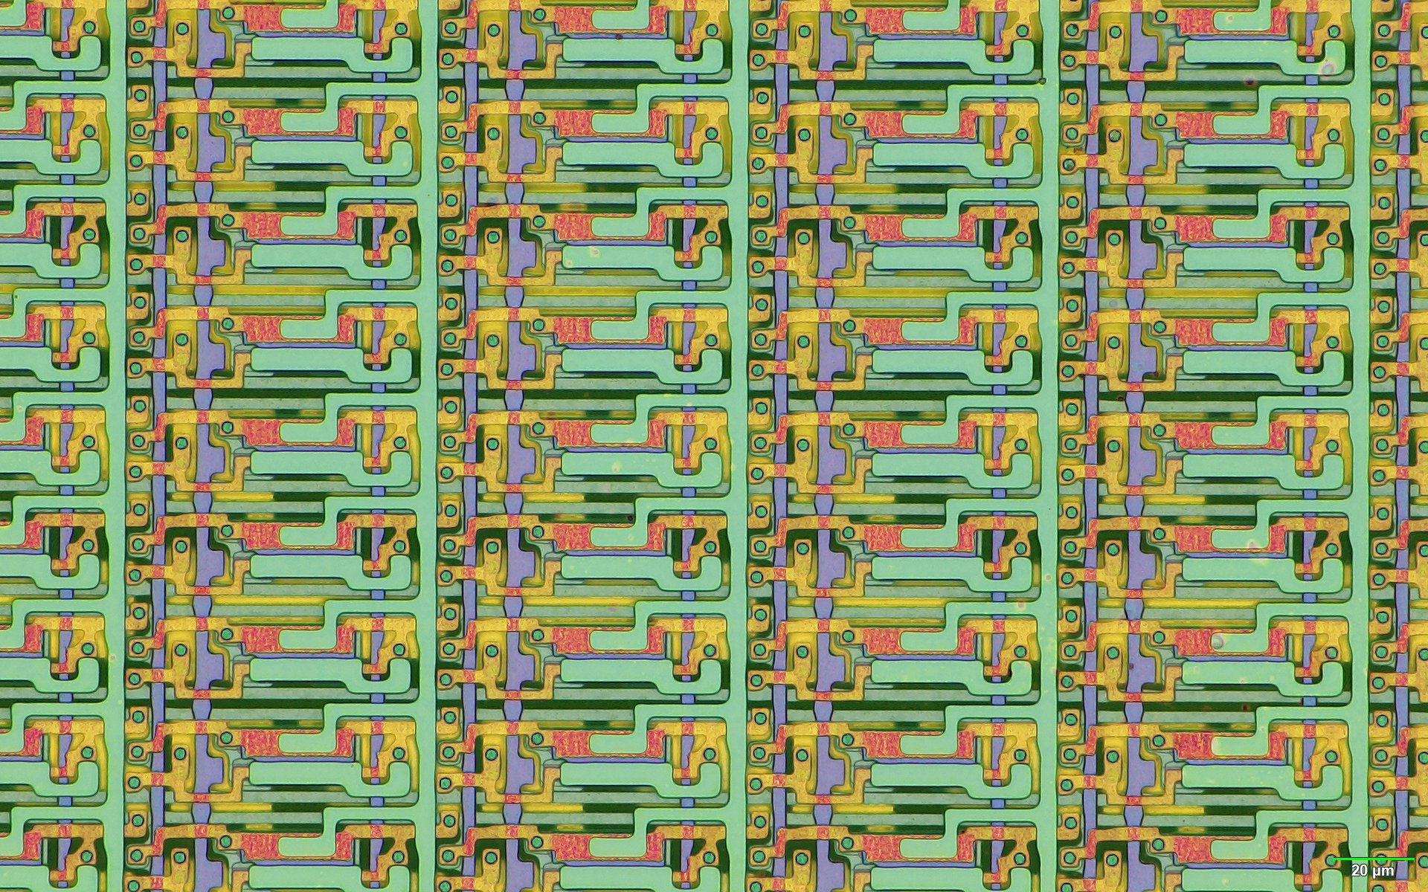
LTPO Structure and Photography
Top
Bottom
The 20th Technical Collaboration Meeting
Technical Collaboration Meeting 2020, January, University of the Ryukyus, Okinawa, Japan
Notes:
These are microscope images of the pixel of apple watch 5.

Slide 8

LTPO Structure and Photography
FIB-SEM
Poly-Si TFT
S/D contact
Oxide TFT
S/D contact
Oxide TFT
S/D contact
S/D
Gate2
Oxide
LS?
Gate1
Gate1
Poly-Si
The 20th Technical Collaboration Meeting
Technical Collaboration Meeting 2020, January, University of the Ryukyus, Okinawa, Japan
Technical Collaboration Meeting 2020, January, University of the Ryukyus, Okinawa, Japan
Notes:
The left image is the top view of the pixel in the apple watch 5.
Also, the right image is the FIB-SEM image of the red part in the left image.
In the right picture, there is another GATE metal other than that of OXIDE TFT.
This is marked as GATE 1 and GATE2.
Gate 1 and Gate 2 are located on different layers.

Slide 9
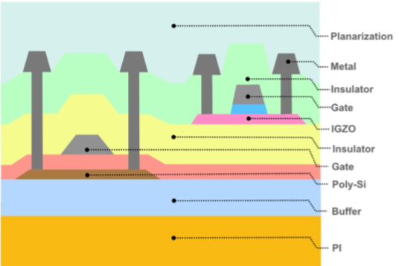
LTPO Structure and Photography
LTPO TFT stack-up with top-gate oxide TFT
The 20th Technical Collaboration Meeting
Technical Collaboration Meeting 2020, January, University of the Ryukyus, Okinawa, Japan
Notes:
This picture expresses the structure of LTPO TFT in apple watch 5.
The LTPS and Oxide TFTs take the structure of the top gate.
And this structure is called the TOP GATE structure of LTPO.

Slide 10
Contents
What is the LTPO?
LTPO Section Plot
LTPO Pixel Circuit
The 20th Technical Collaboration Meeting
Technical Collaboration Meeting 2020, January, University of the Ryukyus, Okinawa, Japan
Notes:
The last topic is the LTPO pixel circuit.

Slide 11
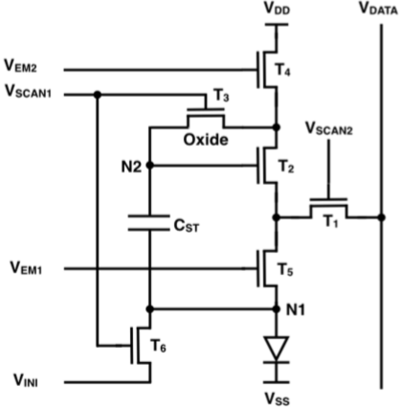
LTPO Pixel Circuit
6Transistor+1Capacitor
LTPS : T1,T2,T4,T5,T6
Oxide : T3
Storage Capacitor : CST
Power Signal : VDD,VSS
Data Signal : VDATA
Initialization Signal : VINI
Control Signal : Vscan,VEM
The 20th Technical Collaboration Meeting
Technical Collaboration Meeting 2020, January, University of the Ryukyus, Okinawa, Japan
Notes:
This is the circuit diagram used in Apple Watch 4.
It consists of six transistors and one storage capacitor.
Except for T3, which is OXIDE TFT, five are LTPS TFTs.
This circuit take power signals from Vdd and Vss.
And it has one data signal and an initialization voltage.
It also has two scan signals and two emission signals.

Slide 12
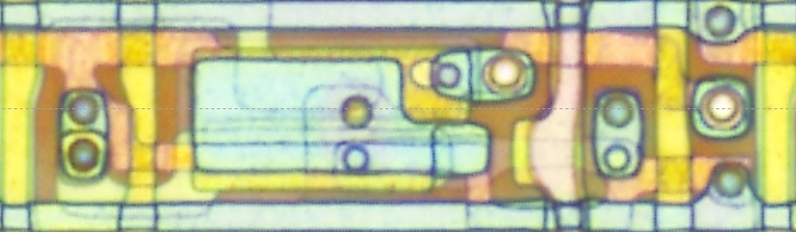
LTPO Pixel Circuit
VDATA
VDD
VINI
EM2
VINI
T4
Vscan1
T6
T3
N1
N2
Cst
T2
EM1
T5
Vscan2
T1
The 20th Technical Collaboration Meeting
Technical Collaboration Meeting 2020, January, University of the Ryukyus, Okinawa, Japan
Notes:
We analyzed the pixel of apple watch 5 based on FIB-SEM images.
The following circuit diagrams have been entered into Apple Watch Series 5.
Using these two pictures, I will explain the operation of the pixel circuit using LTPO.

Slide 13
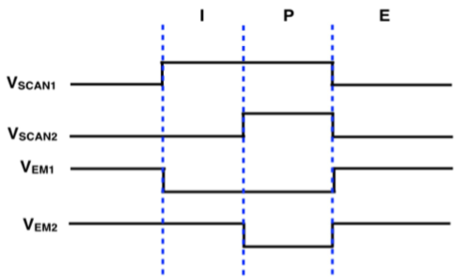
LTPO Pixel Circuit
ON
ON
VDD
ON
VDATA
ON
VINI
VDD
EM2
VINI
ON
T4
Vscan1
T6
T3
N1
VDD
VINI
N2
ON
Cst
T2
EM1
T5
Vscan2
T1
Technical Collaboration Meeting 2020, January, University of the Ryukyus, Okinawa, Japan
Notes:
First, in the initialization section, the scan1 voltage and the emission2 voltage are high voltages.
So, transistors 3, 4, and 6 are turned on.
As a result, node1 and node2 are initialized with initialization voltage and Vdd.

Slide 14
LTPO Pixel Circuit
ON
ON
VDATA
VDD
ON
ON
VDATA
ON
ON
VINI
VDD
EM2
VINI
ON
T4
Vscan1
T6
T3
VDD
N1
VDATA
VINI
N2
ON
ON
Cst
T2
ON
EM1
T5
Vscan2
T1
Technical Collaboration Meeting 2020, January, University of the Ryukyus, Okinawa, Japan
Notes:
The following is the operation of the Programming and threshold voltage Compression section.
The emission2 voltage gets low, and the scan1 voltage and the scan2 voltage get high.
So, transistor 4 is turned off, and transistor 1 is turned on.
And then, Data voltage is programmed into node 2.

Slide 15
LTPO Pixel Circuit
ON
ON
VDATA
VDD
ON
VDATA
ON
ON
VINI
VDD
EM2
VINI
ON
ON
T4
Vscan1
T6
T3
VDD
N1
VDATA
VINI
N2
ON
ON
ON
Cst
T2
ON
EM1
T5
Vscan2
T1
Technical Collaboration Meeting 2020, January, University of the Ryukyus, Okinawa, Japan
Notes:
The following is the drive of the Emission section.
Two scan voltages get low and emission voltages get high.
transistor 4, transistor 2 and transistor 5 are turned on and current path is formed from Vdd to Vss.
As a result, current can flow through OLED pixels.

Slide 16
End of the Presentation
Thank you for Listening!
The 20th Technical Collaboration Meeting
Technical Collaboration Meeting 2020, January, University of the Ryukyus, Okinawa, Japan
Notes:
This concludes the presentation.
I just joined the EDLAB just two months ago.
I studied LTPO, which is classified as a new technology, and set the direction for future research.
I hope next time I can introduce new technology that I have studied.
Thank you for listening to the presentation.

