Slide 1


Introduction to ED LAB
The 19th Technical Collaboration Meeting
Hoseo University
Division of Electronics and Display Engineering
Undergraduate 1st
Young Jin Kim
2019. 08. 31
Technical Collaboration Conference, August 31, 2019, South Korea, Gyeongju IMID
Notes:
Hello everybody.
Today, I would like to talk about our ED Lab

Slide 2
Contents
Introduce LAB people
- Professor
- Doctor’s course
- Master’s course
- Undergraduate
Introduce LAB research
- Presbyopia glass
- Taste Sensor
- Stretchable display
- Interfacial oxidation
Technical Exchange Conference, August 31, 2019, South Korea, Gyeongju IMID
Notes:
Let me introduce the table of contents.
We will introduce the people of the lab first and introduce you to some of the major studies in our laboratory.
목차를 소개하겠습니다.
먼저 연구실 사람들을 소개하고 우리 연구실에서 진행하는 주요 연구들을 소개해 드리겠습니다.

Slide 3
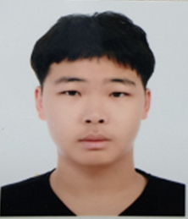
Introduction
Name : YounJin Kim
Age : 20 (Undergraduate)
Major: Electronic Display Engineering
Technical Exchange Conference, August 31, 2019, South Korea, Gyeongju IMID
Notes:
First of all, let me introduce myself.
My name is Young Jin Kim, 20 years old, and I’m a undergraduate, majoring Electronic Display Engineering of Hoseo University.
I became a member to this laboratory in May.

Slide 4
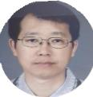
Introduction of ED Lab Personnel
Professor
ByungSeoung Bae
Technical Exchange Conference, August 31, 2019, South Korea, Gyeongju IMID
Notes:
Let me introduce the Electronic Device Laboratory members.
First, Professor ByungSeoung Bae.

Slide 5



Introduction of ED Lab Personnel
Doctor’s course
JongMo Lee
SeungJae Moon
InHye Kang
Technical Exchange Conference, August 31, 2019, South Korea, Gyeongju IMID
Notes:
In the doctor’s course, jongmo Lee, Seungjae Moon, and InHye Kang

Slide 6



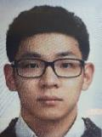
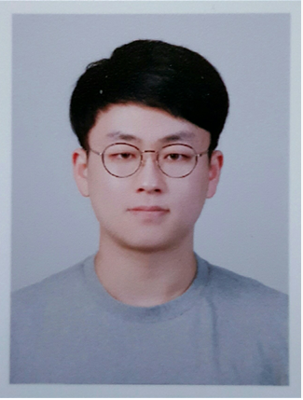
Introduction of ED Lab Personnel
Master’s course
YoungJo Baek
MinSu Kang
SeokJun Kang
SeoGwon Kim
JaeKeun Woo
Technical Exchange Conference, August 31, 2019, South Korea, Gyeongju IMID
Notes:
Master’s course, Young Jo Baek, MinSu Kang, SeokJun Kang, SeoGwon Kim, Jae Keun Woo
Young Jo and Minsu will graduate this time.

Slide 7
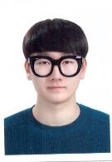
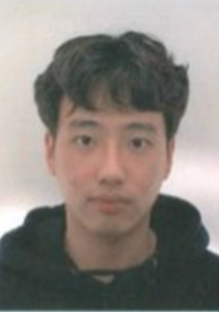
Introduction of ED Lab Personnel
Undergraduates
Seung Han
YoungJin Kim
EunSeong Yu
Technical Exchange Conference, August 31, 2019, South Korea, Gyeongju IMID
Notes:
Finally, Seung Han, me and Eun Seong Yu There are three undergraduates composed.

Slide 8
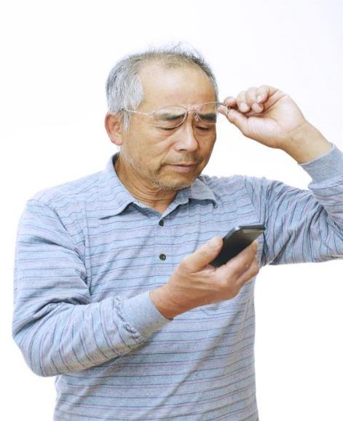
My Research
Presbyopia glass
Technical Exchange Conference, August 31, 2019, South Korea, Gyeongju IMID
Notes:
Next, I would like to introduce you to the laboratory research.
Nowadays, Analyzing presbyopia glasses in the laboratory.

Slide 9
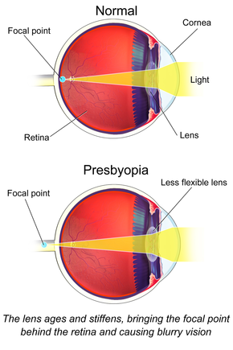
My Research
Presbyopia glass
What is the Presbyopia?
Technical Exchange Conference, August 31, 2019, South Korea, Gyeongju IMID
Notes:
What is the presbyopia? The eye lens becomes hardened by aging, loses elasticity. It cause weakens the control function, so weakens the ability to focus near.
노안이란 무엇인가? 안구 렌즈는 노화로 굳어져 탄력을 잃는다. 그것은 제어 기능을 약화시켜, 가까이 집중하는 능력을 약화시킨다.

Slide 10
My Research
Presbyopia glass
lens
Cholesteric liquid crystal
Front
ITO
Side
Technical Exchange Conference, August 31, 2019, South Korea, Gyeongju IMID
Notes:
We designed glasses for this purpose. First, We prepared two lenses, and deposited ITO on two lenses.
Next, injected the cholesteric liquid crystal between two lenses and encapsulated
우리는 이런 목적으로 안경을 디자인했다. 먼저 렌즈 2개를 준비했고, ITO를 렌즈 2개에 입금했다. 다음으로, 두 렌즈 사이에 콜레스터 액정을 주입하고 캡슐화했다.

Slide 11
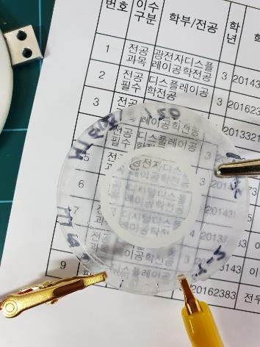
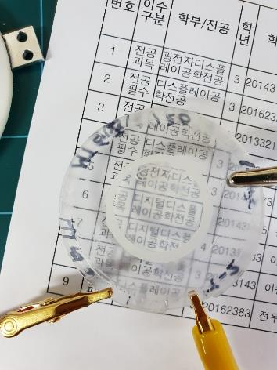
My Research
Presbyopia glass
Off state
On state
Technical Exchange Conference, August 31, 2019, South Korea, Gyeongju IMID
Notes:
We could change the refractive index according to the voltage using the cholesteric liquid crystal.
When the voltage is turned off, the transmittance is lowered, and when the voltage is applied, the transmittance is increased.
As you can see from the video,
Due to the high drive voltage, we are focusing on lowering it.
우리는 콜레스터 액정을 사용하여 전압에 따라 굴절 지수를 변경할 수 있었다. 전압이 꺼지면 투과율이 낮아지고, 전압이 가해지면 투과율이 높아진다.
영상 보시면 아시겠지만
높은 구동 전압 때문에, 우리는 그것을 낮추는 데 초점을 맞추고 있다.

Slide 12
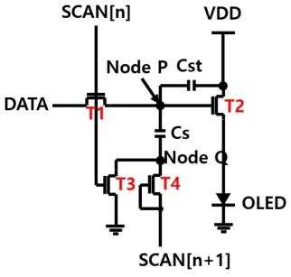
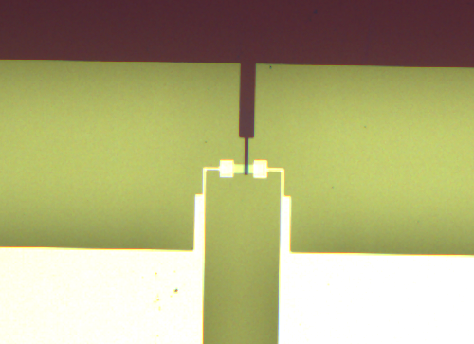
ED Lab Research
We can classify our researches at 2 part,
circuit, and TFT process
Gate
Source
Drain
Technical Exchange Conference, August 31, 2019, South Korea, Gyeongju IMID
Notes:
We can classify our researches at 2 part,
circuit, and Thin Film Transistor process

Slide 13
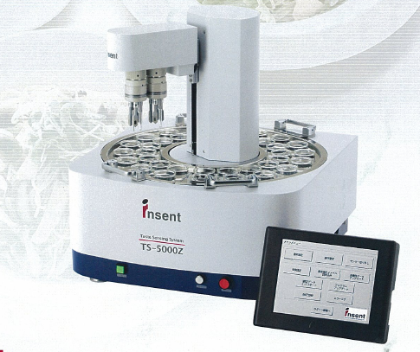
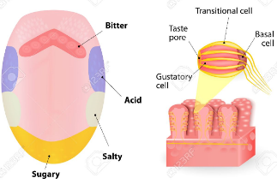
ED Lab Research
Taste sensor
chemical detection membrane for substances a transducer that converts into an electrical signal.
Taste cell
Taste buds
Technical Exchange Conference, August 31, 2019, South Korea, Gyeongju IMID
Notes:
Let me explain about the taste sensor.
To briefly explain the principle of human taste, there are ions in the inside and outside of the taste buds that dissolve in the aqueous solution, When you taste with your tongue, the ion concentration in the inner cell is disturbed by the ion outside the taste bud and the cell membrane, and the membrane potential is generated and electricity flows. The result is transmitted to the nerve and eventually the taste is recognized in the brain. Taste reacts with the sensing membrane of the sensor and reacts differently depending on the taste depending on the taste. This reaction induces a change in charge on the surface of the sensing membrane and generates a surface potential difference. This is the sensing principle of the taste sensor that is currently under research and development. Thus, a taste sensor can be made by mimicking the mechanism of human taste.
미각센서에 대해 소개하겠습니다.
인간이 맛을 느끼는 원리를 간단히 설명하자면, 미뢰의 안쪽과 바깥 부분에는 수용액에 녹아 전기를 띠는 이온이 있는데,
혀로 맛을 느낄 때 미뢰 바깥쪽에 있는 이온과 세포막을 사이에 두고 안쪽 세포 내의 이온 농도가 균형이 깨지면서 막 전위가 생성되어 전기가 흐른다.
그 결과가 신경으로 전달되어 최종적으로 뇌에서 맛을 인지하게 되는 것이다.
맛은 센서의 감지막과 특정 반응을 하는데 맛에 따라 감지막에 따라 다른 반응을 합니다.
이러한 반응은 감지막의 표면에서 전하의 변화를 유도하고 표면 전위차를 발생시킵니다.
이것이 현재 연구개발 되어지고 있는 미각센서의 감지 원리 입니다.
이처럼 인간이 맛을 느끼는 매커니즘을 모방해서 미각센서를 만들 수 있다.

Slide 14
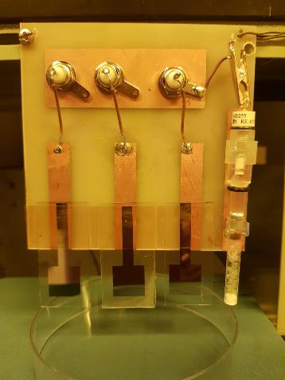
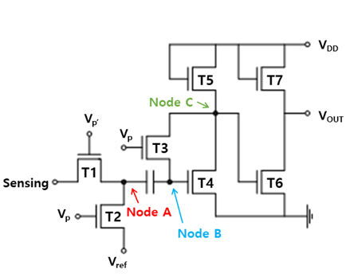
ED Lab Research
Taste sensor
Taste sensor using TFT
Circuit of the amplifier
Technical Exchange Conference, August 31, 2019, South Korea, Gyeongju IMID
Notes:
The photo on the left is a taste sensor made by our TFT, and the right picture is a circuit made to amplify the weak signal. Such sensor membrane fabrication and amplification circuit technology is expected to be applicable to portable portable taste sensor applications.
왼쪽 사진은 우리가 만든 TFT로 만든 미각 센서이고, 오른쪽사진은 신호가 약해서 이를 증폭하기 위해 만든 회로이다.
이러한 센서막의 제작과 증폭회로 기술은 휴대가 가능한 소형 미각센서 어플리케이션에 적용 가능할 것이라고 예상한다.

Slide 15
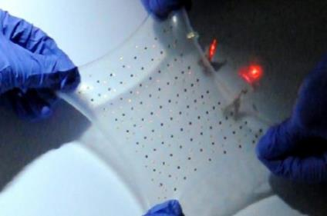
ED Lab Research
Stretchable Display
Stretchable Display
Studying a flexible circuit.
Technical Exchange Conference, August 31, 2019, South Korea, Gyeongju IMID
Notes:
The above picture is a view of a stretchable display, but it is a futuristic display that is expected to be used in a wide variety of industries because the brightness does not change.
위 사진은 스트레쳐블 디스플레이의 모습인데 늘어나도 밝기에 변화가 없어 매우 다양한 산업에 쓰일 것으로 예상되는 미래형 디스플레이다.

Slide 16
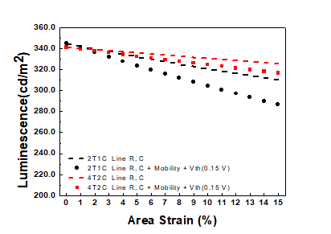
ED Lab Research
Stretchable Display
Luminance depending on elongation
Stretchable OLED circuit.
Technical Exchange Conference, August 31, 2019, South Korea, Gyeongju IMID
Notes:
We made a strainable oled circuit. As can be seen from the figure on the right, the brightness is lowered as the current pixel is drawn, and it is under study to minimize this change.
우리는 스트레쳐블 oled 회로를 만들었다. 오른쪽 그림에서 확인할 수 있듯이, 현재 화소가 연신됨에 따라 휘도가 낮아지는데, 이 변화를 최소화하기 위해 연구 중에 있다.

Slide 17
Thank you for attention
Technical Exchange Conference, August 31, 2019, South Korea, Gyeongju IMID
Notes:
This is the end of my presentation. Thank you for attention.

