Slide 1

ITO deposition on PMMA lens
The 18th Technical Collaboration Meeting
Hoseo University
Electronic Display Engineering
4th grade
20143135
Song Pyeong Seob
Notes:
Hi, this is Song Pyeong Seop from Hoseo University.
The topic is the ITO deposition optimization process on PMMA lenses.

Slide 2
Contents
The 18th Technical Collaboration Meeting
Abstract
Introduction
Experiment
Results & Discussion
Conclusion
Notes:
Table of Contents Introduction, Introduction, Experiment, Results, Discussion, Conclusion.

Slide 3
Abstract
The 18th Technical Collaboration Meeting
SiO₂ was applied as a buffer layer to improve adhesion between PMMA and ITO.
The ITO thin film with SiO₂ buffer layer had surface resistance (123.6 ~ 198.5 Ω/□) and 80 % transmittance was obtained in a 550 nm wavelength region.
The adhesion analyzed by tape test and the adhesion was improved for the thicker SiO₂ buffer layer.
Notes:
SiO₂ was applied as a buffer layer to improve adhesion between PMMA and ITO.
SiO₂ was deposited under the same conditions for 30 minutes, 60 minutes and 90 minutes, respectively.
The ITO thin film with SiO₂ buffer layer had surface resistance (123.6 ~ 198.5 Ω/□) and 70 % transmittance was obtained in a 550 nm wavelength region.
The adhesion analyzed by tape test and the adhesion was improved for the thicker SiO₂ buffer layer.

Slide 4

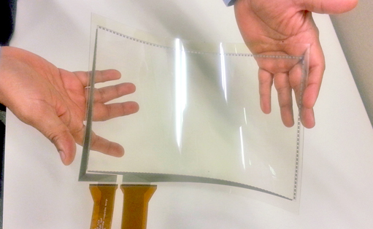
Introduction (1)
The 18th Technical Collaboration Meeting
Electronically tunable Focus Liquid Crystal (LC) lenses have promising applications.
automatic beam steering
cell phone cameras
other mechanical devices
In order to develop the technology and ensure stable product performance, optimized conditions for forming a transparent conductive thin film are required.
Notes:
Electronically tunable Focus Liquid Crystal (LC) lenses have promising applications in automatic beam steering, cell phone cameras, glasses, and other mechanical devices.
Because of the use of curvature plastic lenses as substrates, issues that did not exist in flat panel display process technology using glass or silicon occur.
In order to develop the technology and ensure stable product performance, optimized conditions for forming a transparent conductive thin film are required.

Slide 5
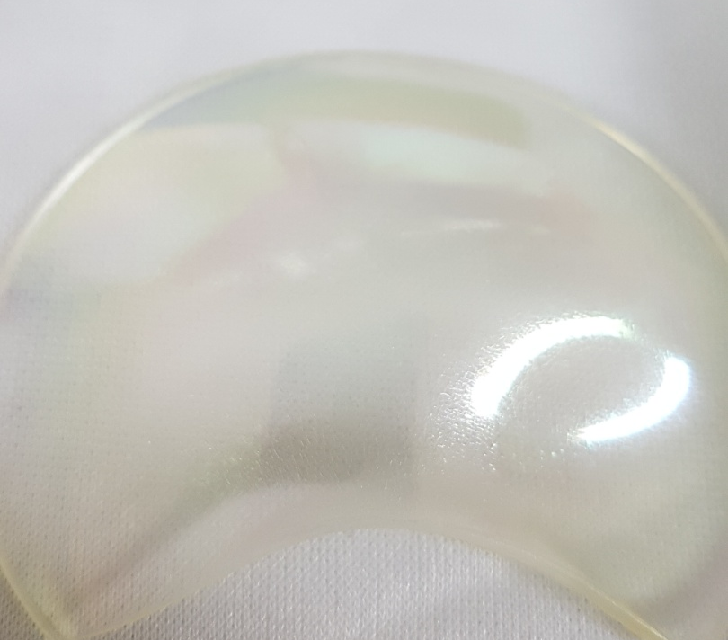
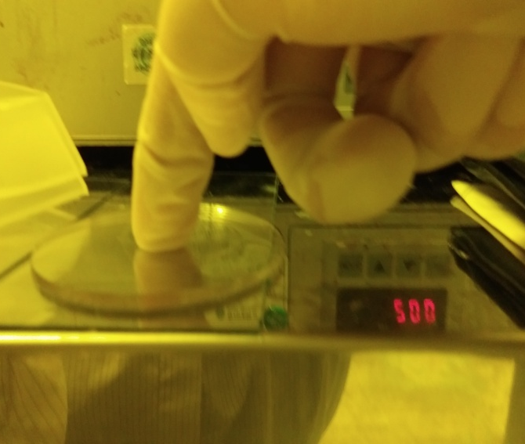
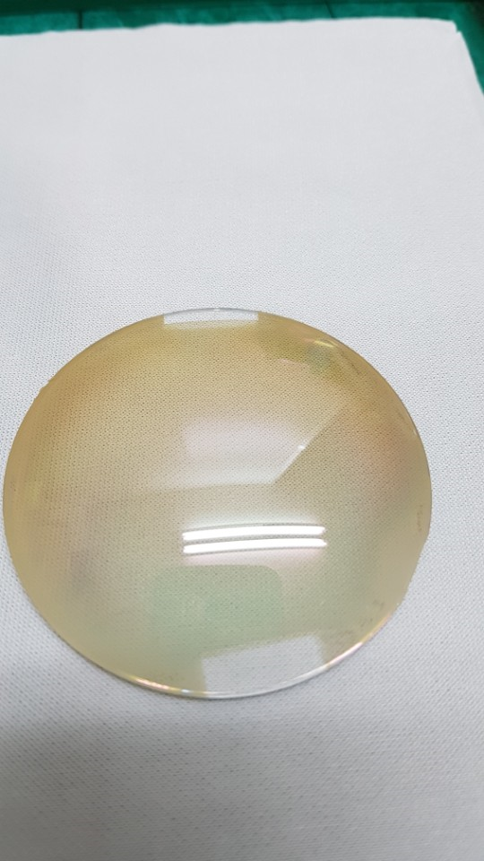
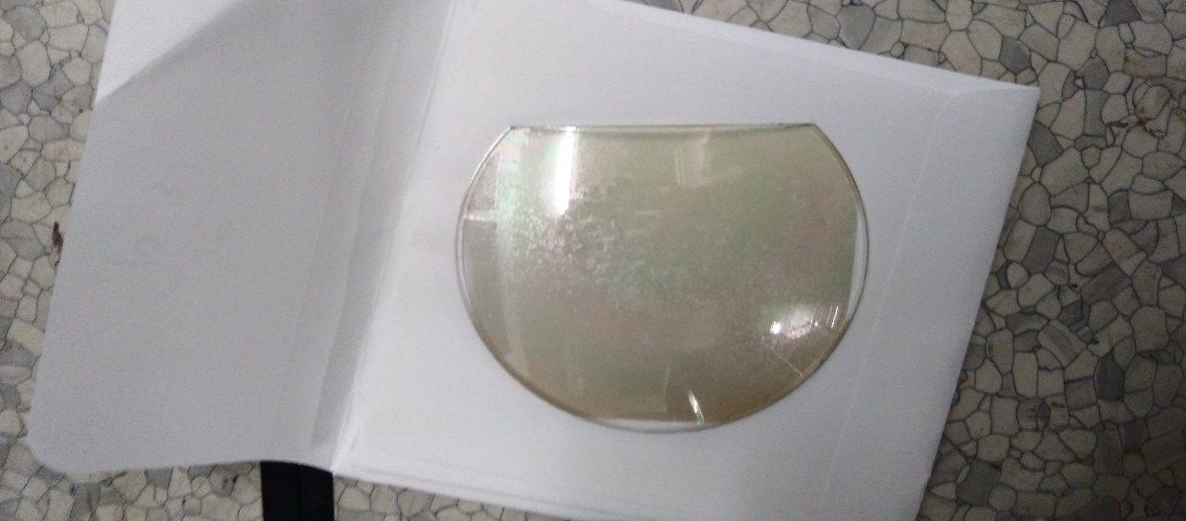
Introduction (2)
The 18th Technical Collaboration Meeting
Polymethylmethacrylate (PMMA) has high optical transparency and excellent homogeneity.
PMMA has a low heat resistance.
(PMMA Tg = 105 ° C)
The ITO thin film formed by sputtering has very weak interfacial adhesion with the PMMA substrate.
Sputter plasma damage
Low heat resistance
Low transmittance
Low adhesion
Notes:
Poly-methyl methacrylate (PMMA) has high optical transparency and excellent homogeneity among various kinds of plastic materials and can be manufactured by an injection process and is applied to various optical products such as a camera lens and a Fresnel lens.
However, since polymers such as PMMA are low in heat resistance (PMMA T_{g} = 105 ℃), it is difficult to carry out the high temperature process of ITO thin film to improve properties.
It can be seen that the ITO thin film formed by sputtering has very weak interfacial adhesion with the PMMA substrate, which causes the problem of peeling of the ITO film in the subsequent cleaning and liquid crystal process.

Slide 6

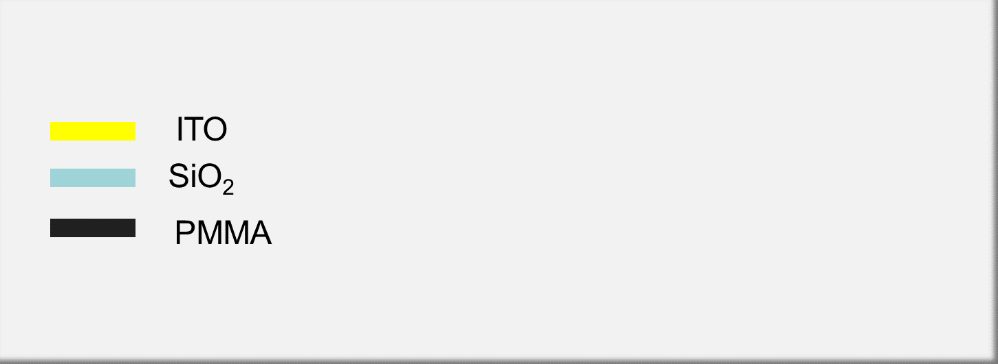
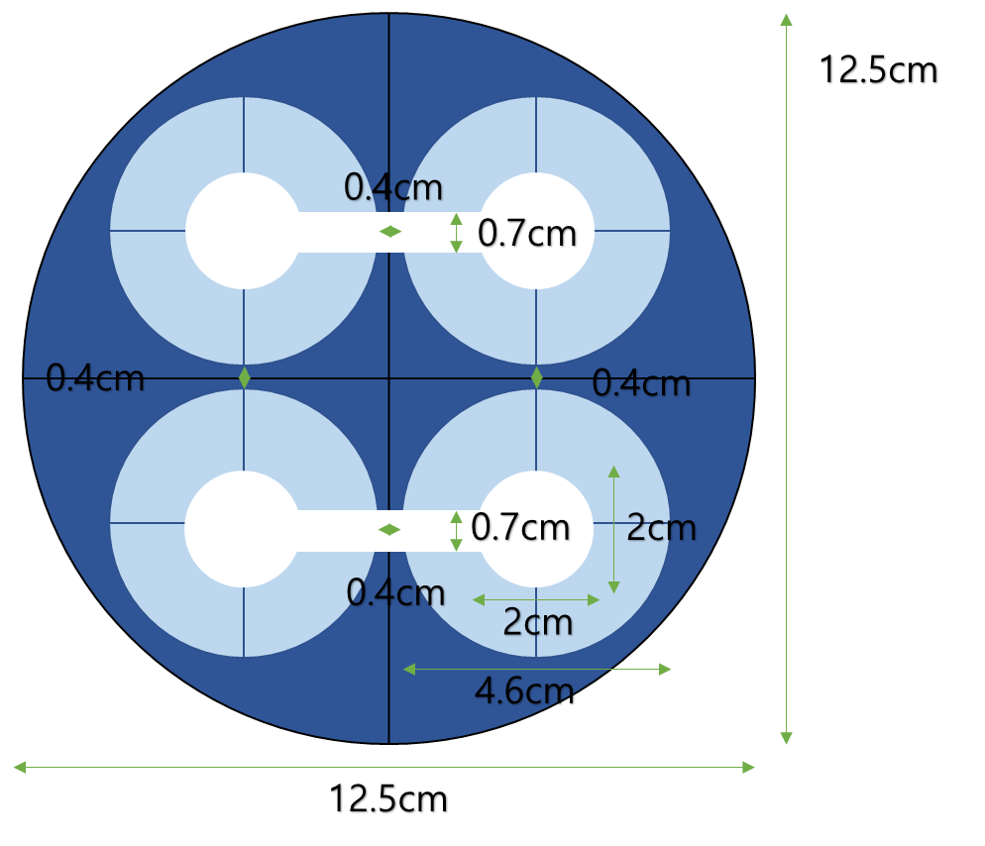
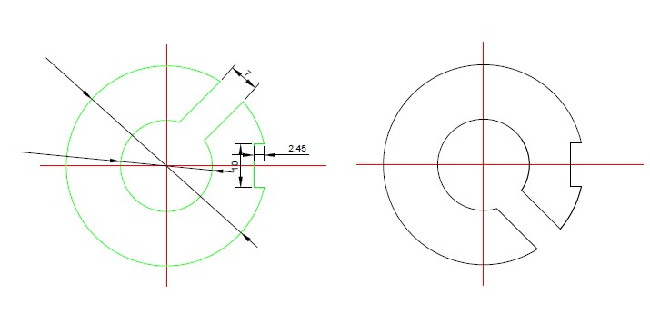
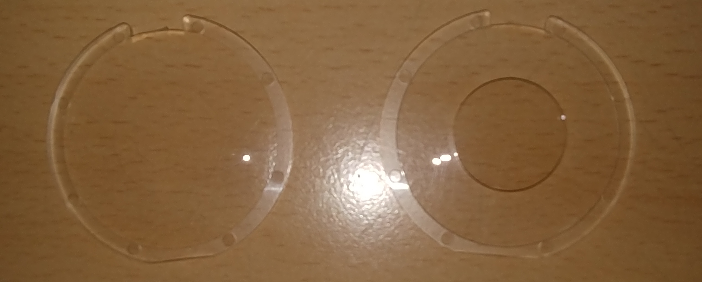
Experiment (1)
The 18th Technical Collaboration Meeting
LC lens 1
LC lens 2
Fig.1. Lens structure for Electronically tunable Focus LC lenses
Fig.2. ITO Shadow Mask(left: metal mask, right: plastic mask) for Focus LC Lenses
PMMA is dissolved in the stripper and ITO etchant and lens has curved surface
→Difficult to apply the photolithography process
Therefore, ITO patterning was performed using a metal shadow mask.
Notes:
pmma is dissolved in the stripper and ITO etchantand lens has curved surface.
Therefore, it is difficult to apply the photolithography process. Therefore, ITO patterning was performed using a metal shadow mask.

Slide 7
Experiment (2)
The 18th Technical Collaboration Meeting
Cleaning
Ultrasonic cleaning 30 min. (surfactant & DI water 1:1)
Pre bake 30min
RIE O₂ plasma treatment 40 sec.
Sputter Deposition
The SiO₂ , ITO deposited by RF magnetron sputtering.
Analysis
The electrical properties - 4 point probe.
The optical properties - Spectrophotometer
Adhesion properties - Test using Teflon tape
Parameter | SiO₂ | ITO
Plasma source | Radio frequency
Power (W) | 60 | 50
Base Pressure | 3.5 ⅹ10⁻⁵ Torr
Working Pressure | 6.0 ⅹ10⁻³ Torr
Gas (cc) | Ar 30 : O₂ 2 | Ar 30
Temperature (°C) | R.T. (24–26) | R.T. (24–26)
Deposition Time (min.) | 90 | 5
Table 1. SiO₂ , ITO process conditions of RF magnetron sputtering
Notes:
Cleaning of the PMMA is important to prevent outgasing during the deposition process.
Ultrasonic cleaning was carried out for 30 minutes with a solution of surfactant and DI water in a ratio of 1: 1.
70 °C pre bake was performed for 30 minutes and O2 plasma was treated for 40 sec. using RIE system.
The SiO₂ of various thicknesses was deposited on PMMA curved lens as buffer layer by RF magnetron sputtering method.
After depositing SiO₂ buffer layer on PMMA lens, ITO electrode was deposited by RF magnetron sputtering method.
The electrical properties of the deposited ITO thin films were analyzed by 4 point probe. For the optical characterization of the specimens, the transmittance was measured using a spectrophotometer in the visible region.

Slide 8
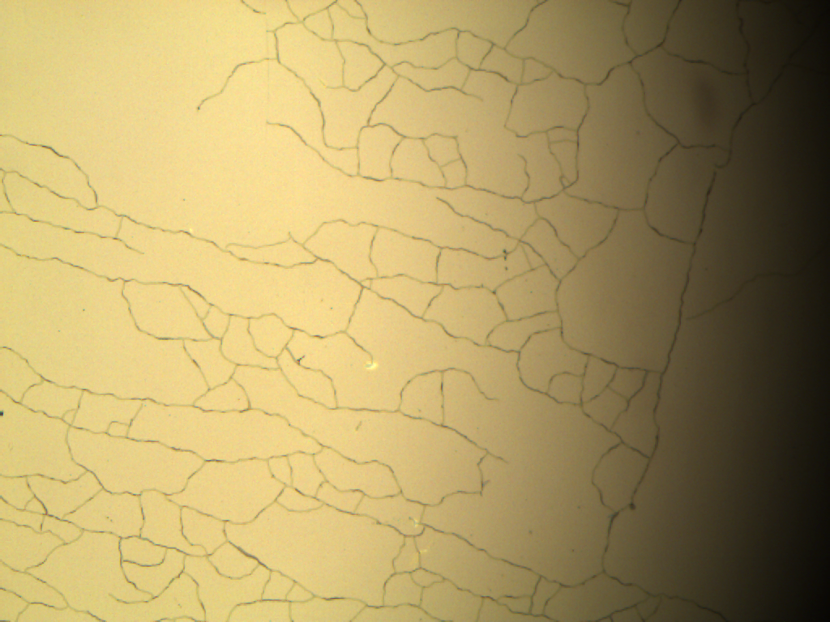
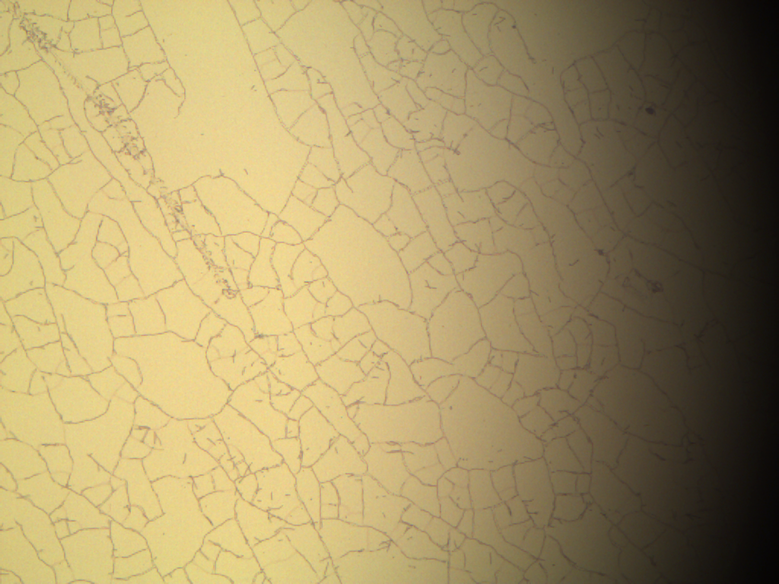
Results & Discussion
The 18th Technical Collaboration Meeting
Deposition Optimization
Division | Ar (cc) | O₂ (cc) | Power (W) | Temp. (℃) | Time (h) | Res. (Ω)
1 | 22.5 | 7.5 | 50 | 120 | 1 | Lens collapsed.
2 | 22.5 | 7.5 | 50 | 100 | 1 | Lens collapsed.
3 | 7.5 | 22.5 | 50 | 80 | 1 | 170~300 M
4 | 7.5 | 22.5 | 50 | 80 | 1.5 | 170~300 M
8 | 20 | 0 | 100 | RT | 0.5 | Lens collapsed.
9 | 20 | 0 | 50 | RT | 0.5 | 80~100
Sputter process parameters on ITO deposition
Using RF sputter (ITO cracks)
Low deposition temperature (< 80 ℃)
Short Deposition time (< 2 hours)
Low sputter power {ex) 2 inch Sputter < 50 W}
Oxygen flow X (decrease of electrical properties)
Table 2. ITO deposition conditions on PMMA lens
Fig.3. Microscope images ITO cracks of PMMA lens
Notes:
Various deposition conditions have been developed to form ITO in PMMA lenses.
The low resistivity and high transmittance of ITO in glass can be achieved by high deposition power, oxygen addition, and heat treatment of 250 degrees or more.
When heat treatment of 100 degrees or more high power of sputtering are applied, ITO in the PMMA cracks the thin film.
It is believed that the crack occur by thermal deformation and out gasing of PMMA during the deposition process.

Slide 9
Results & Discussion
The 18th Technical Collaboration Meeting
Optical properties
In Fig.4., the ITO thin film having the SiO₂ buffer layer has a transmittance of 78% in a 550 nm wavelength.
Fig.4. Transmittance Spectrum of ITO deposited
on a PMMA lens with SiO₂ buffer layers
Notes:
Fig, 4 shows the transmittance of the samples.
The transmittance of the PMMA / SiO2 buffer layer / ITO thin film was measured in the visible region.
When the ITO thin film is formed as a 100-200 ohm resistance, it has a 78% transmittance at 550 nm wavelength.
When ITO is deposited without oxygen addition, the transmittance of the thin film is lowered due to the oxygen deficiency during the deposition, and the electrical conduction characteristics are also changed.
Therefore, it is concluded that it is important to form the ITO film within a short time by using the RF sputter.

Slide 10
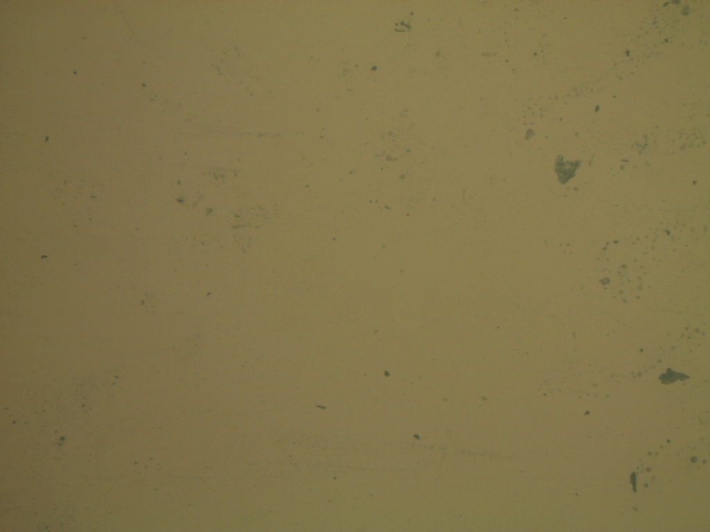
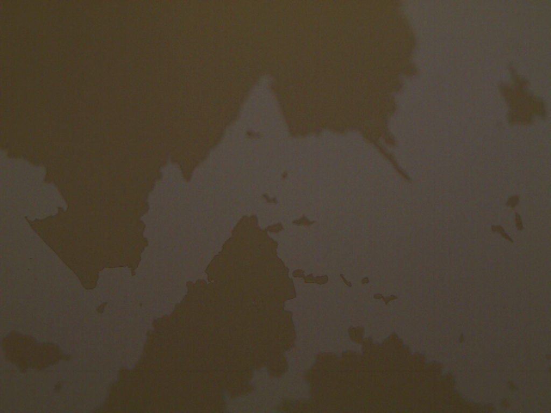
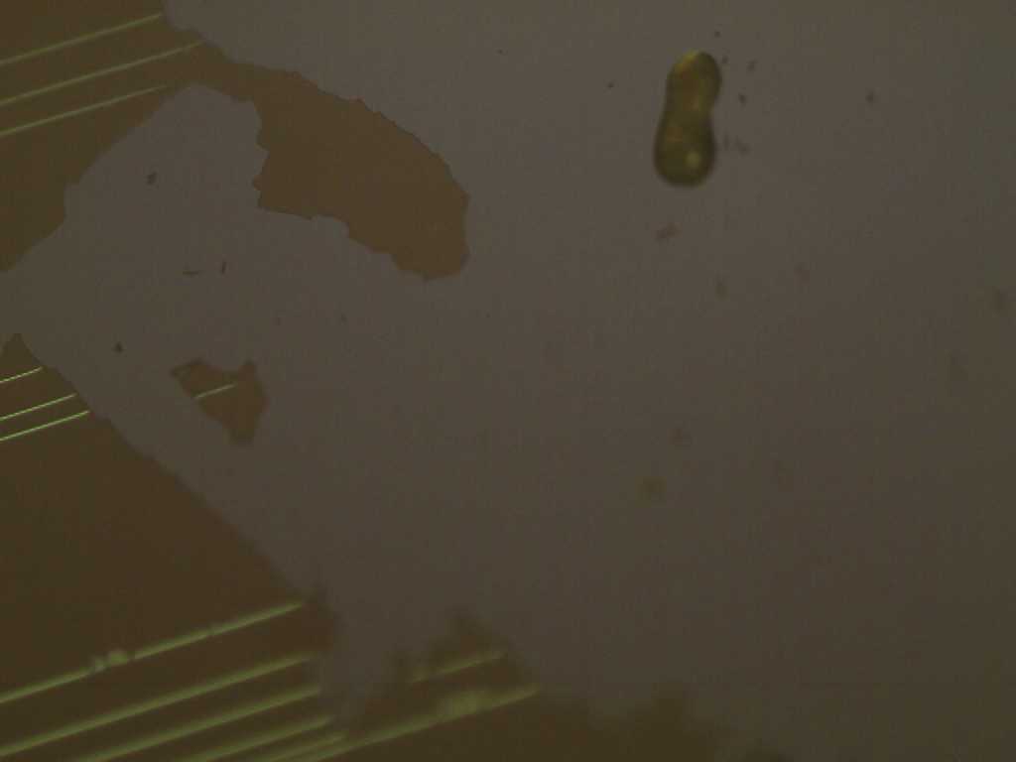
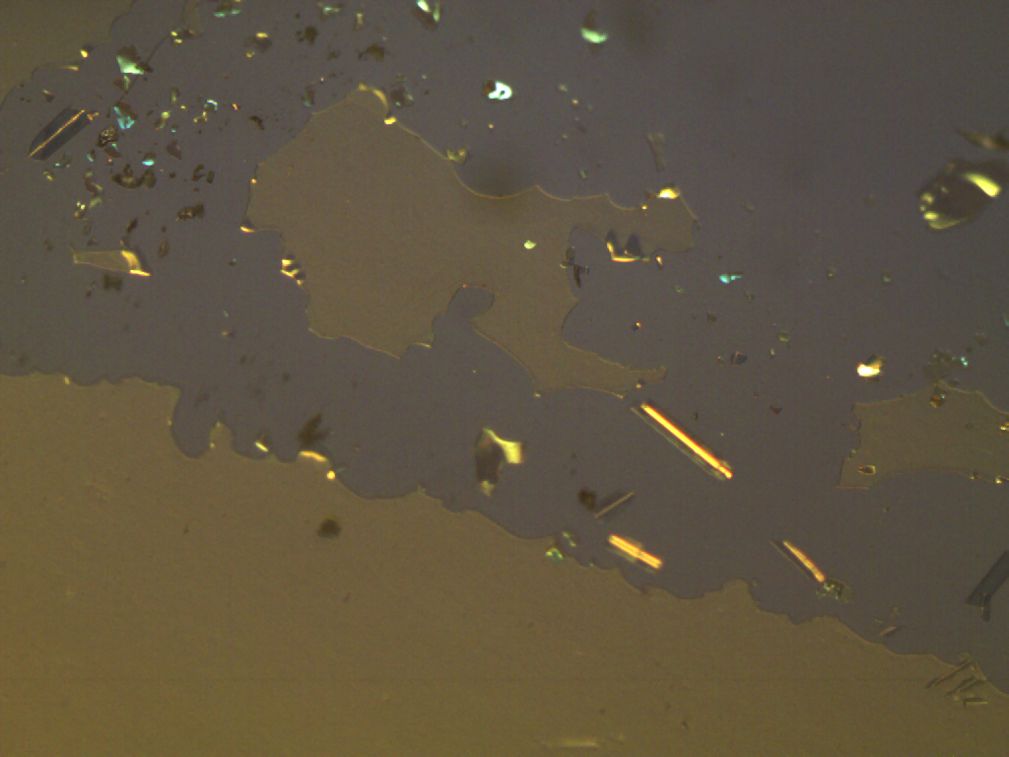
Results & Discussion
The 18th Technical Collaboration Meeting
Adhesion & electrical properties
(a) ITO/ SiO₂ 90 min / PMMA
(b) ITO/ SiO₂ 60 min / PMMA
(c) ITO/ SiO₂ 30 min / PMMA
(d) ITO/ PMMA (none buffer layer)
(a)
(b)
(c)
(d)
Fig.5. Sheet resistance of ITO/ SiO₂/ PMMA
Fig.6. Microscpe images after taping test of ITO films with SiO₂ buffer layers deposited on a PMMA lens
As the thickness of the SiO₂ buffer layer increased, the adhesion and resistivity were improved.
When the SiO₂ film was deposited for more than 90 minutes, the surface was stable even after the taping & scratch test.
Notes:
As the thickness of the SiO2 buffer layer increased, the adhesion and resistivity was improved.
강자연, 김동원, 조규일, 우병일, 윤환준 (2009). PET 기판 위에 SiO₂ 버퍼층 증착에 따른 ITO 박막의 부착 및 전기적 광학적 특성 연구. 한국표면공학회지, 42(1), 21-25
In this paper, as the deposition time of SiO2 increases, the ITO surface resistance increases, but the carrier mobility increased more than without buffer layer.
The reason for this is that the SiO2 buffer layer prevents impurities from flowing from the PET substrate to the ITO side, thereby improving the carrier mobility in the ITO.
As shown in Fig. 5, the sheet resistances of the ITO thin films with the SiO2 buffer layer were 123.6 ~ 198.5 Ω / □.
Figure 6 shows a results of a taping test and microscopic observation to confirm adhesion between PMMA and ITO. When the SiO2 film was deposited for more than 90 minutes, the surface was stable even after the taping & scratch test

Slide 11

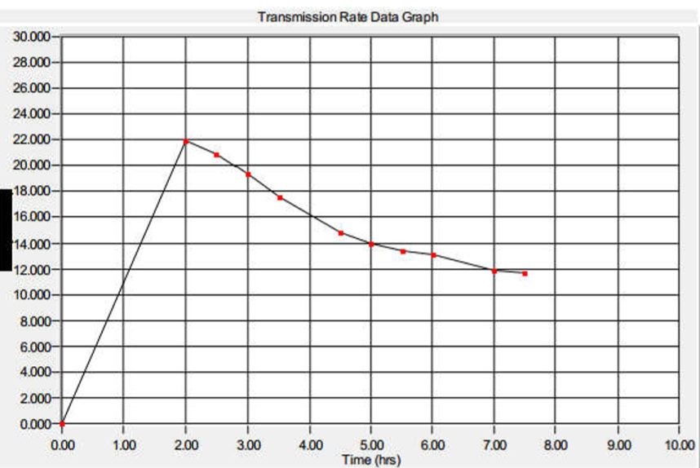
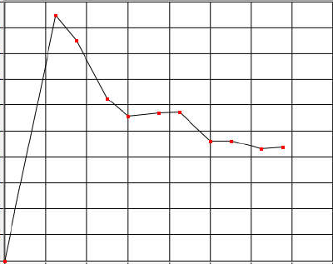
Results & Discussion
The 18th Technical Collaboration Meeting
WVTR도 옥사이드 막이 있을 때 더 적어야 할 것 같은데 좀 이상해요 이 부분은 향후 좀 더 검정을 한 후 발표하는 것이 좋을 듯 합니다. 아니면 산소 투과율만 발표를 하거나
Oxygen permeability & WVTR
Oxygen permeability (cm³/(m²*24hr*atm))
PMMA(bare): 11.7
PMMA/SiO₂ : 8.71
Fig.7. Oxygen permeability
PMMA
PMMA / SiO₂
Time (hrs.)
Notes:
Oxygen permeability and WVTR were measured.
Oxygen permeability decreased by 2.0 cm3 / m2 * 24hr * atm than when SIO2 was applied.
But WVTR increased 0.81 gm [m2 * day].
It was judged that it was modified to be hydrophilic due to O2 plasma treatment.

Slide 12
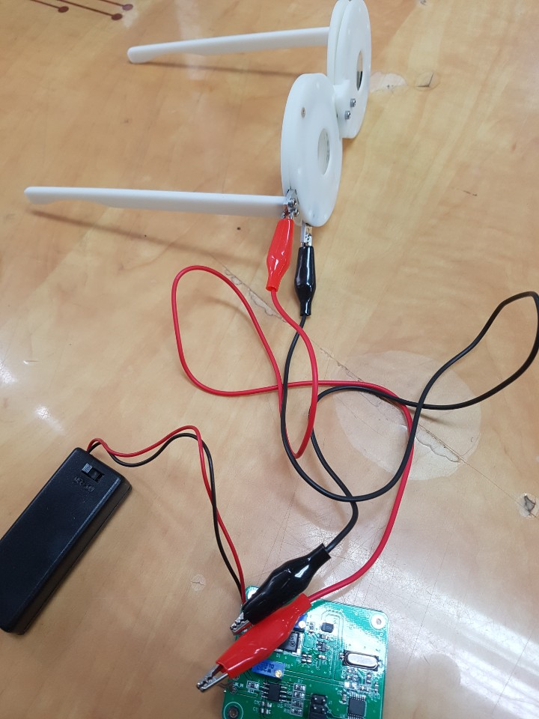
Conclusion
The 18th Technical Collaboration Meeting
In this study, optimized process of ITO thin film on PMMA lens was presented.
High temperature process was impossible due to the PMMA Tg (105 ℃) limit, and that the lens was deformed due to plasma damage when a high voltage was applied.
ITO thin films were deposited by RF sputtering at room temperature without oxygen addition for low resistance.
SiO₂ was applied as a buffer layer to prevent impurities from PMMA and for the better adhesion.
Electronically tunable Focus Liquid Crystal (LC) lens Final Drive kit
Notes:
In this study, to optimize the ITO thin film used as a transparent electrode between focus variable lenses, the SiO2 buffer layer on the PMMA lens and the ITO thin film thereon were deposited by RF magnetron sputtering at room temperature.
However, it was confirmed that the high temperature process was impossible due to the PMMA Tg (105 ℃) limit, and that the lens was deformed due to plasma damage when a high voltage was applied.
Therefore, ITO was deposited by applying low voltage at room temperature to minimize damage.
As a result, the surface resistance of the ITO thin film was increased as the SiO2 buffer layer was thickened, but the adhesion of PMMA and ITO was improved and the transmittance was expected to be improved because SiO2 had a lower refractive index than PMMA.
Therefore, in order to form ITO on the PMMA lens, it is necessary to apply an SiO2 buffer layer.

Slide 13
Thank you
The 18th Technical Collaboration Meeting

