Slide 1


Introduction to ED Lab
The 18th Technical Collaboration Meeting
HOSEO University
Electronic Display Engineering
Seung Han
2019.01.08
Technical Exchange Meeting, January 08, 2019, University of the Ryukyus, Okinawa, Japan
Notes:
Hello everybody.
Today, I would like to introduce our ED Lab

Slide 2
Contents
Introduce lab people
Introduce lab research
- Presbyopia glasses
- Taste Sensor
- Stretchable display
- Interfacial oxidation
Technical Exchange Meeting, January 08, 2019, University of the Ryukyus, Okinawa, Japan
Notes:
Let me introduce the contents. At first I will introduce the people of the lab and introduce you the major studies in our laboratory.
I will briefly explain presbyopia glasses, taste sensor, stretchable display, and interfacial oxidation.
목차를 소개하겠습니다.
먼저 연구실 사람들을 소개하고 우리 연구실에서 진행하는 주요 연구들을 소개해 드리겠습니다.
노안안경, 미각센서, 스트레쳐블 디스플레이, 계면산화 순으로 간략히 설명해드리겠습니다.

Slide 3
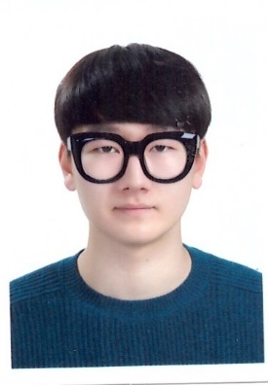
Introduction
Name : Seung Han
Age : 24 (undergraduate)
Major: Electronic Display Engineering
Technical Exchange Meeting, January 08, 2019, University of the Ryukyus, Okinawa, Japan
Notes:
First of all, let me introduce myself.
My name is Seung Han, 24 years old, and I’m an undergraduate student in the division of Electronics and Display Engineering of Hoseo University.
I became a member to the laboratory in last November.
Now I'm learning a lot at the laboratory especially display circuits.

Slide 4
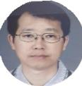







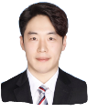



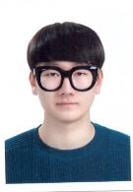
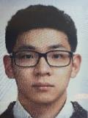
Introduction of ED Lab Personnel
Professor
Byung Seoung Bae
Doctor’s course
Jong Mo Lee
SeungJae Moon
In Hye Kang
Master’s course
YoungJo Baek
Sang Ho Hwang
Min Su Kang
Ye Rin Han
Sung Min Park
Undergraduate
Hee Chan Yang
Pyeong Seob Song
Seok Jun Kang
Seung Han
Seo Gwon Kim
Technical Exchange Meeting, January 08, 2019, University of the Ryukyus, Okinawa, Japan
Notes:
Let me introduce the Electronic Device Laboratory members.
First, Professor ByungSeoung Bae.
In the doctor’s course, jongmo Lee, Seungjae Moon, and InHye Kang.
Master’s course, YoungJo baek, SangHo Hwang, MinSu Kang, YeRin Han, and SungMin Park
Finally, Heechan Yang, Pyeongseob Song, SeokJun Kang, me and SeoGwon Kim. There are five undergraduates composed.
Dr. Seungjae Moon and master SungMin Park are currently studying in France.

Slide 5
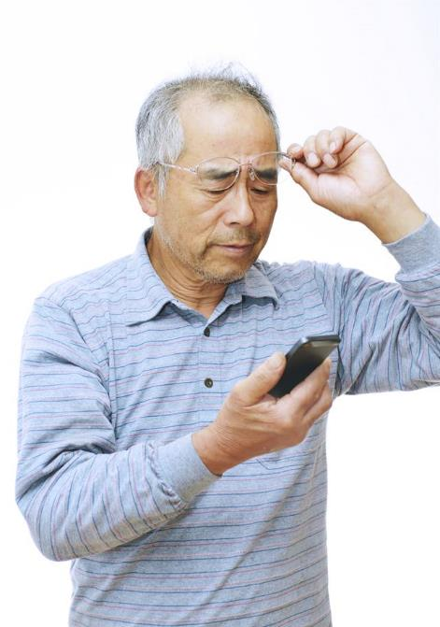
My Research
Presbyopia glass
I am analyzing the Presbyopia glasses
Technical Exchange Meeting, January 08, 2019, University of the Ryukyus, Okinawa, Japan
Notes:
Next, I would like to introduce the laboratory research.
Nowadays, I‘m analyzing the presbyopia glasses.

Slide 6
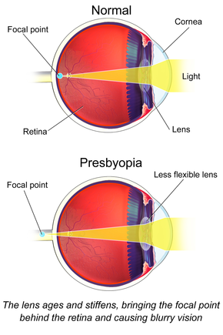
My Research
Presbyopia glass
What is the Presbyopia?
Technical Exchange Meeting, January 08, 2019, University of the Ryukyus, Okinawa, Japan
Notes:
What is the presbyopia? The eye lens becomes hardened by aging, loses elasticity. It weakens the controllability.
Therefore it’s difficult to see the object near the eye.

Slide 7
My Research
Presbyopia glass
lens
Cholesteric liquid crystal
Front
ITO
Side
Technical Exchange Meeting, January 08, 2019, University of the Ryukyus, Okinawa, Japan
Notes:
We designed glasses for this purpose. First, We prepared two lenses, and deposited ITO on two lenses.
Next, injected the cholesteric liquid crystal between two lenses and encapsulated

Slide 8
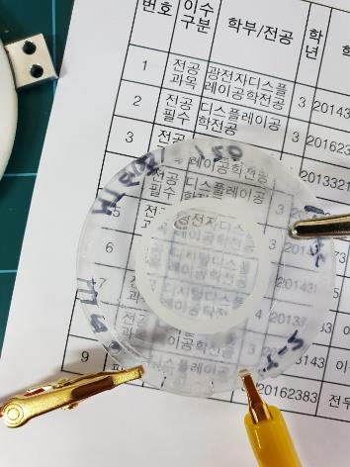
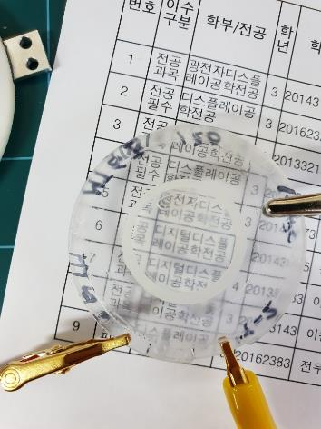
My Research
Presbyopia glass
< Off state >
< On state >
Technical Exchange Meeting, January 08, 2019, University of the Ryukyus, Okinawa, Japan
Notes:
We could change the refractive index according to the voltage using the cholesteric liquid crystal.
When the voltage was not applied, the haze phenomenon was seen, but when the voltage was applied, it appeared more clearly.

Slide 9
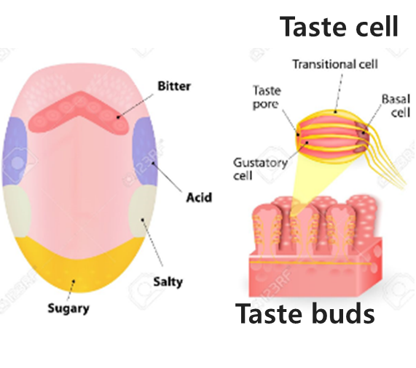
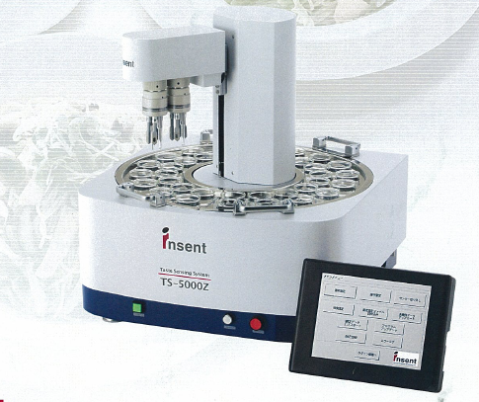
ED Lab Research
Taste sensor
<The process of feeling taste>
<Taste sensor developed by Japanese company>
Technical Exchange Meeting, January 08, 2019, University of the Ryukyus, Okinawa, Japan
Notes:
Let me explai the taste sensor.
Taste reacts specifically with the sensing membrane of the sensor and reacts differently depending on the taste.
This reaction induces a change in charge on the surface of the sensing membrane and generates a surface potential difference.
Thus, a taste sensor can be made by mimicking the mechanism of human taste.
미각센서에 대해 소개하겠습니다.
맛은 센서의 감지막과 특정 반응을 하는데 맛에 따라 다른 반응을 합니다.
이러한 반응은 감지막의 표면에서 전하의 변화를 유도하고 표면 전위차를 발생시킵니다.
이처럼 인간이 맛을 느끼는 매커니즘을 모방해서 미각센서를 만들 수 있다.
(인간이 맛을 느끼는 원리를 간단히 설명하자면, 미뢰의 안쪽과 바깥 부분에는 수용액에 녹아 전기를 띠는 이온이 있는데,
혀로 맛을 느낄 때 미뢰 바깥쪽에 있는 이온과 세포막을 사이에 두고 안쪽 세포 내의 이온 농도가 균형이 깨지면서 막 전위가 생성되어 전기가 흐른다.
그 결과가 신경으로 전달되어 최종적으로 뇌에서 맛을 인지하게 되는 것이다.)

Slide 10
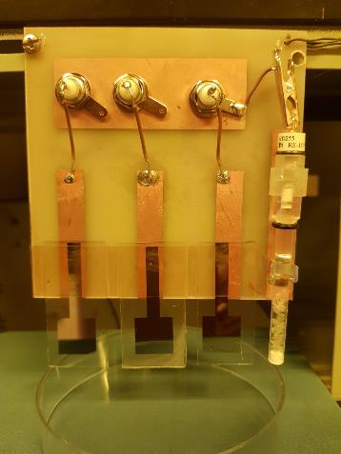
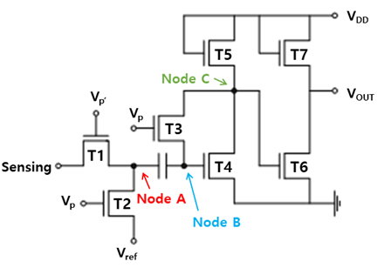
ED Lab Research
Taste sensor
< Taste sensor sample >
< Circuit of the amplifier >
Technical Exchange Meeting, January 08, 2019, University of the Ryukyus, Okinawa, Japan
Notes:
The photo on the left is a taste sensor fabricated, and the right picture is a circuit made to amplify the weak signal. Such sensor membrane fabrication and amplification circuit technology is expected to be applicable to portable taste sensor applications.
왼쪽 사진은 우리가 만든 TFT로 만든 미각 센서이고, 오른쪽사진은 신호가 약해서 이를 증폭하기 위해 만든 회로이다.
이러한 센서막의 제작과 증폭회로 기술은 휴대가 가능한 소형 미각센서 어플리케이션에 적용 가능할 것이라고 예상한다.

Slide 11
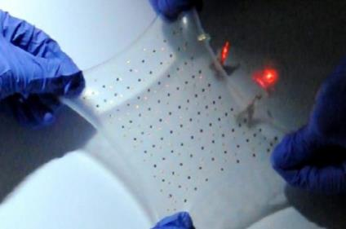
ED Lab Research
Stretchable Display
Studying a flexible circuit
Technical Exchange Meeting, January 08, 2019, University of the Ryukyus, Okinawa, Japan
Notes:
The above picture is a view of a stretchable display. It is a future display that is expected to be used in a wide variety of industries.
위 사진은 스트레쳐블 디스플레이의 모습인데 연신율이 달라져도 밝기에 변화가 없어 매우 다양한 산업에 쓰일 것으로 예상되는 미래형 디스플레이다.

Slide 12
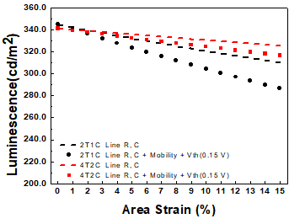
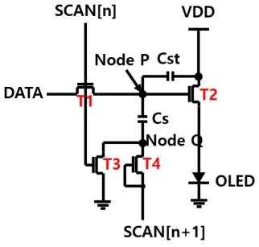
ED Lab Research
Stretchable Display
< Stretchable OLED circuit >
< Luminance depending on elongation >
Technical Exchange Meeting, January 08, 2019, University of the Ryukyus, Okinawa, Japan
Notes:
We developed a stretching compensation oled pixel circuit. As shown in the figure on the right, the brightness is lowered as the panel stretched, and it’s under study to minimize this change.
우리는 스트레쳐블 oled 회로를 만들었다. 오른쪽 그림에서 확인할 수 있듯이, 현재 화소가 연신됨에 따라 휘도가 낮아지는데, 이 변화를 최소화하기 위해 연구 중에 있다.

Slide 13
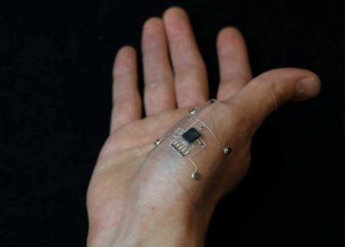
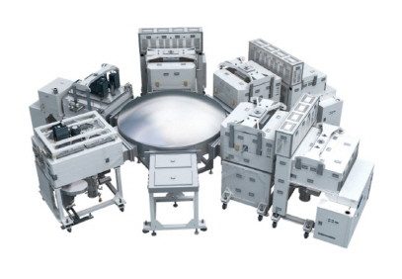
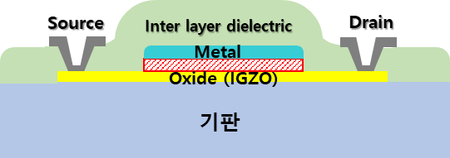
ED Lab Research
Interfacial oxidation
Interfacial Oxidation
Interfacial oxidation research.
Technical Exchange Meeting, January 08, 2019, University of the Ryukyus, Okinawa, Japan
Notes:
In the conventional TFT process, the insulating layer is formed by vacuum process, and we are trying to use the oxidation at the interface between the metal and IGZO.
In this case, we can use small voltage and the power consumption can be decreased. However, it is difficult to control the reaction between the metal and the IGZO.
원래 TFT공정에서 절연막은 진공 장비를 사용해서 막을 형성하는데, 우리는 메탈과 IGZO로 열처리를 통한 산화를 만들어 증착시키지 않고 절연막을 만드는 연구를 진행중이다.
이 때 장점으로는 소비전력을 굉장히 낮출 수 있어서 신체에 접촉하는 등의 미래형 디스플레이를 만들기 용이하다.
하지만 메탈과 IGZO간의 반응을 확실히 컨트롤하기 어렵고, 막의균열도가 떨어져서 개선 중에 있다.

Slide 14
Thank you for attention
Technical Exchange Meeting, January 08, 2019, University of the Ryukyus, Okinawa, Japan
Notes:
This is the end of my presentation. Thank you for attention.

