Slide 1
AMOLED Pixel Circuit Composed of MOSFET
Hoseo University
Electronic Device Laboratory
Min Su Kang
Notes:
Hello.
I’m Min Su Kang in Electronic Device Laboratory.
My Research theme is a AMOLED Pixel Circuit Composed of MOSFET.

Slide 2
Outline
Introduction
AMOLED Pixel Circuit
2T1C Pixel Circuit
4T2C Pixel Circuit
Pixel Circuit Composed of MOSFET
2T1C MOSFET Pixel Circuit
4T2C MOSFET Pixel Circuit
Conclusion & Future works
Notes:
First, I’ll talk about a AMOLED pixel circuit for stretchable display.
And then, i’ll show simulation results for two type of a pixel circuit.
Next, Let’s talk about a MOSFET pixel circuit and measurement results of a MOSFET pixel circuit.
At last, I’ll summarize presentation.

Slide 3
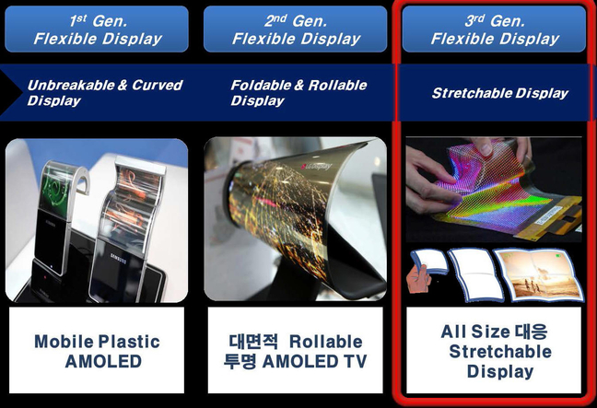
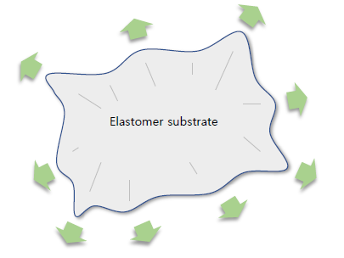
Introduction
Area Strain
Mobile Plastic
Display
Large Area
Rollable Transparent Display
All Size
Stretchable Display
Necessity of
Luminance Compensating Pixel Circuit
Figure 1. Generation of flexible display
Source : Google image
Notes:
Figure 1 shows a generation of flexible display.
In 3rd generation flexible display, so called Stretchable Display is defined as a display with an increased panel width.
In a stretchable display, panel area is changed by strain.
Area stretching reduces the luminance of the panel.
Therefore, a pixel circuit capable of compensating for luminance is required.

Slide 4
2T1C Pixel Circuit
A circuit composed of two TFTs, one capacitor
When the substrate is stretched, → the R, C of wiring increase → the characteristics of TFT changes
Data
V_{DD}
Scan
DR_TFT
SW_TFT
C_{st}
_{OLED}
TFT W/L | Sw_TFT | 10/10 [um]
 | Dr_TFT | 10/15 [um]
Capacitor | C_{st} | 0.05 [pF]
V_{SS}
Figure 2. Conventional 2T1C pixel circuit
Table 1. Simulation parameter of 2T1C pixel circuit
Notes:
Figure 2 shows conventional 2T1C pixel circuit.
It is composed of two TFTs and one capacitor.
When the substrate is stretched, R, C parameter of wire increase and the characteristics of TFT changes.

Slide 5
2T1C Pixel Circuit
그림의 글자가 너무 작습니다.
(a)
(b)
Figure 3. Simulation results of 2T1C pixel circuit (a) OLED current (b) Luminescence
Luminescence decreased due to area stretching
Notes:
Figure 3 shows simulation results of area strain verse current and luminescence of OLED.
The OLED luminescence decreased due to area stretching.

Slide 6
4T2C Pixel Circuit
Scan[n]
V_{DD}
A circuit composed of four TFTs, two capacitor
Compensates for the change of luminance by area stretching
C_{st}
Node P
Data
T1
T2
Node Q
C_{s}
T3
T4
TFT W/L | T1 | 10/10 [um]
 | T2 | 10/40 [um]
 | T3 | 10/10 [um]
 | T4 | 10/10 [um]
Capacitor | C_{st} | 0.06 [pF]
 | C_{s} | 0.05 [pF]
OLED
Scan[n+1]
V_{SS}
Table 2. Simulation parameter of 4T2C pixel circuit
Figure 4. Proposed 4T2C pixel circuit
Notes:
Figure 4 shows proposed 4T2C pixel circuit.
It is composed of four TFTs and two capacitors.
The stretching capacitor, Cs compensates for luminance when expanding the area.

Slide 7
4T2C Pixel Circuit
SCAN[n]
VDD
1
2
3
SCAN[n]
Node P
Cst
DATA
T1
T2
SCAN[n+1]
Cs
DATA
Node Q
T3
T4
OLED
Node P
I_{OLED}
SCAN[n+1]
Figure 5. Timing diagram of 4T2C pixel circuit (1)
Scan[n] becomes high state, T1 and T3 are turned on and the voltage of Node P becomes Data voltage through T1.
At this time, other pulses remain low. The current flows through the OLED from VDD to the cathode.
The currents during this period can be neglected because the time of the current flows is very short t compared to the frame time.
A data voltage is stored at the node P is during this period.
Notes:
Let’s explain the operation of the 4T2C pixel circuit with the timing diagram.
When Scan[n] becomes high state, T1 and T3 are turned on and the voltage of Node P becomes Data voltage through T1.
At this time, other pulses remain low. The current flows through the OLED from VDD to the cathode.
The currents during this period can be neglected because the time of the current flows is very short t compared to the frame time.
A data voltage is stored at the node P is during this period.

Slide 8
4T2C Pixel Circuit
SCAN[n]
VDD
1
2
3
SCAN[n]
Node P
Cst
DATA
T1
T2
SCAN[n+1]
Cs
DATA
Node Q
T3
T4
OLED
Node P
I_{OLED}
SCAN[n+1]
Figure 6. Timing diagram of 4T2C pixel circuit (2)
When Scan [n] is low and Scan [n + 1] is high, the voltage of the node is bootstrapped by Cs through T4.
Although the OLED emits current through the VDD, the emission time is shorter than the frame time and can be ignored.
As the area increases, the capacitance increases, and the voltage stored in the Node P increases. → It is possible to compensate the luminance decreased by stretching.
Notes:
When Scan [n] is low and Scan [n + 1] is high, the voltage of the node is bootstrapped by Cs through T4.
Although the OLED emits current through the VDD, the emission time is shorter than the frame time and can be ignored.
As the area increases, the capacitance increases, and the voltage stored in the Node P increases. It is possible to compensate the luminance decreased by stretching.

Slide 9
4T2C Pixel Circuit
SCAN[n]
VDD
1
2
3
SCAN[n]
Node P
Cst
DATA
T1
T2
SCAN[n+1]
Cs
DATA
Node Q
T3
T4
OLED
Node P
I_{OLED}
SCAN[n+1]
Figure 7. Timing diagram of 4T2C pixel circuit (3)
All the pulses become low, and the TFT T2 becomes ON, and the OLED emits light.
It lasts until the next scan pulse, and it has the longest period among three segments.
Notes:
All the pulses become low, and the TFT T2 becomes ON, and the OLED emits light.
It lasts until the next scan pulse, and it has the longest period among three segments.

Slide 10
4T2C Pixel Circuit
이동도와 문턱전압은 스트레칭에 의해 열화되고 밝기가 그렇지 않은 경우에 비해 더 어두워져야 맞는데… 이거 잘 못 됬습니다.
(a)
(b)
Figure 8. Simulation results of 4T2C pixel circuit (a) OLED current (b) Luminescence
Luminance Compensation
Notes:
Figure 8 shows simulation results of area strain verse current and luminescence of OLED.
The OLED luminescence increased due to proposed circuit’s compensation effect.

Slide 11
MOSFET Pixel Circuit
A typical AMOLED pixel circuit is composed of thin film transistors.
However, the TFT pixel circuit is small in size and currents are much low, which makes it difficult to measure the OLED current directly.
Therefore, the MOSFET pixel circuit was composed to verify the function of the pixel circuit.
The TFTs were replaced by a 2N7000 MOSFET.
Instead of the OLED, resistor was used in measure the current.
Notes:
A typical AMOLED pixel circuit is composed of thin film transistors.
However, the TFT pixel circuit is small in size and currents are much low, which makes it difficult to measure the OLED current directly.
Therefore, the MOSFET pixel circuit was composed to verify the function of the pixel circuit.
The TFTs were replaced by a 2N7000 MOSFET.
Instead of the OLED, resistor was used in measure the current.

Slide 12
2T1C MOSFET Pixel Circuit
Data
V_{DD}
Scan
T1
T2
15 pF
_{1 MΩ}
V_{SS}
(a)
(b)
Figure 9. (a) 2T1C MOSFET pixel circuit (b) Measurement result
Notes:
Figure 9 shows 2T1C pixel circuit composed of MOSFET and measurement result.
For a voltage measurement, the OLED was replaced by a resistor.
The red line represents the scan voltage and the black line represents the data voltage.
The OLED voltages increased when the data voltage and the scan voltage are high.

Slide 13
4T2C MOSFET Pixel Circuit
Scan[n]
V_{DD}
15 pF
Data
T1
T2
15 pF
T3
T4
1 MΩ
Scan[n+1]
V_{SS}
(a)
(b)
Figure 10. (a) Cs=15 pF 4T2C MOSFET pixel circuit (b) Measurement result
Notes:
Figure 10 shows proposed 4T2C pixel circuit composed of MOSFET and measurement result.
Same as 2T1C pixel circuit, the OLED was replaced by a resistor.
The red line represents the scan1 voltage, the blue line represents the scan2 voltage, and the black line represents the data voltage.
The OLED voltage increased proportional to stretching capacitor, Cs.

Slide 14
Conclusions
The Cs increased due to area stretching.
As Cs increased, the OLED voltages increased due to the coupling effect.
Increased OLED voltage resulted in the increase of the currents and luminescence of OLED.
Therefore, the proposed 4T2C pixel circuit is suitable for a stretchable OLED display.
Notes:
The Cs increased due to area stretching.
As Cs increased, the OLED voltages increased due to the coupling effect.
Increased OLED voltage resulted in the increase of the currents and luminescence of OLED.
Therefore, the proposed 4T2C pixel circuit is suitable for a stretchable OLED display

Slide 15
Thank you for your attention.

