Slide 1
Comprehensive study of the electrical properties of AZO films fabricated by RF-sputtering
Electronic Device LAB, Hoseo University
Baebang-eup, Asan City, Chungnam
SeoGwon Kim

Slide 2
Table of contents
Introduction
Experiment
Result & Discussion
Conclusion

Slide 3
Ⅰ. Introduction
TCO
ITO
High optical transmission.
Electrical conductivity close to metals.
An excellent electrical properties.
A limited resource and high price.
AZO
An attention as a transparent conductive oxide(TCO) material in a solar cell.
An alternative material that require mass production and low price.
A good material properties and transparent of solar energy.

Slide 4
Ⅱ. Experiment
AZO films were fabricated on soda-lime-silica glass substrates by using RF-sputter.
A target of ZnO:Al2O3 = 98:2wt (99.99%).
 | Pplasma | Tsub
1st type | 50~200W | RT
 | Annealing | Ar | Time
3rd type | RT~500ºC | 3L/min Ar ambient | 60min
 | Pplasma | Tsub
2nd type | 100W | RT~400ºC
 | Annealing | Ar | Time
4th type | RT~500ºC | 3L/min Ar ambient | 60min
Table 1. parameter of thin films

Slide 5
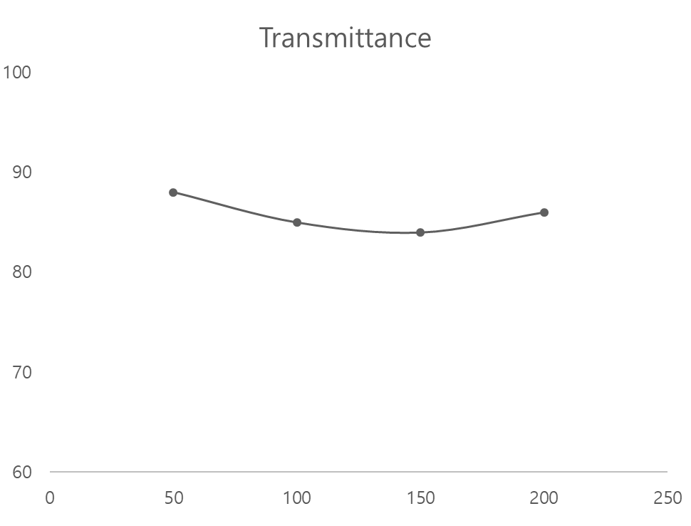
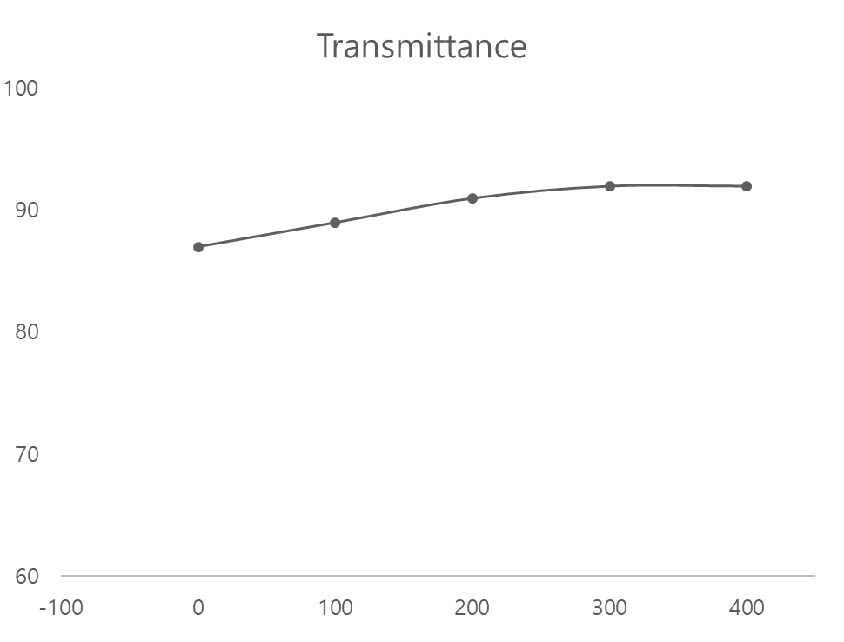
Ⅲ. Result and discussion
Transmittance(%)
Transmittance(%)
Fig 1. Transmittance of the AZO films.
Transmittance was measured as an average in the wavelength range of 400~700 nm.
All of the AZO films have a transmittance of more than 80%.

Slide 6
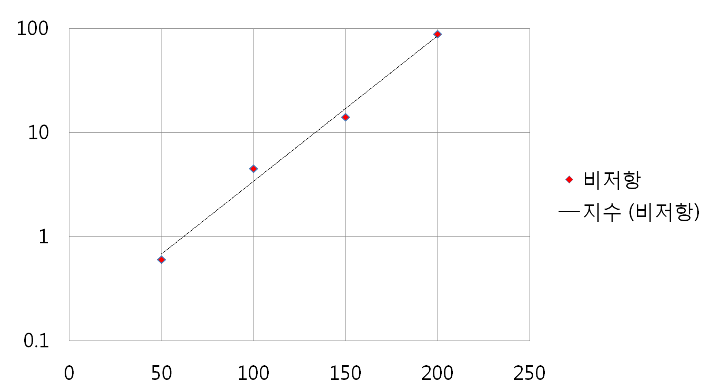
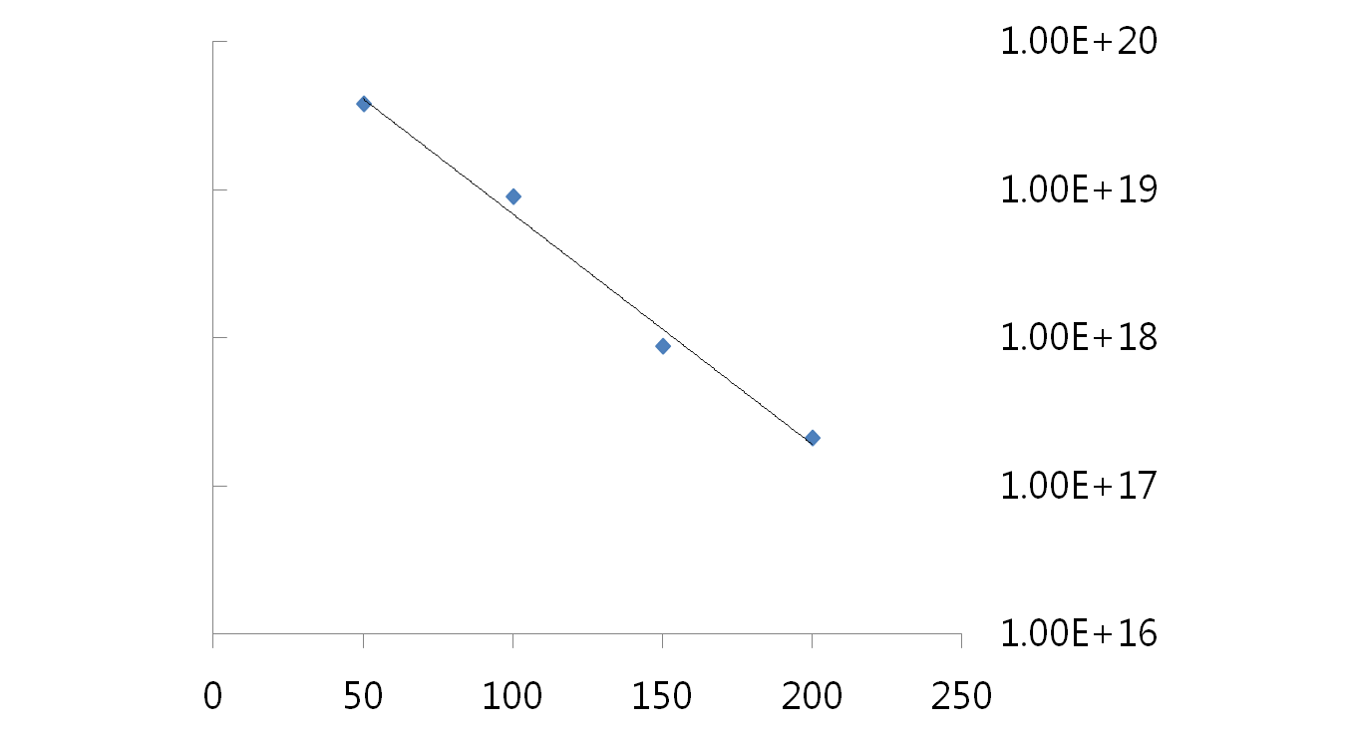
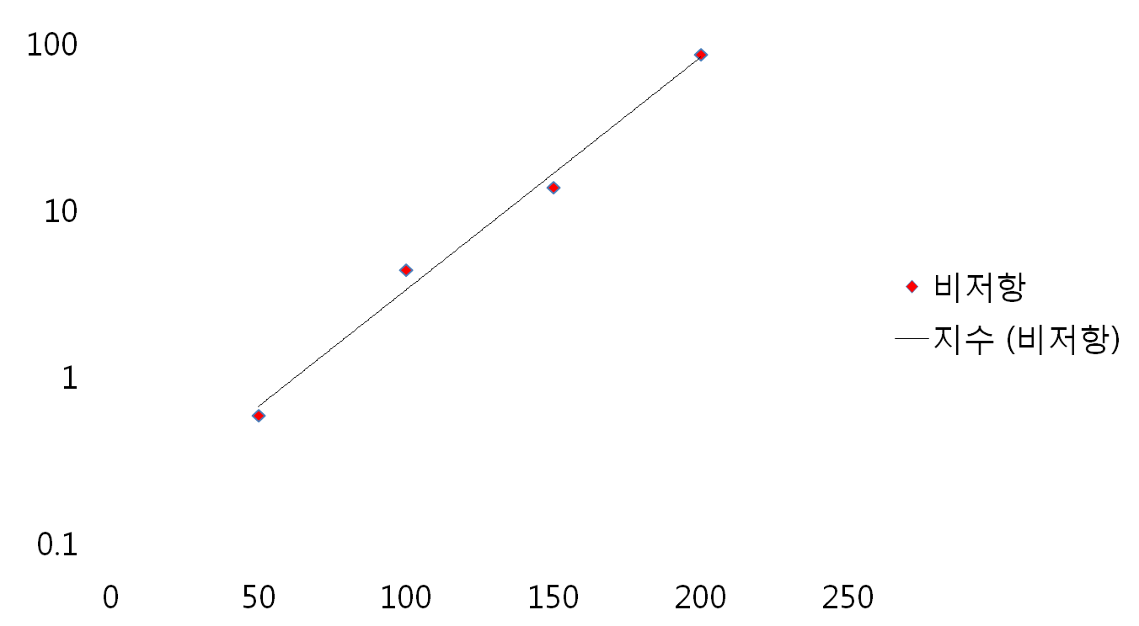

Ⅲ. Result and discussion
Electrical resistivity(Ωcm)
Electron concentration(${cm}^{3}$)
Fig 2. plasma power dependence
Electrical resistivity increase and electron concentration decrease as plasma power increase.
That reason comes from a sputter yield and the films could not be deposited closely.

Slide 7
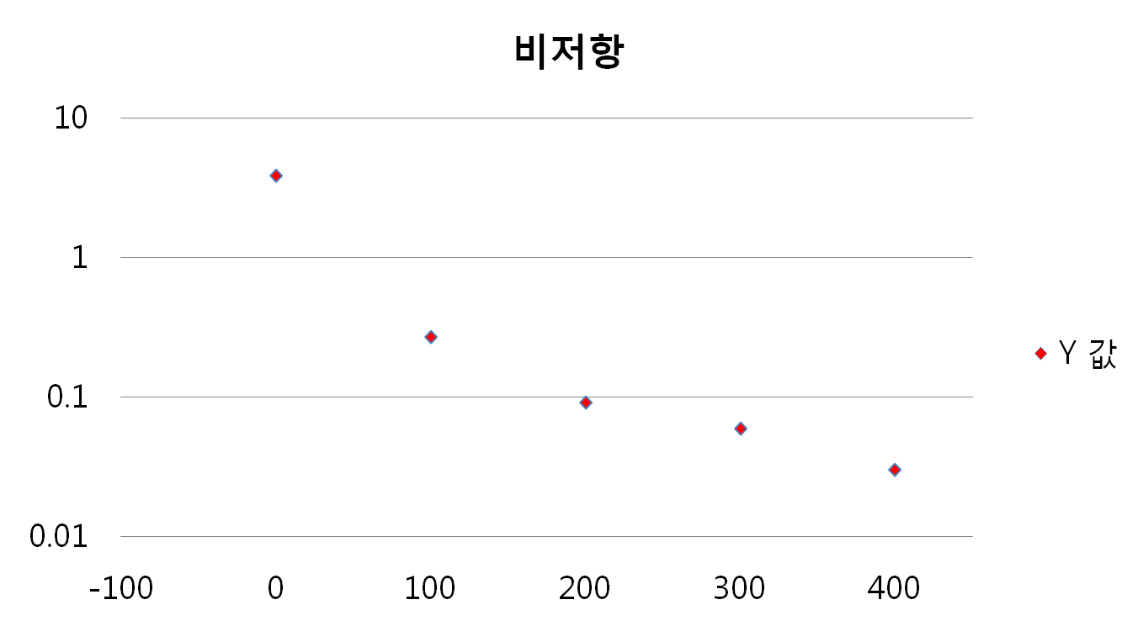
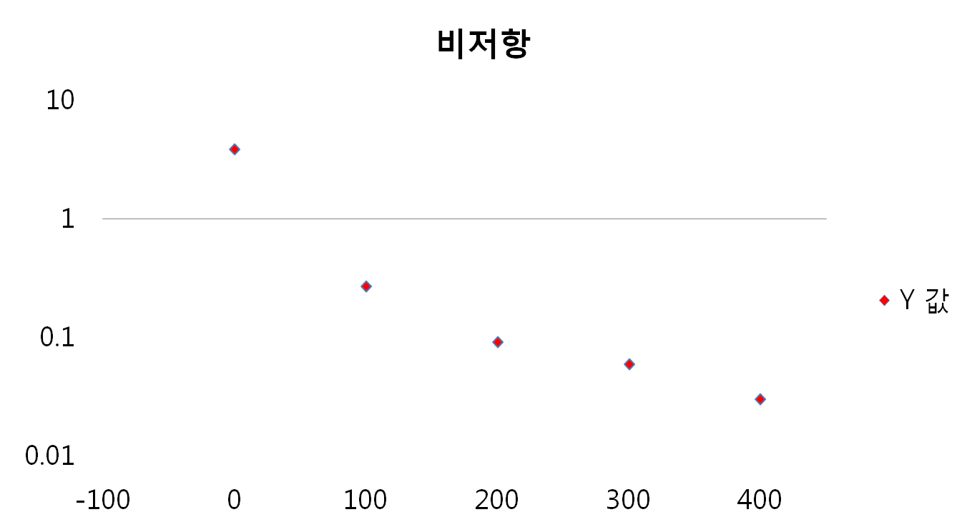
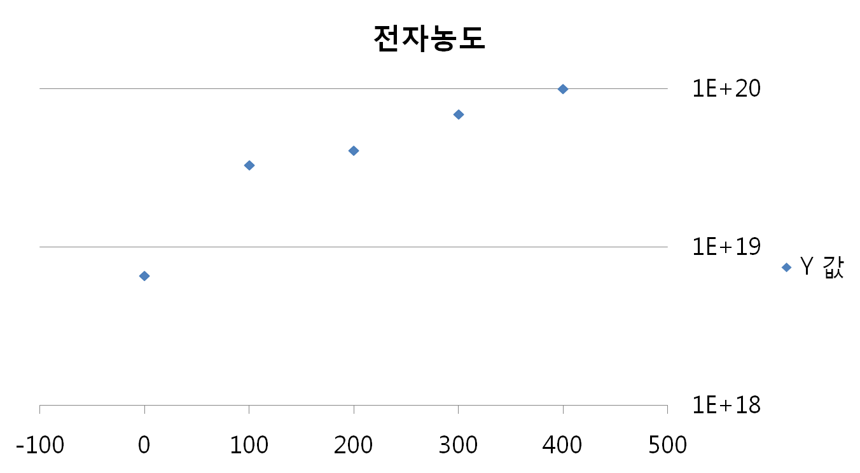
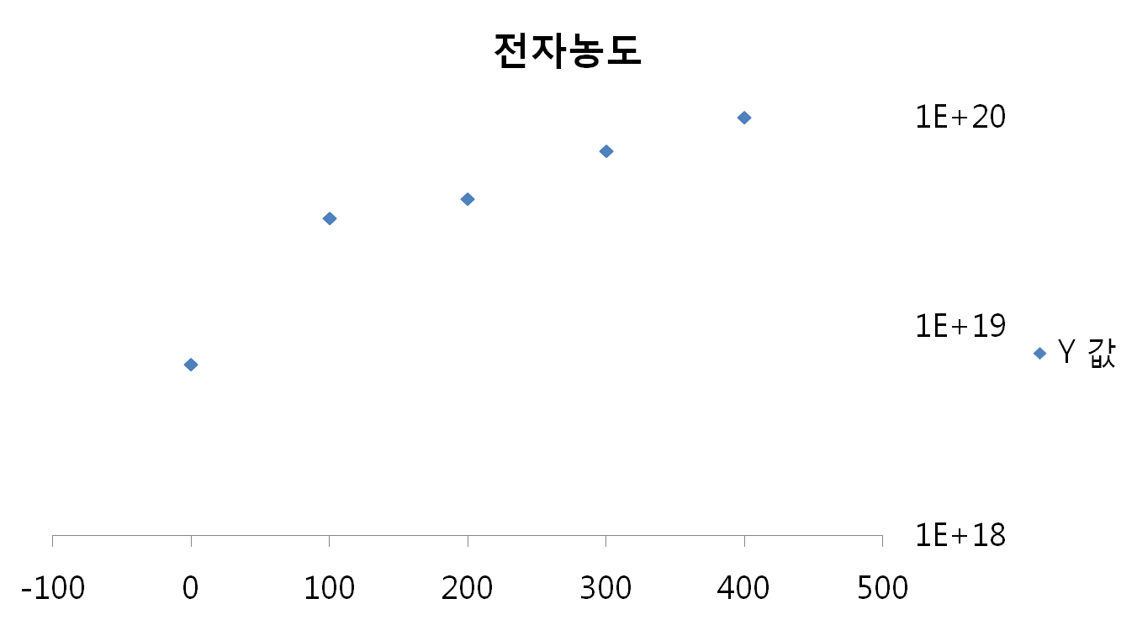

Ⅲ. Result and discussion
Electrical resistivity(Ωcm)
Electron concentration(${cm}^{3}$)
Fig 3. substrate temperature dependence
Electrical resistivity decrease and electron concentration increase as temperature increases.
The increased substrate temperature induces supply of energy of formation.

Slide 8
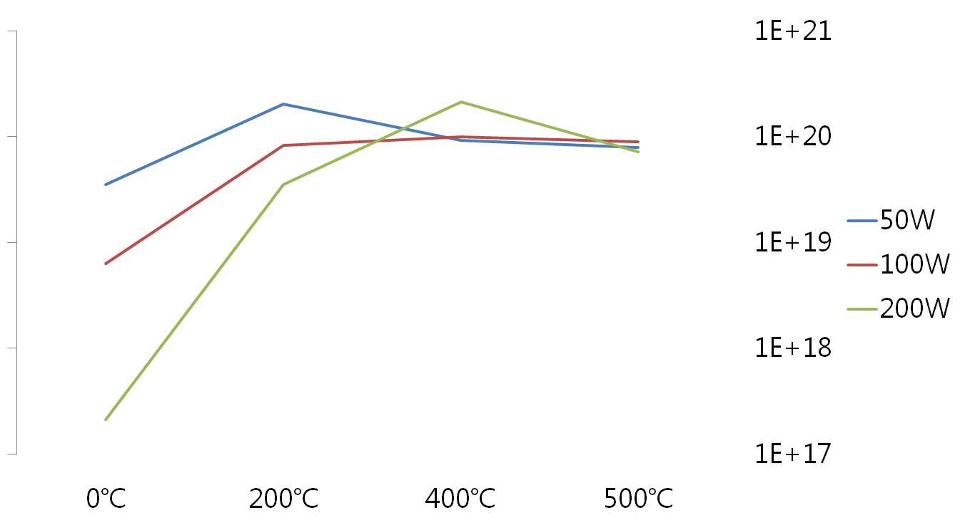
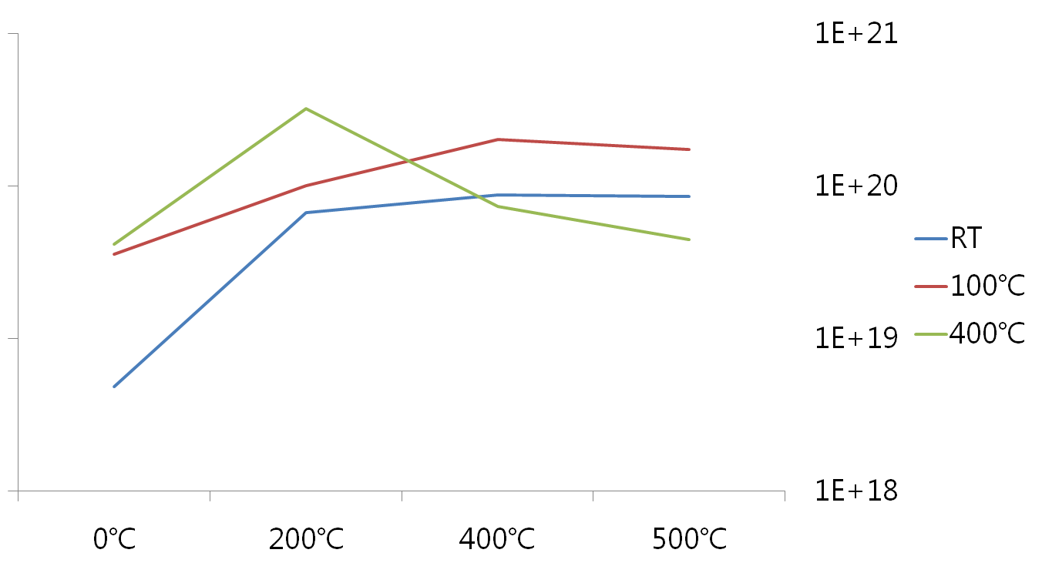
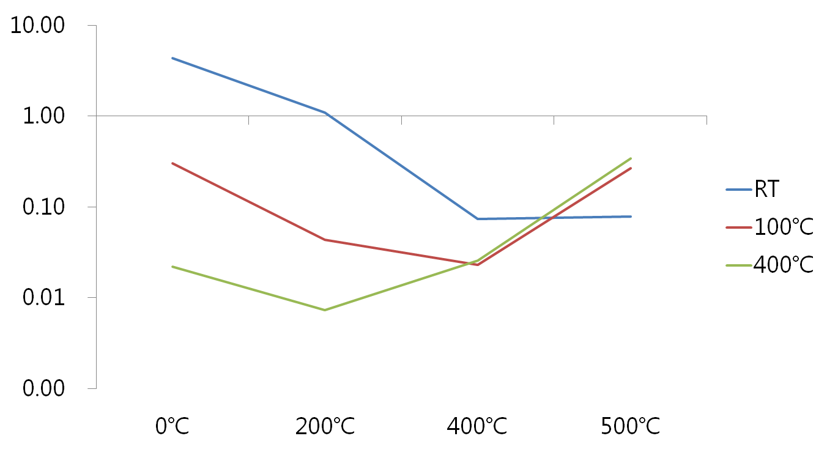
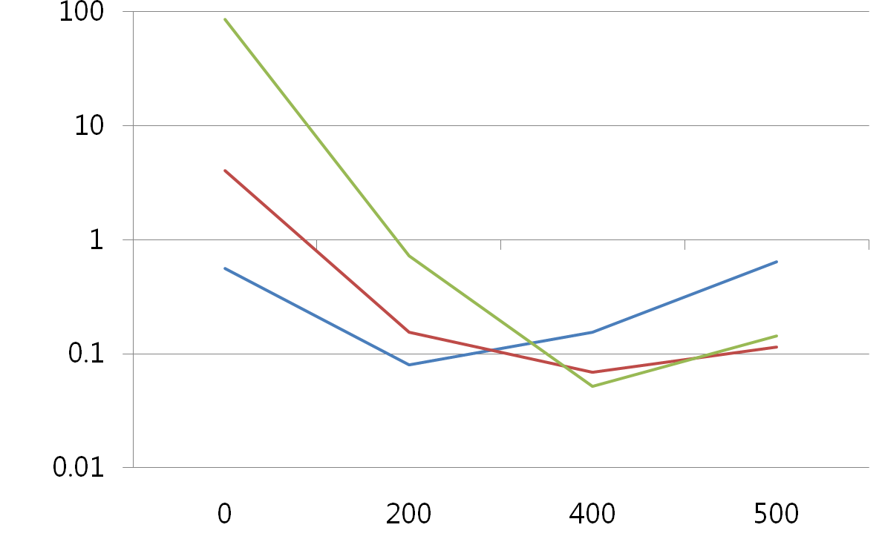


Ⅲ. Result and discussion
1.0
Electrical resistivity(Ωcm)
Electrical resistivity(Ωcm)
Electron concentration(${cm}^{3}$)
Electron concentration(${cm}^{3}$)
Fig 4(a). Annealing temperature dependence : plasma power
Fig 4(b). Annealing temperature dependence : substrate temperature
All samples have a common trend.
With the increase of annealing temperature,
electrical properties improve below 200ºC and decline above 400ºC
The increase of annealing temperature below 200ºC, increases the surface grain size.
However, vacancies of oxygen increase above 400ºC.

Slide 9
Ⅳ. Conclusion
All of the films transparent most of solar energy.
The electrical resistivity increased with the increase of plasma power and decreased with the increase of substrate temperature. The electron concentrate has an opposition to the electrical resistivity.
With the increase annealing temperature, the electrical resistivity decreased and electron concentrations increased below 200ºC
And the electrical resistivity increased and electron concentrations decreased above 400ºC.

Slide 10
Thank you.

