Slide 1


Integrated Taste Sensor Circuit
with Oxide TFT
Hoseo University
NanoBioTronics Master’s course
Electronic Decive LAB
Han Ye Lin
The 17th Technical Collaboration Meeting
September 1, 2018
Notes:
Good afternoon, My name is Ye Lin Han.
I’d like to present “Integrated taste sensor circuit with oxide TFT”

Slide 2
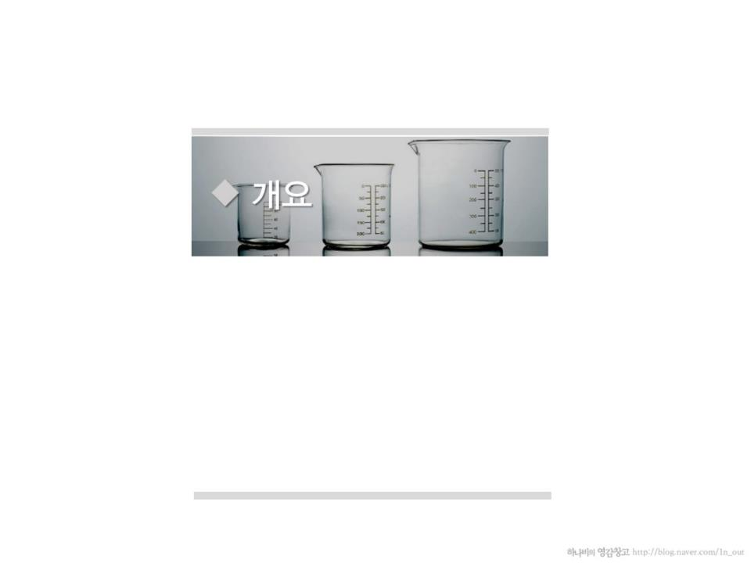
Contents
01 Introduction
02 Simulation
03 Experiment
04 Conclusion
Notes:
Here is the table of contents.

Slide 3

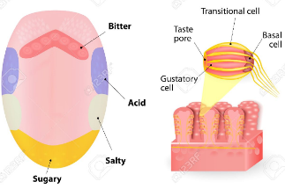
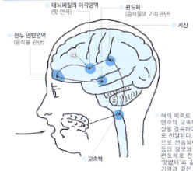
Human taste system (tongue)
01.
Introduction
taste sensor (Electronic tongue)
Sensing membrane
Sensor array
Computer
No. | Processing Level | Name of the Sensing Mechanism
 |  | Humans Tongue | Electronic Tongue
1 | Receptor level | Buds | Membranes of the sensing elements
2 | Circuit level | Neural transmission | Transducer
3 | Perceptual level | Cognition in the thalamus | Computer as well as statistical analysis
Sensors 2016, 16, 668; doi:10.3390/s16050668
Notes:
Humans have five senses.
As science advances, it becomes possible to imitate human senses mechanically and electrically.
In this presentation, I will explain the taste sensing.
First, let's look at a human taste system.
The taste buds of the tongue change the potential of the cell membrane when food is combination. And in the form of electric signals transmitted to the brain through neural networks, and they become aware of the taste.
So the human taste mechanism is divided into a sensing unit capable of recognizing the taste and a recognition unit.
Next, let's look at the electronic tongue, a taste sensor.
The electronic tongue is configured to correspond to each configuration of the human taste system.
The sensor array corresponds to a collection of different taste receptors in the tongue.
The data that is implemented in the computer corresponds to the human brain of the software.
This table summarizes the three levels of analogy between human and electronic tongue taste recognition mechanisms.

Slide 4
Five basic flavors that humans feel
01.
Introduction
sweet
bitter
sour
salty
savory taste (umami)
glucose
quinine
HCl
NaCl
MSG
Grape flavor,
Apply taste and so on
Aroma felt in the nose
Spicy,
Astringent, puckery, tannic taste
Tactile senses
Notes:
We basically can taste five flavors such as sweet, bitter, sour, salty and savory taste.
The taste belongs to a chemical sense, so it can be a chemical equivalent.
The chemicals listed here are typical tastes. Other than that we know "Grape flavor" and "apple taste" are not flavor but aroma felt in the nose, and "spicy taste" and "tannic taste" are tactile senses.

Slide 5
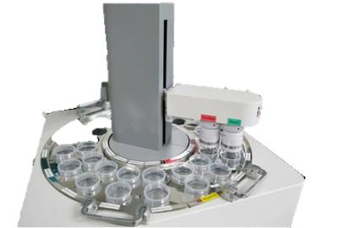

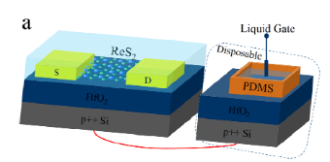
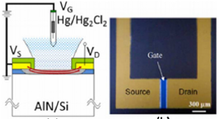
Taste Sensor
If the taste is sensed electrically, it is possible to obtain standard taste information.
01.
Introduction
Conventional taste sensors
large in volume
require expensive equipment
not suitable for portable device
FET-type biosensor
miniaturization and standardization by integrating the sensor and the circuit
ACS applied materials & interfaces 10.8 (2018): 7248-7255.
Sensors and Actuators B: Chemical 207 (2015): 1136-1146.
Notes:
If the taste is sensed electrically, it is possible to obtain standard taste information.
First, this picture demonstrates the taste sensor currently commercialized.
It is require a large amount of test material because they are large in volume.
Also require expensive equipment and not suitable for portable device.
So various types of biosensors have been developed to overcome these drawbacks.
For portable applications a small size taste sensor system is required and a suitable technology for manufacturing such a highly sensitive small-sized sensor is semiconductor technology.
The FET-type biosensor has advantages of miniaturization and standardization by integrating the sensor and the circuit by utilizing the integrated circuit manufacturing process.
Among the devices capable of integrated circuits, thin film transistors with oxide semiconductor materials are one of the candidates having a simpler process than the LTPS TFT and a higher field effect mobility than the a-Si TFT.

Slide 6
ISFET
01.
Introduction
Gate insulator
MOSFET
ISFET (Ion Sensitive FET)
The ISFET consists of a reference electrode, a solution and a sensing film.
The gate potential supplied to the device varies depending on the concentration or kind of the solution.
Electrochemical double layer formation at reference electrode-solution interface and solution-insulating layer interface
→ Potential difference occurs.
Notes:
This slide introduces the ISFET that used as a biosensor.
The ISFET is an ion-sensitive FET.
The difference from the MOSFET is that it consists of a reference electrode, a solution, and a sensing film instead of a gate terminal.
There is a solution between the reference electrode and the gate insulating layer, and the gate potential supplied to the device varies depending on the concentration or kind of the solution.
An electrochemical double layer is formed at the interface between the reference electrode-solution also the solution-insulating layer to generate a potential difference.

Slide 7
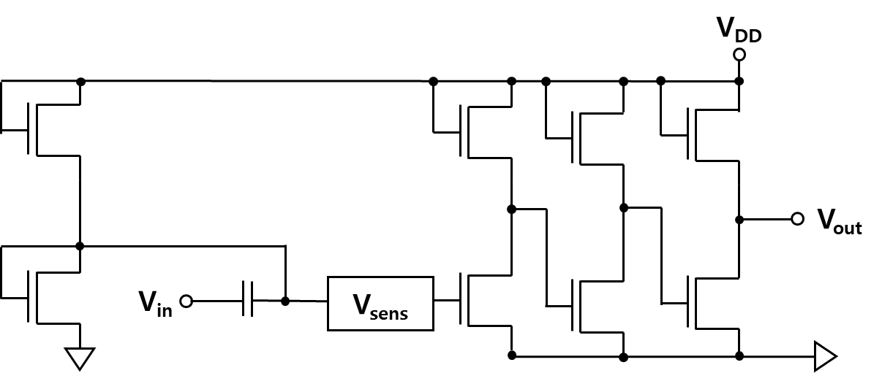
Circuit Ⅰ
02.
Simulation
Reference Vsens is 0 V
At this time, operation voltage is 5.1 V
When Vsens increase, operation voltage decrease.
If the operating point is shifted, the output becomes smaller.
Notes:
Now let me introduce the TFT circuit for taste sensor.
Taste detection is done with a small voltage difference of several tens of mV, so signal amplification is required.
The circuit that amplifies the sensed signal is designed as shown in the figure.
The first block of amplifier circuit is to set the operation point.
The characteristics of the oxide TFT are subject to change due to process variations.
Therefore, it is important to set the operation point well using the appropriate bias voltage.
In self-bias block, the output of the inverter is connected to the input which make the input voltage equals to the output voltage.
Therefore, the operating point is set at the intersection of the DC voltage line and the voltage transfer curve of the inverter.
The second, third, and fourth blocks are amplifiers composed of inverters to amplify the Vsens voltage.
First, when Vsens is 0 V, it means not sensing anything, and the operating point is 5.1 V.
And, when the Vsens is increased by sensing the taste material, the operating point tends to decrease.

Slide 8
Circuit Ⅰ
02.
Simulation
Input voltage : sine wave with amplitude of 0.1 V
Frequency : 1 kHz
Notes:
The graph below shows the inputs and outputs of this circuit.
As the Vsens increases, the output changes as the operating point changes.
If the operating point is shifted, the output becomes smaller.
This indicates that the operating point of the circuit changes due to the change in the concentration of the different taste material or one taste material, and thus different outputs are output.

Slide 9
Circuit Ⅰ
02.
Simulation
Different taste materials get
different gains for each.
Notes:
The taste material changes the operating point of the circuit, changes the output, and eventually gains a different gain.
The gain is 50 at the proper operating point.
However, you can see that the gain decreases as the operating point shift.

Slide 10
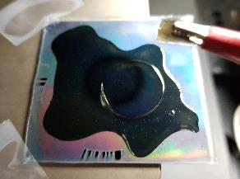
Oxide Thin Film Transistor
03.
Experiment
Active : IGZO
Gate insulator : SOG
Gate : Cr
Inter layer dielectric : SOG
Source / Drain : Al
Inter layer dielectric
Gate
S
Gate insulator
D
Active
Substrate
Sensing membrane
Taste solution
Lipid
Plasticizer + Polymer
Insulator (SOG)
Gate (Cr)
Substrate (glass)
Gate electrode deposition → Insulator coating → polymer coating → lipid dropping → taste solution dropping
Taste solution : salty (NaCl 1g : DI 60 ml)
Notes:
Oxide TFT was applied to the taste sensor circuit.
The TFT structure is a top-gate self-align as shown in th figure.
Nextly I have fabricated sensing membrane.
Deposited gate electrode on the glass substrate and coated insulator on the gate electrode.
And then, coated polymer that is added plasticizer.
Role of polymer membrane is to support and pin lipid.
And it barely reacts to taste solution.
Lastly, coated lipid that reacts or combines to taste solution.

Slide 11
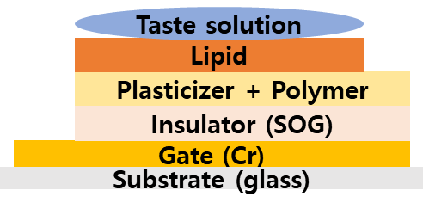
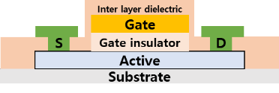
Measurement ㅡㅡㅇ Ⅰ
Electrode of sensing membrane – Gate electrode
03.
Experiment
A | reference
B | connecting TFT and sensing membrane
C | Immediately after dropping the taste solution
D | 10 min after
E | Leakage current
on-current increased slightly.
Notes:
To measure, I have connected TFT gate to sensing membrane electrode.
Measurement result is, like we can see on the graph, on-current has slightly increased.
As change of sensing voltage is mere dozens of mV, I think change of current is also small.
Therefore, it requires amplifier.
But this structure is floating.

Slide 12
Measurement ㅡㅡㅇ Ⅱ
Electrode of sensing membrane – Gate electrode
taste solution – source electrode
03.
Experiment
A | reference
B | connecting TFT and sensing membrane
C | Immediately after dropping the taste solution
D | 10 min after
E | 20 min after
on-current increased and off-current increased too.
Notes:
To reduce floating, this time I’ve connected TFT source and taste solution.
And connected TFT gate to sensing membrane electrode as in the previous measurement.
As shown in the graph, on-current has slightly increased and off-current has largely increased unusually.
The analysis of this result has not yet been made.

Slide 13
I’ve design taste sensor circuit using oxide TFT.
Oxide TFT and sensing membrane were connected to test the current change due to the tasting materials.
I’ve complited design mask layout based on circuit I had designed.
I will fabricate the circuit and measure its operation.
04.
Conclusion
Notes:
I’ve design taste sensor circuit using oxide TFT.
Oxide TFT and sensing membrane were connected to test the current change due to the tasting materials.
I’ve complited design mask layout based on circuit I had designed.
I will fabricate the circuit and measure its operation.

Slide 14
Thank you
for your attention

