Slide 1
17th Technical meeting of univ. of the Ryukyu’s, Kochi Univ. & Hoseo univ.
SOG insulator FTIR Spectroscopy
LEE SEUNG WON
Hoseo univ.
2018. Sep. 1st

Slide 2
Context
3. FTIR spectroscopy
2. Experiment method
1. Abstract
4. Conclusion

Slide 3
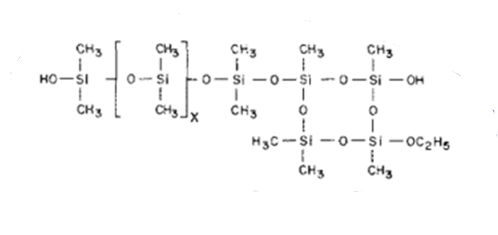
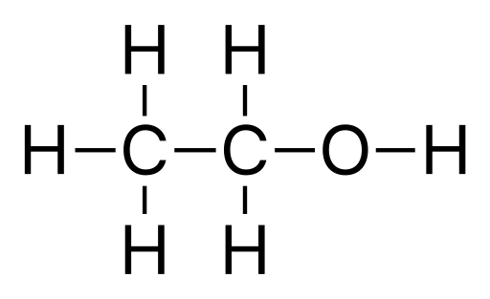
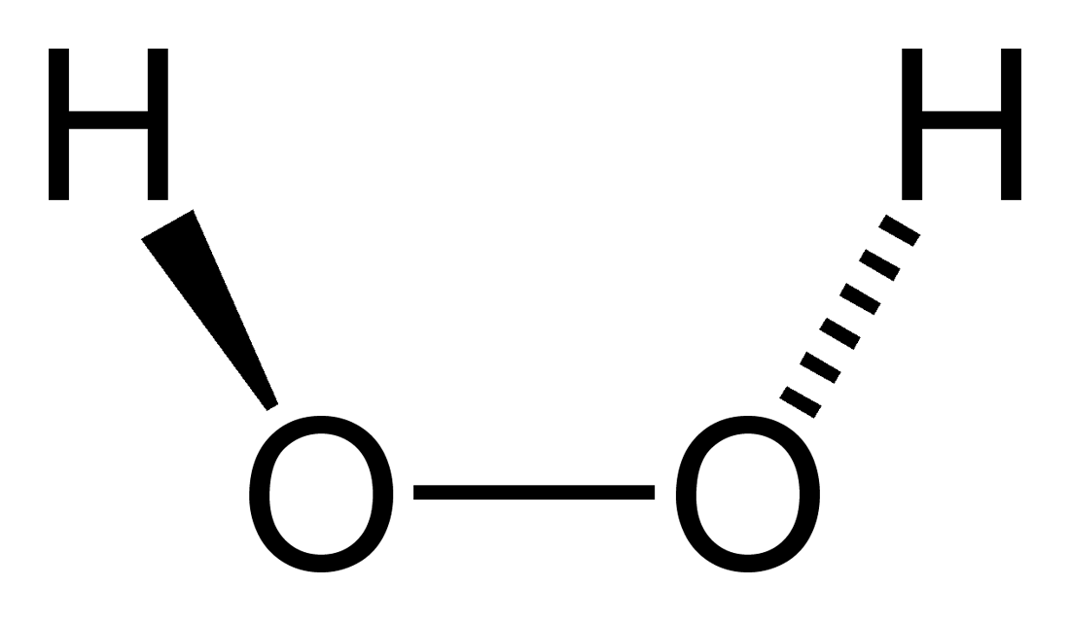

Molecular Structure of Spin-On Glass
Ethanol
SOG
$$H_{2}O_{2}$$
n Si(${OC}_{2}$ $H_{5}$)4 + 2n $H_{2}O$→ n ${SiO}_{2}$ + 4n $C_{2}H_{5}OH$
Notes:
This is the basic structure of SOG, and the experiment undergoed in several phases, dilution with ethanol, adding H2O2, and curing in several temperature. We’ve expected outgassing of methyl group which leads to enhance Si-O network.

Slide 4
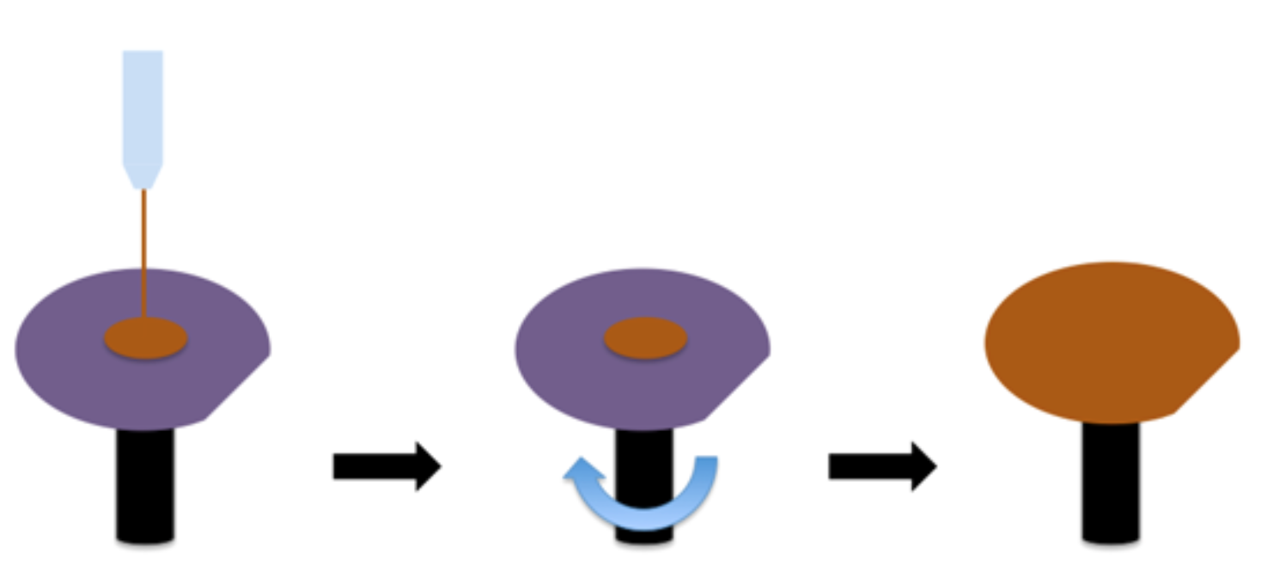
Experimental
Soft bake
180℃
3500RPM, 30sec
Curing
450℃
Notes:
The experiment condition is following to the screen. SOG was coated on the P-type silicon wafer and soft baked on a hot plate at 180 Celsius. Then cured in furnace at 250 Celsius to 450 Celsius.

Slide 5
Coat(3500RPM) → Bake(180℃) → Cure(450℃)
FTIR spectroscopy 1
Notes:
These are each FTIR spectroscopy of coated, baked and cured SOG film. As we can see, Si-O network has enhanced at wavenumber 1040 and near 960 area, Si-OH network has decreased after curing.

Slide 6
FTIR spectroscopy 2
O-Si-C
Notes:
This graph is comparison by curing temperature and we could found that Si-O-C absorption has decreased gradually as curing temperature risen.

Slide 7
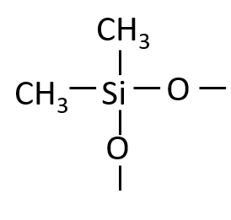
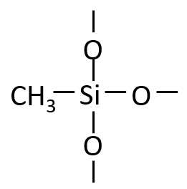
FTIR spectroscopy 2-1
Notes:
Also, if to compare 250 Celsius curing to 450 Celsius curing, decrease in methyl has been spotted.

Slide 8
FTIR spectroscopy 3
Notes:
And by dilution ratio, OH vibration in 900 area has decreased as dilution ratio has increased.

Slide 9
FTIR spectroscopy 4
Notes:
For the last spectrometry, I’ve compared entire IR spectra of 100%SOG solution and 25%SOG solution also with and without H2O2, and there was a single significant difference at wavenumber 2300 area. But I couldn’t analyze this peak yet.

Slide 10
Conclusion
Si-O network is enhanced after curing process
C-Si-O bond decreases as curing temperature increases
Demethylation increases with increase of the cure temperatures
Si-OH decreases as curing temperature increases.

