Slide 1
Reaction between Metal and Oxide
SANG MIN LEE / 李 相 旼
School of Electronic & Display Engineering Hoseo University, Korea
September 1st, 2018
Technical Exchange Meeting, September 01, 2018, Centum Hotel, Busan, Korea
Notes:
Hello everyone!
My name is SANGMIN LEE at a undergraduates fourth grades at a department of Digital display engineering, hoseo university.
I am very glad to be here.

Slide 2
Contents
Introduction
Experiment
Result
Conclusion
Technical Exchange Meeting, September 01, 2018, Centum Hotel, Busan, Korea
Notes:
The table of contents are consist of introduction, experiment, result and conclusion.

Slide 3
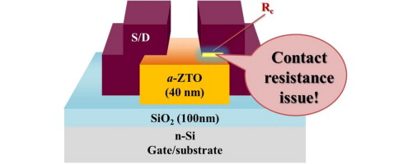
Introduction
Metal | Ionization energy (kJ/mol) | Metal | Ionization energy (kJ/mol)
Ta | - 761.0 | Mo | - 684.3
Al | - 577.5 | In | - 558.3
Ti | - 658.8 | Nd | - 533.1
Table 1. The ionization energies for various metals.
Technical Exchange Meeting, September 01, 2018, Centum Hotel, Busan, Korea
Notes:
First, let me introduce the experiment.
The current flows through source and drain electrode in which the contact resistance between source, drain metal and semiconductor layer influence the on current.
But, the on currents decrease as increasement of the contact resistance. So, My research confirms the interfacial reaction between metal and oxide semiconductor layer at high annealing temperature.
Below the table, among the various metals, aluminium was chosen because it had the lowest ionization energy as shown in the table. Thus, the high temperature annealing enhance the metal oxidation of the Aluminium with the oxygen from IGZO.

Slide 4
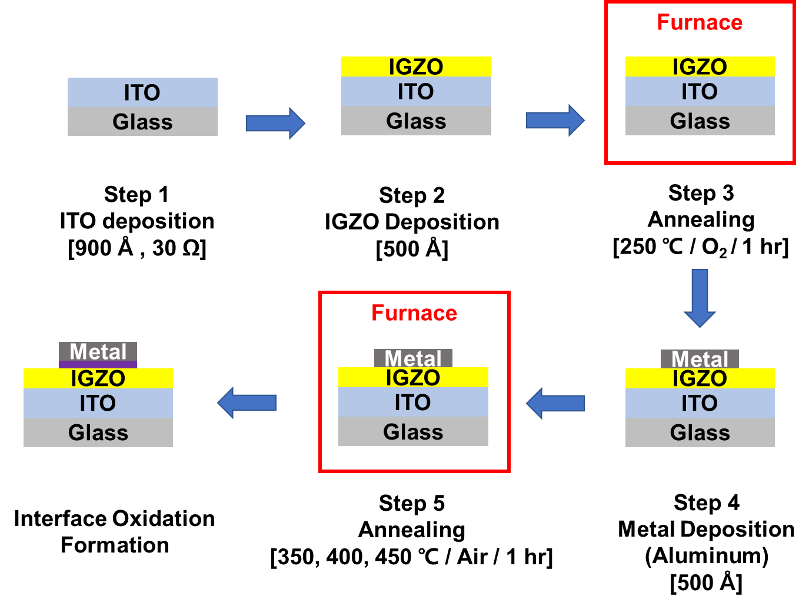
Experiment
Fig. 1. Process steps for interface oxidation
Technical Exchange Meeting, September 01, 2018, Centum Hotel, Busan, Korea
Notes:
This figures show the process for the interfacial oxidation.
First, I used ITO glass as substrate and processed DI water for cleaning.
And, The IGZO semiconductor was deposited on the substrate by RF magnetron sputtering.
Then, annealing was performed in a furnace at 250 °C, 1 hour, and oxygen ambient.
After annealing, top electrode was deposited on IGZO with DC magnetron sputtering using Aluminium.
And, in order to induce the interfacial reaction, annealing was performed for 1 hour in the furnace at each temperature in the air environment.

Slide 5
Result
Fig. 2. The breakdown voltage of the interfacial oxide film according to temperatures
The interfacial oxidation layer thickness became thicker as the annealing temperature increased.
Technical Exchange Meeting, September 01, 2018, Centum Hotel, Busan, Korea
Notes:
Next, this slide shows breakdown voltage vs. temperature. Through to the figure, as the annealing temperature increases, the breakdown voltage increases.
I expected the interfacial oxidation layer thickness became thicker as the annealing temperature increased.

Slide 6
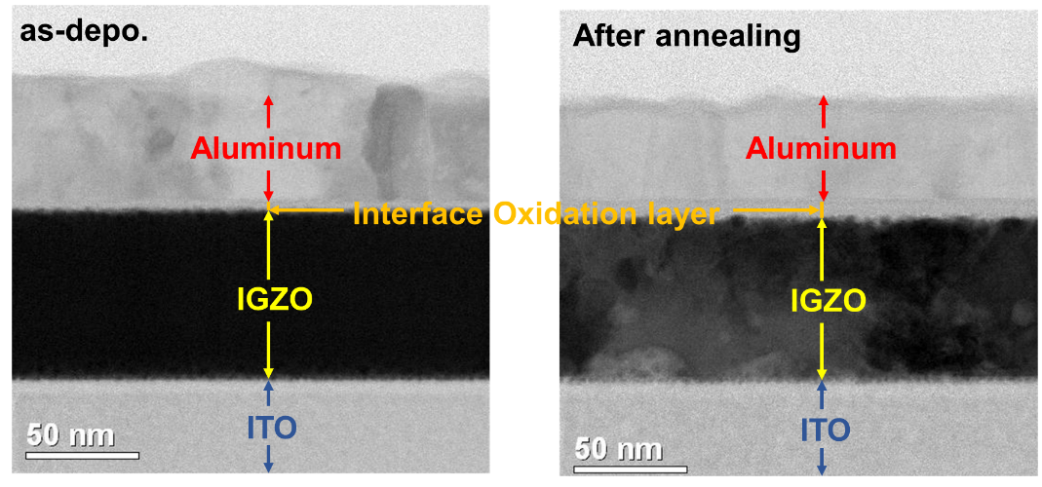
Result
Fig. 3. TEM Cross-sectional structure annealed at 400 ℃
The thickness of the interfacial oxidation layer was increased to 10 nm as compared with 5 nm before annealing.
Technical Exchange Meeting, September 01, 2018, Centum Hotel, Busan, Korea
Notes:
And this slide shows cross-sectional structure annealed at 400 ℃.
When deposited, interfacial oxide layer formed at the interface.
After annealing, the thickness of the interfacial oxidation layer increased to 10 nm as compared with 5 nm before annealing.

Slide 7
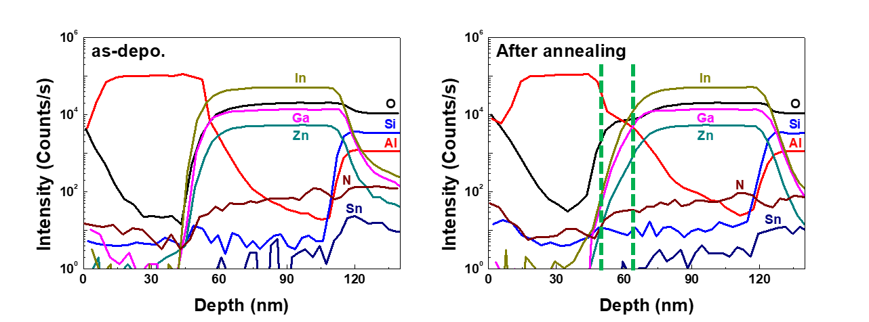
Result
Fig. 4. SIMS analysis of ITO/IGZO/Al stacked film annealed at 400 ℃ analyzed by SIMS
SIMS analysis shows the oxygen diffused to Al layer to form aluminum oxide.
Technical Exchange Meeting, September 01, 2018, Centum Hotel, Busan, Korea
Notes:
And next, this slide shows the result of SIMS analysis of ITO/IGZO/Al stacked film annealed at 400 ℃.
Secondary-ion mass spectrometry is a technique to analyze the composition of solid surfaces and thin films by sputtering the surface of the specimen with a focused primary ion beam and collecting and analyzing ejected secondary ions.
SIMS analysis shows the oxygen diffused to Aluminium layer to form aluminum oxide. Al and O counts decreased at the interface.
The expecting reason for this is that Aluminium and oxygen of IGZO were bonded by high temperature annealing.

Slide 8
Conclusion
The oxidation between metal and oxide material was studied for Aluminum and IGZO materials.
Aluminum forms a very thin oxide layer during deposition, the interface oxidation layer grows from Al at 400 ℃, the interfacial oxidation was enhanced as increasing annealing temperature.
The breakdown voltages increased from 0.1 V to 0.3 V as increase the annealing temperature from 400 ℃ to 450 ℃.
By SIMS and TEM, the thickness of oxide was analyzed. The thickness was about 10 nm after 400 ℃ annealing.
Technical Exchange Meeting, September 01, 2018, Centum Hotel, Busan, Korea
Notes:
Now, I'd like to summarize my talk with a couple of remarks.
The oxidation between metal and oxide material was studied for Aluminum and IGZO materials.
Aluminum forms a very thin oxide layer during deposition, the interface oxidation layer grows from Al at 400 ℃, the interfacial oxidation was enhanced as increasement of annealing temperature.
The breakdown voltages increased from 0.1 V to 0.3 V as increased the annealing temperature from 400 ℃ to 450 ℃.
By SIMS and TEM, the thickness of oxide was analyzed. The thickness was about 10 nm after 400 ℃ annealing.

Slide 9
Thank you for your attention!
Technical Exchange Meeting, September 01, 2018, Centum Hotel, Busan, Korea
Notes:
Thank you for your kind attention.

