Slide 1

TiO₂ Thin Film by Reactive Sputtering
Pyeong Seob Song
School of Electronics & Display Engineering
Hoseo University, Baebang, Asan, Chungnam 31499, Korea
Tel. : 82-10-6543-9189, E-mail: omaha21@naver.com
Technical Exchange Meeeting 2018, 01 September, Haeundae-Centum Hotel, Busan, Korea
Notes:
I am grateful to my professer, professor Noguchi and professor Furuta for introducing me to presentation.
My name is Pyeong Seob Song and I am a third year student at Hoseo University and I work in Electronic Devices Laboratory.
Today, I will speak My research topic, TiO₂ Thin Film by Reactive Sputtering

Slide 2


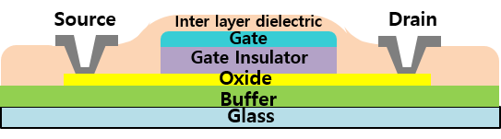
Introduction
Experiment
Result and Discussion
Conclusion
Introduction
As the gate insulator film of the TFTs, inorganic insulator films such as SiO₂ or SiN_{x} formed by the CVD (Chemical Vapor Deposition) method are generally used.
PVD (Physical Vapor Deposition) can deposit insulators at low temperatures.
But amorphous TiO₂ is often observed when the substrate temperature is very low during deposition, which degrades the properties of the insulator.
Therefore, the purpose of this study is to investigate the effect of annealing on the quality of TiO₂ films deposited on Si substrates by reactive DC sputtering at room temperature.
Technical Exchange Meeeting 2018, 01 September, Haeundae-Centum Hotel, Busan, Korea
Notes:
First of all, I ‘ll be speaking about introduction of my experiment.
As the gate insulator film of the TFTs, inorganic insulator films such as SiO₂ or SiN_{x} formed by the CVD (Chemical Vapor Deposition) method are generally used.
CVD has problems with high process temperature and substrate contamination due to gas residues in the chamber, but PVD (Physical Vapor Deposition) can deposit insulators at low temperatures.
But amorphous TiO₂ is often observed when the substrate temperature is very low during deposition, which degrades the properties of the insulator.
Therefore, the purpose of this study is to investigate the effect of annealing on the quality of TiO₂ films deposited on Si substrates by reactive DC sputtering.

Slide 3
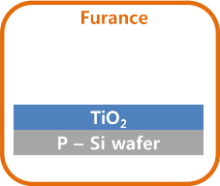
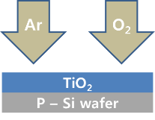
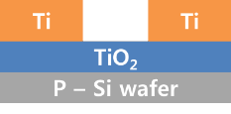
Abstract
Introduction
Experiment
Result and Discussion
Conclusion
Experiment
Step 1 TiO₂ deposition [ 300nm ]
Step 2 Annealing [ 200, 300, 400 ℃ / O₂ / 1h ]
Step 3 Ti deposition [ 300nm ]
50 nm TiO₂ film was formed by DC reactive sputtering on p - Si wafer.
The surface of the p - Si wafer was cleaned with Acetone and IPA, followed by O₂ plasma treatment for 1 min by RIE.
Ti electrode was deposited to a thickness of 300 nm using a Shadow - mask.
Al, was deposited on the back surface of p - Si wafer to a thickness of about 100 Å for back contact.
Technical Exchange Meeeting 2018, 01 September, Haeundae-Centum Hotel, Busan, Korea
Notes:
This page is experimental method.
The experiment was conducted as shown.
50 nm TiO₂ film was formed by DC reactive sputtering on p type Silicon wafer.
The surface of the p type Silicon wafer was cleaned with Acetone and IPA, followed by O₂ plasma treatment for 1 min by RIE.
A 300 nm Ti electrode was deposited using a Shadow - mask.
Aluminum was deposited for back contact to a thickness of about 100 Å.

Slide 4
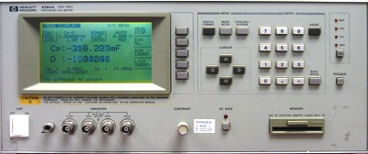
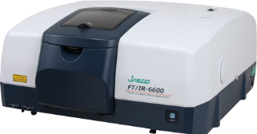
Introduction
Experiment
Result and Discussion
Conclusion
Experiment
Lcr meter - 4284A FT/IR - 6600
The dielectric properties of TiO₂ thin films were analyzed by capacitance - voltage (C - V) characteristics.
Leakage current and breakdown voltage were analyzed by I - V curves.
TiO₂ thin films annealed at 200, 300, and 400 ℃ were analyzed by FTIR.
Technical Exchange Meeeting 2018, 01 September, Haeundae-Centum Hotel, Busan, Korea
Notes:
This slide show explains the analysis method.
The dielectric properties of TiO₂ thin films were analyzed by capacitance-voltage (C-V) characteristics.
Leakage current and breakdown voltage were analyzed by I-V curves.
TiO₂ thin films annealed at 200, 300, and 400 ℃ were analyzed by FTIR.

Slide 5
Introduction
Experiment
Result and Discussion
Conclusion
Result and Discussion
1000 sec. - 06.5 nm
2000 sec. - 16.3 nm
3000 sec. - 32.4 nm
4000 sec. - 45.0 nm
Fig. 1. Deposition rate of TiO₂ by reactive sputtuering
Technical Exchange Meeeting 2018, 01 September, Haeundae-Centum Hotel, Busan, Korea
Notes:
Now we will discuss the results and discussions.
Fig.1. is the deposition rate of TiO_{2.} by DC reactive sputtuering
When deposited for up to 4000 seconds, a thickness of about 45 nm can be identified.

Slide 6
Introduction
Experiment
Result and Discussion
Conclusion
Result and Discussion
0 200 300 400
0 200 300 400
Fig. 2. Leakage current density at 0.5 MV / cm & Dielectric strength
of TiO₂(4000 sec.) annealed at 200, 300 and 400 ℃
The leakage current of basic deposition and the 400 °C annealing showed a difference of 12.5 nA.
Dielectric strength was not confirmed by the 400 °C annealing.
Technical Exchange Meeeting 2018, 01 September, Haeundae-Centum Hotel, Busan, Korea
Notes:
This page describes the I-V curve.
Fig.2. is the Leakage current density at 0.5 MV / cm, dielectric strength of TiO₂(4000 s) annealed at 200, 300 and 400 ℃.
As shown in the left graph, the leakage current decreases as the annealing temperature increases.
The leakage current of basic deposition and the 400 °C annealing showed a difference of 1.25E-05. (twelve point five nm)
The right graph shows the dielectric strength from 0 V to 200 V.
The dielectric strength of TiO₂ at 200 and 300 °C was not changed by the basic deposition, but the dielectric strength was not confirmed by the 400 °C annealing.

Slide 7
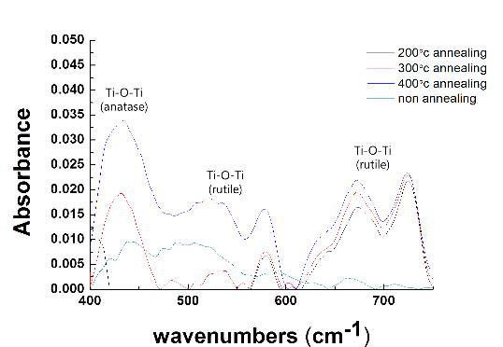
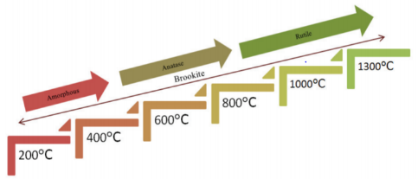
Introduction
Experiment
Result and Discussion
Conclusion
Result and Discussion
Major phase change with annealing temperature
0 - 400 °C: Amorhpous
400 - 800 °C : Anatase
800 °C ~ : Rutile
Wavenumbers (cm⁻¹)
Fig. 3. FTIR results of TiO₂(4000 sec.) annealed at 200, 300 and 400 ℃ in a furnace.
Technical Exchange Meeeting 2018, 01 September, Haeundae-Centum Hotel, Busan, Korea
Notes:
The next page is FTIR measurements of TiO₂ with different annealing temperature.
At 200 ℃, no clear phase can be observed, and anatase phase and rutile phase increase from annealing above 300 ℃.
It is known that increase of rutile phase in the film of TiO₂ leads to decrease of leakage current.

Slide 8
Introduction
Experiment
Result and Discussion
Conclusion
Result and Discussion
0 200 300 400
Fig. 4. C – V curves of TiO₂ (4000 sec.) annealed at 200, 300 and 400 ℃ in a furnace.
Dielectric Constant (K)
as-depo. | 22
200 ° C annealed | 3.3
300 ° C annealed | 13
400 ° C annealed | 13
Technical Exchange Meeeting 2018, 01 September, Haeundae-Centum Hotel, Busan, Korea
Notes:
Now let me show you the C-V measurement data of TiO₂.
The capacitance of TiO₂ annealed at 200 °C to 400 °C was measured.
The dielectric constant of TiO₂ deposited by reactive sputtering is 22.
The dielectric constant is greatly reduced in the 200 °C annealing.
In my opinion, the property of the TiO₂ starts to change phase at the annealing temperature of 200 °C just like the result of FTIR.

Slide 9
Introduction
Experiment
Result and Discussion
Conclusion
Result and Discussion
0 200 300 400
Fig.5. Hysteresis of TiO₂ (4000 sec.) annealed at 200, 300 and 400 ℃ in a furnace.
Hysteresis (ΔV)
as-depo | 0.1
200 ° C annealed | 0.13
300 ° C annealed | 0.03
400 ° C annealed | 0.03
Technical Exchange Meeeting 2018, 01 September, Haeundae-Centum Hotel, Busan, Korea
Notes:
Fig. 5. Hysteresis of TiO₂ annealed at 200, 300, and 400 °C in a furance
As the annealing temperature increases, the hysteresis decreases 0.07, the slope of the graph becomes steep, and the C-V curve shifts in the (+) direction.
it is expected that the decrease of the (+) charge in the insulator and the decrease of the interface defect between Si - TiO₂.

Slide 10
Introduction
Experiment
Result and Discussion
Conclusion
Conclusion
TiO₂ deposited by reactive sputtering & annealing was performed up to 400 °C.
It was confirmed that the leakage current decreased when annealing was performed.
Anatase and rutile phase can be confirmed in the annealed sample. At 200°C, unstable phases of anatase and rutile were identified.
As a result of C-V measurement, it is expected that the decrease of the (+) charge in the insulator and the decrease of the interface defect between Si - TiO₂ can be expected.
Therefore, when TiO₂ is deposited by reactive sputtering, annealing is essential to stabilize the film.
Technical Exchange Meeeting 2018, 01 September, Haeundae-Centum Hotel, Busan, Korea
Notes:
At last, In the summary,
TiO₂ deposited by reactive sputtering & annealing was performed up to 400 °C.
It was confirmed that the leakage current decreased when annealing was performed.
Anatase and rutile phase can be confirmed in the annealed sample. At 200°C, unstable phases of anatase and rutile were identified.
As a result of C-V measurement, it is expected that the decrease of the (+) charge in the insulator and the decrease of the interface defect between Si - TiO₂.
Therefore, when TiO₂ is deposited by reactive sputtering, annealing is essential to stabilize the film.

Slide 11
Thank you for
your Attention
Technical Exchange Meeeting 2018, 01 September, Haeundae-Centum Hotel, Busan, Korea
Notes:
I am grateful to everyone who has listened to my presentation so far. I hope I can meet you with a better theme next time.
질문 받고 먼저 칭찬 먼저 해주기
That’s a good question. That’s a hard question.
페이지로 부연 설명할때..
I'll respond to that question briefly. Let's go back to the third slide.
잘 모를때
This part I have to think a little more about. SO, I want you to give me your contact or email address after the presentation is over.

