Slide 1

Oxide TFT Comparator
Suitable for Biosensor Platform
The 17th Technical Collaboration Meeting
September 1st, 2018
Jade Hall in Haeundae Centum Hotel in Busan, Korea
In Hye Kang
Notes:
Good afternoon, everyone.
I’m In Hye Kang.
I will talk about oxide TFT comparator suitable for biosensor platform.

Slide 2


Contents
Ⅰ
OP Amp & Comparator
Ⅱ
Biosensor
Ⅲ
Simulation Results
Ⅳ
Conclusions
Notes:
This slide shows contents of my topic.

Slide 3

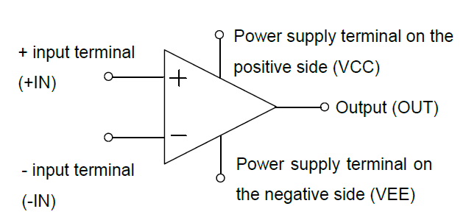
Introduction
OP Amp(Operational Amplifier)
An OP Amp is a differential amplifier that has high input resistance, low output resistance, and high open loop gain.
Its function is to amplify the differential voltage between the + input terminal and the - input terminal.
 | Input resistance | Output resistance
Ideal OP Amp (voltage controlled voltage source) | ∞ | 0
Notes:
An operational amplifier is a differential amplifier that has high input resistance, low output resistance, and high open loop gain.
Its function is to amplify the differential voltage between the + input terminal and the - input terminal.
Each op-amp circuit is composed of five terminals that a power supply terminal on the positive side, a power supply terminal on the negative side, a + input terminal, a - input terminal, and an output terminal.

Slide 4
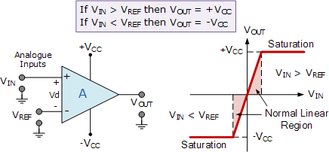
Introduction
Comparator
A comparator has the same terminal structure as an OP Amp composed of five terminals.
When a comparator is used, the voltage is fixed at one of the input terminals as a reference terminal, and the difference between the reference voltage and the output voltage to the other terminal is amplified.
The output voltage is either higher or lower than the reference voltage.
Notes:
A comparator has the same terminal structure as an op-amp composed of five terminals.
When a comparator is used, the voltage is fixed at one of the input terminals as a reference terminal, and the difference between the reference voltage and the output voltage to the other terminal is amplified.
The output voltage is either higher or lower than the reference voltage.

Slide 5
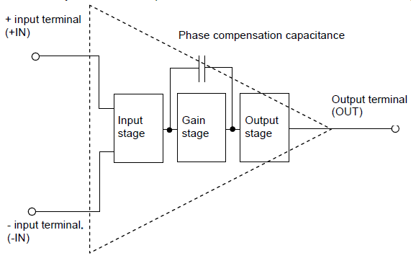
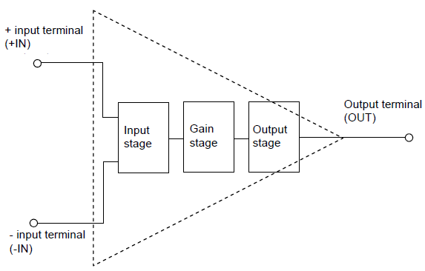
Introduction
OP Amp & Comparator
“ Whether the phase compensation capacitance exists.”
Since OP Amps configure and utilize a negative feedback circuit, they require phase compensation capacitance to prevent oscillation inside the IC.
Comparators will not configure the negative feedback circuit.
→ Since the phase compensation capacitance limits the response time between the input and the output, a comparator without the phase compensation capacitance provides a better responsiveness compared to an OP Amp.
▲ OP Amp
▲ Comparator
Notes:
The major difference between op-amps and comparators is whether the phase compensation capacitance exists.
Since op-amps configure and utilize a negative feedback circuit, they require phase compensation capacitance to prevent oscillation inside the IC.
On the other hand, since comparators will not configure the negative feedback circuit, they do not include the phase compensation capacitance.
Since the phase compensation capacitance limits the response time between the input and the output, a comparator without the phase compensation capacitance provides a better responsiveness compared to an op-amp.

Slide 6
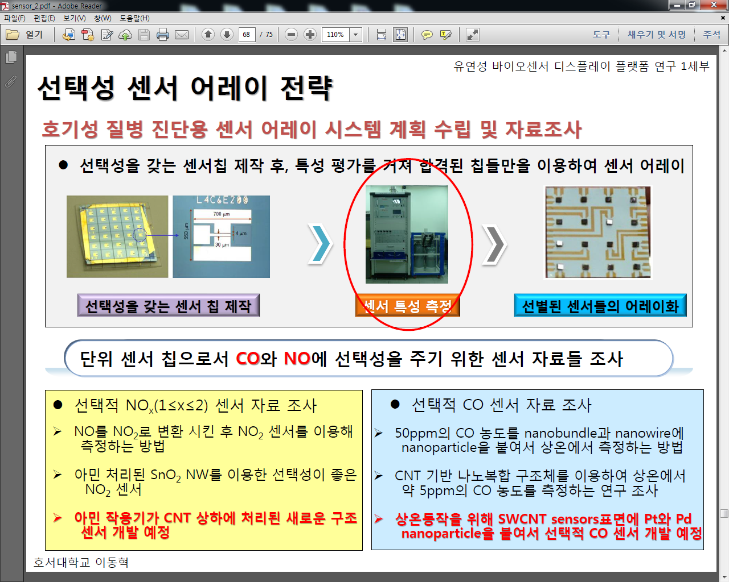
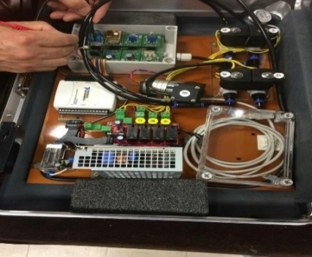
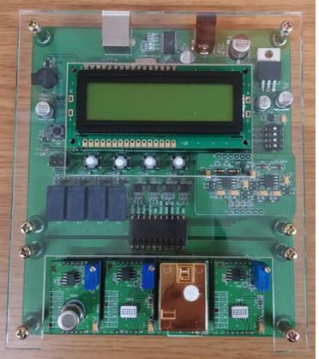
Biosensor
Conventional Biosensor Interface
Conventional biosensors are large because they must be configured a module by connecting IC chips.
Therefore, it is difficult to apply and miniaturize wearable devices with conventional biosensor.
▲ Conventional Sensor Detection Device
▲ Sensor Module (1)
▲ Sensor Module (2)
Notes:
Conventional biosensors like figure are large because they must be configured a module by connecting IC chips.
Therefore, it is difficult to apply and miniaturize wearable devices with conventional biosensor.

Slide 7
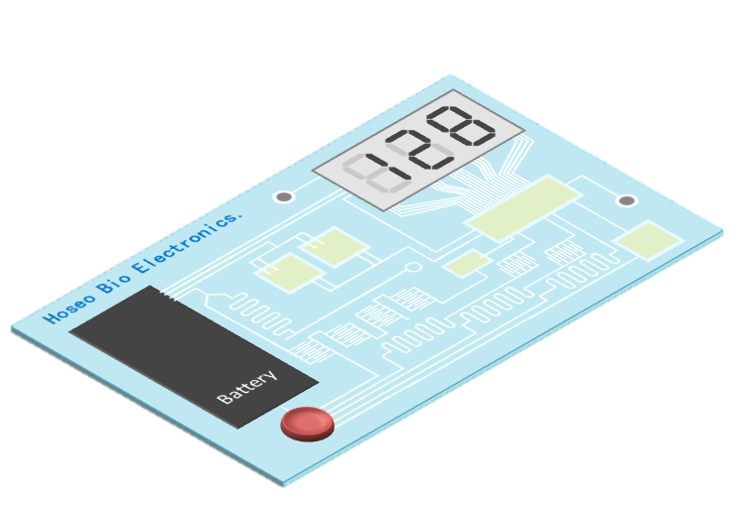
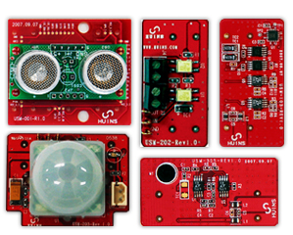
Biosensor
TFT-based biosensor
[TFT-based biosensor]
[Conventional Biosensor Module]
“Technology development issue of TFT-based biosensor circuit”
Compensation circuit is needed to compensate the electrical characteristics of TFT devices with lower operating characteristics than CMOS.
n-type a-IGZO TFT-based analog system and a hybrid system in which the digital system is composed of one block is required.
Notes:
Compensation circuit is needed to compensate the electrical characteristics of TFT devices with lower operating characteristics than CMOS.
n-type a-IGZO TFT-based analog system and a hybrid system in which the digital system is composed of one block is required.

Slide 8
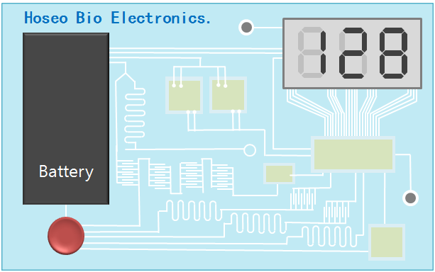
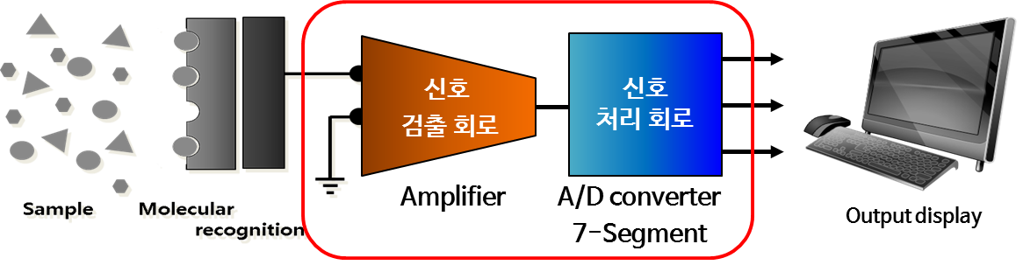
Biosensor
Biosensor Interface
Output
Biosensor signal (analog signal)
→ Signal amplification
→ Analog to digital converter (ADC)
→ 7-segment→DSP(digital signal processing)
→ Image implementation
Circuit
“The comparator is a circuit that plays an important role in the ADC.”
Sensor
Notes:
The final goal of this study is to develop a platform which the analog signal of the biosensor is output to the 7-segment through TFT-based circuit.
The signal processing process of this platform is as follows.
The biosensor signal of small analog signal is amplified through the amplification circuit.
It is then passed through a 4-bit ADC circuit for display as a digital signal.
And then, the digital signal passes through a 7-semgent circuit to be displayed as signal level.
Here, the comparator is a circuit that plays an important role in the ADC.

Slide 9
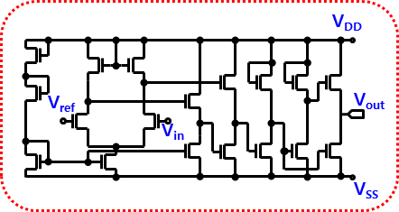
Simulation Results
Comparator Circuit with Oxide TFT
Parameter | Simulated
Device | a-IGZO TFT
Number of TFT | 18 n-type TFT
Power supply [V] | ± 15
Gain [dB] | 69.9
Cutoff frequency [Hz] | 132k
Unit-gain frequency [Hz] | 28M
Slew rate [V/ns] | Up | 0.15
 | Down | 1.73
Offset voltage [V] | 11.28m
Notes:
We proposed comparator circuits-based OP amp which consist of using 18 oxide TFTs.
This circuit has a gain of 69.9 dB, 0.15 of up slew rate, and 1.73 V / ns of down slew rate when applies ± 15 V power supply.

Slide 10

Simulation Results
Comparator Circuit with Oxide TFT
V_{DD}
R1
V_{in}
+
V_{out}
V_{ref}
-
R2
Notes:
This circuit is used to simulate an op amp - based comparator circuit.
To compare the two inputs of input voltage and reference voltage, Voltage difference is amplified to give the result 1 or 0.
For example, when the reference voltage is 5V, it outputs 0 when the input voltage is lower than 5V.
On the other hand, if the input voltage is higher than 5V, 1 is output.

Slide 11
Conclusions
To make the biosensor transparent and miniaturized than conventional sensor, TFT-based biosensors are required.
In the biosensor platform, an ADC is required to convert the sensor's analog signal into a digital signal.
Here, the comparator plays an important role in the ADC.
So, we proposed an OP Amp-based comparator circuit consisting of 18 TFTs.
We have confirmed through simulation that the oxide TFTs based comparator circuit works properly.
We plan to fabrication and measure proposed comparator circuit device later.
Notes:
Finally, let me summarize my topic.
To make the biosensor transparent and miniaturized, TFT-based biosensors are required.
In the biosensor platform, an ADC is required to convert the sensor's analog signal into a digital signal.
Here, the comparator plays an important role in the ADC.
So, we proposed an OP Amp-based comparator circuit consisting of 18 TFTs.
We have confirmed through simulation that the oxide TFTs based comparator circuit works properly.
We plan to fabrication and measure proposed comparator circuit device later.

Slide 12
Thank you for your attention!
The 17th Technical Collaboration Meeting
September 1st, 2018
Jade Hall in Haeundae Centum Hotel in Busan, Korea
In Hye Kang

