Slide 1


Introduction to ED Lab
The 17th Technical Collaboration Meeting
HOSEO University
Electronic Display Engineering
4th grade
SeokJun Kang
2018.09.01
Technical Collaboration Meeeting 2018, 01 September, Ecentum Hotel, Busan, Korea
Notes:
Good afternoon!
I will start introducing the lab.

Slide 2
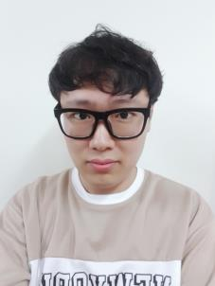
Introduction
Name : SeokJun Kang
Age : 25 (4rd grade)
Technical Collaboration Meeeting 2018, 01 September, Ecentum Hotel, Busan, Korea
Notes:
In this slide let me introduce myself.
My name is SeokJun Kang. I am 25 years old. My house is Seoul. however I am live in front of the University.
I am in the fourth grade of Hoseo University.
I became a member to this laboratory in May.
I'm learning a lot from this laboratory.

Slide 3
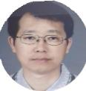







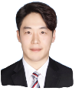

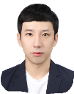


Introduction of ED Lab Personnel
Professor
ByungSeoung Bae
Doctor’s course
JongMo Lee
SeungJae Moon
InHye Kang
Master’s course
YoungJo Baek
SangHo Hwang
MinSu Kang
YeRin Han
SungMin Park
Undergraduate
SangMin Lee
HeeChan Yang
PyeongSeob Song
SeokJun Kang
Technical Collaboration Meeeting 2018, 01 September, Ecentum Hotel, Busan, Korea
Notes:
In this slide Let me introduce the Electronic Device Laboratory members.
First, Professor ByungSeoung Bae.
Second, In the doctoral course, there are jongmo Lee, Seungjae Moon, InHye Kang, there are three people.
Third, master course, YoungJo baek, SangHo Hwang, MinSu Kang, YeRin Han, SungMin Park, there are five people.
Finally, SangMin Lee, Heechan Yang, Pyeongseob Song, SeokJun Kang There are four undergraduates composed.
Currently Dr. Seungjae Moon, master SungMin Park is in France for research and is not here.

Slide 4
My Research
Source
Drain
IGZO
SiO₂
Wafer
I am analyzing the IGZO layer.
Technical Collaboration Meeeting 2018, 01 September, Ecentum Hotel, Busan, Korea
Notes:
In this slide is My research activity is IGZO deposition and we collaborate with a company called Selcos.
수위센서 터치센서 사용 가능 정전용량식 센서
화소회로 OLED

Slide 5
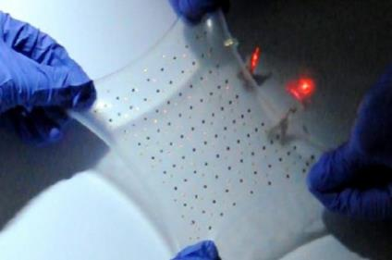
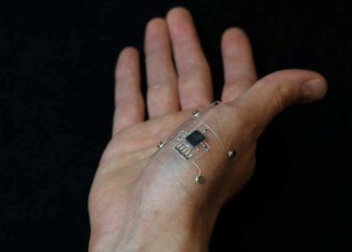
ED Lab Research
Stretchable Display
Studying a flexible circuit.
Technical Collaboration Meeeting 2018, 01 September, Ecentum Hotel, Busan, Korea
Notes:
In this slide introduce my laboratory research.
First research is Stretchable.
This research is under study to design a stretch and flexible circuit as shown above.

Slide 6
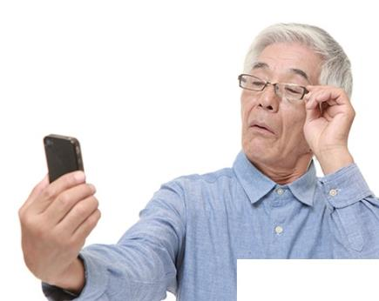
ED Lab Research
Presbyopia glasses
Presbyopia glasses by changing the refractive index using liquid crystal.
Technical Collaboration Meeeting 2018, 01 September, Ecentum Hotel, Busan, Korea
Notes:
The second research is Presbyopia glasses.
The research is to inject liquid crystals between glasses to change refractive index making it easier to see.

Slide 7
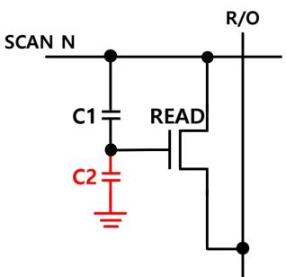
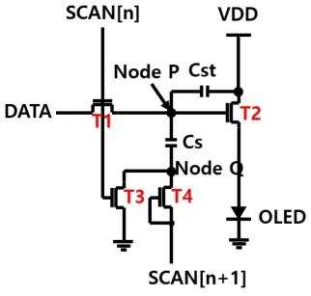
ED Lab Research
Fig 1 Capacitive Sensor.
Fig 2 OLED pixel circuit.
Capacitive sensor, OLED pixel circuit.
Technical Collaboration Meeeting 2018, 01 September, Ecentum Hotel, Busan, Korea
Notes:
The third research is capacitive sensor, OLED pixel circuit.
Figure 1 is a capacitive sensor. This circuit allows water level sensor and touch sensor.
Figure 2 is a OLED pixel circuit.

Slide 8
ED Lab Research
Interfacial oxidation
Metal
Interfacial Oxidation
IGZO
Glass
Interfacial oxidation research.
Technical Collaboration Meeeting 2018, 01 September, Ecentum Hotel, Busan, Korea
Notes:
The Finally, Interfacial oxidation.
Reducing the Interfacial oxide between IGZO and metal is important to reduce the contact resistance.

Slide 9
Thank you for attention
Technical Collaboration Meeeting 2018, 01 September, Ecentum Hotel, Busan, Korea
Notes:
Thank you for attention.

