Slide 1
Clock-Generator Embedded Charge Pump Circuit Using Oxide TFT
PPT模板下载：www.1ppt.com/moban/ 行业PPT模板：www.1ppt.com/hangye/
节日PPT模板：www.1ppt.com/jieri/ PPT素材下载：www.1ppt.com/sucai/
PPT背景图片：www.1ppt.com/beijing/ PPT图表下载：www.1ppt.com/tubiao/
优秀PPT下载：www.1ppt.com/xiazai/ PPT教程： www.1ppt.com/powerpoint/
Word教程： www.1ppt.com/word/ Excel教程：www.1ppt.com/excel/
资料下载：www.1ppt.com/ziliao/ PPT课件下载：www.1ppt.com/kejian/
范文下载：www.1ppt.com/fanwen/ 试卷下载：www.1ppt.com/shiti/
教案下载：www.1ppt.com/jiaoan/
Hoseo University
Electronic Device Laboratory
Master’s Course 3rd
Min Su Kang
Notes:
Hello.
My name is Min Su Kang.
I'd like to talk about “Clock-Generator Embedded Charge Pump Circuit Using Oxide TFT”.

Slide 2
Contents
1
Wearable Device
2
Proposed Circuits
3
Simulation Results & Layout
4
Summary
Notes:
There are five main thing dealt with in my presentation.
First, The wearable device
Second, Proposed Circuit
Third, Simulation Results and Layout
And last content is Conclusion

Slide 3
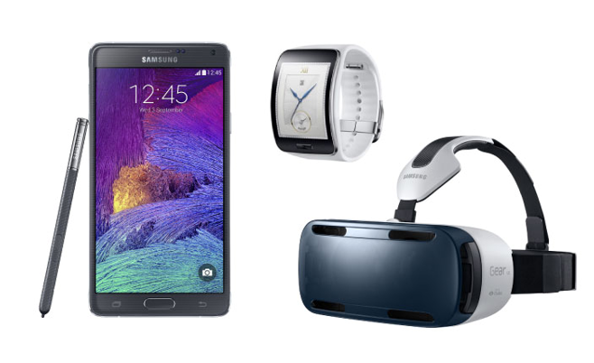
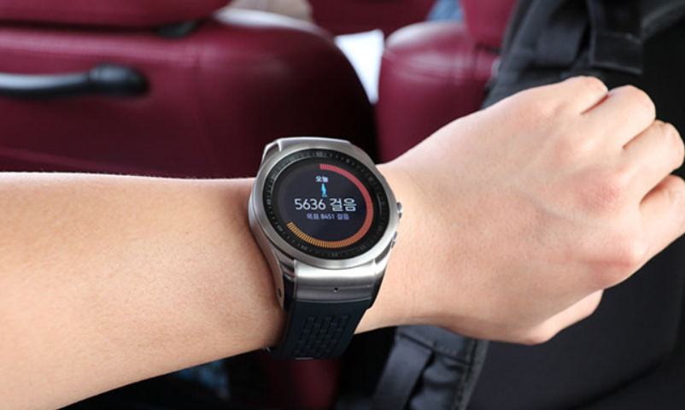
Wearable Device
Wearable device refers to a device that is always in contact with the body beyond the carrying smartphone.
Notes:
Wearable device refers to a device that is always in contact with the body beyond the carrying smartphone.
It was originally developed as a complementary product for smartphones, but it is expected to be used infinitely as its technology is developed and its network connection is made.

Slide 4



Wearable Device
If we use some small battery, we need some boost up circuit such as charge pump for driving of the wearable display.
We developed charge pump circuit with clock generator based a-IGZO TFT for flexible wearable devices.
Notes:
In wearable device, information should be displayed. For the application to wearable display, drive circuit is necessary.
If we use some small battery, we need some boost up circuit such as charge pump for driving of the display.
We developed integrated drive circuit for flexible wearable devices. For this aim, charge pump circuit with clock generator was developed using a-IGZO TFT.

Slide 5
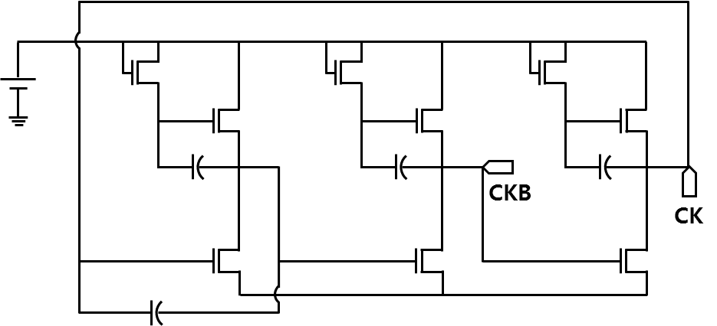
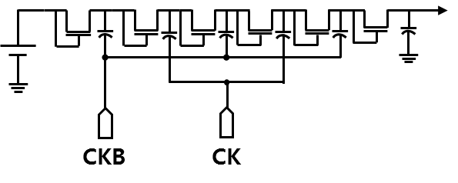
Proposed Circuits
Clock Generator
Parameter | Value | Unit
Bootstrap TFT | 50/10 | μm
Drive TFT | 50/10
Load TFT | 100/10
C | 5 | pF
Charge
Pump
Parameter | Value | Unit
TFT1~6 | 30/10 | μm
C | 1 | pF
Proposed clock generator circuit generates two pulse voltages, CK and CKB.
The CK and CKB pulse supplies the oscillating voltage required to drive the charge pump circuit.
The charge pump circuit is driven by a 1.5 V mercury battery.
Notes:
The circuit that generates the clocks CK and CKB necessary for driving the charge pump circuit is shown in top figure.
The clock generator has the same configuration as the RC oscillator and alternately outputs square wave of 1.5 V at regular intervals.
And then, this two square waves are applied to the CK and CKB signals of the charge pump circuit shown bottom figure.
Here, charge pumps and Clock generator circuit are used same 1.5V mercury batteries for low power design, which means that no additional power is required.
Let me explain about the principle of charge pump circuit operation.
In the first stage, the capacitor is charged equal to the supply voltage.
In the second stage, the circuit is connected in series with the power supply and the load.
Finally, the voltage across the load increases to twice the sum of the supply voltage and the capacitor voltage.

Slide 6
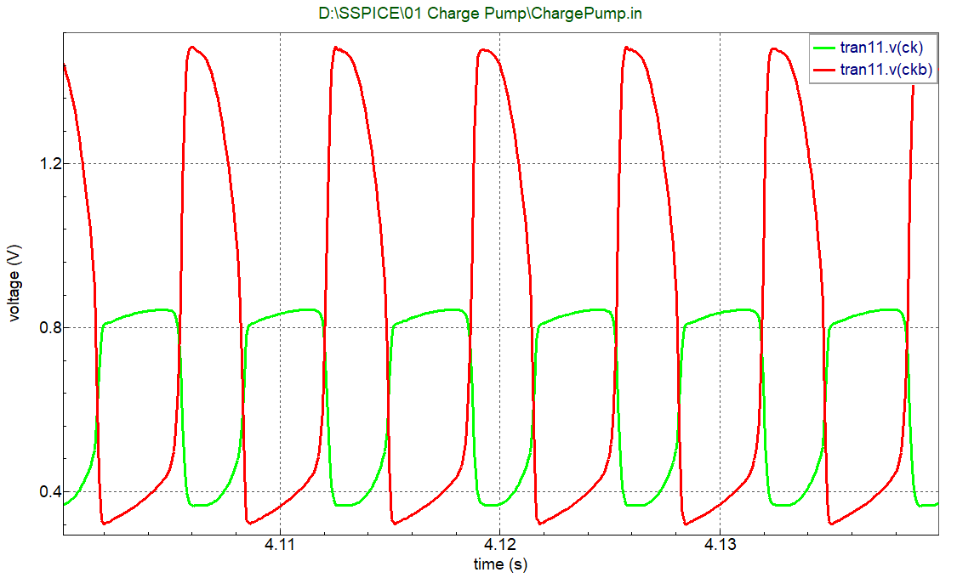
Simulation Results
Output of proposed clock generator circuit
Output of proposed charge pump circuit
Proposed clock generator showed that oscillation occurs at a constant period between about 20 ms.
Voltage swing of clock generator circuit was from 0.3 to 1.5 V.
Simulation results showed that output voltage of the proposed charge pump circuit reached 6 V.
The output voltage of the proposed circuit increases as the number of TFTs increases.
Notes:
Proposed clock generator showed that oscillation occurs at a constant period of about 20 ms.
Voltage swing of clock generator circuit was from 0.3 to 1.5 V.
Simulation results showed that output voltage of the proposed charge pump circuit reached 6 V.
The output voltage of the proposed circuit increases as the number of TFTs increases.

Slide 7
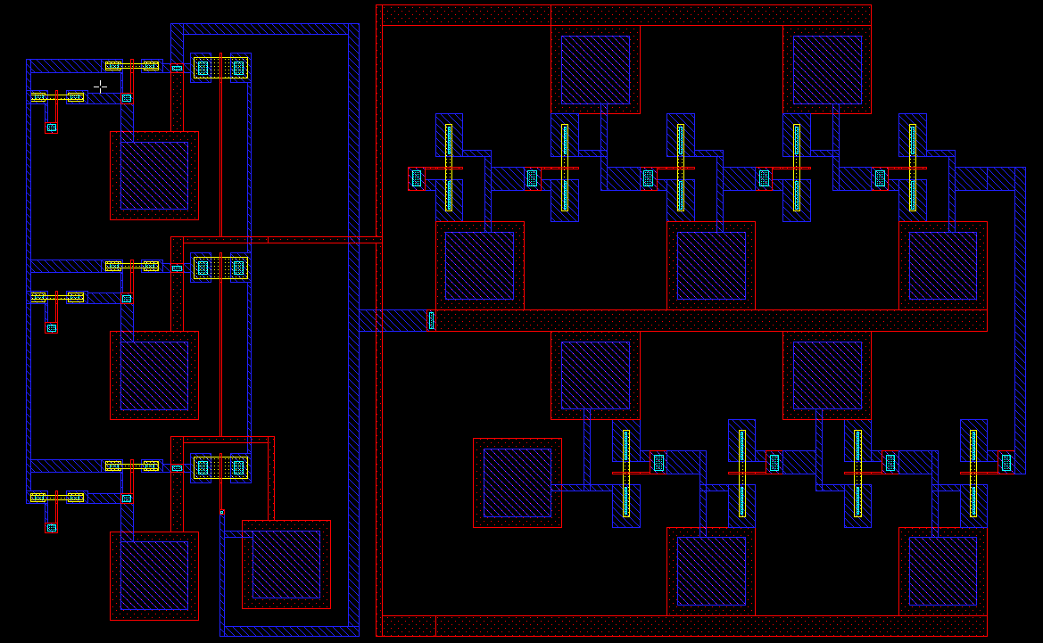
Layout
Clock generator
Charge pump
Notes:
We have been designed layout, so we plan to fabricate and measure proposed Clock generator embedded Charge Pump device.

Slide 8
Summary
We suggested TFT integrated circuit for wearable device driving.
After square waves required for charge pump driving were generated by an RC oscillator, boosting the voltage 1.5 to 6 V.
In addition, 1.5 V mercury batteries in charge pumps are used, which means that no additional power is required.
The output voltage increases linearly with respect to the input voltage.
This circuit can be integrated and applied to flexible substrate for wearable device.
Notes:
We suggested TFT integrated circuit for wearable device driving.
We embedded clock generator by RC oscillator. Clokcs are used for the operation of DC-DC converter.
The generated clocks were used for the DC-DC converter which boost up the voltage up to the 6 V.
In addition, 1.5V mercury batteries in charge pumps are used also for the clock generator, which means that just one battery is enough for the operation.
The simulation results show that the output voltages increased linearly with respect to the input voltage.
This circuit can be integrated and applied to flexible substrate for wearable device.

Slide 9
Thank you for your attention!
Notes:
Thank you for your kind attention.

