Slide 1
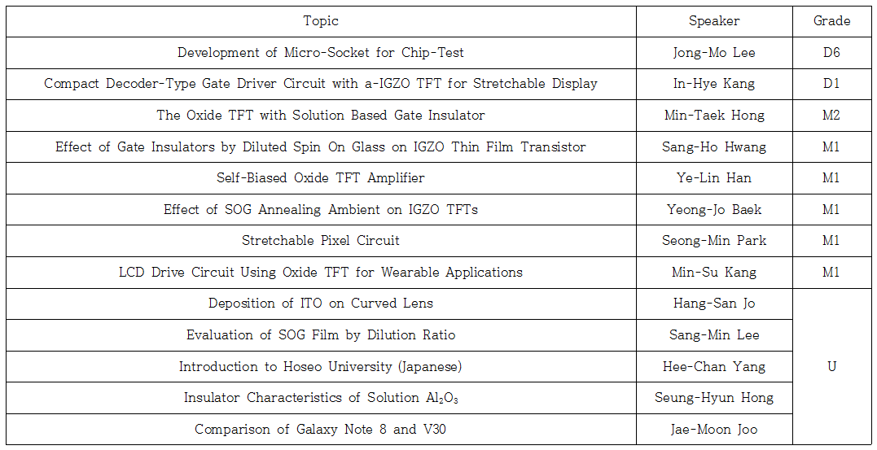
16th Technical Collaboration Meeting

