Slide 1


Insulator Characteristics of Solution Al₂O₃
18.01.13
Junior in HOSEO University
Electronic Display Engineering
Hong, Seung Hyun
洪承鉉

Slide 2
Contents
Introduction
-Solution process
-Solution meterial
Experiment
Result
Conclusion
Future research

Slide 3
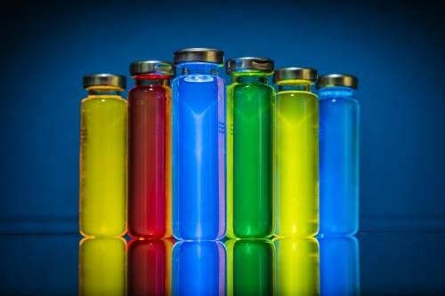
Solution process
Advantage
  Inexpensive costs
  Saving time
  Low temperature
Disadvantage
  Not good membranous
  Less stability

Slide 4
Solution Selection(Al₂O₃)
A high Dielectric constant
Large band gap (8.7 ev)
Excellent electrical insulation (1x10¹⁵ Ωcm)
High heat resistance

Slide 5
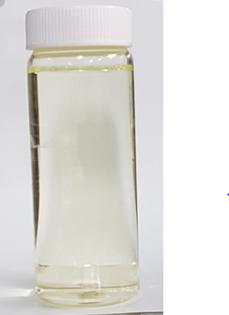
Experiment
0.2M solution
  - Al(NO₃)₃.9H₂O 0.755g / DMAC 20mL
  - Equipment - stirrer
    Temperature - 100℃
    Velocity - 1000rpm
    Time - 72hour

Slide 6
Experiment
O2 Plasma
O2
O2
O2
O2
O2
solvent
Al₂O₃
Al₂O₃
wafer
wafer
wafer
O2/Plasma treatment
1min
Spin coater
500rpm 30sec
1000rpm 30sec
1500rpm 30sec
Soft baking
60°C 5min > 70°C 5min > 80°C 5min > 90°C 5min
Al
Al
Al₂O₃
Al₂O₃
wafer
wafer
Hard baking
300° 1hour
Sputtering
Pre sputter 300sec
Sputter 600sec

Slide 7



Result
 | 500rpm | 1000rpm | 1500rpm
Coating state

Slide 8
Result
 | 100°C | 200°C | 300°C | 400°C
I-V Leakage
I-V Breakdown voltage

Slide 9
Conclusion
In this experiment, insulation film was made using an aluminum oxide solution and the characteristics were compared according to RPM and hard baking temperature.
The leakage current was improved according to the hard baking temperature and the breakdown voltage was increased from around 100V to 140V.
400 degree hard baking and 1500 RPM coating conditions gave the best performance and we saw the potential for them to be applied to a gate insulator.

Slide 10
Thank you

