Slide 1


16th Technical Collaboration Meeting
The Oxide TFT with Solution Based Gate Insulator
2018. 01. 12
Hoseo University
Electronic Device Laboratory
2st Master’s Course
Min-Taek Hong (洪敏澤)
Electronic Device Laboratory
Notes:
My topic is ~ that is for my graduation.
Actually, I already presented about this topic.
So I summarized my finally data.

Slide 2
Contents
■ Introduction
1. Background
2. Purpose
■ Experiment
■ Results
1. Hard-Bake Temperature
2. Exposure Time
■ Conclusion
Electronic Device Laboratory
Notes:
You can see the contents.

Slide 3
Contents
■ Introduction
1. Background
2. Purpose
■ Experiment
■ Results
1. Hard-Bake Temperature
2. Exposure Time
■ Conclusion
Electronic Device Laboratory
Notes:
Maybe, everyone already know introduction.
So I will explain very simply.

Slide 4
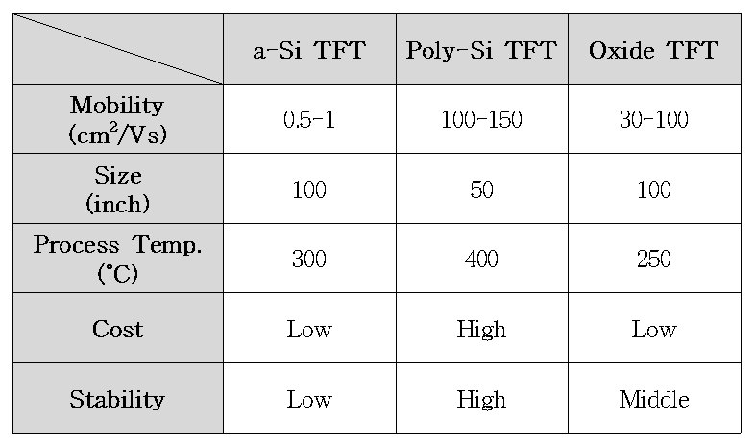
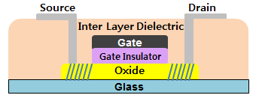
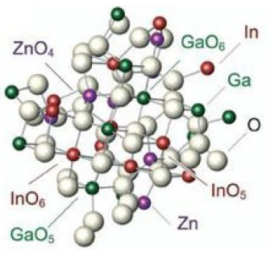
Background
Oxide TFT with Top Gate Structure
Comparison of Main TFT
Top Gate Structure
1. Self-Aligning
- No Mask
- No Photo-Lithography
2. No Parasitic Capacitance
- Signal Delay Decrease
- Low Leakage Current
3. Oxide Doping Effect
- Contact Resistance Decrease
출처 : LG Display 블로그
a-IGZO
■ High Mobility (10 cm²/Vs ↑)
■ Low Cost Process
■ Wide Band-Gap (3 eV ↑)
■ Low Temperature Process
출처 : 한양대학교 전자공학과
Electronic Device Laboratory
Notes:
This table shows the performance of various main TFT.
You know some advantages of oxide semiconductor like a-IGZO.
Next is advantages of top gate structure.
And you can check this presentation after finish.

Slide 5
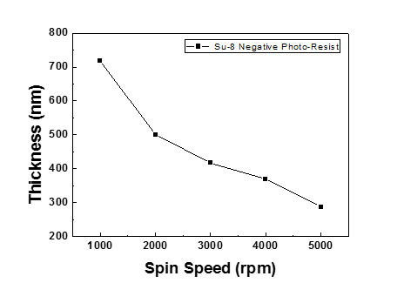
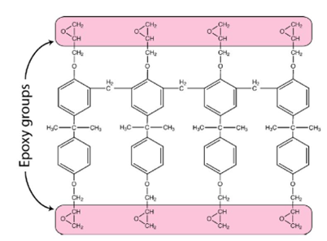
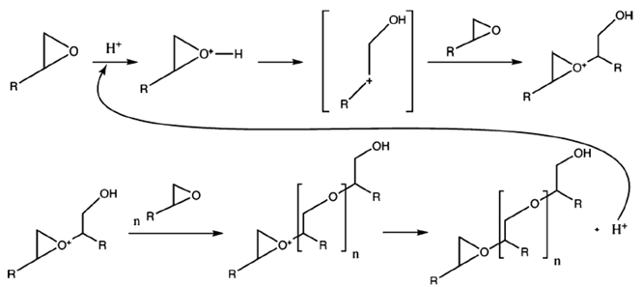
Purpose
Solution Process and SU-8 Negative Photoresist
Vacuum Process
• High Investment and Maintenance Cost
• Low Productivity
Solution Process
• Simple Process and Low Cost
• Fast Running Time
• No Plasma Damage
SU-8 Negative Photoresist
출처 : Antonis Olziersky, et al. J. Appl. Phys. (2010)
8 Epoxy Structure
Cross-Linking by UV Exposure
Electronic Device Laboratory
Notes:
Than, I used to SU-8 for the gate insulator with solution process.
SU-8 is negative photo-resist
And this figures show the structure and principle of SU-8.

Slide 6
Contents
■ Introduction
1. Background
2. Purpose
■ Experiment
■ Results
1. Hard-Bake Temperature
2. Exposure Time
■ Conclusion
Electronic Device Laboratory

Slide 7
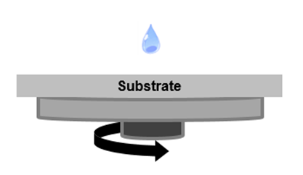
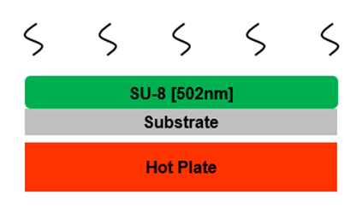
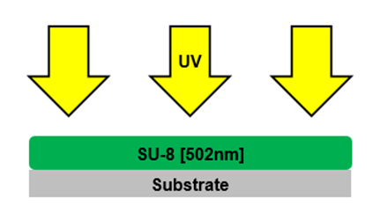
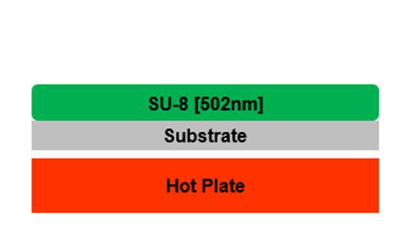

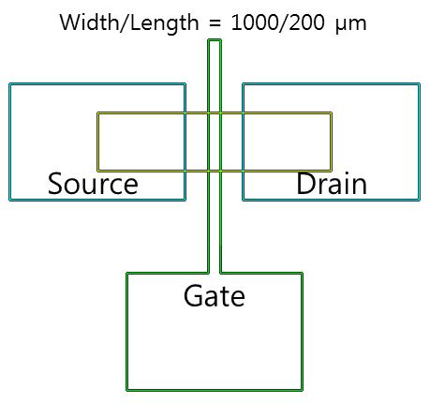

Experiment
SU-8 Process and Device Fabrication
SU-8 Process
Coating
▶
Soft-Bake
▶
Exposure
▶
Hard-Bake
• HMDS Coating
- 2000 rpm 30 s
• SU-8 Coating
- 2000 rpm 30 s
• 1st Soft-Bake
- 65 ˚C 5 min
• 2nd Soft-Bake
- 95 ˚C 5 min
• Exposure
- I Line 365 nm
- 13 mJ/s
- 10, 20, 30, 40 s
• Post Exposure Bake
- 95 ˚C 5 min
• Hard-Bake
- 95, 125, 155, 185 ˚C 20 min
Device
■ TFT Process Step
- Substrate cleaning
- Source / Drain deposition [ Cr 100 nm ]
- Active deposition [ a-IGZO 50 nm ]
- O₂ Annealing 250 ˚C 60 min
- Gate Insulator coating [ SU-8 502 nm ]
- Gate deposition [ Cr 150 nm ]
- O₂ Plasma etching + doping 150 s
MIS Capacitor
Top Gate Staggered a-IGZO TFT
Electronic Device Laboratory
Notes:
Typical solution process was shown as this figure.
And you can check process condition with under words in detail.
MIS capacitor and IGZO TFT was fabricated with shadow mask.
So device have very big dimension.
And you can see the TFT process steps like this.

Slide 8




Experiment
Measurement and Analysis
■ Polymerization (FT-IR)
• 915 cm-1
■ Crack (SEM)
■ C-V Characteristic ( LCR Meter 4285A – Agilent )
• Dielectric Constant
• Inflection Voltage
• Hysteresis
■ I-V Characteristic ( Source Meter 2400, Picoameter 6487 – Keithley )
• Breakdown Voltage
• TFT Parameter
$∈_{r} = \frac{C_{OX}T}{A∈_{0}}$
$$\frac{d^{2}(\frac{1}{C^{2}})}{d^{2}(V_{G})}=0$$
$$1^{st} V_{IF} − 2^{nd} V_{IF}$$
$${I_{Dsat}= C_{OX}μ\frac{W}{2L}[V_{G}−V_{TH}]}^{2}$$
Electronic Device Laboratory
Notes:
Fabricated devices was measured for this analysis.
FTIR or SEM…
And dielectric properties and electrical characteristics.

Slide 9
Contents
■ Introduction
1. Background
2. Purpose
■ Experiment
■ Results
1. Hard-Bake Temperature
2. Exposure Time
■ Conclusion
Electronic Device Laboratory
Notes:
Results is devided into 2 chapter.
One is the hard-bake temperature and the other is the exposure time.

Slide 10
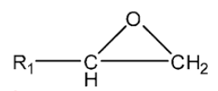
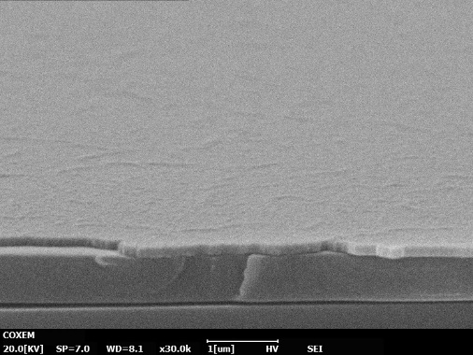
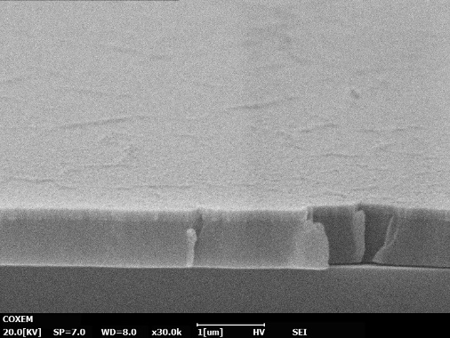
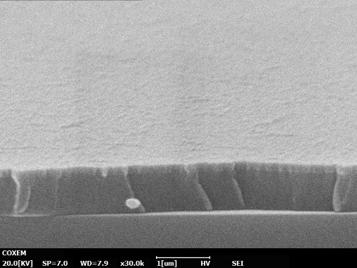
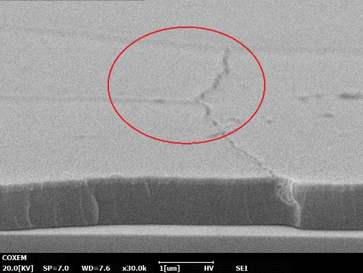
Results 1
FT-IR Measurement and SEM Analysis
FT-IR Measurement
• 915 cm⁻¹ Peak means epoxy ring.
• When Hard-Bake Temperature was over 125 ˚C,
epoxy ring was polymerized perfectly.
SEM Analysis
• The crack was generated at 185 ˚C.
095 ˚C.
125 ˚C.
155 ˚C.
185 ˚C.
Electronic Device Laboratory
Notes:
You can see the FTIR results about various hard-bake temperature.
915 wavenumber peak means epoxy ring which means uncompleted polymerization.
The peak is very small but we can see the peak when the hard-bake temperature is 95 degree C.
But the crack was generated by excessive polymerization which is identified with SEM.

Slide 11
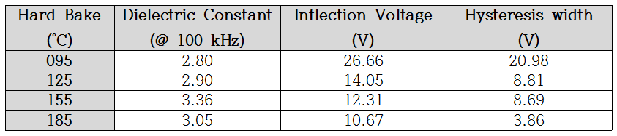
Results 1
C-V Characteristics
C-V Curve
Hard-Bake : 095 ˚C
125 ˚C
155 ˚C
185 ˚C
Dielectric Constant
Defects and Trap Charge
Electronic Device Laboratory
Notes:
This page shows the C-V characteristics as various hard-bake temperature.
You can see the highest dielectric constant at 155 degree C with C-V curve.
And we can compare amount of defects in interface or bulk.
Inflection voltage and hysteresis of C-V curve means that the defects in interface and bulk was decreased.

Slide 12
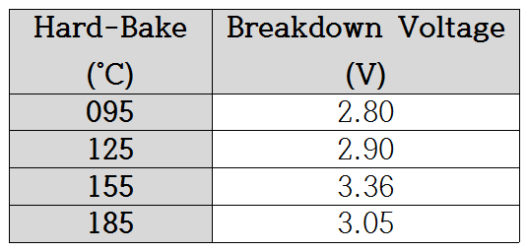
Results 1
Breakdown Voltages and TFT Characteristics
Breakdown Voltage
• Figure shows that Leakage Current was decreased
as increasing Hard-Bake Temperature. ( 095~155 ˚C )
→ Leakage Current influence Off current of TFT.
• Leakage Path by crack was increased at 185 ˚C.
→ Breakdown Voltage
was decreased by heating.
→ Increased Leakage Current
cause high On, Off current
Transfer Curve
Hard-Bake : 095 ˚C
125 ˚C
155 ˚C
185 ˚C
Electronic Device Laboratory
Notes:
This crack influence to breakdown voltages too.
The breakdown voltage was increased as increasing hard-bake temperature from 95 to 155 degree C,
But this was decreased at 185 degree C.
The TFT characteristics with SU-8 gate insulator was shown here.
You can see that Off current by Leakage current was decreased effectively.

Slide 13
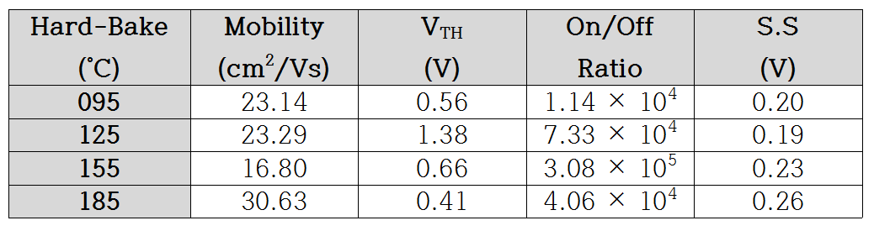
Results 1
TFT Parameters
TFT Parameters
• Threshold Voltage decreased and Subthreshold Slope
increased as increasing temperature from 95 to 185 ˚C.
• By the lowest Leakage Current, 155 ˚C Hard-Bake
showed high contrast.
Electronic Device Laboratory
Notes:
I calculated some parameters from TFT characteristics.
Totally, The switching characteristics of TFT is the highest when the hard-bake temperature is 155 degree C.
So I decided process condition to 155 degree C for next experiment.

Slide 14
Results 2
FT-IR Measurement and Breakdown Voltage
FT-IR Measurement
• SU-8 need to more Exposure than 20 s to polymerize.
Breakdown Voltage
• Breakdown Voltage was increased as increasing
Exposure Time from 10 s to 30 s.
• Photo-initiator with UV react to produce strong acid
which give H⁺ to cross-linking.
→ After polymerization reaction, remaining H⁺ make defects
when overfull UV was applied on SU-8.
Electronic Device Laboratory
Notes:
We measured FTIR to analysis polymerization as exposure time, again.
As the results, I think that SU-8 need to more exposure than 20 s to polymerization.
Also, breakdown voltage was increased as increasing exposure time,
but it was decreased again at 40s.
This results was influenced by concentration of hydrogen ion, not crack.
When the exposure was applied on SU-8, hydrogen ion for cross-linking was generated.
However, too many hydrogen ion will be defect.
So we should control concentration with exposure.

Slide 15

Results 2
C-V Characteristics
C-V Curve
Exposure Time : 10 s
20 s
30 s
40 s
Dielectric Constant
Defects and Trap Charge
Electronic Device Laboratory
Notes:
Then, you can see that the highest dielectric constant was shown at exposure 30s.
Also, hysteresis by bulk defects was increased as increasing exposure time.
I analysis that it make the shift of threshold voltage in TFT.

Slide 16
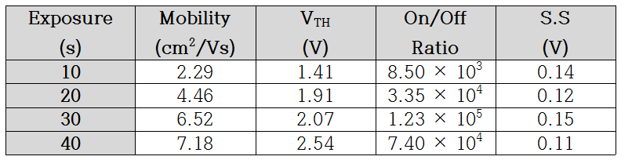
Results 2
TFT Characteristics and Parameters
Transfer Curve
• Electron trap was generated by + voltage
which Threshold Voltage shift.
• Increased On current cause high mobility.
• When the Exposure was 30 s, TFT drive stably.
TFT Parameters
Electronic Device Laboratory
Notes:
That is transfer curve.
You can see the threshold voltage shift and increasing On current by leakage current.
Therefore, mobility was increased, because Leakage current influence both On and Off current.
Totally, The switching characteristics of TFT is the highest when the exposure time is 30s.

Slide 17
Contents
■ Introduction
1. Background
2. Purpose
■ Experiment
■ Results
1. Hard-Bake Temperature
2. Exposure Time
■ Conclusion
Electronic Device Laboratory

Slide 18
Conclusion
■ In this paper, solution based SU-8 negative photo resist was applied to oxide TFT as gate insulator.
■ MIS structure capacitor and top gate staggered structure a-IGZO TFT was fabricated
with various hard-bake temperature and exposure time.
■ The temperature to complete polymerization was over 125 ˚C as the results of FT-IR,
but crack was generated at 185 ˚C which caused high leakage current and low dielectric constant.
→ Polymerization increase (95~155 ˚C) and crack generation (185 ˚C)
■ Synthetically, when the hard-bake of SU-8 gate insulator was 155 ˚C,
a-IGZO TFT had best switching characteristic by the lowest Off current.
■ As the results of Exposure Time experiment, SU-8 need to more Exposure than 20 s to polymerize.
Breakdown Voltage and Dielectric Constant was increased by longer UV.
→ Polymerization increase (10~30 s) and H+ residue generation (40 s)
■ For the gate insulator of TFT, when the Exposure was 30 s, device had high Mobility and shows stable drive.
■ The optimized process condition of SU-8 is Hard-Bake Temperature 155 ˚C and Exposure Time 30 s.
Electronic Device Laboratory
Notes:
I summarized about this topic.
please check one more about this experiment,
The optimized ~

Slide 19
Thank you for your kind attention !
The Oxide TFT with Solution Based Gate Insulator
2017년
호서대학교 전자디스플레이공학
석사과정 홍 민 택
Electronic Device Laboratory

