Slide 1


My Research
Self-Biased Oxide TFT Amplifier
Hoseo University
Nano Bio Tronics Master’s course
Electronic Decive LAB
Hoseo LAB
Han Ye Lin
Notes:
Hello, My name is Han Ye Lin and I am a master course at the electronic device lab of Hoseo University.
So today the topic of my presentation is self biased oxide TFT amplifier.

Slide 2
Index
001/ Introduction
002/ Experiment
003/ Result and disscusion
004/ Mask design
005/ Conclusion
2
Notes:
Here is the table of contents.

Slide 3
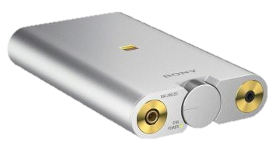
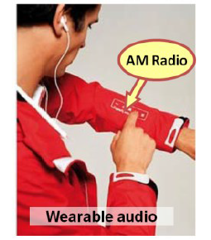
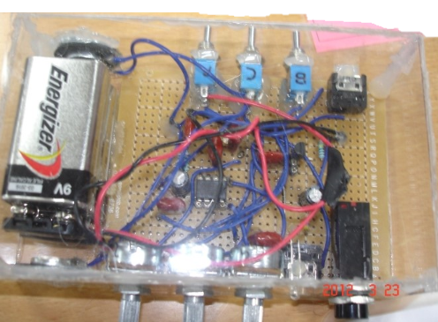
001/ Introduction
Existing Audio Amplifier
Future Audio Amplifier
disassemble
3
Notes:
The picture on the left is an existing audio amplifier.
As you can see, portability is not good.
Below is an exploded view of the audio amplifier.
Portable audio amplifiers require low power and compact design.
Furthermore, in the future, audio amplifiers can be integrated using wearable technology and the radio can be inserted into the clothes.
Likewise for the compact and flexible devices, fully integrated circuit on a substrate is necessary.
Among the possible devices for integrated circuits, thin film transistor (TFT) with oxide semiconductor material is one of the candidate due to its higher field effect mobility than amorphous silicon TFT and simple process compared to low temperature polycrystalline silicon (LTPS) TFT.

Slide 4
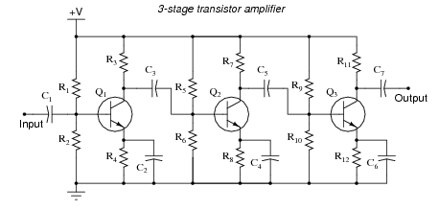
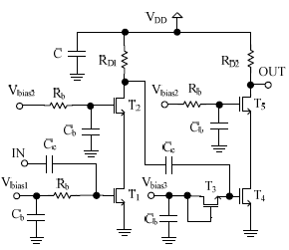
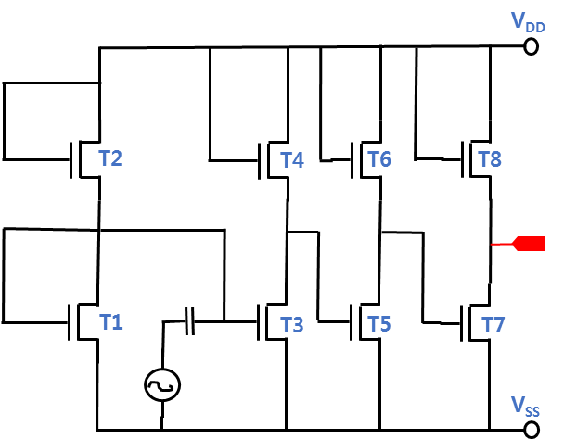
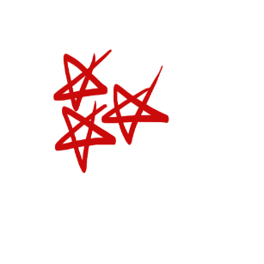
001/ Introduction
Oxide TFT has a disadvantage that large shift of a threshold voltage due to a process variation.
The bias effect of the transistor which can control the threshold voltage and the I-V characteristic of the device is very important.
Resistive voltage divider
Separate bias voltage source
Self-biased TFT amplifier
4
Notes:
Such an oxide TFT has a disadvantage that it can not exhibit a desired output in a circuit due to a large shift of a threshold voltage due to a process variation.
For this reason, the bias effect of the transistor which can control the threshold voltage and the I-V characteristic of the device is very important.
However, as with the circuits listed here, the voltage distribution bias, or the addition of an external bias voltage, circuit becomes complicated, and the integration is difficult.
We want a simple circuit that is not complicated in process yield, small area, and flexible substrate.
But, among the amplifiers studied so far, there are few proposed circuit techniques to solve this bias problem.
In this study, an audio amplifier with an oxide TFT was investigated and optimized for optimal conditions without distortion of the waveform.
The proposed amplifier circuit does not require a separate bias voltage source because it is self-biased in strong inversion.
Instead of a resistive voltage divider, a transistor structure is used to reduce the large area occupied by resistors and capacitors

Slide 5
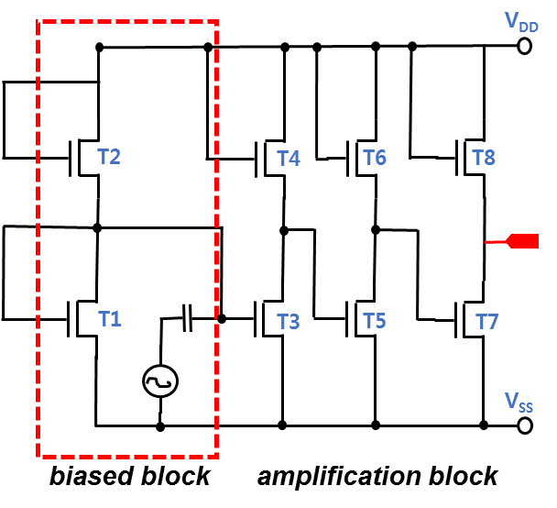
002/ Experiment
The first block of amplifier circuit is to set the operation point of the TFT T3.
Since the capacitance needs large electrode area which can decrease the yield of the circuit fabrication,
we removed the capacitors between each amplifier stage.
Each block was directly connected
after optimization of the output
being optimum operation voltages for the next block.
TFT | W/L | TFT | W/L | v_{in}
T1 | 40μm/20μm | T5 | 20μm/20μm | 0.1 V
T2 | 20μm/20μm | T6 | 200μm/20μm | V_{DD}
T3 | 80μm/20μm | T7 | 20μm/20μm | 5 V
T4 | 20μm/20μm | T8 | 300μm/20μm | F = 1 kHz
Proposed self-biased
TFT amplifier circuit
5
Notes:
To get high amplification gain, we designed a common source amplifier in which n-channel oxide TFT was used as a load resistor as shown in ficture.
The input operation point is important, and the conventional way to get the operation voltage is resistor divider.
The proposed amplifier circuit is composed of 8 TFTs, and it was optimized by the adjustment of channel width of each TFT.
For simulation, the common-source amplifier was biased by VDD = 5 V and VSS = GND.
The sine wave with amplitude of 0.1 V was used for the input voltage. The input frequency was 1 kHz.
The first block of amplifier circuit is to set the operation point of the TFT T3.
Since the capacitance needs large electrode area which can decrease the yield of the circuit fabrication, we removed the capacitors between each amplifier stage.
Each block was directly connected after optimization of the output being optimum operation voltages for the next block.
The dimensions of the optimized transistors through simulation are summarized in Table.

Slide 6
003/ Results and disscusion
Proposed self-biased
TFT amplifier circuit
Input voltage vs Output voltage at each stage
The output wave forms at each stage
The advantage of the self-bias block is self-optimization of the operation voltage, even when the TFT threshold voltages vary.
The DC operation voltage for the input gate electrode is much important and self-bias block is much useful.
6
Notes:
This graph shows the output wave forms at each stage of amplifier, and right graph shows the output voltage at each stage for input voltage.
The graph shows a well-defined voltage transfer curve with a steep slope, indicating a high gain in the transition region.
The characteristics of the oxide TFT are subject to change due to process variations. Therefore, it is important to set the operation point well using the appropriate bias voltage.
However, if the operation voltage is generated by resistors, the power consumption increases by a current through resistor and circuit becomes complicated by voltage divider.
We have solved this problem by remove of voltage divider and using self-bias block for first stage of amplifier. The advantage of the self-bias block is self-optimization of the operation voltage, even when the TFT threshold voltages vary.
The DC operation voltage for the input gate electrode is much important and self-bias block is much useful.

Slide 7
003/ Results and disscusion
Proposed self-biased
TFT amplifier circuit
Frequency characteristic of the inverter amplifier circuit
The gain according to threshold voltage variation
A gain of ∼16.5 dB is obtained and forms a low-pass filter with a roll-off around 500 kHz due to the input capacitance connected to the wave input.
In this simulation, for a reference level of 14 dB, the proposed circuit allows 4.4 V threshold voltage change.
7
Notes:
The second block, the third block and fourth block are cascaded common-source amplifiers.
After optimization of sizes of TFTs, we could obtain the voltage gain of 16.5 dB.
This graph shows the simulated frequency responses of the proposed amplifier circuit by circuit simulator.
The graph shows the frequency response of the inverter amplifier circuit obtained by dividing the output amplitude by the input amplitude.
A gain of ∼16.5 dB is obtained and forms a low-pass filter with a roll-off around 500 kHz due to the input capacitance connected to the wave input.
For greater amplification gain, the amplifier stage can be further connected with the increased area of the circuit.
In this simulation, for a reference level of 14 dB, the proposed circuit allows 4.4 V change.
Simulation results show that the proposed self - biased amplifier gives wide range of high gain as shown in right graph.
Due to self-bias block the gain is constant even if the threshold voltage shifts.

Slide 8
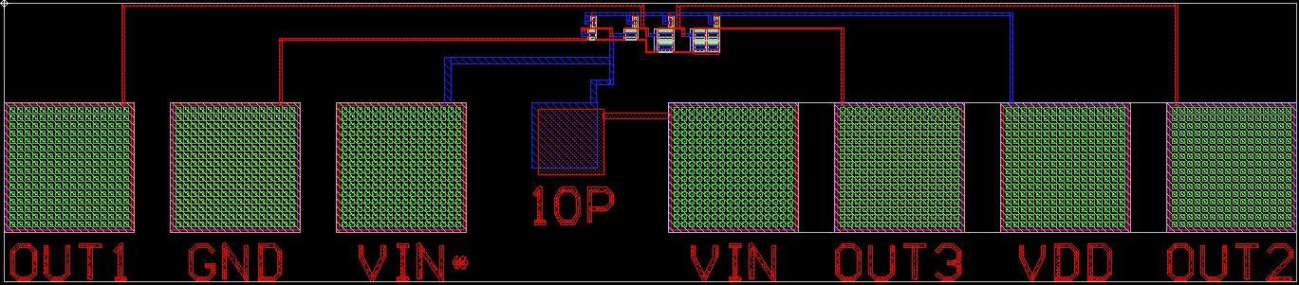
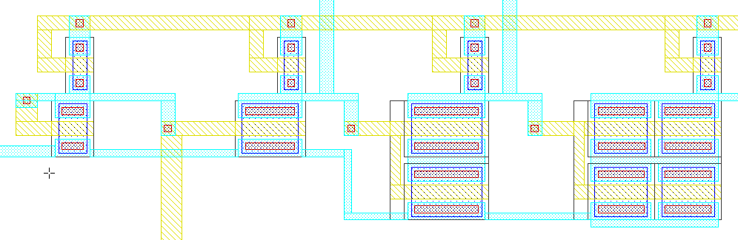
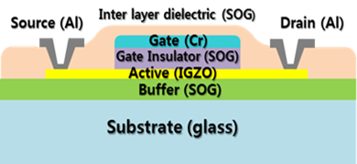
004/ Mask design
Chip size
1.01 mm * 0.3 mm
self-align top gate oxide TFT structure.
8
Notes:
Through simulation, we developed an optimal circuit and designed a mask layout for the TFT process.
Only four masks are required with top gate self-align technology. A chip area of 1 mm * 0.3 mm, which is smaller than the amplifiers reported in the past. So far, the mask layout has been completed, and the next work to do is to use an oxide TFT process to make the amplifier.
The ultimate goal is to make it a wearable device.

Slide 9
005/ Conclusion
We simulated self- bias audio amplifier with oxide TFTs.
The voltage gain of 16.5 dB was obtained with three cascaded amplifiers.
Since the characteristics of the oxide TFT can be varied according to the process conditions, we optimized the operation point after adjusting the sizes of the TFTs.
The proposed circuit does not require a separate bias voltage source and the capacitor or resistors which occupy a large area.
The proposed circuit operates well even for the threshold voltage change of 4.4 V.
So far, the mask layout has been completed, and the next work to do is to use an oxide TFT process to make the amplifier.
The ultimate goal is to make it a wearable device.
9
Notes:
We simulated self- bias audio amplifier with oxide TFTs.
The voltage gain of 16.5 dB was obtained with three cascaded amplifiers.
Since the characteristics of the oxide TFT can be varied according to the process conditions, we optimized the operation point after adjusting the sizes of the TFTs.
The proposed circuit does not require a separate bias voltage source and the capacitor or resistors which occupy a large area.
The proposed circuit operates well even for the threshold voltage change of 4.4 V.
So far, the mask layout has been completed, and the next work to do is to use an oxide TFT process to make the amplifier.
The ultimate goal is to make it a wearable device.

Slide 10
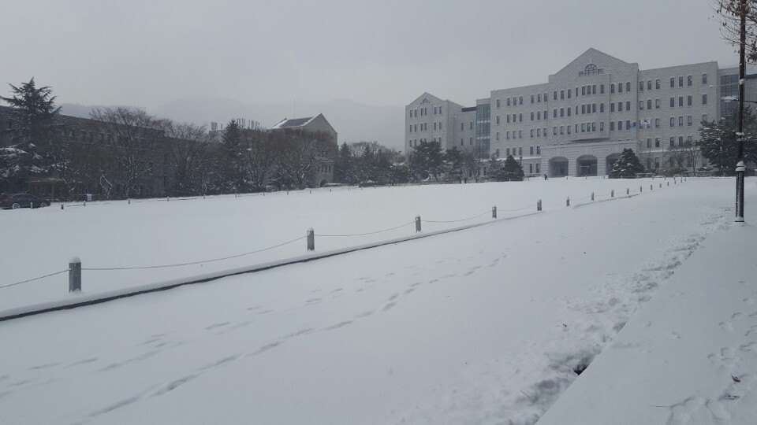
Thanks for your attention

