Slide 1
LG V30 Pixel Circuit
Hoseo University
Jae moon, Ju

Slide 2
Contents
Comparison of Samsung Galaxy S5 and LG V30 phones
LG V30 Decomposition
LG V30 Pixel Circuit
Samsung Galaxy S5 vs. LG V30 Pixel Circuit Simulation
Conclusion

Slide 3
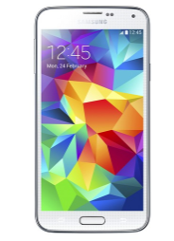
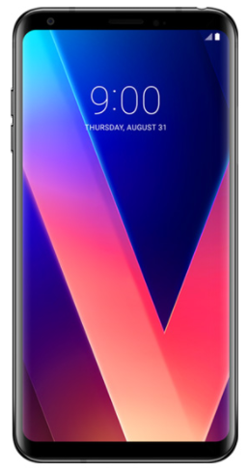
Samsung Galaxy S5 vs. LG V30
Model | Galaxy S5
Screen Size | 5.1 inches
Density | 432 ppi
Resolution | 1920 x 1080
Display Type | AMOLED
Model | V30
Screen Size | 6.0 inches
Density | 537 ppi
Resolution | 2880 x 1440
Display Type | AMOLED

Slide 4
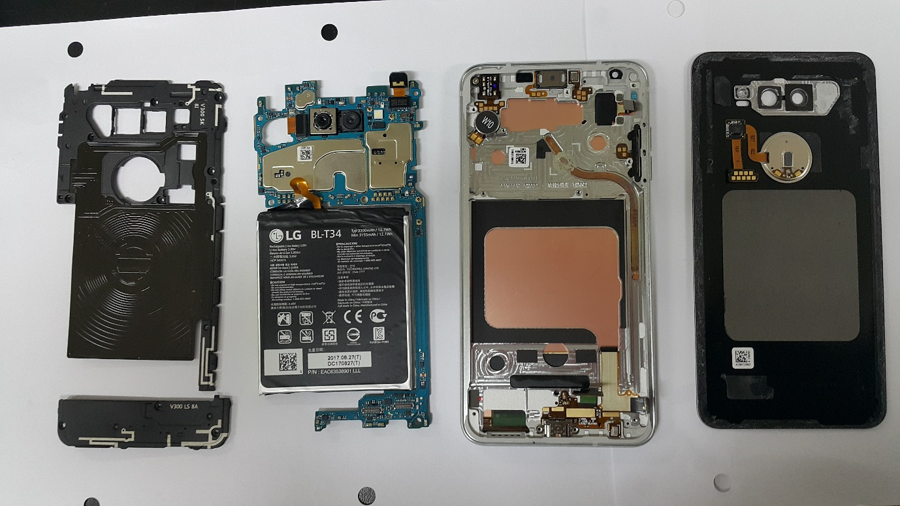
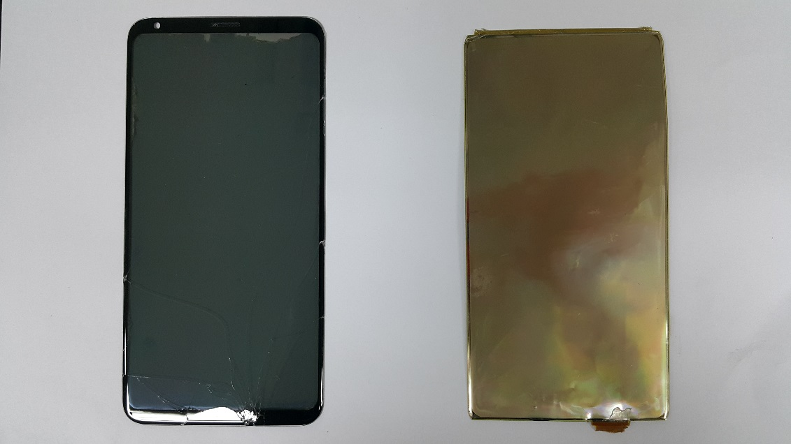
LG V30 - Decomposition
Panel
The center part of the rightmost panel shown in the photograph was cut out and magnified with a microscope, and the pixel circuit part was analyzed to simulate it.

Slide 5
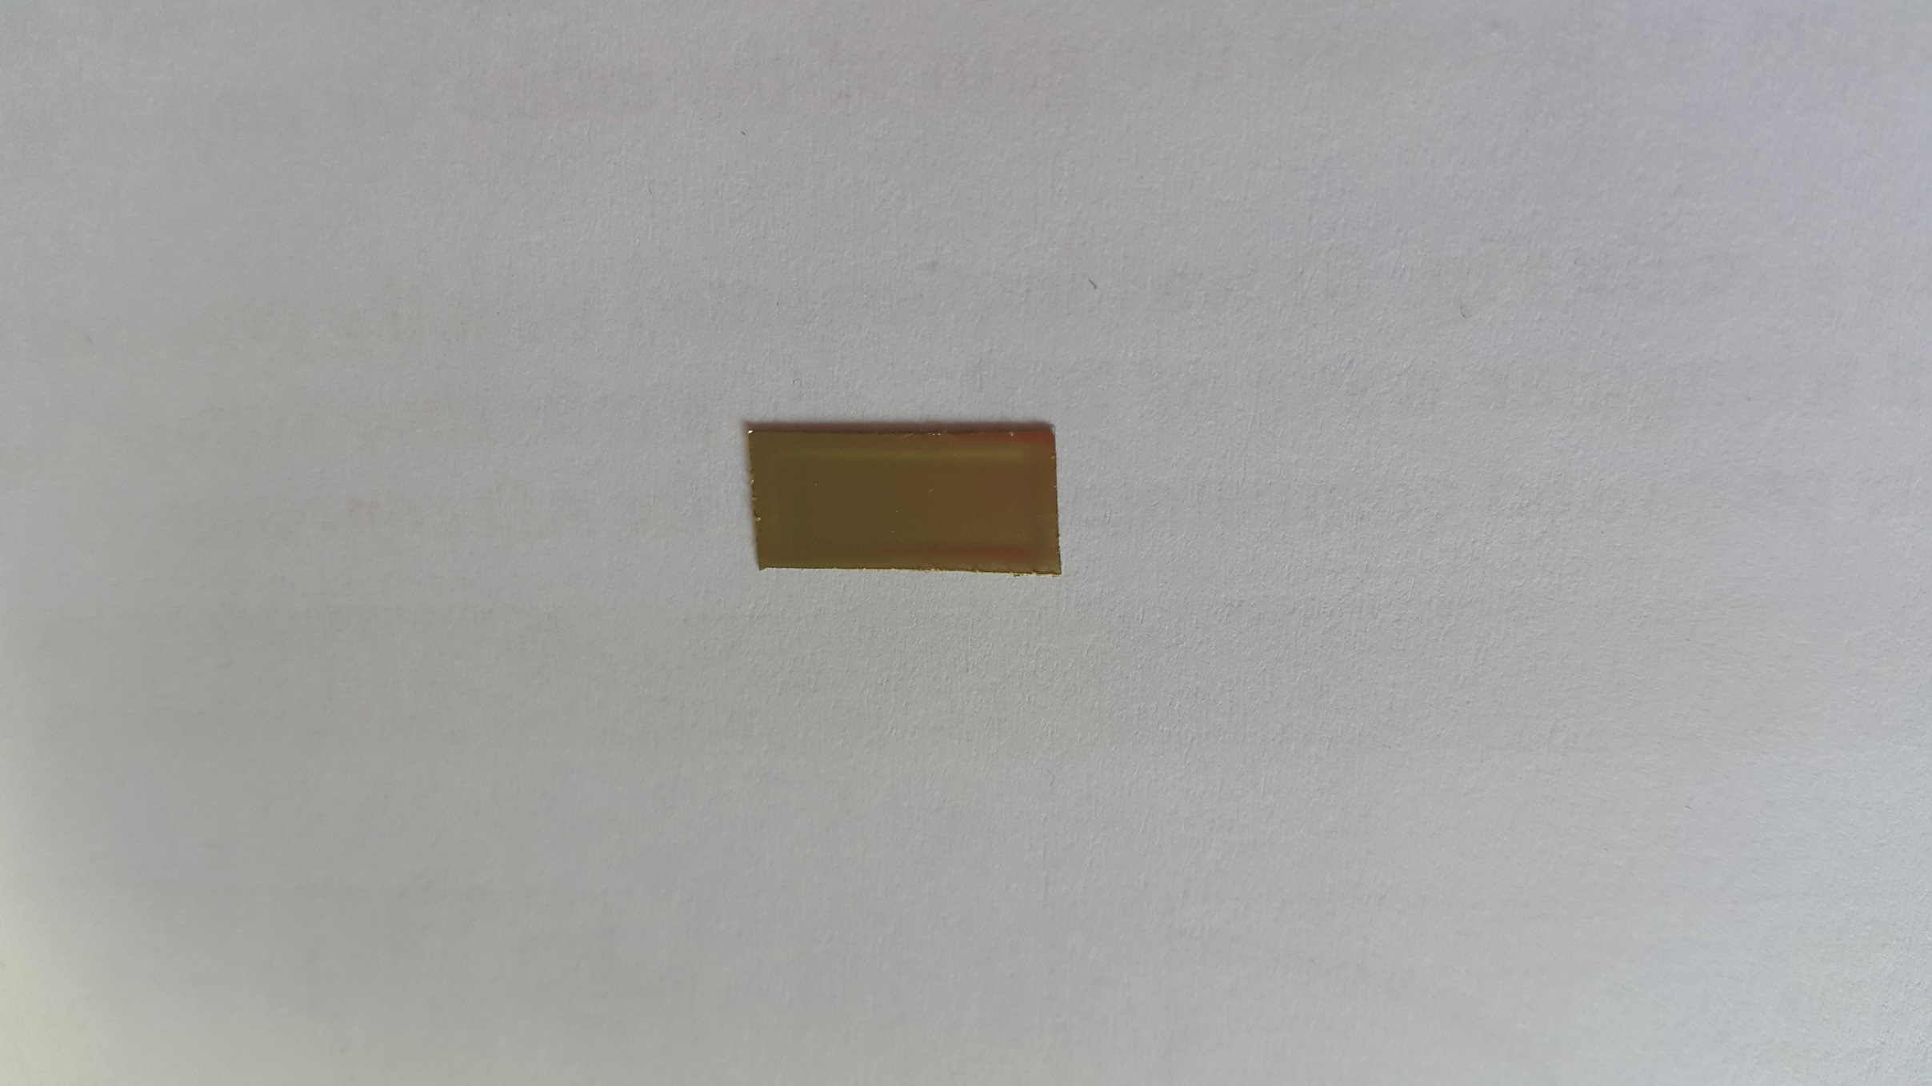
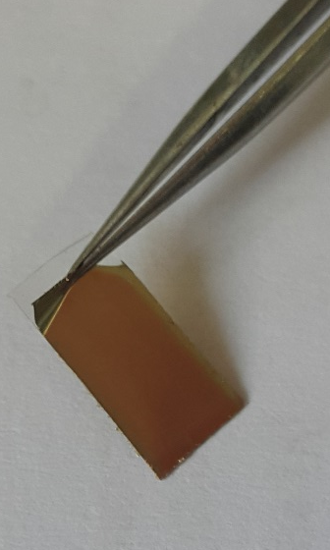
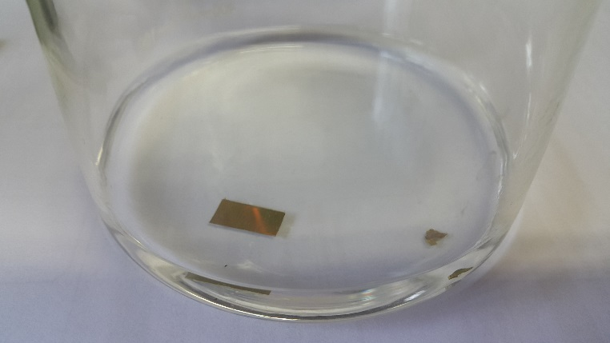
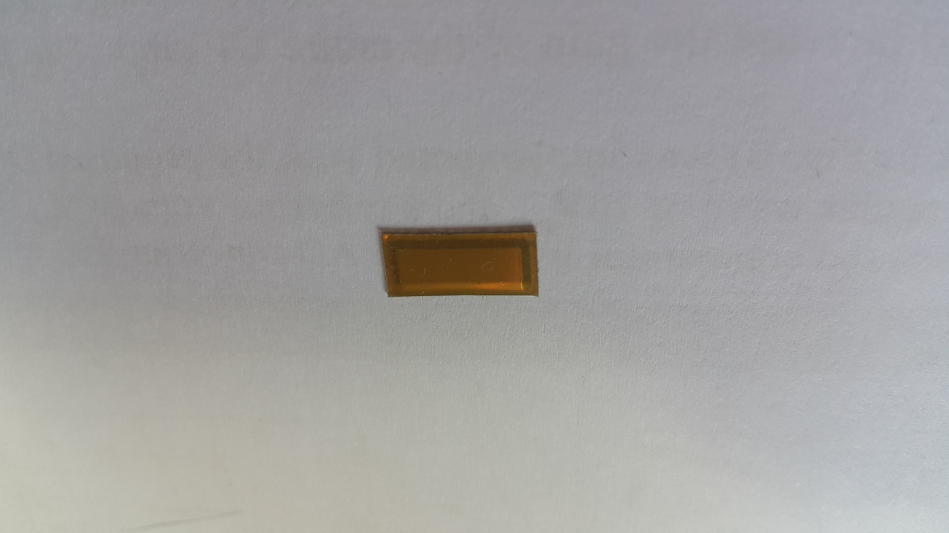
LG V30 - Decapsulation
Aceton
Front
Back
Decapsulation
In order to confirm the circuit, it is necessary to remove the protective film. Therefore, the cut panel is put in the acetone until a gap is formed in the acetone.
The gap between the PI substrate and the protective film was separated using a tweeter.

Slide 6
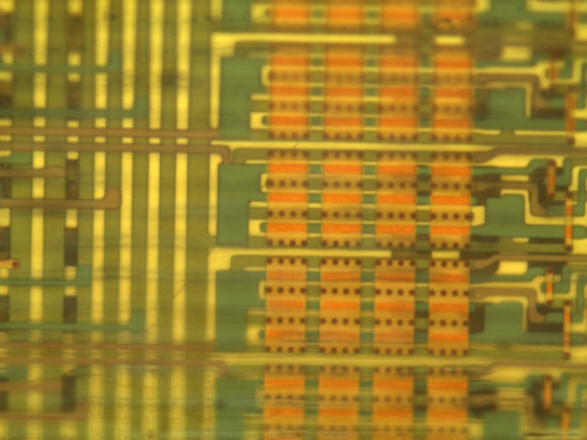
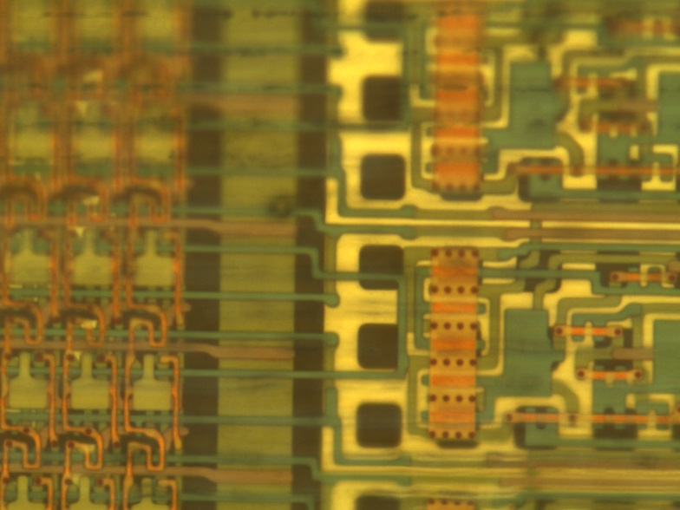
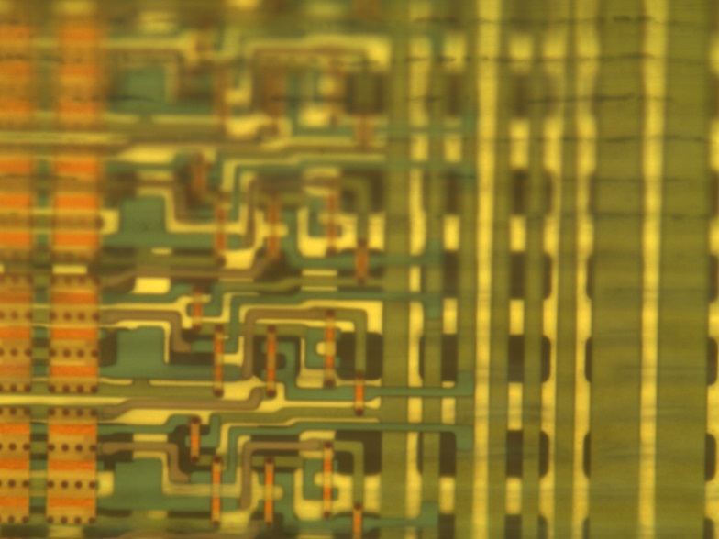
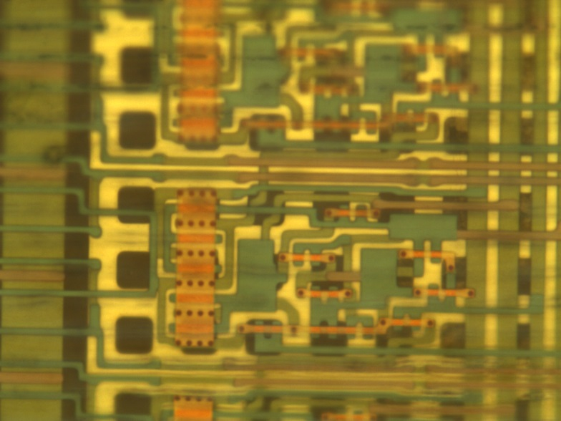
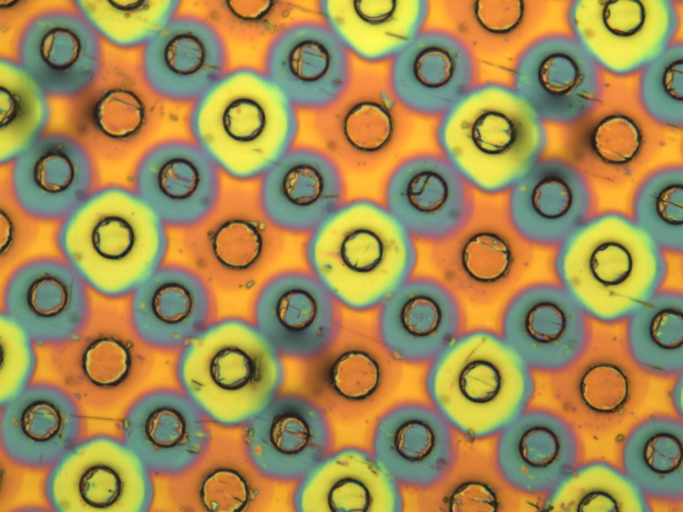
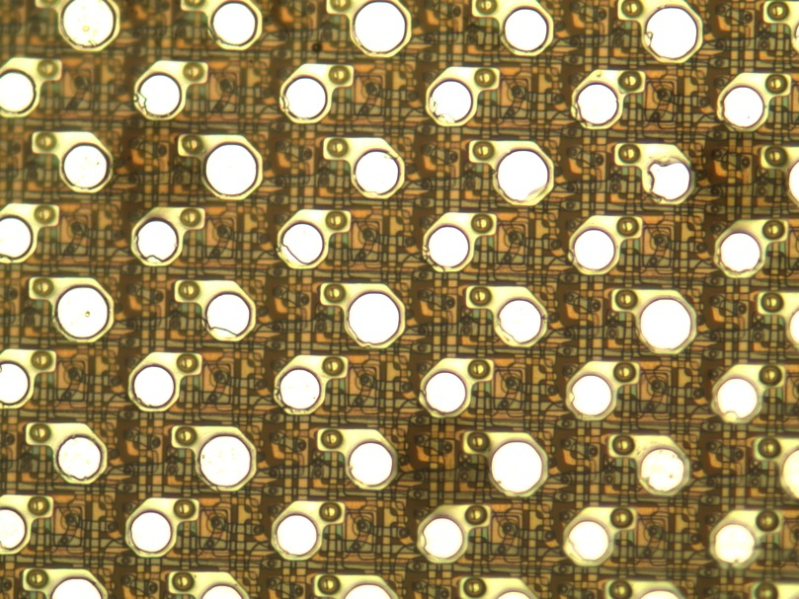
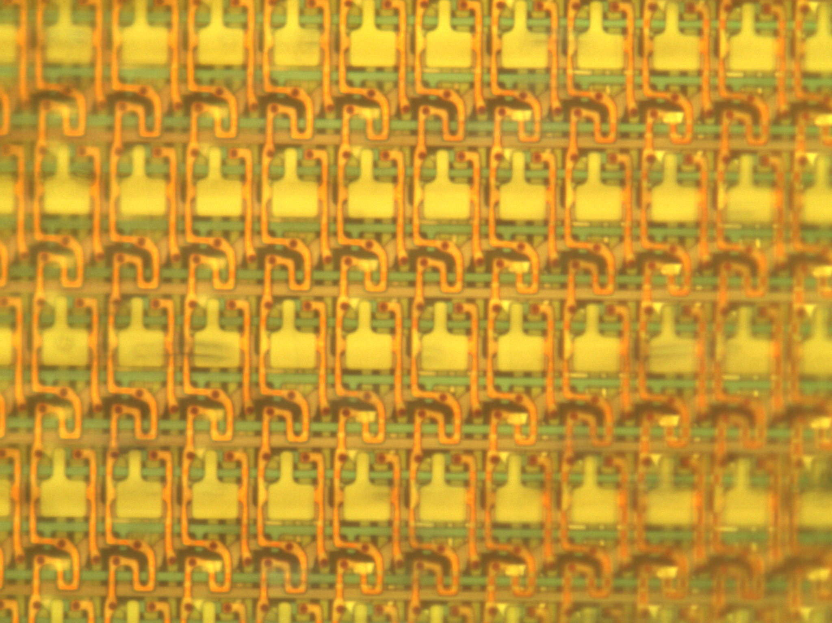
LG V30 - Pixel circuit
Pixel Corcuit & EM Driver Circuit & Scan Driver Circuit
Pixel Circuit
EM Driver Circuit
Scan Driver Circuit
Front
Back

Slide 7
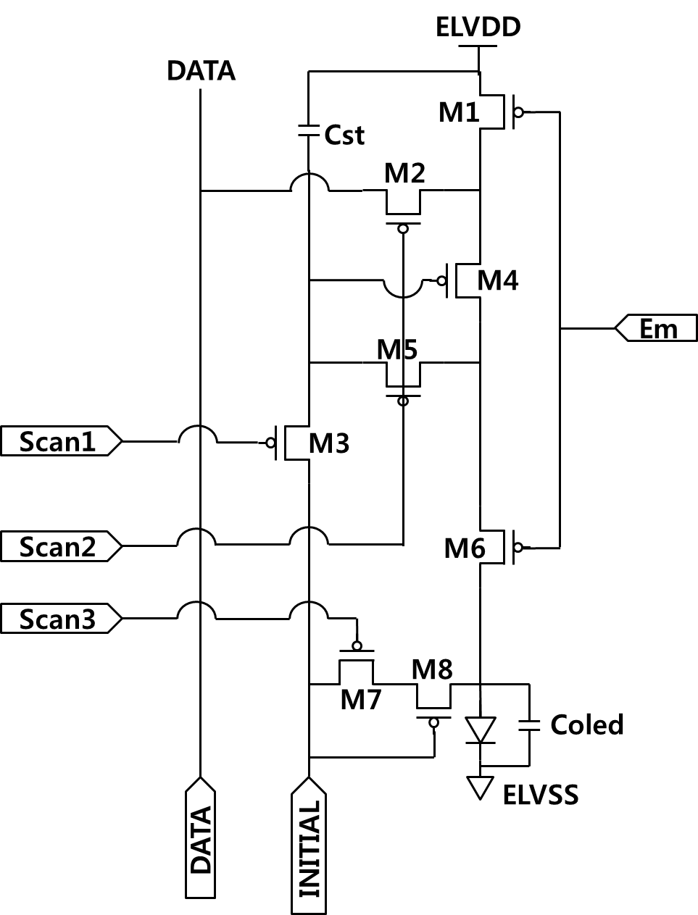
LG V30 - Pixel Circuit
ELVDD
DATA
M3
S1
M5
M2
S2
Cst
ELVDD
M4
M6
M1
EM
M8
initial
M7
S3

Slide 8
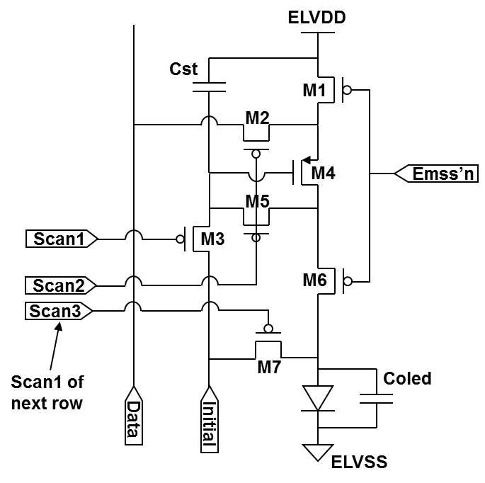
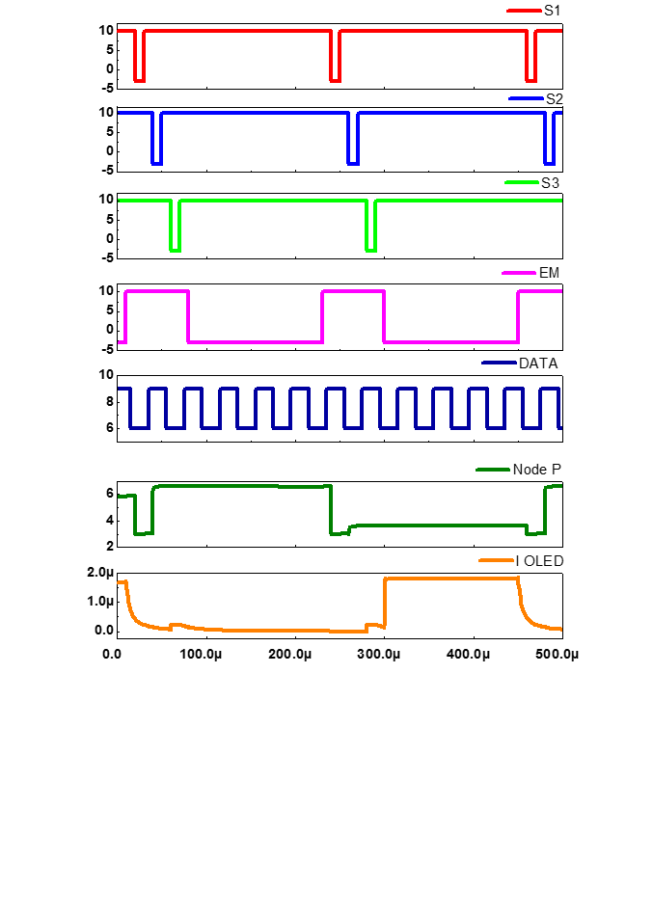
Samsung Galaxy S5 - Pixel Circuit simulation
Node P
Voltage (V)
 | Low voltage | High voltage | Pulse width | Period
ELVDD | 9 V
Initial | 3 V
S1, S2, S3 | -3 V | 10 V | 10 us | 220 us
EM | -3 V | 10 V | 70 us | 220 us
DATA | 6 V | 9 V | 20 us | 40 us
Current (A)
White
Black
Time (s)

Slide 9
LG V30 - Pixel Circuit Simulation
Node P
Voltage (V)
 | Low voltage | High voltage | Pulse width | Period
ELVDD | 9 V
Initial | 3 V
S1, S2, S3 | -3 V | 10 V | 10 us | 220 us
EM | -3 V | 10 V | 70 us | 220 us
DATA | 6 V | 9 V | 20 us | 40 us
Black
White
Current (A)
Time (s)

Slide 10
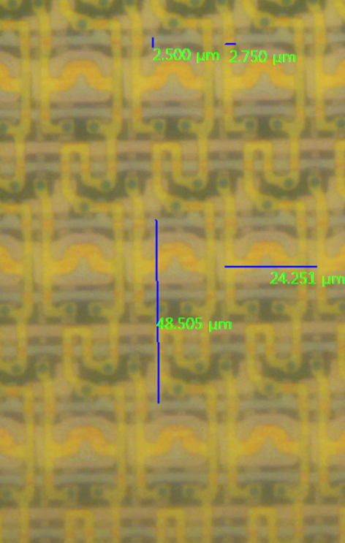
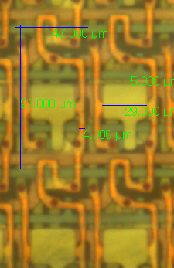
Samsung Galaxy S5 vs. LG V30
S5
V30
Sub-pixel Size : 48.5 ㎛ x 24 ㎛
Line width : 2.6 ㎛
Switch TFT : W/L = 3 ㎛/3 ㎛
Sub-pixel Size : 93 ㎛ x 47 ㎛
Line width : 5 ㎛
Switch TFT : W/L = 5 ㎛/5 ㎛
One transistor is added to see that the V30 is larger than the Galaxy S5.

Slide 11
Conclusion
Current (A)
Time (s)
The LG V30 has increased in size due to the addition of one transistor compared to the Samsung Galaxy S5, and thus the aperture ratio has been reduced.
However, the addition of a transistor makes the OLED current change more stable.

Slide 12
Thank you

