Slide 1


LCD Drive Circuit using Oxide TFT for Wearable Applications
Hoseo University
Electronic Device Laboratory
Master’s Course 1st
Min Su Kang
The 16th Collaboration Meeting
2018. 1. 10
University of the Ryukyus, Japan
Notes:
Good afternoon everyone.
My name is Min Su Kang.
The topic of my presentation today is “LCD Drive Circuit using Oxide TFT for Wearable Applications”

Slide 2
Contents
Wearable Device
TFT-LCD Driving Circuit
Proposed Circuits
Simulation Results
Conclusion
Notes:
I will begin by going over the main contents of my presentation and it’s divided five subjects.
There are five main thing dealt with in my presentation.
First, The wearable device
Second, TFT-LCD Driving Circuit
Third, Proposed Circuit
Fourth, Simulation Results
And last content is Conclusion

Slide 3
Wearable Device
Google glass
Nike+ FuelBand
A wearable device is a computer in a form that can be worn like a pair of glasses, a watch, and clothes.
Information should be displayed and LCD is most popular display.
For the application of LCD to wearable display, LCD drive circuit is necessary.
SAMSUNG Gear
Figure 1. Wearable devices
Notes:
A wearable computer referred to as a wearable device is a computer in a form that can be worn with glasses, watches, clothing, and the like. Ultimately, the user can always wear and use as part of the body without the sense of discomfort, and the goal is to supplement or double up the ability of the human being.
Basic functions are required to be easy to use (convenient), easy to wear (comfortable to wear), safe and easy to see (stability / sociality)
The advantage of a wearable device is that it can continuously collect detailed information about the surrounding environment or change of the individual's body in real time continuously.
Smart glasses, for example, can record all the information that is visible, while smart underwear can steadily capture vital signs such as body temperature and heart rate.
In wearable device, information should be displayed and LCD is most popular display.
For the application of LCD to wearable display, LCD drive circuit is necessary.

Slide 4
TFT-LCD Driving Circuit
Data line
Common
electrode
Oscillator
Cs
Clc
TFT
DC-DC Converter
Pixel electrode
Gate line
Figure 2. LCD driving circuit
For flexibility, circuit should be integrated on a substrate.
DC Power
Notes:
For wearable applications, flexibility is also important. For flexibility, circuit should be integrated on a substrate. With the discrete devices, it is difficult to bend.
If we use some small battery, we need some boost up circuit such as DC-DC boost converter and alternating voltages for inversion driving of the LCD.
For required LCD operation, DC-DC boost converter circuit and alternating voltage generator are necessary.
Figure 2 shows schematic diagram for LCD driving to achieve such aim.

Slide 5
Proposed Circuits
1.5 V
T1
T2
T3
T4
T11
DC-DC Boost Converter
2 μF
CKB
CK
(a)
TFT | W / L
T1~11 | 3000 / 5
nTFT_2 | 10 / 10
nTFT_3 | 10 / 10
nTFT_4 | 80 / 10
DC-DC boost converter output voltage
→ Ring oscillator input voltage
1 MΩ
0.6 pF
Vin
nTFT_2
nTFT_1
Table 1. W / L value of TFT
Ring Oscillator
100 kΩ
nTFT_3
110 nF
Vout
(b)
Figure 3. Proposed Circuits
Proposed DC-DC boost converter
Proposed Ring oscillator
Notes:
We developed integrated LCD drive circuit for flexible wearable devices. For this aim, DC-DC boost converter circuit and Ring Oscillator was developed using a-IGZO TFT (thin film transistor).
Boost converters are used in almost all mobile devices and provide a stable output voltage under unstable power condition.
The required voltage for the operation of liquid crystal is around 5 V.
Figure 3 shows proposed circuits.
With a small voltage such as 1.5 V of small mercury battery for DC power of DC-DC boost converter.
And LCD need periodic alternating voltages for reliable operation.
For the inversion driving of LCD, we need above 10 V instead of 5 V because the voltage is changed every frame against a common voltage.
If the common voltage is 5 V, the voltages are below 5 V once and next they are above 5 V. Therefore, the required voltage swing is over 10 V.
The first step is boost up the small voltage to 10 V by DC-DC boost converters and then we need oscillatory square wave for LCD driving.
The swing of the square wave is from 1.5 to 10 V.
the output Voltage of the DC-DC converter used DC power for the generation of square wave.
Oscillation circuit was integrated with oxide TFT and the DC power voltage was supplied from DC-DC boost converter.

Slide 6
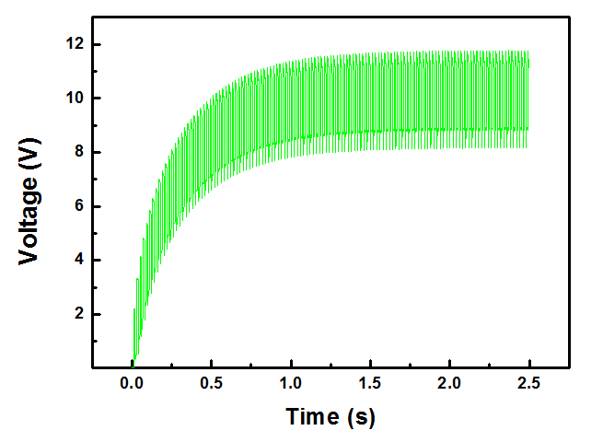
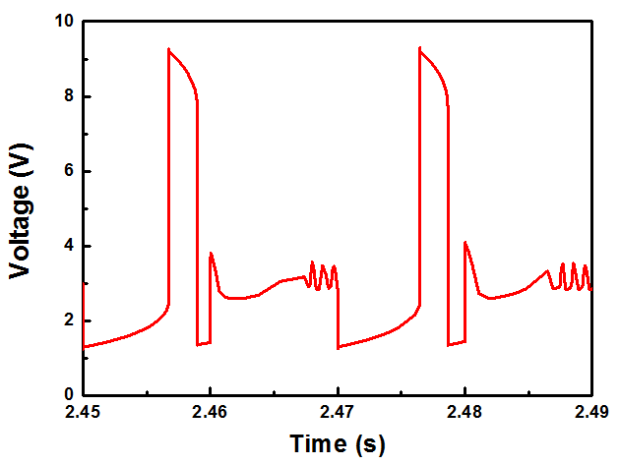
Simulation Results
(a)
(b)
Figure 4. Simulation result
Output of proposed DC-DC boost converter circuit
Output of proposed Ring oscillation circuit
Notes:
The simulation results show that the output voltage of the proposed DC DC boost converter is more than 10V.
The output voltage reached 10 V after about 2 seconds.
Simulation results of the proposed oscillator shows that oscillation occurs at a constant period between about 20ms
The voltage swing of oscillation circuit is 0.5 V ~ 10 V.

Slide 7
Conclusion
LCD is conventional display and LCD drive circuit should be integrated for wearable device.
We suggested TFT integrated circuit for LCD driving. After boosting the voltage 1.5 V to 10 V, square waves required for LCD driving were generated by an ring oscillator.
The output voltage of the DC-DC boost converter was used for power voltage of the vibrator to generate a square wave.
This circuit can be integrated and applied to flexible substrate for wearable application such as shutter glasses.

Slide 8
Q & A
Notes:
Thank you for your attention

