Slide 1
Effect of SOG Annealing Ambient on IGZO TFTs
Hoseo University
Electronic Device Lab.
Master Course
Yeong Jo Baek
Notes:
Hi I am Yeong Jo Baek, a master’s course under the professor Bae.
Today I’m going to talk about ‘the effect of SOG annealing condition’.

Slide 2




Contents
PART ONE
PART TWO
PART THREE
PART FOUR
Conclusion
&
Future plan
Introduction
experiment
Result
Notes:
I divided this presentation into four parts.
First, I will introduce about my research and materials, and then talk about experiment, result and conclusion

Slide 3
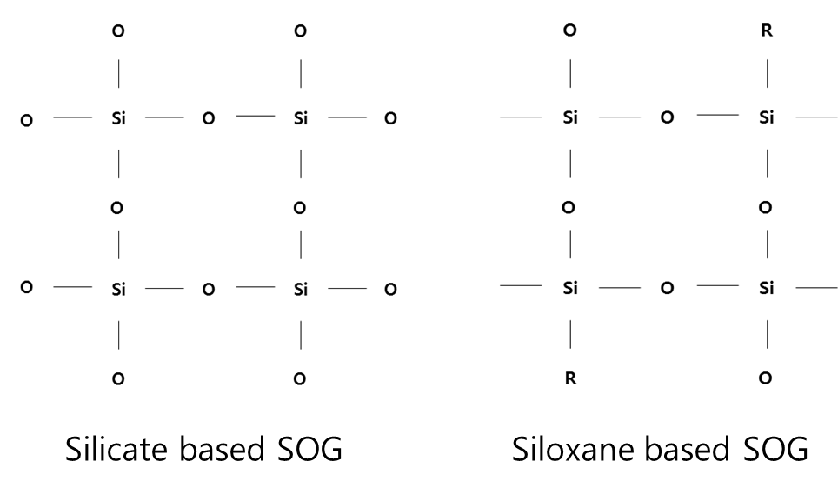
1.1
What is the SOG?
SOG (Spin-On-Glass) has Si-O network and dissolves in an organic solvent.
it can be coated by spin coating, and the SiO₂ film can be obtained through annealing.
Fig. 1. SOG category
Generally, insulator film annealing progress in a nitrogen ambient.
But, there is no accurate annealing result of the nitrogen ambient on the SOG.
I conducted annealing in nitrogen, oxygen and air ambient.
And oxide TFT using SOG as G / I and passivation layer was fabricated and analyzed
Silicate based SOG feature
low viscosity
poor flatness
high thermal stability
moisture and oxygen plasma insensitivity
Siloxane based SOG feature
contains CH₃ or C₂H₅
high viscosity
good flatness
reliability
Notes:
a brief introduction to SOG, SOG (Spin on glass) is a material that dissolves a precursor containing a Si-O network in an organic solvent.
it can be coated by a solution process such as spin coating, and the SiO2 film can be obtained by evaporating the organic solvent through annealing.
Figure one shows the type of SOG.
Silicate based SOG has low viscosity and poor flatness compared to other type, and characterized by high thermal stability and moisture and oxygen plasma insensitivity.
siloxane based SOG contains CH3 or C2H5, has higher viscosity and good flatness than silicate SOG.
however, it is more susceptible to moisture which may cause reliability problems.
In this study, I used siloxane SOG.
(animation) Generally, the insulator film annealing progress in a nitrogen ambient, but there is no accurate annealing result of the nitrogen ambient on the SOG.
therefore, I am studying the effect of annealing ambient in the process of annealing SOG, and we are conducting annealing in nitrogen, oxygen, and air ambient. I would like to introduce the results of my research in this presentation.

Slide 4
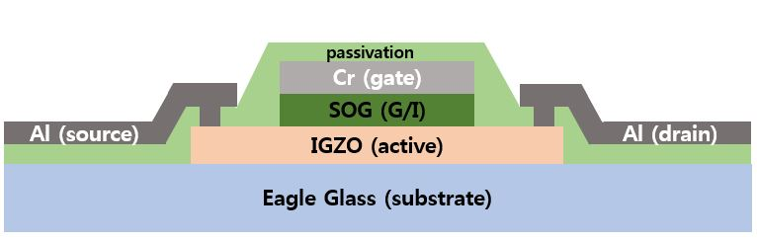
2.1
Experiment
Fig. 2. The structure of fabricated TFTs (a)
IGZO deposition
& patterning
SOG coating & annealing
Cr deposition
& patterning
Table 1. Annealing condition of SOG gate insulator.
Device | Curing ambient | Curing temperature and time (1H)
A | Nitrogen | 150℃ 15min | 250℃ 15min | 350℃ 15min | 450℃ 15min
B | Oxygen
C | Air
Active
G/I
Gate
SOG etching
SOG coating & annealing
Contact hole patterning
Al deposition
& patterning
G/I
Passivation
Passivation
Source / Drain
Fig. 3. flow chart of TFTs fabrication
Notes:
experiment
I fabricated a Top Gate TFTs with the structure shown in Fig. 2.
IGZO was used as an active layer material, SOG for gate insulator and passivation layer, Cr and Al for Gate and Source and drain, respectively.
SOG was etched using RIE, and the remainder was patterned using photolithography.
Table 1 summarizes the annealing process conditions. as you can see, annealing was performed under three conditions of nitrogen, oxygen and air in furnace.
Annealing was carried out at 450 ° C for 1 hour and increased by 100 ° C at 150 ° C.

Slide 5
SOG
Si wafer
3.1
Result
(a)
SOG
Si wafer
(b)
Fig. 4. I-V characteristics of fabricated TFTs
Table 2. Parameters for TFT cured under nitrogen ambient.
Mobility | Threshold voltage | S.S. | On/Off ratio
4.26 cm²/V.S | 1.75V | 0.36V | 1.9 x 10⁶
Fig. 5. D-SIMS data (a) nitrogen, (b) Oxygen
Notes:
Result
Fig. 4. shows the I-V characteristics of the fabricated TFT.
the width of TFT was 40 micro meter and length was 20 micro meter.
The I-V characteristics show that the best TFT characteristics are obtained when annealing in a nitrogen ambient.
Table 2 shows the parameters of the TFTs annealed in a nitrogen ambient.
We conducted the D-Sims analysis to see how the annealing affects the TFT in the nitrogen ambient and is shown in Fig. 5.
the content of nitrogen in SOG (a) and the content of oxygen through (b) can be confirmed.
It should be noted here that the nitrogen content increases at the SOG and lower film interface.
We can confirm that SOG nitrogen heat treatment affects IGZO, the bottom layer.
It is known that the defects in the IGZO are reduced by structural relaxation during the nitrogen annealing.
Through the Sims data, we thought that the nitrogen annealing of the SOG was influenced by the IGZO, which is the bottom layer, to improve the TFT characteristics.

Slide 6
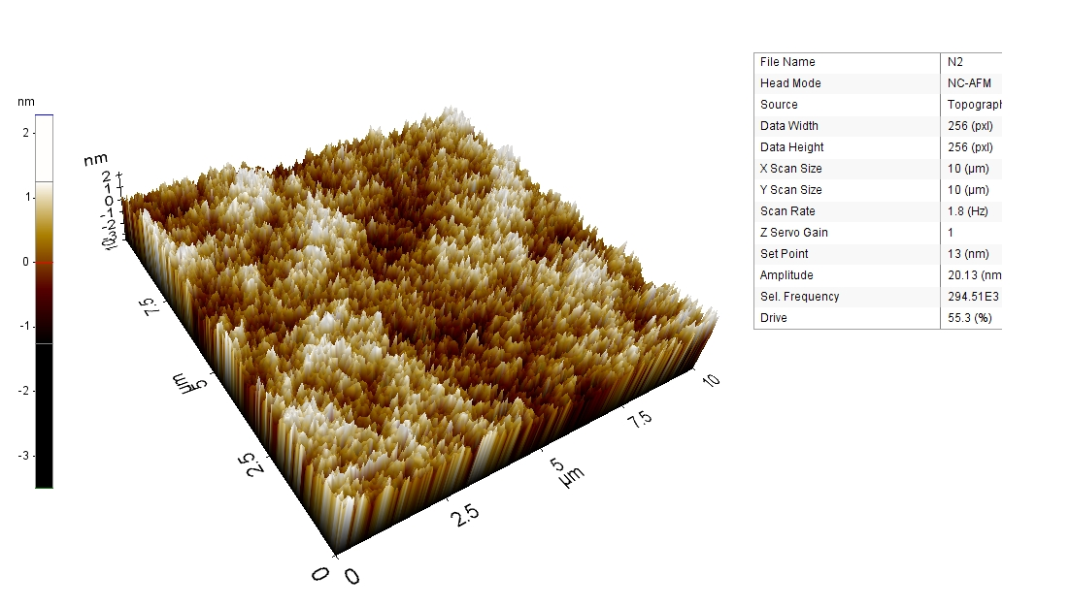
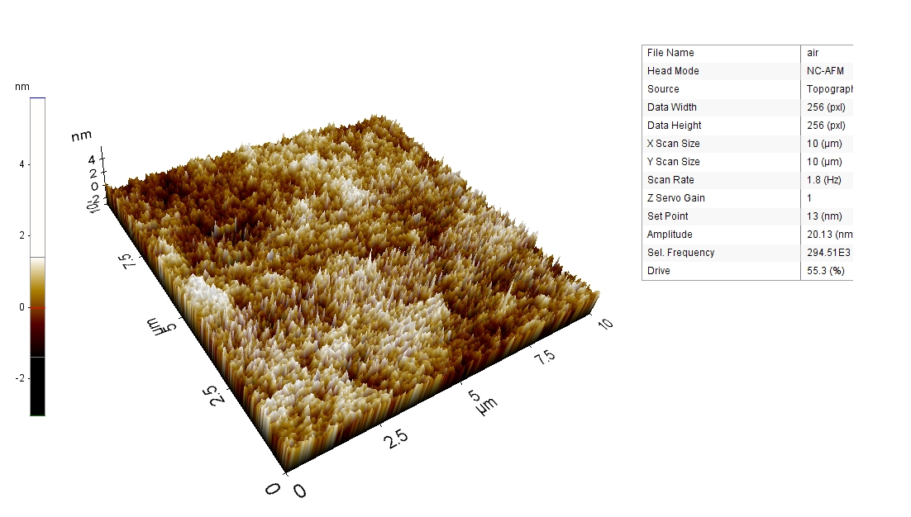
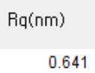
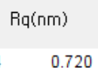
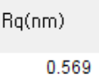
3.1
Result
Nitrogen ambient
air ambient
oxygen ambient
(a)
(b)
(c)
Fig. 6. The AFM data (a), (b), and (c) for each annealing ambient nitrogen, air, and oxygen annealing, respectively.
Notes:
We conducted AFM analysis because we thought that the change of TFT characteristics depending on the annealing atmosphere of SOG will be affected by the surface roughness.
Fig. 6. shows the AFM data of the SOG film formed in each annealing atmosphere.
The Rq value shows a slight difference depending on each ambient, but it can be confirmed that the SOG surface roughness has little influence on the TFT characteristics.

Slide 7
4.2
Conclusion
In order to investigate the effect of SOG annealing atmosphere, TFT was fabricated and its characteristics were evaluated.
The SOG annealing was performed in three kinds of atmosphere of nitrogen, air, and oxygen.
The device annealed in a nitrogen ambient had the best characteristics.
Through the SIMS data, it was concluded that the SOG annealing affected the IGZO, which is the bottom film, and the characteristics were improved.
Table 2. Parameters for TFT cured under nitrogen ambient.
Mobility | Threshold voltage | S.S. | On/Off ratio
4.26 cm²/V.S | 1.75V | 0.36V | 1.9 x 10⁶
Notes:
Conclusion
In order to investigate the effect of SOG annealing atmosphere, TFT was fabricated and its characteristics were evaluated.
The SOG annealing was performed in three kinds of atmosphere of nitrogen, air, and oxygen.
The device annealed in a nitrogen ambient had the best characteristics.
Through the SIMS data, it was concluded that the SOG annealing affected the IGZO, which is the bottom film, and the characteristics were improved.

Slide 8
Thank you !
Yeong Jo Baek
Notes:
Thank you for listening to my presentation.

