Slide 1


Effect of Gate Insulators by Diluted Spin On Glass (SOG)
On a-IGZO Thin Film Transistor
Sang Ho Hwang
School of Electronic, & Display Engineering
Hoseo University, Korea
12 January 2018
Notes:
Thank you, Chairman.
Good morning, ladies and gentlemen.
My name is Sang Ho Hwang, I’m graduate student in Hoseo Univ.
(●)
My topic is the Effect of gate insulators by diluted spin on glass on a - IGZO thin film transistor.

Slide 2
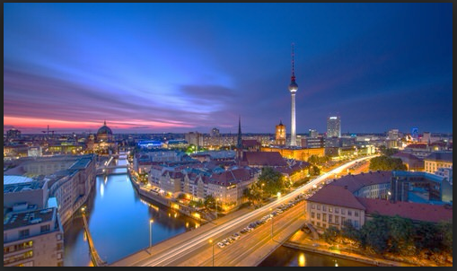
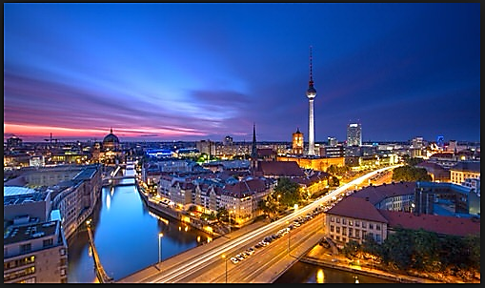
1.1 Display Trend
< Low resolution >
< High resolution >
As displays advance, high resolution, large area and low cost process are required.
Therefore, the small size of the TFT used in backplane, and fast switching are important.
Notes:
This page is display trend.
(▣)
As displays advance, high resolution, large area and low cost are required.(as display 맞나 확인)
(▣)
Therefore, the small size of the TFT used in backplane, and fast switching are important.

Slide 3
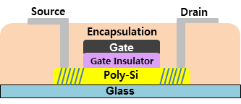
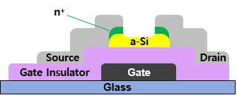
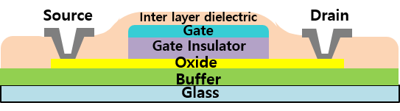
1.2 Types of TFT
< a-Si : H TFT >
< Oxide TFT >
< LTPS TFT >
Lower cost than LTPS TFT
Compatible with existing process lines
Higher mobility than a-Si : H TFT
Transparent element (high aperture ratio)
Higher mobility than Oxide TFT, a-Si : H TFT
Excellent reliability and TFT characteristics
Most of the layers are deposited by vacuum plasma process such as PECVD or Sputtering.
In the oxide TFT of the top gate structure, the oxide semiconductor is deteriorated by plasma ion bombardment.
The one way to avoid plasma ion damage is solution process.
Notes:
(●)As shown in this slids, several kinds of TFTs are being used for the backplane of the display.
(●)Oxide TFT has been getting much attention by higher mobility than amorphous silicon TFT and lower cost than LTPS TFT.
(▣), most of the layers are deposited by vacuum plasma process such as PECVD or sputtering.
However(▣), in the oxide TFT of the top gate structure, the oxide semiconductor is deteriorated by plasma ion bombardment.
(▣) The one way to avoid plasma ion damage is solution process.

Slide 4
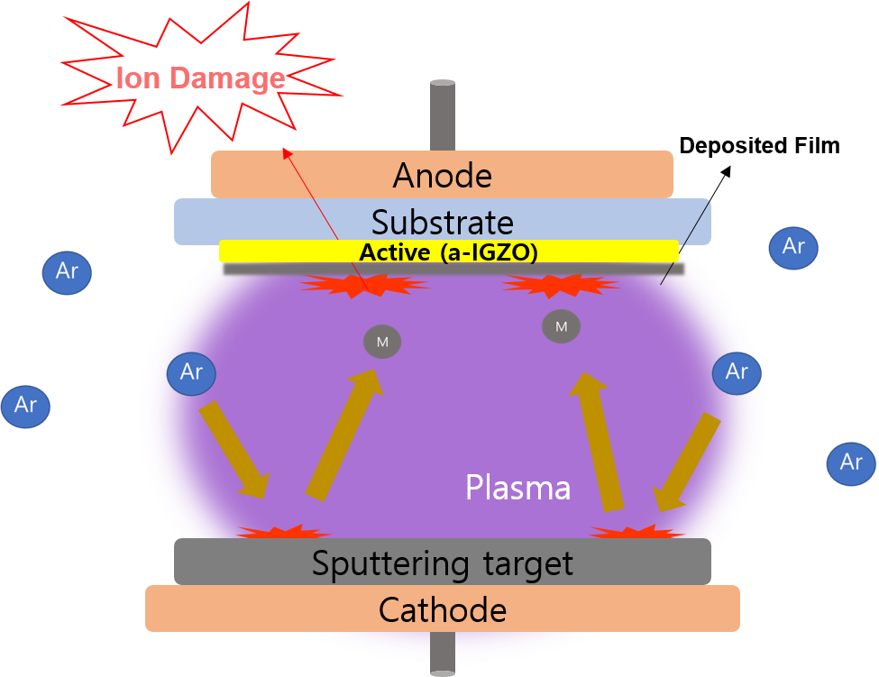
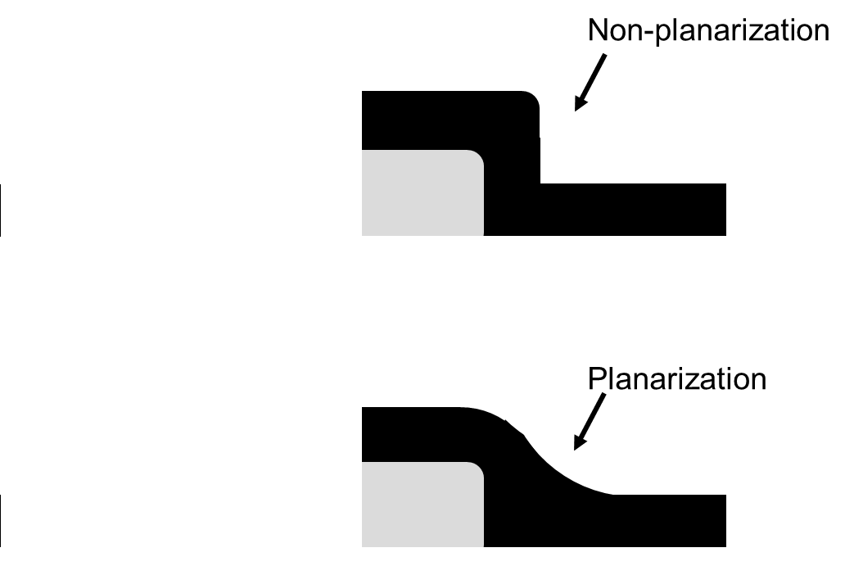
1.3 Solution Process
 | Vacuum process | Solution process
Advantages | High film uniformity High process reproducibility | Reduce process costs Simple process Possible to multi layer
Disadvantages | High initial equipment cost High material consumption rate Complex process | Low film uniformity in large area Low process reproducibility
< Ion damage >
< Planarization >
Notes:
The advantages and disadvantages of vacuum process and solution processes are shown in the table.
Vacuum proces is now widely used, and the disadvantages can be overcome by the solution process.
As mentioned before, there is a problem that the active layer is subjected to (●) ion damage during deposition of an insulator, particularly in the case of a top gate oxide TFT.
This problem is easily solved by applying the solution process.
The other advantages of the solution process is planarization as shown on the(●) right figure.

Slide 5
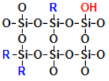
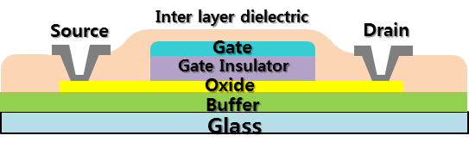
1.4 Spin On Glass (SOG)
Methyl siloxane based SOG
Proposed structure
of oxide TFT with SOG
We developed and evaluated the device by applying SOG for the buffer layer, gate insulator, and dielectric inter-layers to TFT.
SOG is excellent for planarization and allows multiple coatings to smooth the surface.
SOG was diluted for better performance.
The SOG solution forms a silicate polymer with Si-O structure and forms a thin film by heat treatment in the range of 400 ℃ ~ 900 ℃.
It is planarization material widely used for semiconductor passivation.
Notes:
This slide introduces SOG, one of the materials used in the solution process.
(▣) The SOG solution forms a silicate polymer with Si-O structure and forms a thin film by heat treatment in the range of 400℃ ~ 900℃.
(▣) It is Planarization material widely used for semiconductor passivation.
(▣) We developed and evaluated the device by applying SOG for the buffer layer, gate insulator, and dielectric inter-layers to TFT.
SOG is excellent for planarization and allows multiple coatings to smooth the surface.
Therefore, a planarized film free from plasma ion damage can be obtained in the top gate structure in which the gate insulator is deposited on the oxide semiconductor.
SOG was diluted for better performance and the effect of dilution on oxide TFT was investigated.

Slide 6

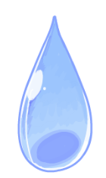
2.1 SOG Dilution
H₂O₂
SOG
Ethanol
Heating
Glass substrate
Heat treatment
Bake at 80 ℃ in hotplate
Coating process
3500 RPM, 30 s
SOG Dilution
Device | Material | SOG/(SOG+Ethanol) | Thickness | Coating number
D | SOG 40 ml + H₂O₂ 1 ml | 1.00 | 496 nm | 1
E | SOG 20 ml + Ethanol 20 ml + H₂O₂ 1 ml | 0.50 | 335 nm | 2
F | SOG 10 ml + Ethanol 30 ml + H₂O₂ 1 ml | 0.25 | 335 nm | 5
Device | Material | SOG/(SOG+Ethanol) | Thickness | Coating number
A | SOG 40 ml | 1.00 | 340 nm | 1
B | SOG 20 ml + Ethanol 20 ml | 0.50 | 238 nm | 2
C | SOG 10 ml + Ethanol 30 ml | 0.25 | 238 nm | 5
Easly & Quickly process
Planarization
Notes:
The slide shows the dilution and bake process of SOG.
(●) SOG material was diluted with (●) ethanol. The dilution ratio was varied from 0 to 75%.
(●)샘플 A is not diluted. (●) 샘플 B is SOG 20 ml with Ethanol 20ml. (●) 샘플 C is SOG 10 ml with ethanol 30 ml .
**D, E, F were same ratio to A B C, but with addition of small amount of (●) H2O2.
After dilution it was spin coated at 3500 rpm.
For the diluted solution, it was coated several times to meet the desired thickness.

Slide 7
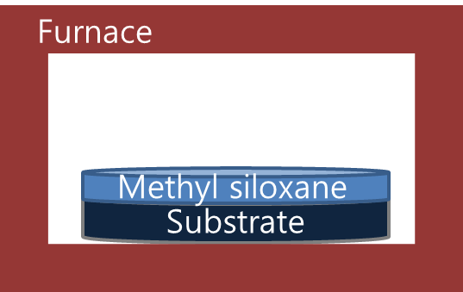
2.2 SOG Curing
Methyl siloxane
Methyl siloxane
Substrate
Substrate
Hot Plate
Hot Plate
Cure
nitrogen ambient
450 ℃, 60 min
Soft bake
Air 85 ℃, 2 min
Hard bake
Air 180 ℃, 3 min
The organic Methyl siloxane can be transformed into an inorganic substance by curing.
During curing, polymer crosslinking occurs, which provides mechanical integrity and film stability in subsequent processes.
Notes:
This slide is SOG (●) curing.
After spin coating, hard bake was done at 180 ℃ for 3 min after soft bake at 85℃ for 2min.
Finally, it was cured at 450°C under a nitrogen ambinbet to convert it to an inorganic material.
Curing times varied from 30 minutes to 60 minutes in the temperature range of 150°C to 450°C.
(▣)During curing, polymer crosslinking occurs, which provides mechanical integrity and film stability in subsequent processes.

Slide 8
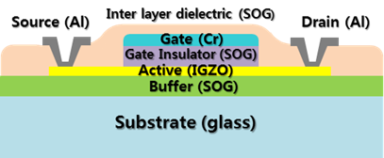
2.3 TFT Fabrication
Buffer layer (SOG)
350 nm
Air curing, 1 h, 450 ℃
L / W = 20 ㎛ / 40 ㎛
Mask #1
Active layer (a-IGZO)
RF sputtering 50 nm
Patterned, wet etching
O₂ annealing, 1 h, 250 ℃
Gate insulator (SOG)
N₂ curing, 1 h, 450 ℃
Mask #2
Gate electrode (Cr)
DC sputtering 115 nm
Patterned, wet etching
Gate insulator etching
RIE, self-aligned
TFT structure.
Top-gate a-IGZO TFT with SOG dielectric
Inter layer dielectric (SOG)
Air curing, 1 h, 300 ℃
Mask #3
Contact hole
Patterned, RIE
Mask #4
Source Drain electrode (Al)
DC sputtering 115 nm
Patterned, wet etching
Notes:
**We developed self-aligned a-IGZO TFT with SOG insulator, as shown in the (●) figure.
TFT is top-gate –top contact with 4 mask process.
SOG was used for buffer layer, gate insulator and inter layer dielectric.
The buffer layer was coated with SOG to prevent the contamination from the glass substrate.
And (a-IGZO) active layer was deposited by RF magnetron sputtering and patterned.
Then, SOG was spin coated for a gate insulator.
After curing, chrome was deposited for the gate electrode.
The gate insulator was etched by dry etching except the gate insulator under the gate electrode, and the source and drain region of IGZO layer was doped by oxygen plasma.
SOG was coated as an inter layer dielectric and contact hole was formed by dry etching.
At Last, source and drain electrodes were formed with Al.
The channel length and width were (●) 20 and 40㎛, respectively.

Slide 9
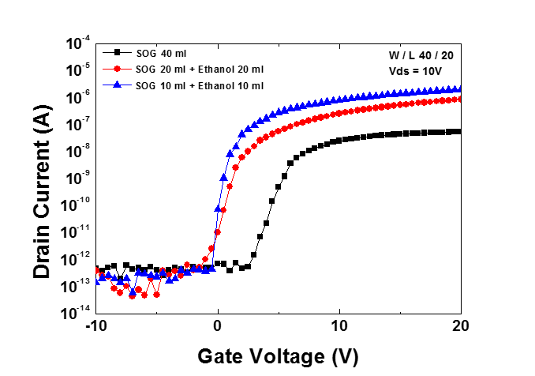
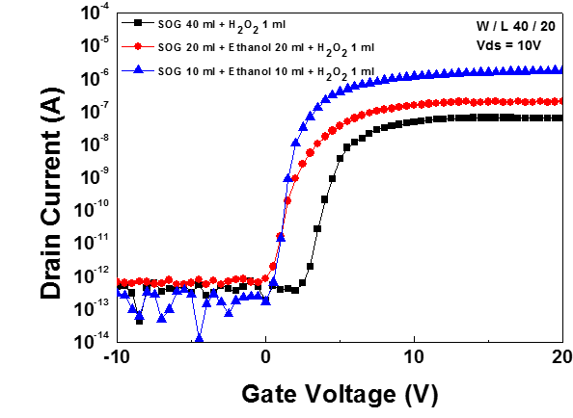
3.1 Transfer Characteristics
Transfer curved
SOG + Ethanol
Transfer curved
SOG + Ethanol + H₂O₂
The left figure shows the effect of ethanol dilution on TFT characteristics.
The on current increased with dilution and the V_{th} shifted to the left.
The right figure shows the effect of addition of H₂O₂ on TFT characteristics.
The on current increased and the V_{th} shifted to the left as increasing dilution ratio.
Notes:
(▣)
The left figure shows the effect of ethanol dilution on TFT characteristics.
The on current increased with dilution and the V_{th} shifted to the left.
The right figure shows the effect of addition of H2O2 on TFT characteristics.
The on current increased and the V_{th} shifted to the left as increasing dilution ratio.

Slide 10
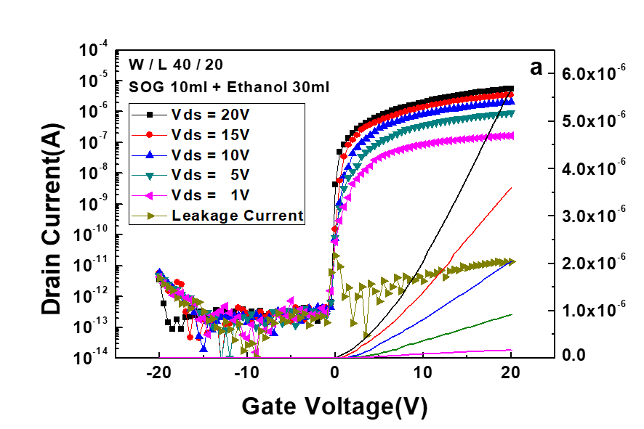
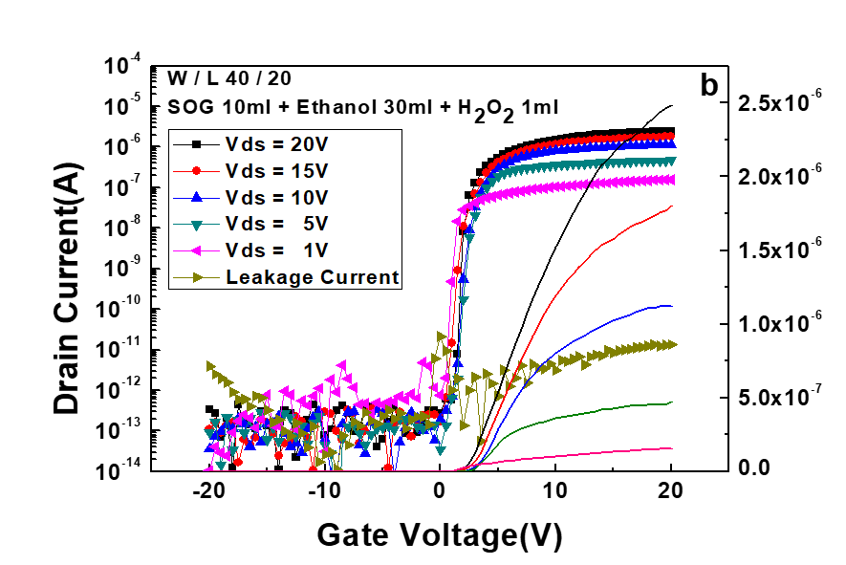
3.1 Transfer Characteristics
Without addition H₂O₂
With addition H₂O₂
Device C. Diluted SOG
(SOG 10 ml + Ethanol 30 ml)
Device F. Diluted SOG
(SOG 10 ml + Ethanol 30 ml + H₂O₂ 1 ml)
With addition of H₂O₂ the slope of on current is more steep than that without addition of H₂O₂.
H₂O₂ is good oxidant, which results in reduced vacancy to achieve higher field effect mobility due to less scattering and charge trap.
However, on current increase becomes slower as current increases, which means the contact resistance between oxide active layer and source/drain metal electrode is higher than without H₂O₂. The contact resistance should be decreased.
Notes:
Those two figures show the transfer curves of fabricated TFTs.
Both graphs were for diliuted SOG, SOG 10ml and Ethanol 30ml
(●) Left graph is without H2O2 addition and (●) right graph is with H2O2 addition.
(▣)
With addition of H2O2, the slope of on current is more steep than that without addition of H2O2.
(▣)
H2O2 is good oxidant, which results in reduced vacancy to achieve higher field effect mobility due to less scattering and charge trap.
However, on current increase becomes slower as current increases, which means the contact resistance between Oxide active layer and Source/drain metal electrode is higher than without H2O2.
The contact resistance should be decreased.

Slide 11
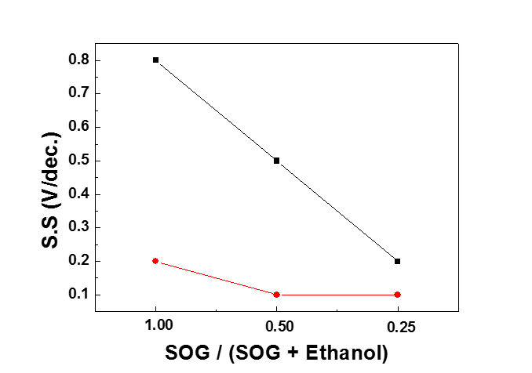
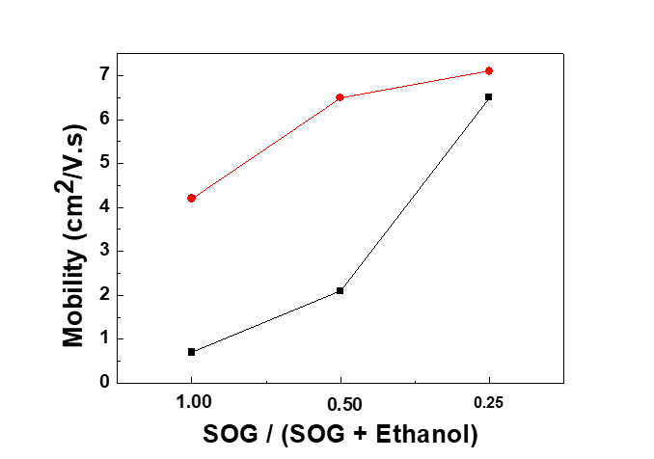
3.1 Electrical Characteristics of TFT
With H₂O₂
Without H₂O₂
Without H₂O₂
With H₂O₂
S.S according to SOG dilution ratio
Mobility according to SOG dilution ratio
The decreased S.S. was attributed to the decreased interface defects by SOG dilution.
The oxidant H₂O₂ can compensate the oxygen vacancy and reduce more the interface defects.
The reduced interface defects also decrease the scattering of the carrier, which results in increase of the mobility.
The addition of H₂O₂ gives additional increase of mobility.
Notes:
The sub threshold swing (S.S.) according to SOG dilution ratio is shown in left figure.
The S.S. strongly depends on the interface defects and decrease with decreasing of interface defects.
Therefore, reduced S.S. means that the oxidant H2O2 can reduce the oxygen vacancy and reduce more the interface defects.
** The reduced interface defects also decrease the scattering of the carrier, which results in increase of the mobility.
Right figure shows the increase of mobility as a function of dilution ratio.
The addition of H2O2 gives additional increase of mobility.
The dilution of SOG results in increased mobility which can be explained by reduced oxygen vacancy and decreased interface defects.

Slide 12
3.1 Electrical Characteristics of TFT
A,C,E : SOG + Ethanol
B*,D*,F* : SOG + Ethanol + H₂O₂
TFT Parameters
Device | V_{th} (V) | S.S. (V/dec.) | I_{on}/I_{off} | μ (cm²/V.s)
A | 5.1 | 0.8 | 5.4 × 10⁴ | 0.7
B* | 1.5 | 0.2 | 1.3 × 10⁷ | 4.2
C | 1.1 | 0.5 | 1.1 × 10⁵ | 2.1
D* | 1.0 | 0.1 | 2.8 × 10⁷ | 6.5
E | 0.8 | 0.2 | 3.3 × 10⁷ | 6.5
F* | 0.5 | 0.1 | 3.5 × 10⁷ | 7.1
SOG based Gate insulator
Interface Roughness, Pinhole
Improvment of electrical characteristics
Interface defects, Oxygen vacancy
Notes:
As we can see in this table.
The electrical characteristics such as the Vth, mobility, S.S and on/off ratio were improved with dilution.
As increasing dilution, threshold voltage decreased from 5.1 to 0.5V.
S.S decreased from 0.8 to 0.1V/dec(디케이드). mobility increased 0.7 to 7.1 cm²/V.s(세컨드) .
** To analyse the reason for the impovement.
AFM, FTIR, and capacitance measurements were carridout.

Slide 13
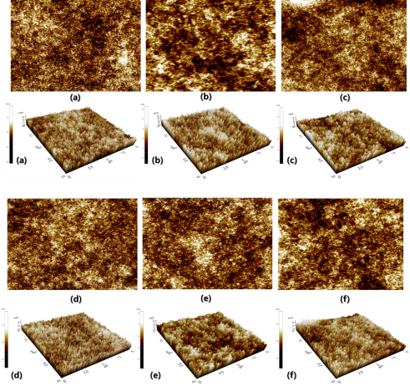
3.2 Film Analysis (AFM)
A,C,E : SOG + Ethanol
B*,D*,F* : SOG + Ethanol + H₂O₂
The surface roughness
measured by AFM for various dilution conditions.
The root mean square (RMS) roughness
Device | SOG/(SOG+Ethanol) | Coating numbers | Roughness
A | 1.00 | 1 | 0.74 nm
B* | 1.00 | 1 | 0.73 nm
C | 0.50 | 2 | 0.73 nm
D* | 0.50 | 2 | 0.70 nm
E | 0.25 | 5 | 0.71 nm
F* | 0.25 | 5 | 0.51 nm
Dilution and multi coating.
planar the surface and reduce the defects such as void and pin hole.
reduces scattering and trapping of the carrier.
improve the electrical characteristics .
increase of mobility.
The surface roughness is also important parameter to the TFT characteristics.
The RMS roughness was decreased from 0.74 nm to 0.51 nm as increasing dilution.
Notes:
Dilution and multi coating can plenaries the surface and reduce the defects such as void and pin hole,
which reduces scattering and trapping of the carrier and improve the electrical characteristics.
Therefore, the surface roughness is also important parameter to the TFT characteristics.
Figure A to F show the surface roughness measured by AFM for various dilution conditions.
The root mean square (RMS) roughness are summarized in this table.
** The dilution changes the viscosity of SOG and the RMS roughness was decreased from 0.74 nm to 0.51 nm as increasing dilution.
The decrease of roughness results in less scattering and higher mobility.

Slide 14
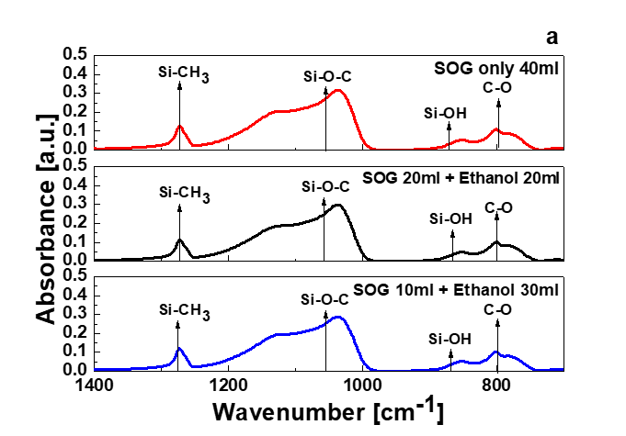
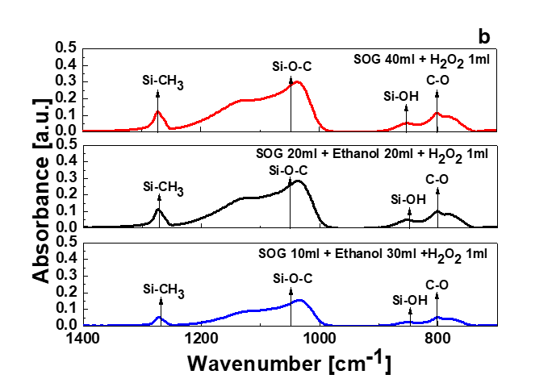
3.2 Film Analysis (FTIR)
FTIR spectra of ethanol diluted SOG
FTIR spectra of H₂O₂ added
to ethanol diluted SOG
The Si-O bond appears at 1250 cm⁻¹, the Si-O-C bond at 1108 cm⁻¹, the Si-O-Si bond at 970 cm⁻¹, and the Si-OH bond at 880 cm⁻¹.
Especially, the broad peak at 835 ~ 1050 cm⁻¹ consists of the Si-OH bond and Si-O-Si bond.
The FTIR shows that there are no significant changes of bonding or chemical group by dilution or addition of H₂O₂, which means the dilution doesn’t affect the chemical bond of SOG film but affect the interface defects.
Notes:
This slide show FTIR analysis.
To analyze SOG thin films, FTIR spectra were obtained as shown in figure.
Left figure is FTIR spectra of ethanol diluted SOG and right figure is FTIR spectra of ethanol diluted SOG with addition of H2O2.
(▣)
The FTIR shows there are no significant changes of bonding or chemical group by dilution or addition of H2O2,
which means the dilution doesn’t affect the chemical bond of SOG film but affect interface defects.

Slide 15
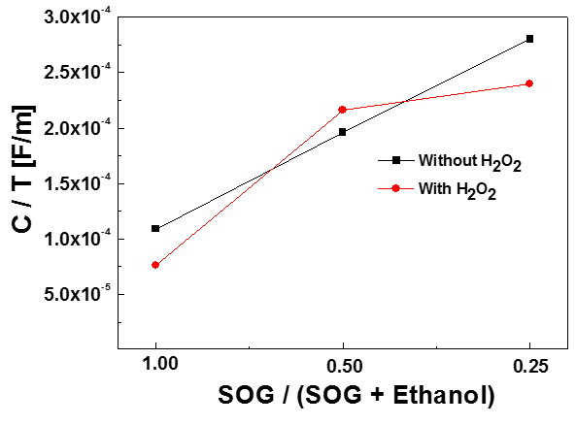
3.2 Film Analysis (Capacitance)
T : Thickness , C : Capacitance
Ethanol diluted SOG
Device | C/T [F/m]
1.00 | 1.0E-4
0.50 | 1.9E-4
0.25 | 2.8E-4
H₂O₂ added to ethanol diluted SOG
Device | C/T [F/m]
1.00 | 7.6E-5
0.50 | 2.1E-4
0.25 | 2.4E-4
Dielectric constant for diluted SOG film
The increase of normalized capacitance by larger dilution was attributed to the decrease in voids.
Normalized capacitances depend on dilution but not on addition of H₂O₂.
Notes:
This slide show capacitace analysis.
The normalized capacitance is the capacitance devided by thickness.
The normalized capacitances for each dilution are shown in figure and value was summarized in the table
Normalized capacitance was increased with increasing dilution ratio.
(▣)
The increase of normalized capacitance by a larger dilution was attributed to the decrease in voids.
Normalized capacitance depend on dilution but not on addition of H₂O₂.
The increased capacitance can increased induced change which results in high on – current.

Slide 16
4. Conclusion
Top gate amorphous IGZO TFTs with SOG for the buffer layer, gate insulator, and dielectric inter-layers were developed.
The improvement of TFT characteristics by dilution of SOG was attributed to the decrease in the surface roughness, oxygen vacancies and interface defects.
The top gate a-IGZO TFTs with diluted SOG gate insulators showed the better electrical properties, when H₂O₂ was added.
We got the mobility of 7.1 cm²/Vs, threshold voltage of 0.5 V, subthreshold swing of 0.1 V/dec., and on/off ratio of 3.6 × 10⁷ for optimized TFT.
In this work, we successfully developed top gate a-IGZO TFT with solution-based SOG insulators, such as, a buffer layer, gate insulator and inter layer dielectric.
Notes:
Top gate amorphous IGZO TFTs with SOG for the buffer layer, gate insulator, and dielectric inter-layers were developed.
The improvement of TFT characteristics by dilution of SOG was attributed to the decrease in the surface roughness, oxygen vacancies and interface defects.
The top gate a-IGZO TFTs with diluted SOG gate insulators showed the better electrical properties. When H₂O₂ was added.
We got the mobility of 7.1 cm²/Vs, threshold voltage of 0.5 V, subthreshold swing of 0.1 V/dec(디케이드)., and on/off ratio of 3.6 × 10⁷(타임스 텐두더 세븐⁾ for optimized TFT.
In this work, we successfully developed top gate a-IGZO TFT with solution-based SOG insulators, such as, a buffer layer, gate insulator and inter layer dielectric.

Slide 17
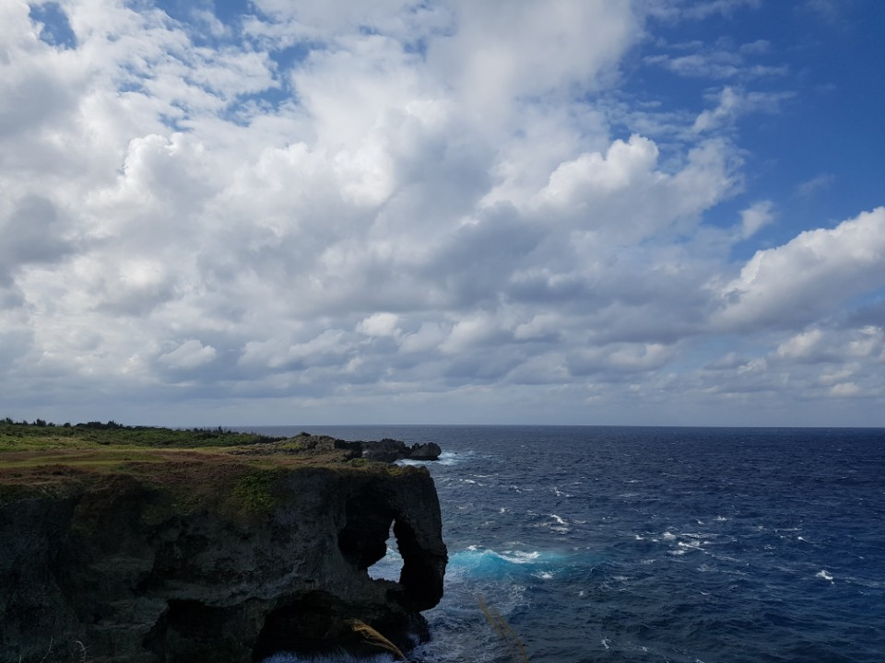
Thank you for
your Attention
Notes:
Thank you for your Attention.
질문 받고 먼저 칭찬 먼저 해주기
That’s a good question. That’s a hard question.
페이지로 부연 설명할때..
I'll respond to that question briefly. Let's go back to the third slide.
잘 모를때
This part I have to think a little more about. SO, I want you to give me your contact or email address after the presentation is over.

