Slide 1
Oxide Thin Film Transistor
with SOG Gate Insulator
Hoseo University
Electronic Device LAB
Hwang Sang Ho
Hoseo University – Electronic Device LAB – Hwang Sang Ho
Notes:
Good afernoon everyone~~!
Nice to meet you again.
My name is Sang Ho Hwang and l study in Hoseo University .
My presentation subject is oxide TFT with SOG gate insulator.

Slide 2
INDEX
1. Introduction
2. Experimental
3. Results and Discussion
4. conclusion
Notes:
Contents include introduction, experimental, results and discussion, conclusion.

Slide 3


Introduction
S
D
S
Passivation SOG
D
Gate
Active
Gate Insulator
Gate Insulator
Active
Active
Gate
Glass
Glass
Glass
Fig.1 Bottom gate structure
Fig.2 Top gate structure
SiO₂ was used by insulator and passivation
6 mask
Long process time
SOG was used by insulator and passivation
4 mask
Short process time
Hoseo University – Electronic Device LAB – Hwang Sang Ho
Notes:
There are two types of TFT structures, one is bottom gate and the other is top gate.
For the bottom gate TFT, SiO2 was used as an insulator and passivation layer and we used six masks for bottom gate TFT.
However, for top gate TFT, we used SOG as an insulator and passivation layer and used 4 masks.
Top gate takes less process time because we used solution process, while we used vacuum process for a bottom gate TFT, which takes a long process time.

Slide 4
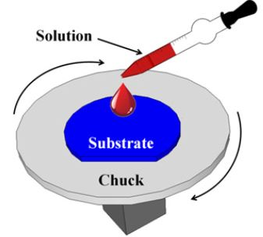
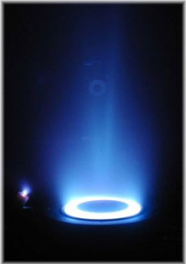
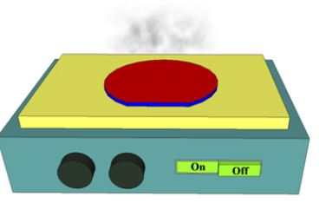
Introduction
Solution process
Easily and quickly producing.
Does not use plasma.
it can avoid plasma damage on the active layer.
Hoseo University – Electronic Device LAB – Hwang Sang Ho
Notes:
Less defects and trap centers are required for the gate insulator and the conventional material is SiO₂ for which vacuum equipment are used.
However, for the printing process and low cost process, solution based process is beneficial.
The material of the spin-on method can produce a thin film easily and quickly on a large area and gives the advantage of the planarization.
Therefore, the series of methyl siloxane SOG has been used widely as an inter-metal insulating material in semiconductor devices and also used for the TFT .
The application of the SOG to the oxide TFT for passivation have been conducted to improve the reliability for the bias stress and light, also.
In this experiment, we used spin on glass (SOG) as an insulator instead of vacuum deposited SiO₂.
The solution processed gate insulator was investigated for the oxide TFT with top gate structure.
Since the gate insulator is deposited on the active layer for the top gate structure, active layer can be deteriorated by plasma ion bombardment during deposition of the gate insulator in the case of PECVD or sputtering.
Plasma damage exerted on the active layer during the deposition of the gate insulator has an adverse effect on the TFT characteristics. On the other hand, solution process does not use plasma; therefore, it can avoid plasma damage on the active layer.

Slide 5
Experimental
Table.1 process steps
Buffer coating
(SOG)
Active (IZGO)
Deposition
Gate insulator
Coating (SOG)
Gate (Cr)
Deposition
Passivation
(SOG)
Source / Drain
(Al) Deposition
Contact Hole
S
Passivation SOG
D
Mask 1
Gate
Gate Insulator
Active
Active
Mask 2
Mask 3
Glass
Glass
Fig. 3 Cross-sectional structure of the
top gate oxide TFT
Mask 4
SOG was used by insulator and passivation
4 mask
Short process time
Hoseo University – Electronic Device LAB – Hwang Sang Ho
Notes:
In this experiment, methyl siloxane based spin on glass was used for the gate insulator, buffer, and passivation.
Basic processing steps for both materials consist of spin coating, soft-bake, and cure.
Spin coating of both materials is carried out via standard spin coater.
The bake processes carried out to remove carrier solvents. General bake temperatures are in the range of 150°C.
The curing process for the materials is carried out in a quartz-tube furnace generally under inert atmosphere such as nitrogen ambient.
Processing times vary from 30 to 60 minutes in a temperature range of 350 to 425°C.
The curing process provides polymer cross linking to provide mechanical integrity and film stability during subsequent processes.
On a glass the buffer SOG was processed and IGZO active layer was deposited and patterned.
Gate insulator was SOG and gate metal was chrome. After patterning of the gate, passivation was formed by SOG.
After contact hole, source/drain electrodes were formed with Al metal.

Slide 6
Result and Discussion
Table.2 Dilution of the SOG with IPA .
Device | Material | Concentration | Thickness | Coating count
Material | SOG 10ml + IPA 30ml | 25% | 70.9nm | 5
Fig. 4 Leakage current of insulator with SOG.
Table.3 Transistor parmeter.
V_{th} | Mobility | s.s | On/Off ratio
0.15V | 7.61cm²/v.s | 0.357V | 2.51E⁺⁷
Fig. 5 TFT Transfer curve.
Hoseo University – Electronic Device LAB – Hwang Sang Ho
Notes:
Figure 4 shows the current densities of the SOG insulators for the various dilutions with IPA.
The leakage currents were reduced for the diluted solution. With dilution of SOG with IPA, dielectric properties were improved.
Figure 5 shows the transfer curve of top gate oxide TFT.
The channel length and width are 20 um and 40 um, respectively.
L/C means leakage current through the gate insulator.
Left graph shows device A with SOG undiluted.
Table 2 shows we used diluted solution and concentration was 25% and then thickness 70.9nm and coating count 5.
Table 3 shows the measured parameters for the fabricated oxide TFT.
The mobility was 7.61cm²/V/s and the threshold voltage was 0.15 V.

Slide 7
Conclusion
Solution based insulator was applied to the top gate a-IGZO oxide TFT.
Since the solution process is free from plasma ion damage, the defect generation
by ion bombardment can be avoided.
SOG was used in this experiment for the buffer layer, gate insulator, and passivation.
We investigated the dilution effect of IPA on SOG for the better dielectric property.
With dilution, the dielectric properties of SOG were improved.
Hoseo University – Electronic Device LAB – Hwang Sang Ho
Notes:
Solution based insulator was applied to the top gate a-IGZO oxide TFT.
Since the solution process is free from plasma ion damage, the defect generation by ion bombardment can be avoided.
SOG was used in this experiment for the buffer layer, gate insulator, and passivation. We investigated the dilution effect of IPA on SOG for the better dielectric property.
With dilution, the dielectric properties of SOG were improved.

Slide 8

Question Answer
<THANK YOU>
Notes:
Do you have any question?
Thank you listening to my presentation.
Good luck to you.

