Slide 1
Evaluation of
Water Level Sensor based on
Capacitive Sensor Circuit
Hoseo University
Electronic Device Laboratory
Han Ye Lin
Notes:
Hello, My name is Han Ye Lin and I am preparing a master course at the electronic device lab of Hoseo University.
I have been studying the TFT process for a year and now I am studying the TFT circuit design.
So today the topic of my presentation is Evaluation of Water Level Sensor based on Capacitive Sensor Circuit.

Slide 2




CONTENT
Introduce
Simulation
Measurement
Conclusion
Notes:
I will presented introduction, simulation, measurement and result of the proposed circuit.

Slide 3
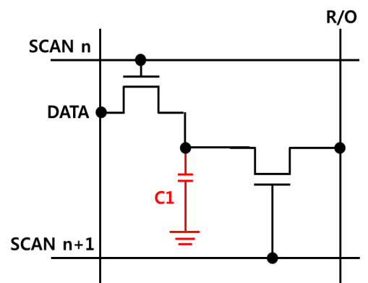
Introduce
Reference Circuit
Proposed Circuit
Read Out
2 TFT
4 Signal line
SCAN
1 TFT
2 Signal line
T1
C1
T2
NET3
T1
C2
When a finger touches it | When a finger non touches it
Capacitance increase of C2 | Small capcitance of C2
SCAN high → NET3 Voltage low → T1 off → Readout Voltage X | SCAN high → NET3 Voltage high → T1 on → Readout Voltage high
5
SCAN
0
15
READRESET
0
-10
Notes:
The fingerprint recognition touch sensor presented by Kang In-hye earlier is capacitive and operates with the difference of parasitic capacitance between touching and non-touching.
This minimizes used devices and signal lines, because it uses just one TR much simple than the conventional circuit configuration.
Let's briefly explain the operation principle of a circuit, *as the capacitance of the sensing electrode is increased *due to the finger touching, even if the signal of the scanning line is high, the voltage of NET3 is not increased, so that the magnitude of the gate voltage of T1 does not increase greatly and the *Readout voltage does not increase either.
Conversely, when the finger is not touched, the capacitance is relatively small, and when the scan line becomes high voltage, the voltage of NET3 rises and T1 becomes ON and the current increases. So Readout Voltage is high.
In order to reset the lead-out line, it is necessary to give a lead reset signal to the external circuit.
Based on this fingerprint recognition touch sensor, I applied it to the water level sensor which can recognize the amount of water.

Slide 4

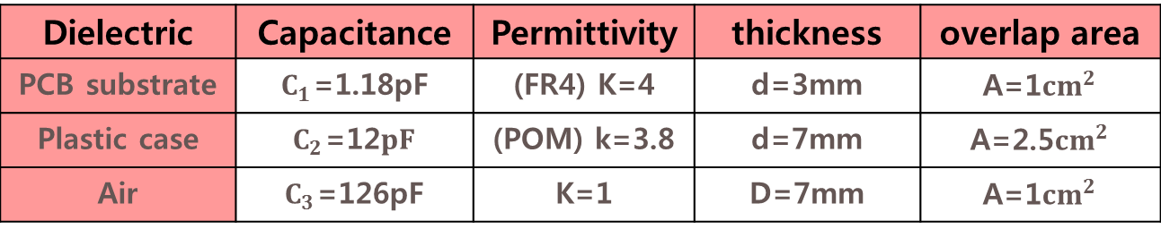


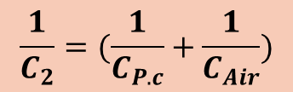
Water Level Sensor Application
$$C=\frac{ε_{0}εA}{d}$$
$ε_{0}$: 8.855X10⁻¹²F/m
$ε$: relative permittivity
$d$: dielectric thickness
$A$: area
Signal wiring
Water tank
$$\frac{1}{C_{2}}=(\frac{1}{C_{P.c}}+\frac{1}{C_{Air}})$$
Dielectric | Capacitance | Permittivity | thickness | overlap area
PCB substrate | $C_{1}$=1.18pF | (FR4) K=4 | d=3mm | A=1${cm}^{2}$
Plastic case | $C_{2}$=12$pF$ | (POM) k=3.8 | d=7mm | A=2.5${cm}^{2}$
Air | $C_{3}$=126pF | K=1 | D=7mm | A=1${cm}^{2}$
Metal
Mosfet
PCB Substrate
Metal
Plastic case
Air
 | With Water |  | Without Water
Dielectric material | PCB Substrate | Plastic case | PCB Substrate | Plastic case + Air
Capacitance | C₁=1.18pF | C₂=12pF | C₁=1.18pF | C₂=0.125pF
W A T E R
Notes:
The figure above shows the touch sensor applied to the Water level sensor.
First, *when there is no water in the water tank, you need to consider not only the capacitance of the PCB board between the two metals, but also the capacitance in the air as well as the plastic case.
*The formula to calculate each capacitance is as follows.
Since the Epsilon is the fixed permittivity value of the material used, and the thickness and area are determined by the process and design.
So capacitance values can be calculated and their values are shown in the table.
Therefore, when there is no water, as in the above equation, the two capacitors are added in series so that the capacitance becomes relatively small, and if there is water,* the capacitance increases.

Slide 5
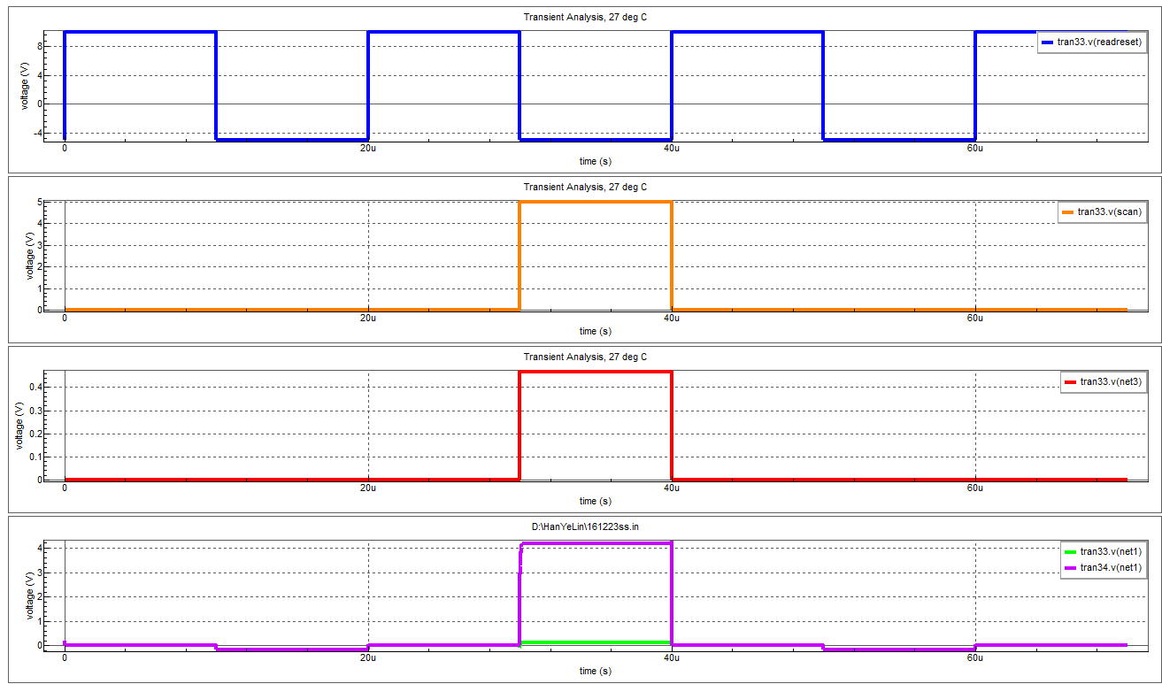

Simulation
The output gain of 5V
makes it possible to distinguish between
when the water is present and when it is not.
SCAN
C1
NET3
T1
ReadReset
C2
Read
Out
T2
SCAN
Read Reset
NET3
Detect differences in capacitance
$Δ$5V
ReadOut
5V
A
B
A : Small capacitance
B : Large capacitance
A Output signal
Without Water
With Water
B Output signal
Notes:
After setting these values, I will show you the simulation result.
First, with the scan pulse of 5V to the scan line and we checked the output. With the absence of water, capacitance C2 is small due to the series addition of the capacitance A. But the capacitance C2 is increased when water present.
As a result, we can see the difference of output voltage of 5V.
Therefore, this output voltage of 5V * makes it possible to distinguish between water-in and water-out.

Slide 6
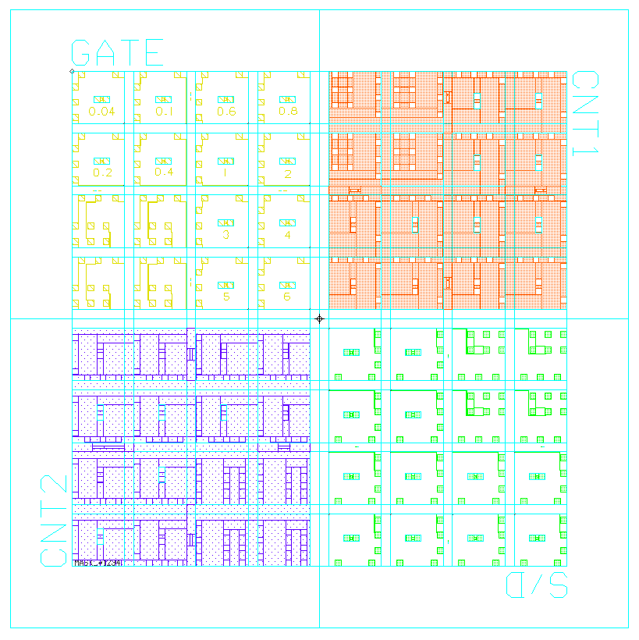
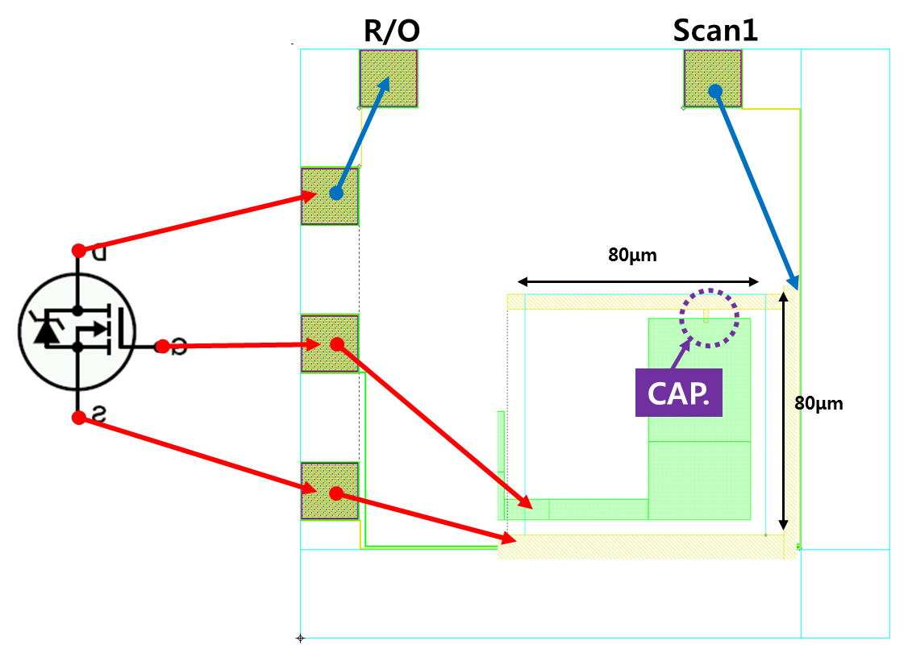
PROCESS
Passivation (SOG)
S/D Metal (Al)
Gate Insulator (SOG)
Gate Metal (Cr)
Glass Substrate
Water
Air
<Device Structure>
<Mask Layout>
<one of the Pattern>
Since we did not use TFT Process we used MOSFET
Mosfet
Notes:
In order to measure this simulated circuit by making device, mask was made and process was done.
The structure is simpe that the metal Cr is deposited on the glass substrate and the insulation film is coated with SOG.
After depositing Al metal on it, finally, SOG was coated to form a passivation layer..
The picture is a mask layout, and the right picture is one of the patterns in the mask layout.
The water level was measured using the sample produced.
Since we did not use TFT Process we used MOSFET

Slide 7
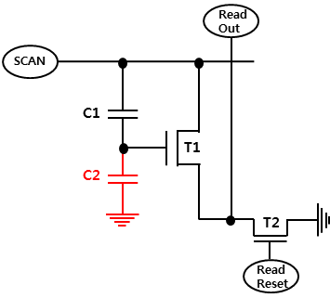
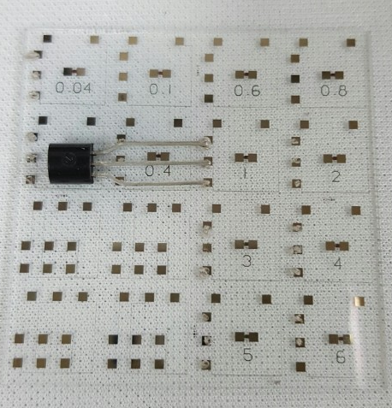
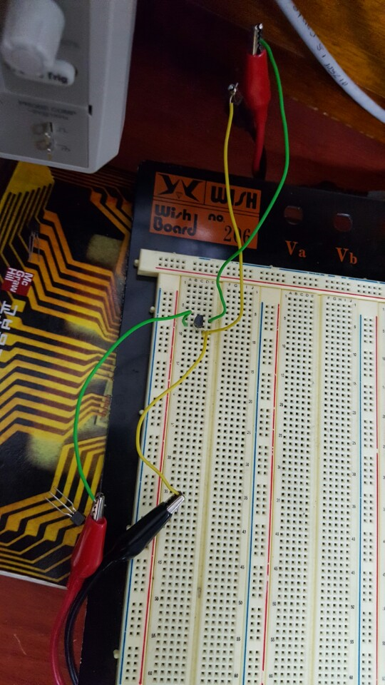
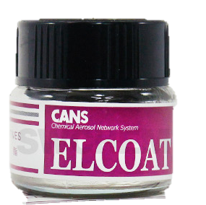
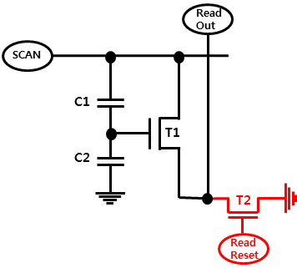
Measurement
Circuit Configuration
MOSFET - mounted sample
Reset transistor is installed as an external MOSFET
Scan and Readreset Signal
Attached using
Silver paste
5
SCAN
0
15
READRESET
0
-10
Notes:
First, prepare the signals of the scan line and the read reset line like the configured circuit.
Then attach the MOSFET to the pad using silver paste on the sample.
A read out line is connected to the ground using a MOSFET for the reset of the read out line.

Slide 8
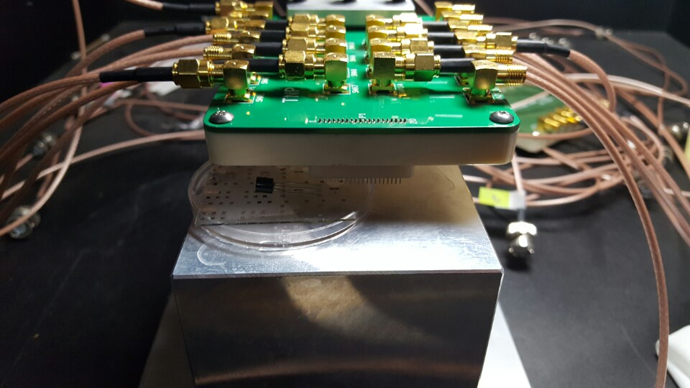
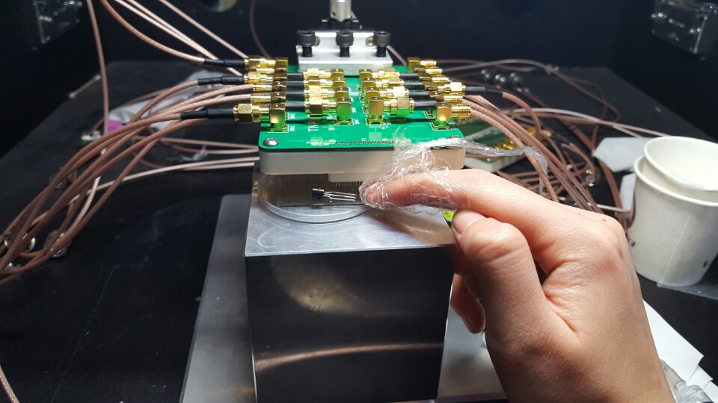
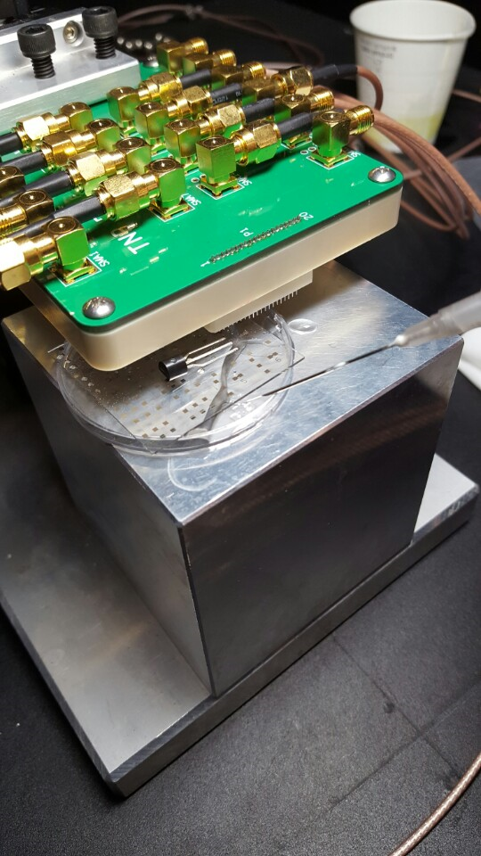
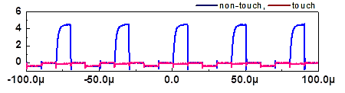
Measurement
Output voltage measurement
Touch to check the operation
of the sensor
Measure after filling water
Mask layout
Output
when touch
Diagram
Voltage (V)
non touch, touch
Time (s)
Notes:
Probe pins and sample pads are connected to measure Readout value, the output without water is shown here.
And first, touch the sample to test whether the sensor works.
As shown in the graph above, after making sure the sensing of the sensor, fill water to the bottom of the sample.

Slide 9
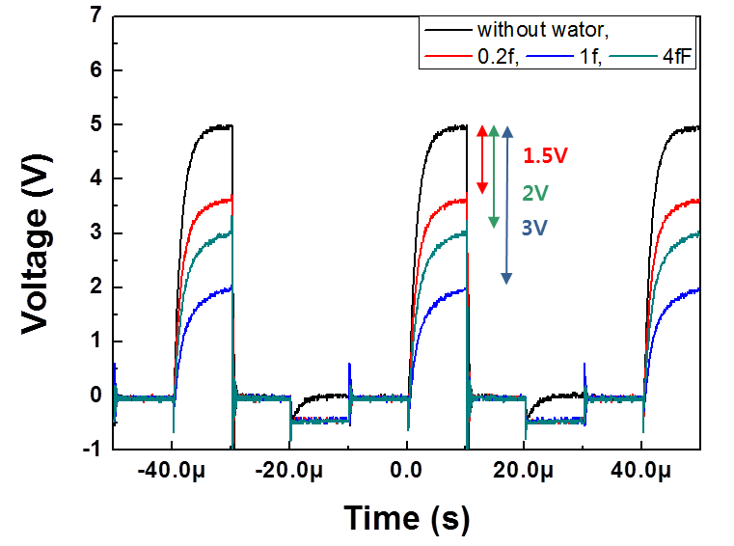

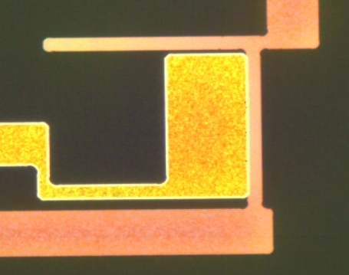
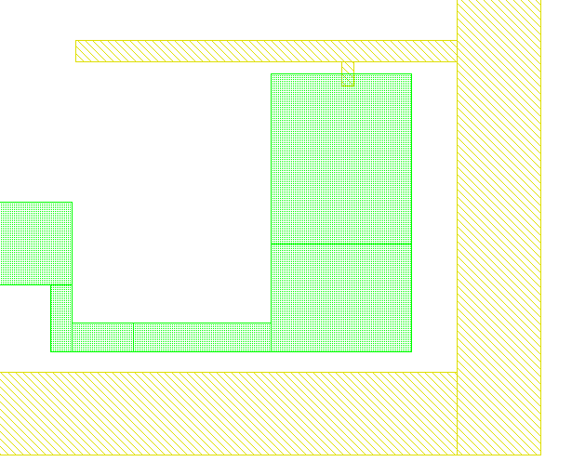
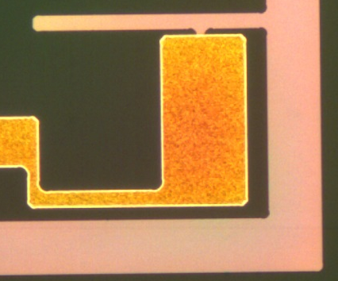
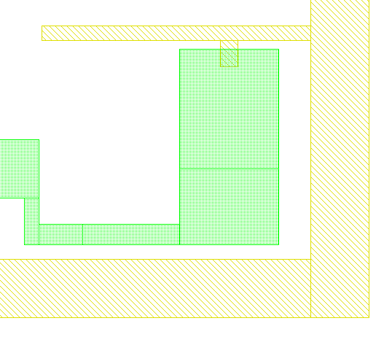
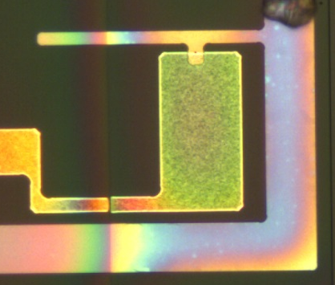
Measurement Result
0.2fF
1fF
4fF
1.5V
3V
2V
Mask layout & Microscopic observation [Cr/SOG/Al/SOG]
Notes:
As a result, output voltage difference of 1.5v, 1v, 3v was obtained for several capacitances of C1, and it shows that the sensor can be applied to the water level sensor using this simple structure.

Slide 10

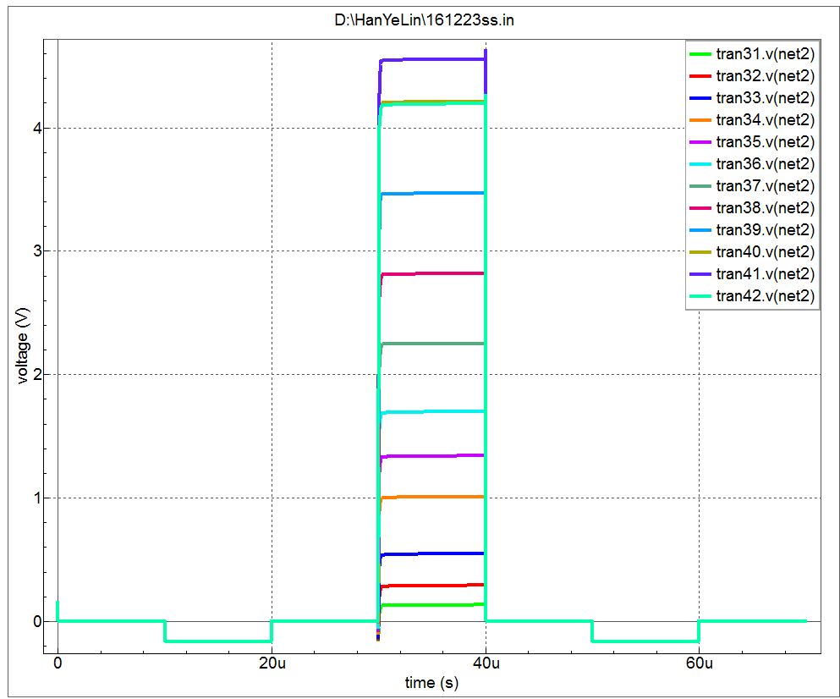
Simulation - Detecting water level
When there is no water
Signal wiring
Water tank
Metal
Mosfet
PCB Substrate
Metal
Plastic case
When the water is full
Air
As the area of the dielectric varies
with the height of the water filled,
the magnitude of capacitance changes step by step.
The difference of output voltage (ReadOut) can be checked.
W A T E R
Notes:
An additional simulation was done for various water level. .
The simulation results show that not only the presence of water but also the level of water can be detectable. As the water level gradually increases, the area of the dielectric varies, so the magnitude of the capacitance changes step by step, So we can see the difference in output voltage.

Slide 11
Conclusion
Simple fingerprint recognition touch sensor circuit with two signal line and one transistor can be applied to water level detection.
We can detect not only the presence of water but also the water level.
It can be used cheaply and simply in the part where the water level such as boiler or water tank should be measured.
I have plan to actually make and experiment it.
Notes:
This is a summary and conclusion.
Unlike existing sensor circuits using 2Signal line and 1TR, we developed the sensor circuits with only one TR which was applied for water level sensor.
We verified that we can detect not only the presence of water but also the water level through the simulation of the circuit.
The water level sensor based on this capacitive sensor circuit will be inexpensive and simple to be used in water tanks.
In the future we will experiment further for various sizes of the sample and test them in real water tank.

Slide 12
Thank you for your attention
Notes:
감사합니다.

