Slide 1
Electronic Deviece Laboratory
Title | Introduce Our Laboratory
Year | 2017
Presenter | Seong-min Park

Slide 2
Contents
001 Laboratory Introduce
002 Member
003 Seong-min

Slide 3

1
Laboratory
Introduce

Slide 4
Laboratory Introduce
Characterization and circuit operation through simulations using virtual devices.
Using P-spice,
Smart spice.
Process
Circuit Design
Oxide TFT process research, characterization, Interfacial oxidation, Plated

Slide 5

2
Member

Slide 6
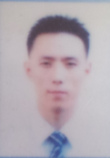

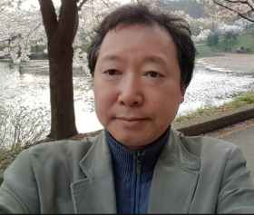
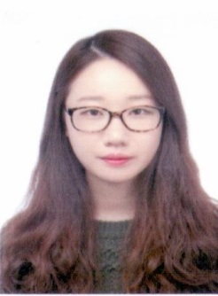
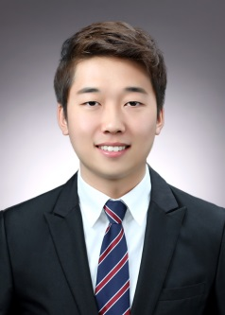

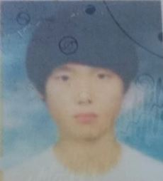
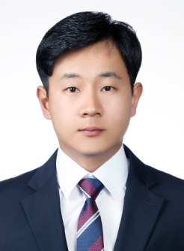
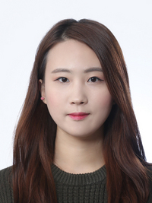
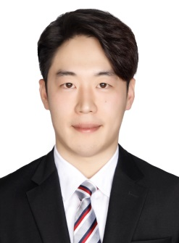
Member
Ph.D
Design & Process
Process
ink-jet printing
Prof. Bae
Master
Design
Sensor
Process
SnO TFT
Process
SnO TFT
Under Graduated Student
Process
Plating
Process
SOG
Design
Sensor
Design
Circuit

Slide 7

3
My favorite

Slide 8

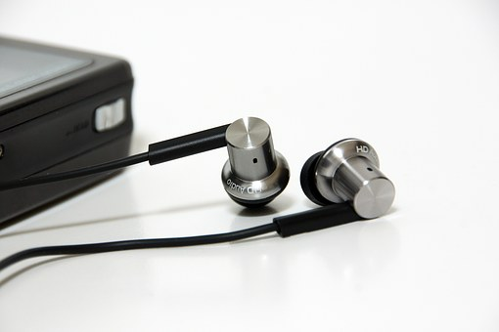

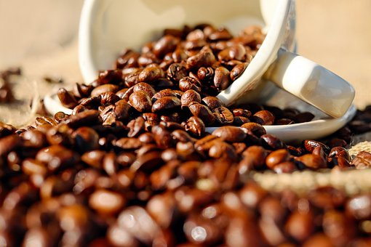
Hobby
Basket Ball
Music
Friends
Coffee

Slide 9
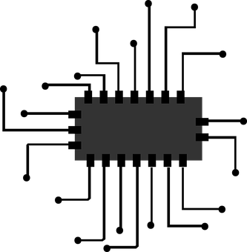

Interest
Circuit Design
Fassion

Slide 10
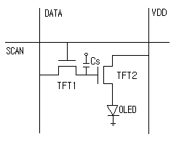
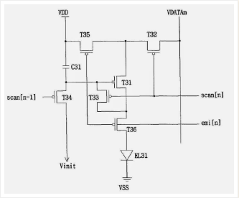
Seong-min
TFT Circuit.
VDD : Drive current line
TFT1 : Switching TFT
TFT2 : Drive TFT
Cs : Capacitor
T31 : MAIN DRIVING TR
T34 : CAP INITIAL
T35 T36 : EMISSION CONTROL TR
T32 : DATA GATE TR
T33 : Vth Compensation TR
C31 : DATA STORAGE CAP

Slide 11

Thank you for
attention

