Slide 1
Fabrication Probe Tip using MEMS
HOSEO UNIVERSITY
Electro Device Lab
Yeong Jo Baek
Notes:
Let me introduce myself before I present. I am studying Probe Tip using MEMS process and I going to enter graduate course in March and will study in Professor Bae’s lab.

Slide 2
Index
1
MEMS(Micro Electro Mechanical Systems)
2
Process
3
Result
4
Future Plan
Notes:
First, i will briefly introduce what MEMS is and what kind of technology is used in.
Next, I will make the presentation in process, process result and future plan.

Slide 3
MEMS
What is the MEMS
<MEMS?>
MEMS stands for Micro Electro Mechanical Systems and also called Micromachines.
MEMS is a fine mechanical system that uses semiconductor process technology to create microstructures on a micro scale.
<Process>
we fabricate frame using Photo Lithography and then make structure by electroplating.
Photo
Lithography
Electroplating
Micro Scale
Structure
Notes:
MEMS is an abbreviation of Micro Electro Mechanical System. It is also called Micromachines, and it is a method to make micro structure by using semiconductor process such as lithography.
I will explain the details of the process later, but briefly, lithography is used to make the frame and make the structure by electroplating.

Slide 4
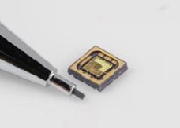
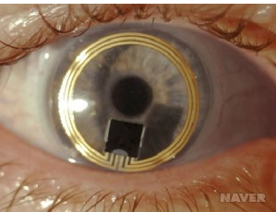
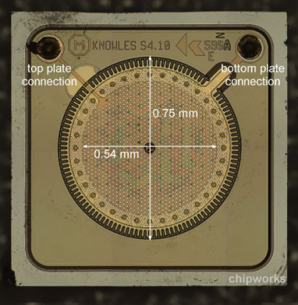
MEMS
The field where MEMS is used?
<Sensor or Micro structure>
Field
Smartphone or Smart band
Healthcare(bio)
Pressure sensor, acceleration sensor etc…
Feature
Micro scale
Use direction information of movement or movement of product.
Used to store and transmit voice signals.
Pressure sensor
Contact lens type sensor
MEMS Microphone
Notes:
MEMS processes are mainly used to fabricate sensors and fine structures, and these products are used in a variety of sensors such as smart phones, healthcare products, pressure sensors, acceleration sensors and so on.
By using MEMS process, it is possible to fabricate minute structure of micro scale, to inform movement or direction information of products, and to transmit and store voice signals

Slide 5
Process
Notes:
I will explain the process in more detail

Slide 6
Process
<Flowchart>
Wafer Cleaning
Ti & Cu
Deposition
Copper
Electroplating
PR
Coating
Glass wafer
Glass wafer
Glass wafer
Glass wafer
Exposure
Develop
Cobalt-Nickel
Electroplating
PR
Remove
Glass wafer
Glass wafer
Glass wafer
Glass wafer
Cu
Etching
Copper is approximately plated 20um.
Cobalt-Nickel is approximately plated 70um.
→ Used negative PR because of plated Cobalt-Nickel thickness.
Notes:
I have created a process flow chart to help you understand.
First, the glass wafer is cleaned and Ti and Cu are deposited as an electrode part for plating.
Next, because Cu is plated as a sacrificial layer, Ti is deposited as an electrode part to improve the adhesion.
However, since the adhesive force between glass and copper is not good, Ti is deposited to improve adhesion between copper and glass.
After Copper is deposited, 20um copper is electroplated as a sacrificial layer and photolithography process forms the desired pattern.
After nickel cobalt electroplating, the PR stripped out and sacrificial Cu layer are etched to separate the electroplated pattern structure.
We used negative PR because the height of the target structure should be 70um in height.

Slide 7
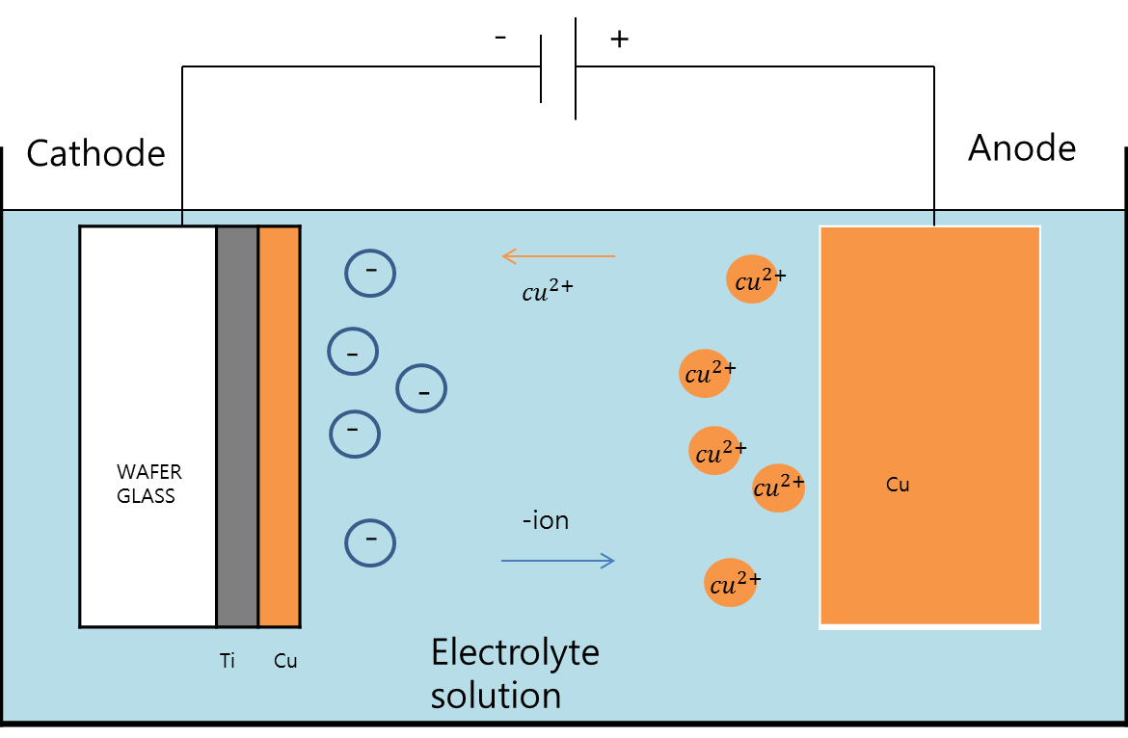
Process (Electroplating)
1
Rinse
Defatting
Remove oxidation, fingerprints and oil
10% Sulfuric acid
prevent of pollution and oxidation of Cu.
Surface activation
Remove particle
2
The type of electrode
What kind of metal used at electrode is important
Current density
Determine plating speed
Process time
High Temperature > Uneven plating thickness
Determine plating thickness
Temperature
Optimal temperature is important.
They are added to improve the quality
Concentration of solution
Reduced concentration > burning of high current area
Variety additives
3
Sulfuric acid
Cleaning
dry
Remove the oxide layer and make gloss
Notes:
I have explained the whole MEMS process and I will explain the electroplating process
First, plating is classified into three processes: preprocessing, main processing, and post-processing.
In the pre-processing, it removes particles, organic matters and minerals, and activates the surface of the substrate before plating with a little acidic solution.
Next, electroplating is performed.
when electricity is applied in a copper sulfate solution, the copper of the anode is ionized in the solution, and the copper ions are deposited on the cathode substrate.
Depending on the type of anode used, the composition of the solution varies and additives may be added to improve gloss and hardness. In addition, the industry is also plated with gold to prevent oxidation after plating.
Post-processing is the process of preventing the oxidation of the plated film and cleaning the solution on the substrate.
The table below shows several factors to affect the quality of plating.
The kind of metal to be plated, Current density, process time, temperature, concentration of solution, and additives affect the quality of plated metal.
Several additives are used to control the formation of the good film and the physical properties such as ductility and hardness.

Slide 8
Result
Notes:
I will explain the results of the experience.

Slide 9
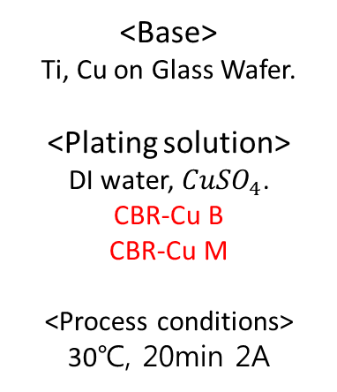
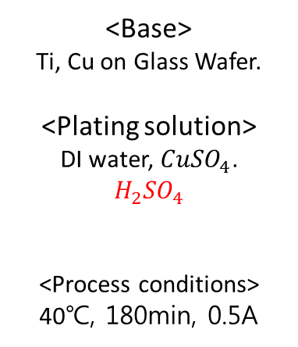
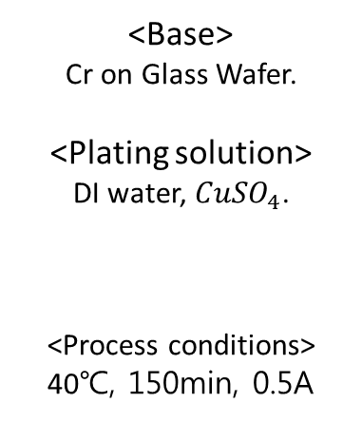
Result
16.07.26
16.08.09
16.09.07
<Base>
Cr on Glass Wafer.
<Plating solution>
DI water, ${CuSO}_{4}$.
<Process conditions>
40℃, 150min, 0.5A
<Base>
Ti, Cu on Glass Wafer.
<Plating solution>
DI water, ${CuSO}_{4}$.
$$H_{2}{SO}_{4}$$
<Process conditions>
40℃, 180min, 0.5A
<Base>
Ti, Cu on Glass Wafer.
<Plating solution>
DI water, ${CuSO}_{4}$.
CBR-Cu B
CBR-Cu M
<Process conditions>
30℃, 20min 2A
Additive
Notes:
The picture on the left is the result of first plating in July, 16th.
I used Cr as the electrode, but the adhesion with copper was not good, so the copper flowed out immediately after I took it out from the plating solution.
After that we found that Ti and Cu deposited on the glass improve the adhesion.
The photo on the right is the result of the experiment using the copper plating additive to improve the surface condition, When the process was carried out without using sulfuric acid or hydrochloric acid, the plated film was not formed well.

Slide 10
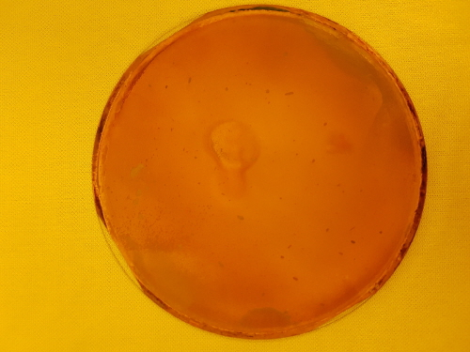
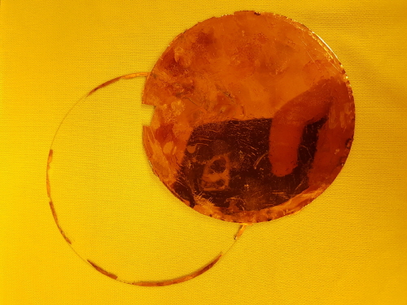


Result
16.09.17
16.09.19
<Base>
Ti, Cu on Glass Wafer.
<Plating solution>
DI water, ${CuSO}_{4}$
CBR-Cu B
CBR-Cu M
<Process conditions>
30℃, 120min, 2A
<Base>
Ti, Cu on Glass Wafer.
<Plating solution>
DI water, ${CuSO}_{4}$, $H_{2}{SO}_{4}$
CBR-Cu B
CBR-Cu M
<Process conditions>
30℃, 120min, 2A
Notes:
The picture on the left was the same condition shown on September 7, but we decided that the time for plating was too short and increased the plating time to 2 hours.
The photo on the right is the result of adding sulfuric acid to the existing process conditions.
Although it is glossy, it can be seen that there are shapes like 'flying eggs' on the surface.

Slide 11
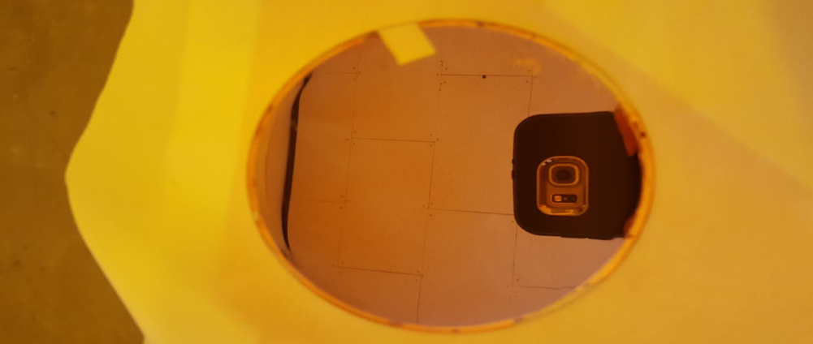
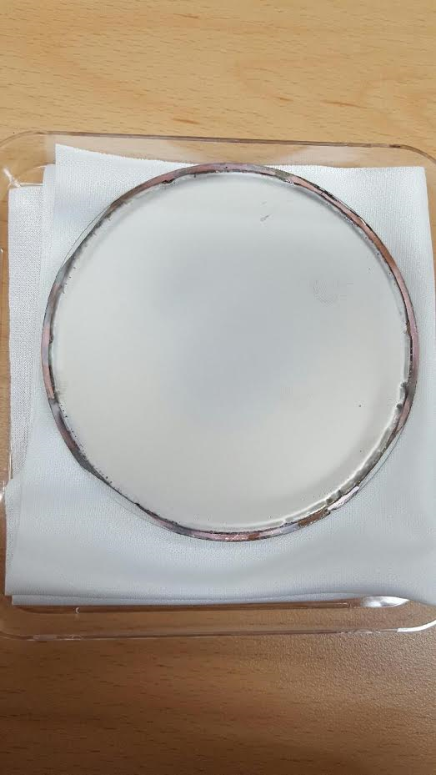


Result
16.10.04
16.10.24
<Base>
Ti , Cu on Glass Wafer
<Plating solution>
Water , ${CuSO}_{4}$
CBR-Cu B
CBR-Cu M
$H_{2}{SO}_{4}$, HCl
<Process conditions>
22℃, 60min, 1A
<Base>
Ti , Cu on Glass Wafer
<Plating solution>
DI Water, ${NiSO}_{4}$
${NiCl}_{2}$, $H_{3}{BO}_{3}$
None additive
<Process conditions>
22℃, 60min, 1A
Notes:
This is the result of adding a small amount of chlorine ion in order to overcome the 'flying eggs’ phenomenon.
Because tap water contains a small amount of chlorine ions, Di water is not used.
Since the concentration of chlorine ion was insufficient, a very small amount of hydrochloric acid was added. By that, the surface became clean and desired film quality was obtained.
The photo on the right is the result of nickel plating, and the process was carried out by modifying various conditions like copper plating.
By adding the additive and proceeding the process, a glossy surface such as copper was obtained, but the 4“ sputter in the lab has a problem so could process later.
We will proceed with further processing to obtain a glossy surface as soon as the equipment is fixed.

Slide 12
Future Plan
Notes:
I will explain plans for the future.

Slide 13
Future Plan
<Process>
Ni Electroplating with additives
Catching process conditions of Ni Cobalt electroplating
Photolithography process for micro structure (ex: probe tip, spring)
<Analysis>
Thickness of Cu and Ni by Alpha step, SEM
Hardness of micro structure (ex: probe tip, spring)
Cu, Ni Surface and interface
Notes:
As mentioned before, we plan to obtain a glossy nickel surface.
In addition, we have learned that nickel cobalt plating is used rather than nickel plating through communication with companies, and nickel cobalt process conditions will be recaptured.
We plan to complete the plating process perfectly and then proceed with the lithography process to make the microstructure.
I will analyze the physical properties of the plated metal more precisely, such as hardness, ductility as well as plating thickness..

Slide 14
ありがとうございます
Notes:
Thank you!!

