Slide 1
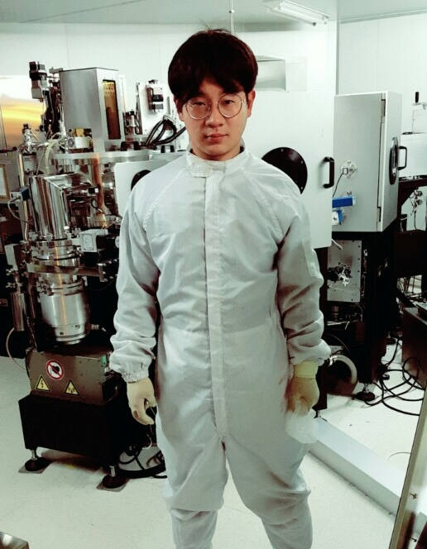
Oxide TFT with SOG Gate Insulator
Hoseo University
Electronic Device LAB
Hwang Sang Ho
Notes:
Pleasant afernoon everyone~~! My name is Sang Ho Hwang and l study Hoseo University .
I am research about oxide TFT with SOG gate insulator.

Slide 2
INDEX
Introduction
Experimental
Results and Discussion
conclusion
Notes:
Contents include introduction, experimental, results and discussion, conclusion,

Slide 3

Introduction
Source
Drain
Drain
Gate
Source
Gate
Insulator
Afs
Active
Active
ACTIVE
Gate Insulator
Buffer
Gate
Glass
Glass
Bottom gate structure
Top gate structure
SiO₂ was used by insulator and passivation
6 mask
Long process time
SOG was used by insulator and passivation
4 mask
Short process time
Notes:
Tft structure has a bottom gate and top gate.
Bottom gate is used sio2 as an insulator and passivation and using a six mask.
But top gate is used SOG as an insulator and passivation and using a four mask.
Top gate consumed less process time because It coated with the solution process, while bottom gate by using a vacuum deposition equipment takes a long process time.

Slide 4
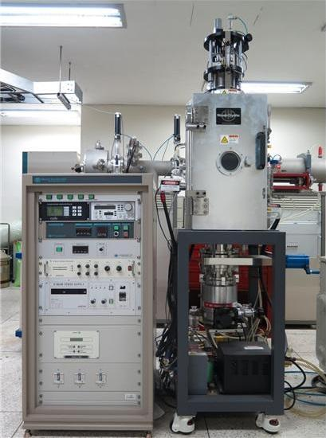
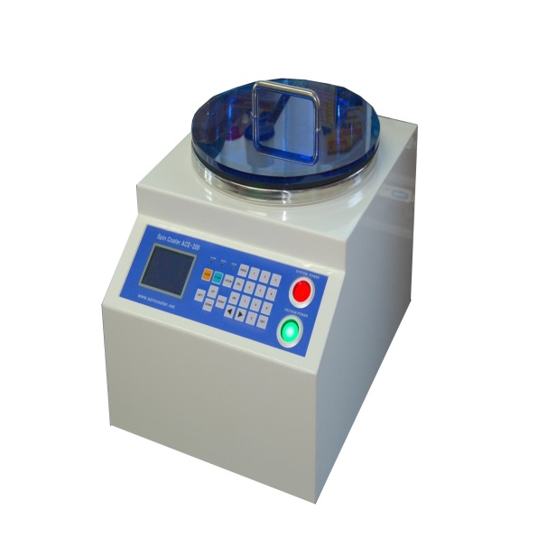
Introduction
Solution process
easily and quickly producing.
does not use plasma
it can avoid plasma
damage on the active layer
vacuum equipment
Spin coater
Notes:
Less defects and trap centers are required for the gate insulator and the conventional material is SiO₂ for which vacuum equipment are used to deposit it. However, for the printing process and low cost process, solution based process is beneficial. The material of the spin-on method can be easily and quickly producing a thin film on a large area and gives the advantage of the planarization. Therefore, the series of methyl siloxane SOG has been used widely as an inter-metal insulating material in semiconductor devices and also used for the TFT . The application of the SOG to the oxide TFT for passivation have been conducted to improve the reliability for the bias stress and light, also.
In this experiment, we used spin on glass (SOG) as an insulator instead of vacuum deposited SiO₂. The solution processed gate insulator was investigated for the oxide TFT with top gate structure. Since the gate insulator is deposited on the active layer for the top gate structure, active layer can be deteriorated by plasma ion bombardment during deposition of the gate insulator in the case of PECVD or sputtering.
Plasma damage exerted on the active layer during the deposition of the gate insulator has an adverse effect on the TFT characteristics. On the other hand, solution process does not use plasma; therefore, it can avoid plasma damage on the active layer.

Slide 5
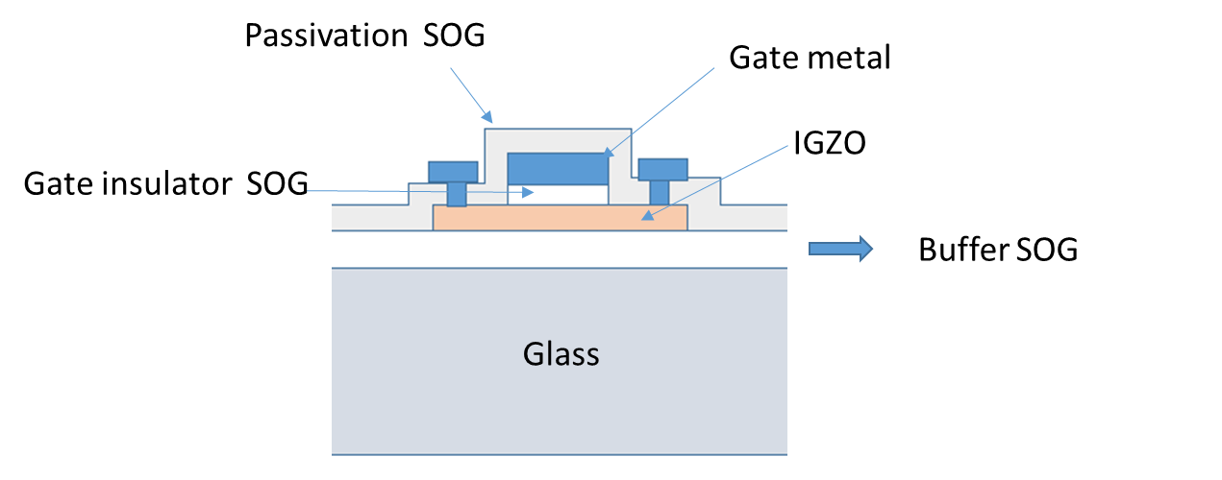
Experimental
process steps
Buffer coating
(SOG)
Active (IZGO)
Deposition
Gate insulator
Coating (SOG)
Gate (Cr)
Deposition
Passivation
(SOG)
Source / Drain (Al) Deposition
Contact Hole
Mask 1
Mask 2
Mask 3
Cross-sectional structure of the top gate oxide TFT
Mask 4
Notes:
In this experiment, methyl siloxane based spin on glass was used for the gate insulator, buffer, and passivation. Basic processing steps for both materials consist of spin coat deposition, soft-bake, and cure. Spin coating of both materials is carried out via standard, commercially available spin coater. The bake processes carried out to remove carrier solvents. General bake temperatures are in the range of 80 to 350°C. This process is most often performed on hotplates or in an oven.
The curing process for the materials is carried out in a quartz-tube furnace generally under inert atmosphere such as nitrogen ambient. Processing times vary from 30 to 60 minutes in a temperature range of 350 to 425°C. The curing process provides polymer cross linking to provide mechanical integrity and film stability during subsequent processes.
On a glass the buffer SOG was processed and IGZO active layer was deposited and patterned. Gate insulator was SOG and gate metal was chrome. After patterning of the gate, passivation was formed by SOG. After contact hole, source/drain electrodes were formed with Al metal.

Slide 6
Experimental
Device | Material | Concentration | Thickness | Coating count
A | SOG 40ml | 100 % | 340.4 nm | 1
B | SOG 20ml + IPA 20ml | 50 % | 162.4 nm | 2
C | SOG 10ml + IPA 30ml | 25 % | 70.9 nm | 5
Notes:
For the good planarization effect, lower viscosity is better. We investigated the effect of dilution of the SOG with IPA (isopropyl alcohol). For the investigation of dielectric property of the diluted SOG, it was coated on a p-type Si wafer with 3500 rpm spin speed. For the diluted solution, we coated several times for the desired thickness of the gate insulator. Detail for dilution concentration and number of coating is summarized in table.
After spin coating of the SOG, hard bake was done for 20 min at 170℃ after soft-bake for 20 min at 85℃. Final cure was done for 1 hour at 420℃ in nitrogen ambient. On SOG layer, aluminum was deposited by the DC magnetron sputter with shadow mask to form metal electrodes.

Slide 7
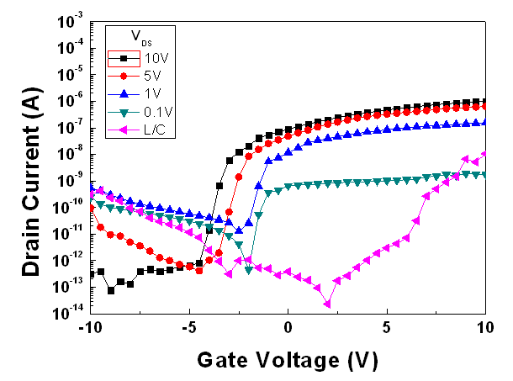
Results and Discussion
A | Device | C
SOG 40ml | Material | SOG 10ml + IPA 30ml
100 % | Concentration | 25%
340.4 nm | Thickness | 70.9nm
1 | Coating count | 5
Notes:
These picture shows the transfer curve of top gate oxide TFT.
The channel length and width are 20 um and 40 um, respectively. L/C means leakage current through the gate insulator.
Left graph shows device A with SOG undilution. As you can see, the higher leakage current.
Right picture is graph of device C. It diluted solution and concentration is 25%. For the diluted solution, we coated 5l times for the desired thickness of the gate insulator. So we can see that the leakage current is lower.

Slide 8
conclusion
Solution based insulator was applied to the top gate a-IGZO oxide TFT.
Since the solution process is free from plasma ion damage, the defect generation by ion bombardment can be avoided.
SOG was used in this experiment for the buffer layer, gate insulator, and passivation.
We investigated the dilution effect of IPA on SOG for the better dielectric property.
With dilution, the dielectric properties of SOG were improved.
V_{th} | Mobility | S.S | On/off ratio
0.71V | 5.48cm²/V.s | 0.64V | 2.44E+7
measured parameters for the fabricated oxide TFT
Notes:
Solution based insulator was applied to the top gate a-IGZO oxide TFT. Since the solution process is free from plasma ion damage, the defect generation by ion bombardment can be avoided. SOG was used in this experiment for the buffer layer, gate insulator, and passivation. We investigated the dilution effect of IPA on SOG for the better dielectric property. With dilution, the dielectric properties of SOG were improved.
Table shows the measured parameters for the fabricated oxide TFT. The mobility was 5.48cm²/V/s and the threshold voltage was 0.71 V.

Slide 9

Question Answer
Notes:
Do you have any question?

Slide 10
Thank you!!
Notes:
Thank you very much for listening to my presentation.
Good luck to you.

