Slide 1

Top Gate Oxide TFT
with Solution Based Gate Insulator
16. 08. 27
Hoseo University
Electronic Device Laboratory
1st Master’s Course
Min-Taek Hong
Electronic Device Laboratory

Slide 2
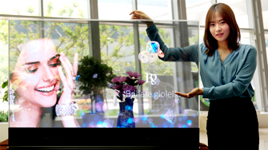
Contents
■ Back ground
- Thin Film Transistor
- Gate Insulator
■ Solution Process
- Top Gate Structure
- Su-8
■ Experiment
■ Result and Conclusion
Electronic Device Laboratory

Slide 3
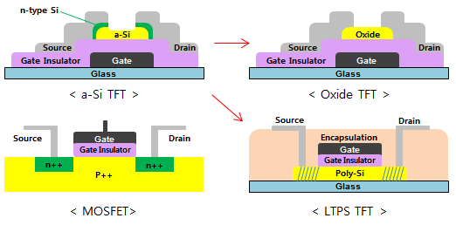
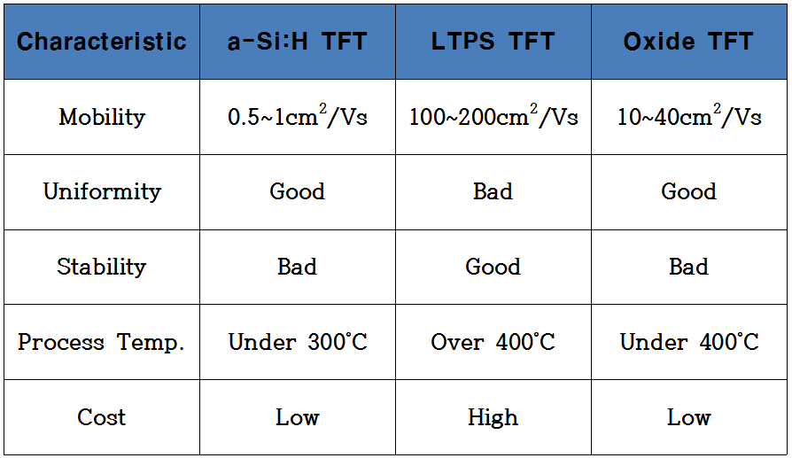
Thin Film Transistor
[ Structure and Characteristics of various TFT ]
■ Low Temperature Poly-Si (LTPS) and Oxide TFT are developed
for the better performance of the active matrix display.
■ Recently, oxide TFT has been investigated intensively due to simple process
and higher µ than amorphous silicon TFT.
Electronic Device Laboratory
Notes:
Thin Film Transistor is widely used for the active matrix display
And a-Si TFT is most common for the liquid crystal display.
Low temperature poly-Si and Oxide TFTs are used for the high mobility devices.
LTPS TFT shows high mobility and good stabilities compared to a-Si TFT,
However, it need expensive equipment like the ion doping machine and excimer laser.
Therefore, oxide TFT has been investigated due to simple process like a-Si TFT
Which reduce both the investment and maintenance cost.

Slide 4
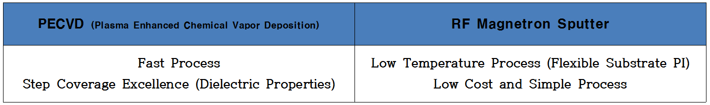
Gate Insulator
■ Typical parameters of TFT are mobility, threshold voltage and On/Off ratio
which are influenced by gate insulator.
■ The widely used material for gate insulator is SiO₂
→ Si is rich in the earth and inexpensive (Clarke’s number 27.72%)
→ SiO₂ have high stability because easy oxidation (Etch Stopper, Passivation)
→ Transparent and dielectric
■ Deposited SiO₂ with vacuum equipment
Electronic Device Laboratory
Notes:
Typical parameter of TFT are mobility, threshold voltage and On/Off ratio
which are influenced by gate insulator.
Therefore, the gate insulator is much important for the electrical performance of the TFT.
The widely used material for gate insulator is SiO2 Which is rich in the earth and inexpensive.
SiO2 is deposited by this equipments.
The vacuum equipment for the deposition of SiO2 like the PECVD and RF Magnetron Sputter
need large investment and maintenance cost than non vacuum process.

Slide 5
Solution Process
Vacuum Process
Nonvacuum Process
High investment and maintenance cost
Decrease productivity for keeping vacuum
Low cost
Very simple process
Fast running time
Oxide TFT
Solution process as active layer has been investigated
Solution process as gate insulator is important, too
Electronic Device Laboratory
Notes:
On the other hand, non-vacuum process have many adventage.
One is Low cost, another is very simple process and the other is fast running time.
After a while, I will explain detail about this.

Slide 6
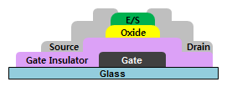
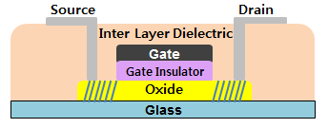
Top Gate Structure
■ Adventage of top gate TFT
1. Self-Align
- No mask
- No photolithograpy
- No Etch Stopper
2. No parasitic capacitance
between Gate and Source/Drain
- Low Leakage current, High Stability
3. Active Doping Effect
Electronic Device Laboratory
Notes:
The oxide TFT of top gate structure reduces the parasitic capacitance
between gate and source/drain electrodes as shown in this figure.
Also, top gate structure has many advantage.
But the plasma damage during deposition of gate insulator to an oxide active layer
cause the defects which deteriorate TFT characteristics.
On the other hand, the gate insulator by solution process reduces the defects by plasma process.

Slide 7
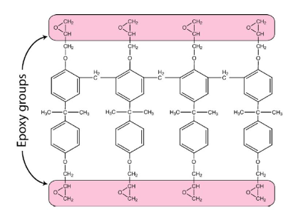
Su-8
Su-8 : Negative Photo Resistor
■ Cross-linking gives high chemical stabilities
and high electrical resistance
■ Occurrence of crack during process is issue
[ 8 epoxy group + Photosensitizer ]
■ Thickness of Su-8 is controlled
by spin speed
■ Solution process is
shorter process time
for the thicker insulator
[ SOG Thickness as coating speed ]
[ SOG Process Time as thickness ]
Electronic Device Laboratory
Notes:
Su-8 which is a negative photoresist has been being used widely in MEMS.
It is constituted with octuplet epoxy groups and includes photosensitizer to react with UV light.
The UV generated cross-linking
which is accelerated by baking gives high chemical stabilities and high electrical resistance.
Thickness of Su-8 is controlled by spin speed during spin coating.
This figures show the thickness comparison between spin coating and sputtering.
The one of the advantages in solution process is shorter process time for the thicker insulator.
The organic insulator with low temperature solution-based material such as Su-8 process
Will be suitable for the future large-area flexible devices.
Occurrence of crack during process is issue in Su-8.
Therefore Su-8 is generally processed under 115 degree.
If temperature increases higher than this temperature, Possibility to generate crack increases.
The low process temperature is also enough for flexible devices.
In this study, Su-8 was used for the gate insulator of the oxide TFT
and investigated the effect of the Su-8 gate insulator on the oxide TFT.

Slide 8



Experiment
■ Su-8 Running Step
P-type Si Wafer
Su-8 [300nm]
P-type Si Wafer
Su-8 [300nm]
Hot Plate
P-type Si Wafer
Su-8 Drop and Coating
- 2000rpm
Soft-Bake
- 95˚C Hotplate
- 90s
Exposure
- 365nm / 320mJ/s
- 30s, 60s, 120s, 240s
Oven
Furnace
Su-8 [300nm]
Su-8 [300nm]
Su-8 [300nm]
P-type Si Wafer
P-type Si Wafer
P-type Si Wafer
Hard-Bake
- 115˚C Oven
- 20min
Metal Deposition
- Al 1500Å
Post-Annealing
- 115˚C Furnace
- 30min
Electronic Device Laboratory
Notes:
We investigated the characteristics of gate insulator of Su-8 as changing UV exposure time.
Su-8 was coated by spin coating with 2000rpm on p-type Si wafer as shown this figure.
After soft-bake, Exposure times were varied as 30s, 60s, 120s, and 240s.
Than hard-bake was done for 20 min at 115 degree.
An Al layer was deposited on Su-8 with shadow mask as shown this figure.
And The electrical properties of the Su-8 were measure after post-annealing.

Slide 9
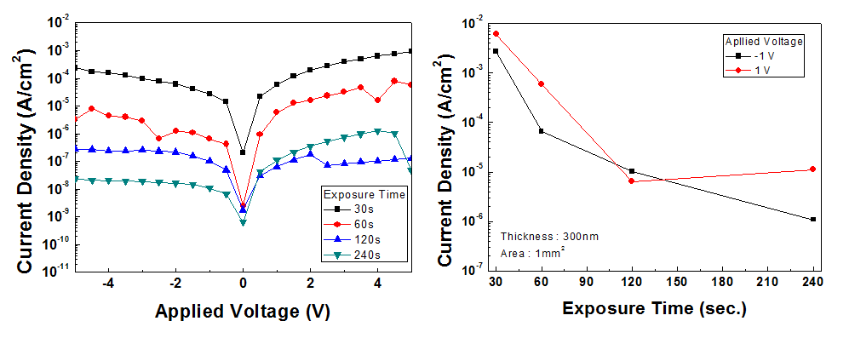
Result
■ The leakage currents decreased as the exposure time increased from 30s to 240s
■ UV exposure time longer than 120s is necessary for the gate insulator of oxide TFT
Electronic Device Laboratory
Notes:
This figure shows the current densities of Su-8 insulator for various exposure times from 30s to 240s.
As shown in figure, the leakage currents decreased as the exposure time increased from 30s to 240s.
The proper UV exposure is important, and this figure shows that UV exposure time longer than 120s
is necessary for the gate insulator of oxide TFT.

Slide 10
Conclusion
■ Gate insulator by solution process provides simple process
and reduces the defects by plasma process.
■ We investigated the characteristics of gate insulator of Su-8 negative PR
as changing UV exposure time.
■ The leakage currents decreased as the exposure time increased from 30s to 240s.
■ The polymer network generated by cross-linking
has chemical stabilities and high electrical resistance.
■ The experimental results show that the exposure time longer than 120s
is necessary for the gate insulator application.
Electronic Device Laboratory
Notes:
Recently, oxide TFT has been investigated intensively due to simple process and higher mobility than a-Si TFT.
Than typical parameters of TFT are influenced by gate insulator.
And,
So,
Because,
So,

Slide 11
Thank You for your attention
16. 08. 27
Hoseo University
Electronic Device Laboratory
1st Master’s Course
Min-Taek Hong
Electronic Device Laboratory

Slide 12
Source
http://blog.naver.com/burningneon/220306648564
http://blog.naver.com/ckbc6101/220467343214
http://hdtv.ca/plasma_lcd_projector/what_is_tft_lcd.php
http://users-phys.au.dk/philip/pictures/physicsfigures/node9.html
https://en.wikipedia.org/wiki/Threshold_voltage
http://www.kps.or.kr/storage/webzine_uploadfiles/1072_article.pdf
Su-8 패시베이션을 이용한 솔루션 IZO-TFT의 안정성 향상, 김상조, 부산대학교
Electronic Device Laboratory

