Slide 1
Amplifier Circuit with Oxide Thin Film Transistor
Hoseo University
Electronic Device Laboratory
Han Ye Lin
Notes:
Hello my name is Han Ye Lin. I study at hoseo university. My topic is amplifier circuit with oxide thin film transistor.
Oxide TFT (thin film transistor) has higher electron mobility and less leakage current than amorphous silicon TFT and the IGZO TFT has being studied by many researchers and being used in the display backplane. In this work, an amplifier circuit with oxide TFTs is presented.
For portable audio amplifier, low power and compact design are necessary. For the compact and flexible devices, fully integrated circuit on a substrate is necessary. Among the possible devices for integrated circuits, thin film transistor (TFT) with oxide semiconductor material is one of the candidates due to its higher field effect mobility than amorphous silicon TFT and simple process compared to low temperature polycrystalline silicon (LTPS) TFT. The audio amplifier with oxide TFT was investigated and optimized for the optimum condition without distortion of the waveform.

Slide 2
INDEX
Introduction
Experimental and Result
Conclusion
Notes:
As you can see, the story goes like this

Slide 3
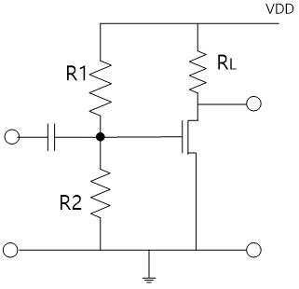
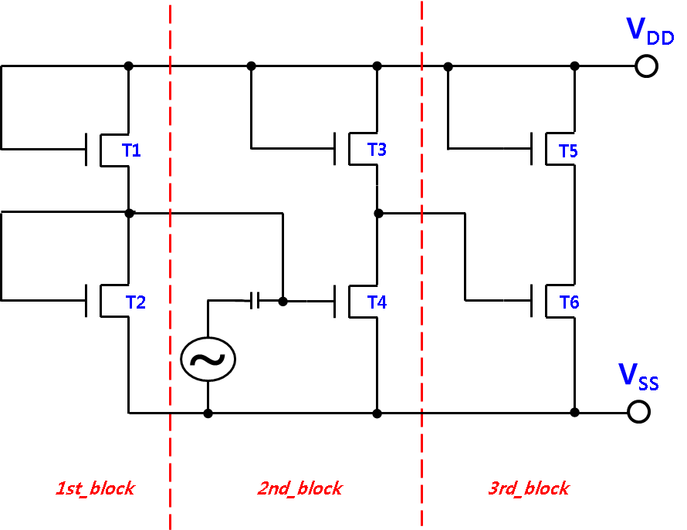
Introduction
The class A amplifier with TFT
The most common and simplest form of power amplifier
Amplifier circuit with inverter
Notes:
Most commonly used type of power amplifier is the class A amplifier as shown in left picture. The class A amplifier is the most common and simplest form of power amplifier, in which transistor is always in on-state so that it conducts during one complete cycle of the input signal waveform producing minimum distortion and maximum amplitude to the output. The efficiency of this type of circuit is low and delivers small power outputs.
To get high amplification gain, we designed a common source amplifier in which TFT was used as a load resistance as shown in right picture. For the load resistance the gate is connected with drain electrode, which is the inverter circuit. In that type of amplifier circuit, the ratio of the widths of load transistor and drive transistor should be optimized for the highest gain. The DC operating voltage for the input gate electrode is also important, and the conventional way to get the operation voltage is using resistor divider, in which we should design the resistor divider according to the characteristics of TFT.

Slide 4
Experimental and Result
V_{DD} = 12V
V_{SS} = GND
Input voltage = 0.1V
(amplitude sine wave)
Input frequency = 1kHz
Dimensions of TFTs
TFT | W/L | TFT | W/L
T1 | 200μm/20μm | T4 | 2500μm/20μm
T2 | 3000μm/20μm | T5 | 200μm/20μm
T3 | 200μm/20μm | T6 | 1200μm/20μm
Notes:
The proposed amplifier circuit is composed of 6 TFTs, and it was optimized by the adjustment of channel width of each TFT. For simulation, the common-source amplifier was biased by V_{DD} = 12V and V_{SS} = GND and 0.1V amplitude sine wave was used for the input voltage. The input frequency was 1kHz the dimensions of TFTs are summarized in that table .

Slide 5
Experimental and Result
The DC operation voltage for the input gate electrode is important!!
To set the operation point of the TFT T4
Notes:
The first block of amplifier circuit is to set the operation point of the TFT T4. Constitutes the operating point stage. For the linearity and high gain, optimum operation point is important in class A amplifier. Instead of resistor voltage divider, inverter was used after connecting the input and output of the inverter, which supply the optimum operation voltage to the gate electrode of the TFT T4. The advantage of the inverter for the operation voltage is self-optimization, even the TFT threshold voltages varies. For this purpose, the ratio of T1 to T2 keeps similar to the ration of T3 to T4.
The DC operation voltage for the input gate electrode is important. The comparison for output waveforms with correct operating point and incorrect operating point are shown in right picture.

Slide 6
Experimental and Result
Amplified voltages of 2nd block and 3rd block
obtain the voltage gain of 10
Notes:
Since the capacitance needs large electrode area which can decrease the yield of the circuit fabrication, we removed the capacitor between 2nd block and 3rd block. We directly connected by optimization to keep the output of the 2nd block as optimum operation voltages to the 3rd block.
The second block and the third block are cascaded common-source amplifiers. After optimization of sizes of TFTs, we could obtain the voltage gain of 10.

Slide 7
Experimental and Result
The oxide TFT can be varied according to the process conditions
Stable output amplification waveform for the threshold voltage change from -2 to 3 V
Notes:
Since the characteristics of the oxide TFT can be varied according to the process conditions, we optimized the circuit to operate even the threshold voltage of the oxide TFT changed. As shown these picture, the circuit amplifies well for the threshold voltage change from -2 to 3 V.

Slide 8
Conclusion
We developed class A audio amplifier with oxide TFTs.
The voltage gains of 10 was obtained with two cascaded amplifiers.
The capacitor was removed between two amplifiers by optimization of the operation point after adjusting the sizes of the TFTs.
The proposed circuit operates well for the threshold voltage change of the TFT from -2 to 3 V.
Notes:
At last I summing up my opinion.
First, We developed class A audio amplifier with oxide TFTs.
The voltage gains of 10 was obtained with two cascaded amplifiers.
The capacitor was removed between two amplifiers by optimization of the operation point after adjusting the sizes of the TFTs.
The proposed circuit operates well for the threshold voltage change of the TFT from -2 to 3 V.

Slide 9
Thank you
Notes:
Thank you

