Slide 1
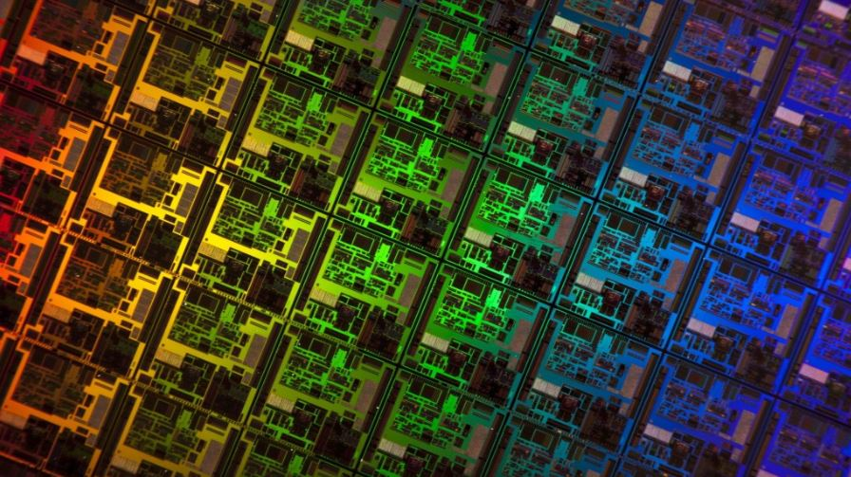
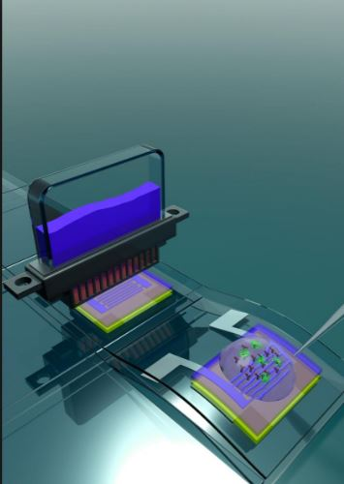


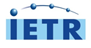
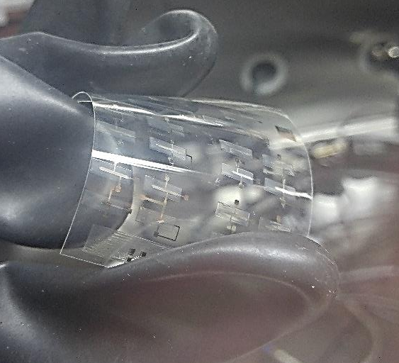
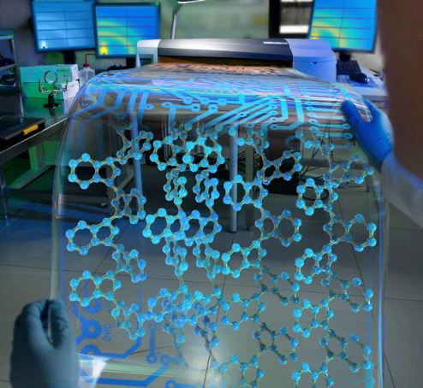
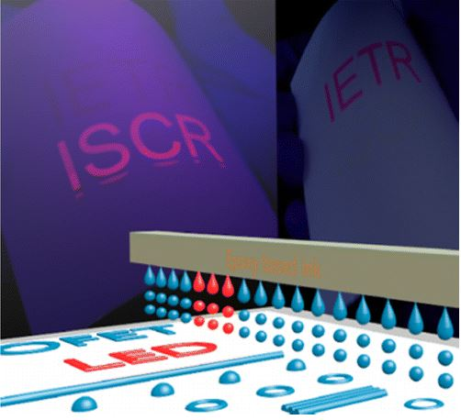
Development of Inkjet Printed N-type Organic Electronics :
OFETs and Circuits.
Seung Jae, Moon^{1, 2}
sjm12012@gmail.com
Wenlin Kuai¹, Byung Seong Bae², Tayeb Mohammed-Brahim¹, Maxime Harnois¹, and Emmanuel Jacques^{1*}
¹ Institut d'Électronique et des Télécommunications de Rennes, Université Rennes 1, UMR CNRS 6164, Campus de Beaulieu, 35042 Rennes Cedex, France
Tel.:33-2-23-23-66-91, E-mail: emmanuel.jacques@univ-rennes1.fr
² Department of Display Engineering, Hoseo University, Asan, Chungnam 336-795, Republic of Korea
우편번호 바꼈습니다.
Notes:
Good evening, ladies and gentlemen.
My name is Seung Jae Moon, and i`m master course student in Hoseo Univ. and I was worked as an internship student of the I.E.T.R in France.
Today`s my topic is the inkjet printing process, and the title is ‘the development of printing OFET’.

Slide 2
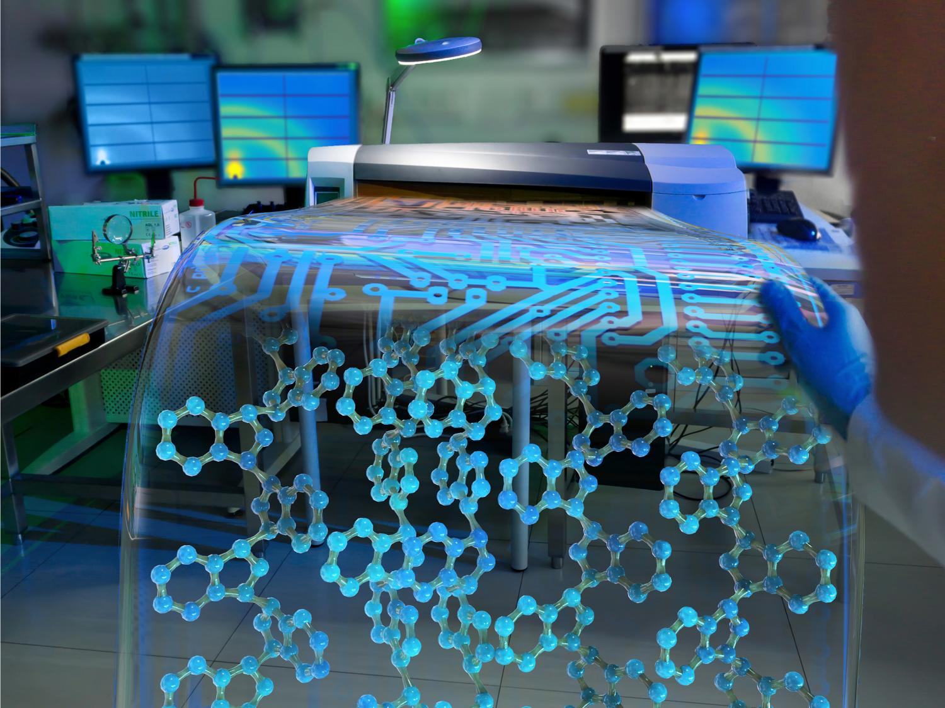


IMID
2016
CONTENT
Introduction
Experiment
Result & discussion
Morphological control
OFET electrical behavior
Electrical stability of printing OFET
Simple elementary electronics
Conclusion
Notes:
This is the contents.
At first, I will start using brief introduction which is contains about the basic of inkjet printing. And after, I will introduce the process of fabrication.
And in this result & discussion, we I will talk about the morphological control of the insulator using which is epoxy based ink and talk about the properties of OFETs and electronics such as the invertor and 5 stage – ring oscillator using by this printing technology. Finally, it will be finished with the summary of conclusion.

Slide 3

01. Introduction
Inkjet printing technology
Overlap
Notes:
Introduction

Slide 4
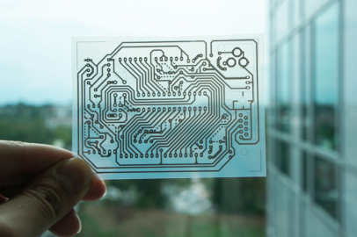
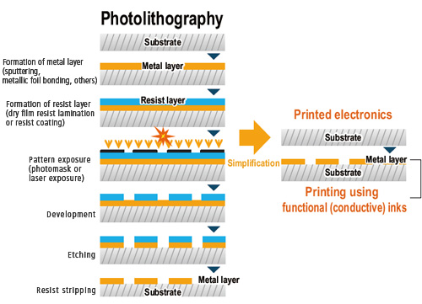
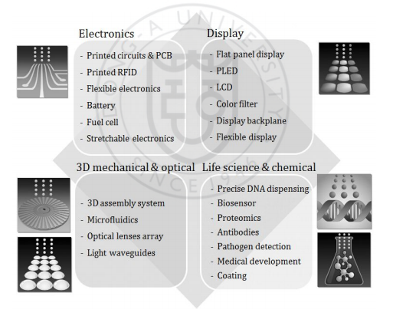

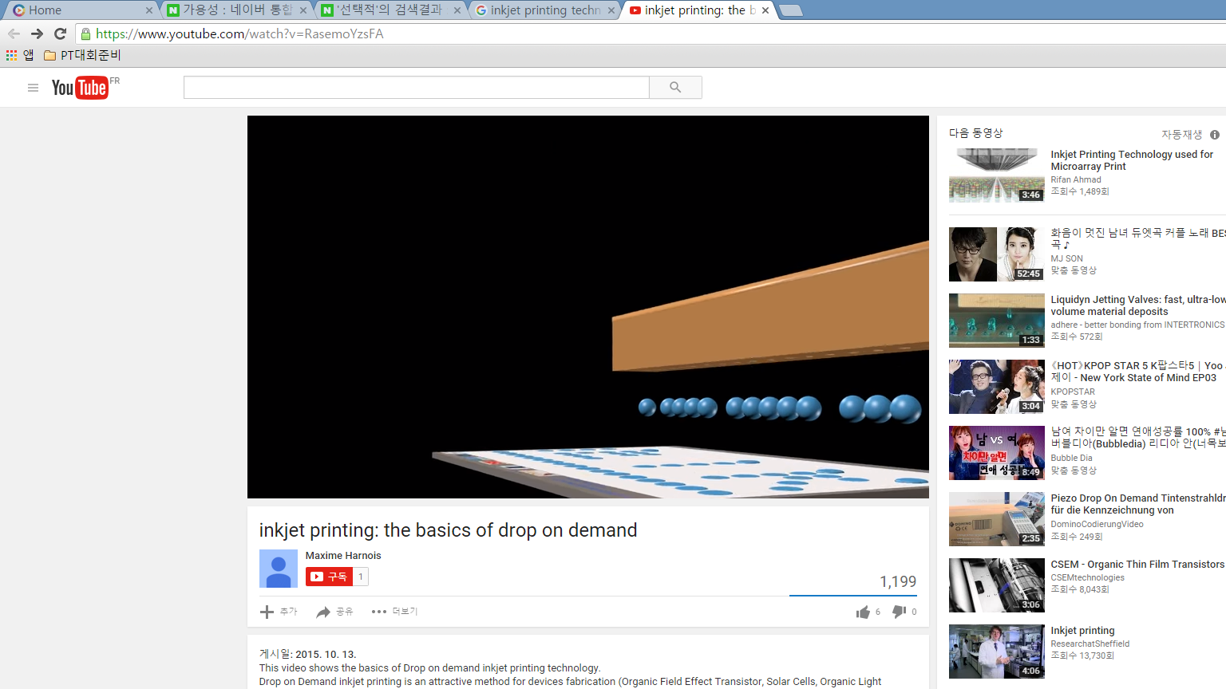
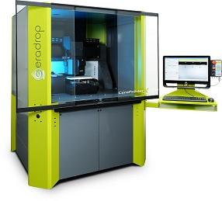

IETR
Hoseo Univ.
Introduction – why printing?
Simple
-Low cost
Non vacuum/R.T process
But!
Printing accuracy highly depend on substrate and deposited materials (ink)
Substrate surface wettability & ink reological parameters
Printing parameters are important.
drop spacing, substrate temperature
Difficulty of nm-process
Drop size ≥ 50 ㎛
Environment-
friendly process
Fast & Wide
Selectively printable process.
Low consumption of matterials.
Minimize the waste gas, waste fluid.
Large area process.
High speed and productivity.
Notes:
Why we trying to use the printing technology.
There is the several advantages.
At first, process becomes simple it can be realized the simple process. In the printing process, the mask which is used in the photolithography is not necessary. It is a non-contact process that selectively deposits a wide range of materials onto a wide range of substrates in a drop-by-drop manner. Ink consumption and material wastage are minimal. So, these two advantages mean, the inkjet printing is the low cost and environment friendly process..
another reason is the non vacuum and room temperature process. Thereby using the non vacuum and room temperature, it makes a lot of possibilities in the electronics, display area. Especially, it is suitable for the flexible devices. At last, It is suitable for a wide range of production scales, from prototyping to large-scale industrial production.
But, the printing process performance(?) depends on the dimension, and structure layout of target devices and material properties.

Slide 5
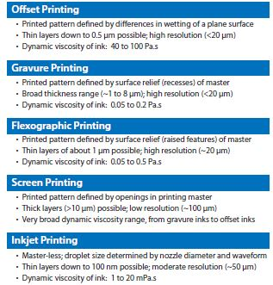
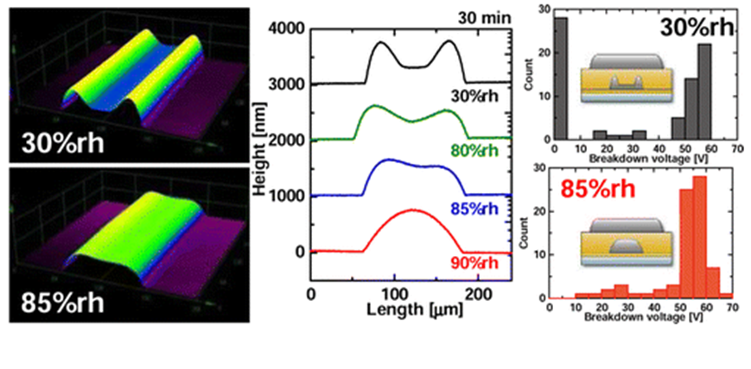
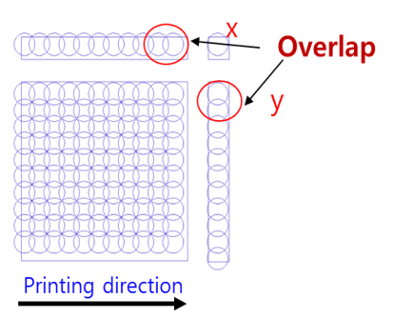
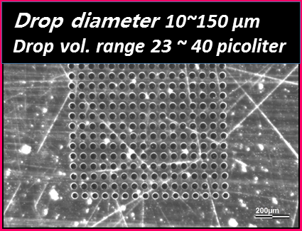
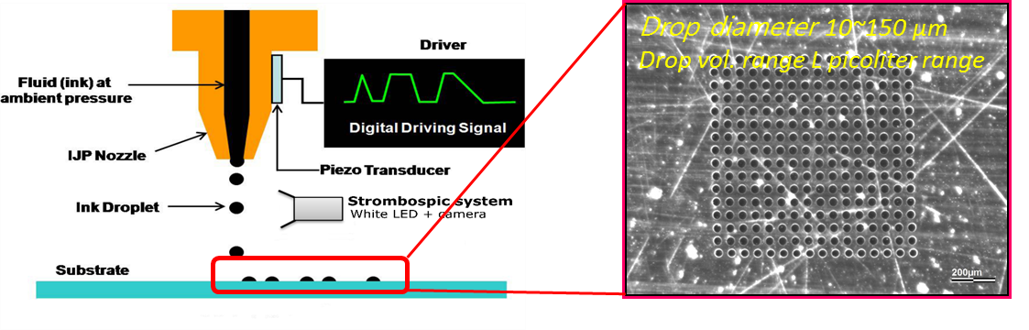
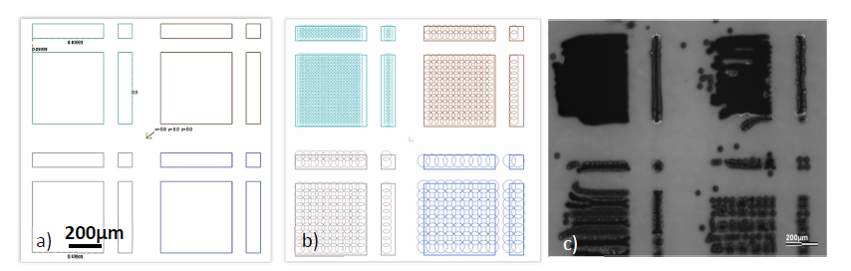
IETR
Hoseo Univ.
Introduction – Ink jet printing technology
Parameters to adjust :
Firing voltage
Shape of temporel voltage signal
Frequency of jetting
Source : Fukuda, Kenjiro, et al., ACS applied materials & interfaces 5.9 (2013): 3916-3920.
Notes:
The inkjet printing technology produces droplets of the ink contained in the fluid channel, with diameters ranging from 10 to 150 μm,⁶ which approximately corresponds to the diameter of the nozzle. The volume of the droplets is in the picoliter range.
These drops were controlled by the several parameters. Firing voltage, shape of temporel voltage signal and frequency of jetting.
And also, each drops were formed dropped both the x and y axis direction of with overlap. The overlap size is related to the film formation as shown in these figure,
Obviously, numerous works focus on printed semiconductor morphology

Slide 6
IETR
Hoseo Univ.
Introduction – Why N-type?
P-type organic semiconductors for OTFTs
N-type organic semiconductors for OTFTs
Year | Material | Mobility (cm2/Vs)
2001 | Dioctadecyldithiaanthracene | 0.01-0.02
 | DH-FTTF | 0.02-0.03
2002 | Pentacene precursor | 0.89
 | BP2T | 0.66
 | DH-FTTF | 0.11
2004 | PQT-12 | 0.14
2005 | Tetrathiafulcalenedericatives | 0.06-0.42
 | Rubrene | 0.7
 | DHTAnt | 0.5
 | Hybrid acene-thiophene | 0.12-0.5
 | Pentacene | 7
2006 | TES-ADT | 0.1
2007 | BTBT | 0.44-1.71
 | TIPS pentacene | 1.21
2008 | diF-TESADT | 0.1~1.0
2009 | PXX derivatives | 0.4~0.6
2010 | PDBT-co-TT | 0.94
 | diF-TESADT+PTAA | 2.08
Year | Material | Mobility (cm2/Vs)
2002 | Quinodimethane | 0.005
 | BBL | 1.4 ~ 5.0 x 10⁻⁴
2003 | DFH-4T | 0.048
 | DFH-5T | 0.026
2005 | DFHCO-4T | 0.6
 | Thiazolothiazole derivative | 0.3
 | DFCO-4T | 0.45
2007 | Dicyanomethylenesubstituted thienoquinoid oligomers | 0.16
 | Fluorinated PeryleneDiimides | 0.042
2008 | TIFDMT | 0.1 ~ 0.16
 | 60PCBM | 0.2
 | SnCl₂Pc | 0.3
2009 | PDI-FCN₂ | 0.1
 | C₆₀TH-Hx | 0.02
2010 | Core-Expanded Naphthalene Diimides | 0.5
 | P(NDI₂OD-T2) | 0.18
For advanced TFT with p-n junction study on n-type organic semiconductor is expected.
Source : Sun Hee Lee (2011), et al., Dissertation for the Degree of Doctor of Philosophy, Kyung Hee University, Seoul, Korea
Notes:
The most important factor parameters of OTFT characteristics depends mostly on organic semiconductor property. Several research groups have been developed soluble organic semiconductors which provide high mobility and good environmental stability. P-type OFETs are well developed now even if fully all organic P-type OFETs are still in way. N-type OFETs performance do not reach that of till now the P-type TFT. standard. Espectially, The pentacene has been reported to exhibit mobility of order 1 cm2/Vs which is comparable to the mobilities exhibited by amorphous silicon transistors. There are several reasons why development of high-performance n-channel organic TFT materials has lagged behind that of p-channel materials.

Slide 7
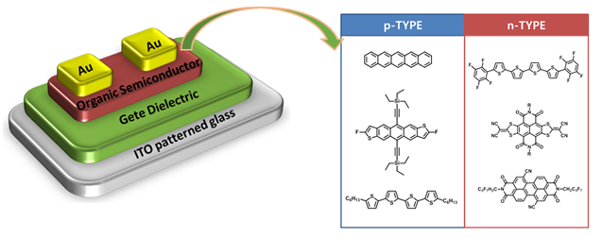
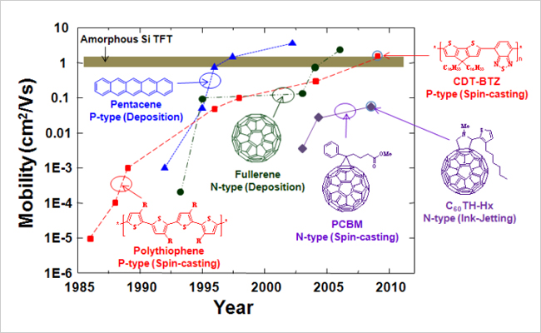
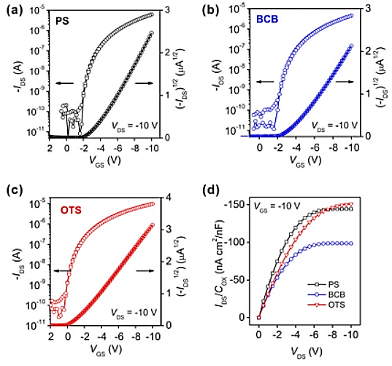
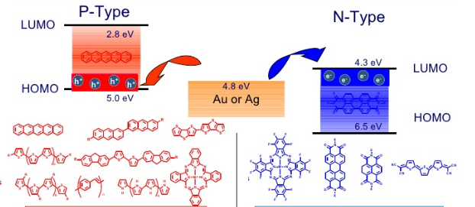
IETR
Hoseo Univ.
Introduction – N type Organic materials
Source :Zhang, Xiao-Hong, Shree Prakash Tiwari, and Bernard Kippelen.
Organic Electronics 10.6 (2009): 1133-1140.
N type organic material
High φ suited for injection of hole/electron into HOMO/LUMO
Small electron affinity
Au 4.8~5.1 eV
Ag 4.1 eV
Source : Introduction to Organic Electronics– Research Overview in Yan’s Group
Notes:
The first reason is source-drain metal which is typically used Au, Ag and other noble metals with high work functions better suited for injection of holes into the HOMO than that of electrons into the LUMO for n-type organic semiconductors.
second reason is related small electron affinity of un-substituted oligothiophene and oligoacene. Because the low electron affinity results in low electrical stability,

Slide 8
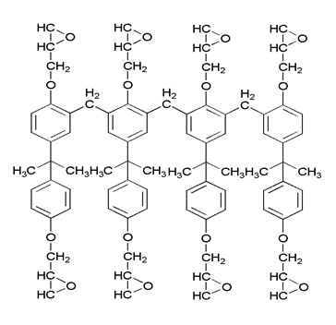
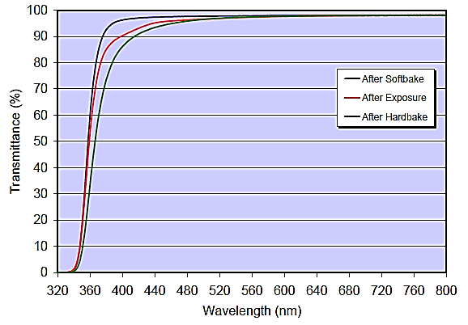
IETR
Hoseo Univ.
Introduction – Epoxy based ink (Su-8)
8 bezene rings
8 epoxy groups
(≒7 kDa)
cyclopentanone
Molecular structure of Su-8
Optical Transmittance of Su-8
Source : Process guideline for Su-8, ©Micro-chem.
Promising inkjet Processing Properties
Promising Physical Properties
Un-cross-linked photoresist.
Low molecular weight
☞ Jettable
Polymerization occurred under UV light after jetting ☞ easy drop ejection (small molecule)
Above 365 nm exhibiting low propagation losses ☞Transparent
Good insulator with high breakdown electric field
Wettability for the contact angle ☞ ink formation ☞ hydrophobic surfaces.
(Su-8; 7 KDa, hard to jetting ≥ 20KDa)
source: ACS Appl Mater Interfaces. 2015 Oct 7;7(39):21975-84
Notes:
The first reason is source-drain metal which typically used Au, Ag and other noble metals with high work functions better suited for injection of holes into the HOMO than that of electrons into the LUMO for n-type organic semiconductors.
second reason is relatively small electron affinity of un-substituted oligothiophene and oligoacene. Because the high electron affinity was related with the electrical stability,

Slide 9
02. Experiment

Slide 10
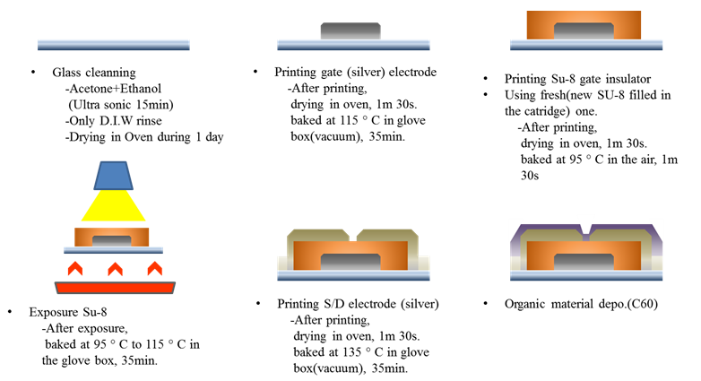
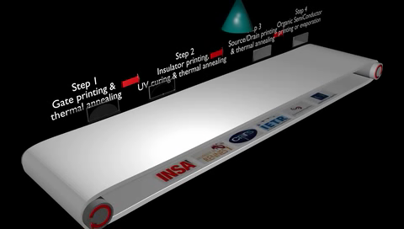
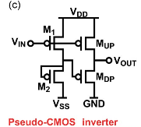
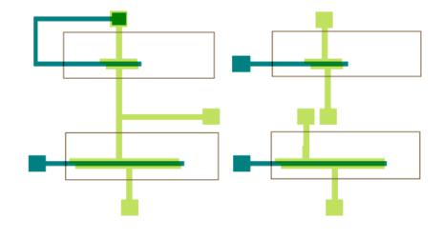
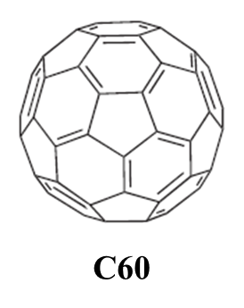
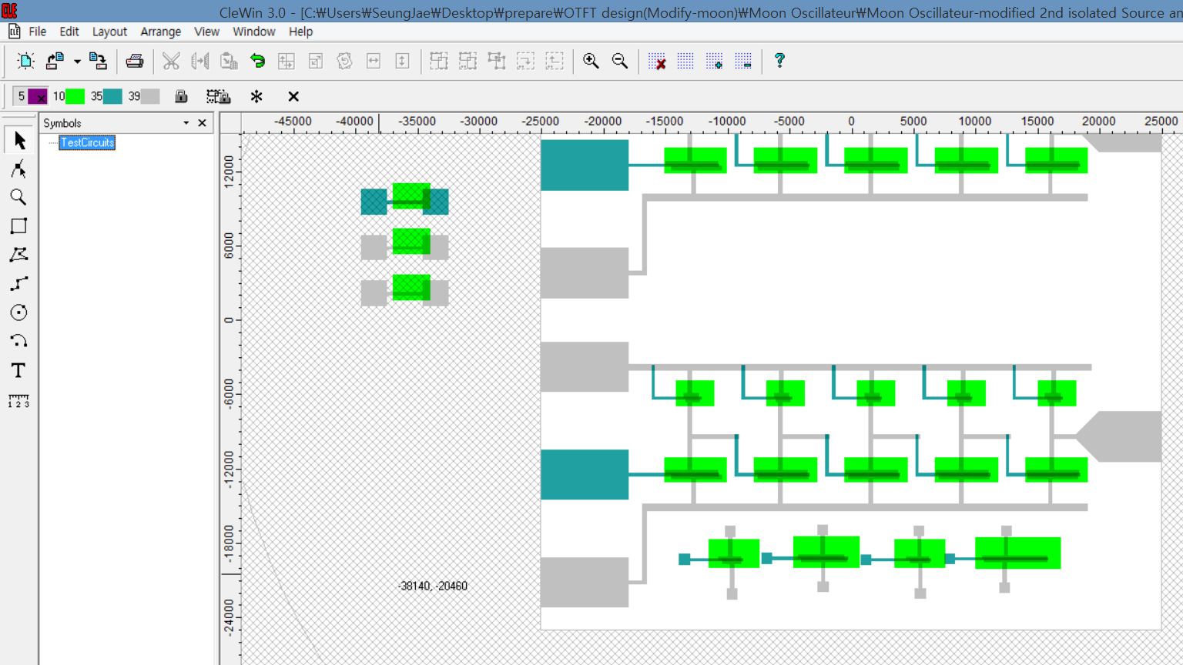
(a)
IETR
Hoseo Univ.
Inverter & Oscillator fabrication & driving
High electron affinity
Low cost
(2.26 $ / g)
(b)
Inverter
Testing TR
(c)
High yields
(d)
(a)
Figure 1. (a) Printing process for OFET and fabrication period. (b) Circuit diagram of pseudo-CMOS inverter. (c) Design for inverter and same dimension of testing TR (d) Design for Oscillator
The Printing process for the n - type OFET is shown (video) (a). TFT was produced by all the printing process except an evaporated active layer (C₆₀).
Optimized process condition of each layer
Gate, S/D : Ag,
Insulator: Su-8 (epoxy based ink))
Active layer: evaporated C₆₀ (n-type organic material)
Pseudo-CMOS Inverter was used and tested 5stage ring oscillator
Notes:
Fullerene C60 has a high electron affinity and yields provides high-performance FETs.(I think TFT is better than FET)

Slide 11
03. Result and discussion
Morphological control
Electrical behavior of the IJP OFET
Electrical stability of printing OFET
Simple elementary electronics

Slide 12
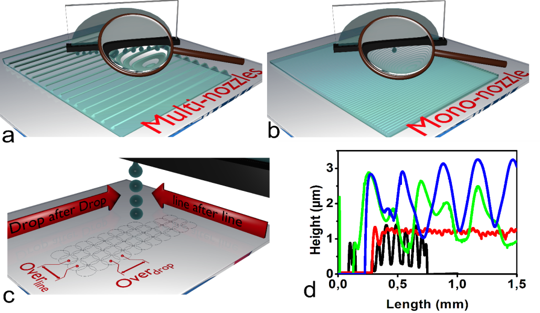
IETR
Hoseo Univ.
Morphological behavior
Figure 2. Schemes showing morphological control of printed insulator by number of nozzle (a) multi nozzle, (b) mono nozzle, (c) two overlapping distances(Over_{drop}&Over_{line}), (d) 4 types of printing Su-8 (epoxy based ink for insulator) profiles.
Morphologies of insulator (SU-8) depending on different parameters:
Drop Overlap, line capillarity(distance between each nozzle) and number of jetting nozzles.
2. Formable morphology of Su-8
Smooth
Small wave
Large wave
Multi-nozzle wave

Slide 13
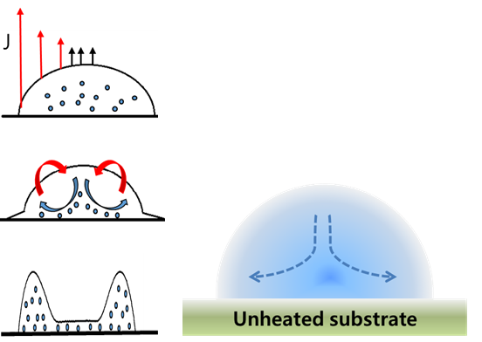
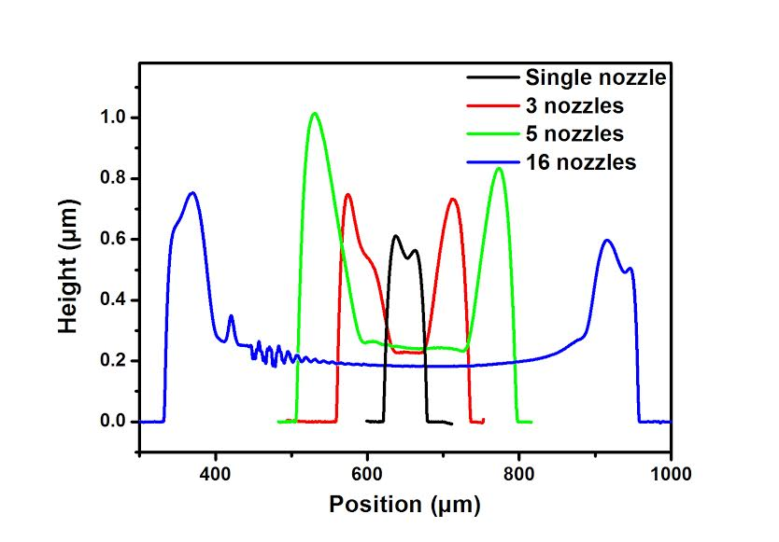
IETR
Hoseo Univ.
Morphological behavior
1. When a drop containing particle is drying, the particles transport from center to edge by replenishing flow as shown in figure 3.
2. Figure 4 shows the effects of the number of jetting nozzles .
Multi nozzle printing is suitable.
Reducing the number of the activated jetting nozzles (from 16 to 1) results in a thicker insulator film (low gate leakage current).
5. Due to the coffee strain effect, peaks and valley are formed on the printing layer.
Figure 3. Illustration of radial flow that occurs during drying
Figure 4. Profile of inkjet printing films in function of number of activated printing nozzles.

Slide 14
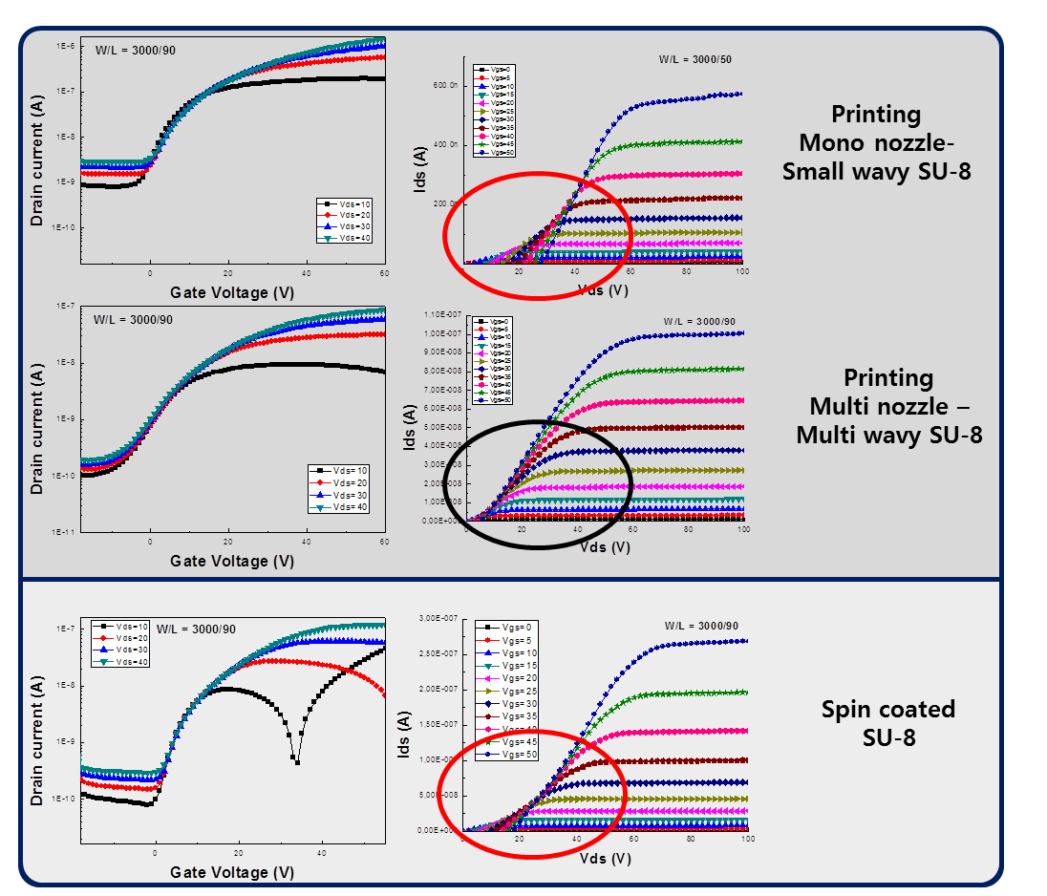
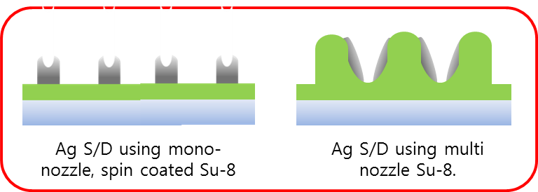


IETR
Hoseo Univ.
Insulator morphological impact
Electrical behavior
Multi nozzle was better in terms of morphology
It seems that insulator morphology affects the leakage current and the contact reistance between semiconductor and S/D metal.
The evaporated organic semiconductor will have a different packing on the different insulator surface. And it can also affects on carrier trapping which is main reason for electrical in-stability.
Figure 5. Electrical characteristics of the printing OFET using different morphologies of insulator.

Slide 15
IETR
Hoseo Univ.
Electrical behavior of the IJP OFET
W/L = 5000/100 (µm) | Vds = 20 V | Multi nozzle OFET
V_{th} (V) |  | 6.55
S.S. (V/dec) |  | 4.5
I_{off} (A) |  | 7.75x10⁻¹¹
I_{on} (A) |  | 1.06x10⁻⁵
I_{on/Ioff} (A) |  | 1.37x10⁵
μ_{sat} (cm²/V.s) |  | 2.26x10⁻¹
(a)
(b)
Figure 6. Printing n-type OFET electrical characteristics and electrical parameters
(a) transfer characteristics (b) output characteristics.
We fabricated IJP n-type OFET using multi activated nozzle on Su-8 (epoxy based insulating layer).
The field effect mobility of 2.26x10⁻¹ (cm²/V.s) was obtained with n-type organic material C₆₀.

Slide 16

IETR
Hoseo Univ.
Electrical stability on printing OFET
Figure 7. Hysteresis characteristics of OFET using multi nozzle.
Figure 8. Drain-source current vs time behavior under continuously applied constant drain-source voltage (VDS = 10V) and gate-source voltage (V_{GS} = 20V)
We can obtain some information about capacitance, carrier density and flat band voltage variation from the following relation.
β is very low (0.34) and is often related to the interface between the semiconductor / insulator.
Obseved β , τ and correlation factor R² shows high stability of developed OTFT.
Notes:
the hysteresis analyse that allows evaluating the threshold voltage shift with a forward and backward voltage scan. We can obtain some information about capacitance, carrier density and flat band voltage variation with the following relation.
With a τ value of 1.6x10⁶ s and a correlation factor R² = 0.998, the printed OFET using organic insulator, silver electrode and C60 as organic semiconductor could be considered as a stable device.

Slide 17
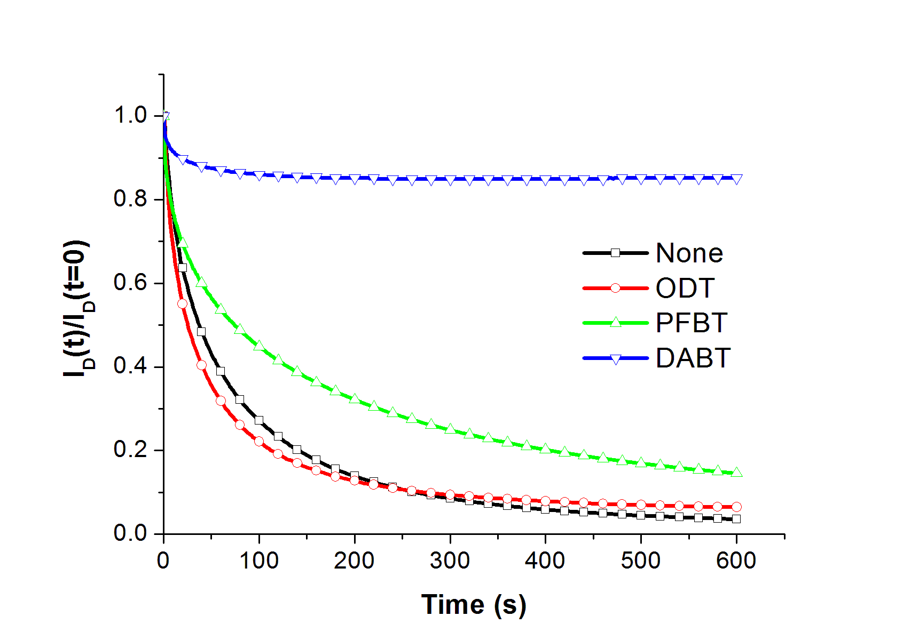
IETR
Hoseo Univ.
Electrical stability on printing OFET
More Stable
With Ag S/D
With Au S/D
Printed Ag | None functionalize Au | Au-ODT | Au-PFBT | Au-DABT
93 % | 8 % | 11 % | 18 % | 88 %
Figure 9. Comparison of the drain-source current vs time behaviour under constant drain-source voltage between IJP OFET using Ag and Au (with different chemical functionalization).
OTFT with Ag S/D shows better electrical properties than Au S/D, the stability is superior with Ag S/D.
It seems that the interface between S/D and semiconductor plays an important role.
Chemical functionalization is not required when we using use the Ag S/D
Notes:
the hysteresis analyse that allows evaluating the threshold voltage shift with a forward and backward voltage scan. We can obtain some information about capacitance, carrier density and flat band voltage variation with the following relation.
With a τ value of 1.6x10⁶ s and a correlation factor R² = 0.998, the printed OFET using organic insulator, silver electrode and C60 as organic semiconductor could be considered as a stable device.

Slide 18
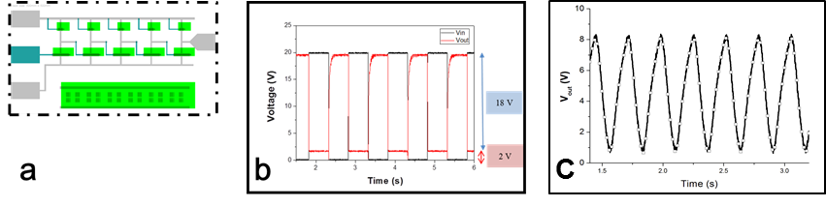
IETR
Hoseo Univ.
Simple elementary electronics
Figure 10. Inkjet printed pseudo-CMOS circuits using N-type OFETs → N channel OTFTs
(a) design of ring oscillator constituted by 5 pseudo-CMOS inverters (b) input and output voltage of inkjet printed pseudo-CMOS inverter (c) output voltage of a 5-stage inkjet printed oscillator.
By using an inverter logic gate made by N type OFET, 5-stage ring oscillators have been designed and operated successfully working.
Constant With supply voltage of V_{DD} = 10 V, oscillation from 0.7 V to 8.2 V have been observed (supply voltage has been applied during 12 hours). And operated stably for over 12 hours.
Such experimental results show were shown a uniform behavior and an interesting electrical stability to perform in more complex devices.

Slide 19
04. Conclusion
Summary

Slide 20
IETR
Hoseo Univ.
Summary
Morphological control
IJP OFET with insulator by multi nozzles shows better performance than that of mono nozzle jetting or spin coating.
Morphology control is important and affects the gate leakage current and S/D interface.
N type OFET using C₆₀
We`ve got an filed effect mobility of 2.26x10⁻¹ (cm²/V.s) which have 10 times more higher than previous result of `09 (2.00x10⁻² (cm²/V.s))
Insulating layer using epoxy based ink (Su-8)
Focusing on devices achieved using polymeric gate insulator (i.e., independent of processing technics, electrodes material, OSC material), a mobility in the range 0.01−1 has been obtained. 이건 고민좀 해보는 게 좋을 듯
These original experiments prove that epoxy based inks are an alternative versatile material to achieve OFET devices.
Stability of IJP n-type OFET
The fabricated OFET showed a good electrical stability compared to the previous ones. The electrical stability was investigated by hysteresis analysis and continuous polarization.
β is very low (0.34), and the τ and correlation factor R² shows high stability of developed printing OTFT.
When it compared with the Au, OFET with Ag have a high stability.
Simple elementary electronic circuit using printed OFET
Based on optimized electrical stability and parameters, the Inverter, 5 stage ring oscillator were fabricated and showed good stability up to 12 h operation.
Notes:
Uniformity 가 가끔 나오는데 균일성에 대한 실험결과가 없는데 uniformity 가 왜 나오는지 잘 모르겠어요 설명을 해 주세요….

Slide 21
THANK YOU

Slide 22
Additional data

Slide 23
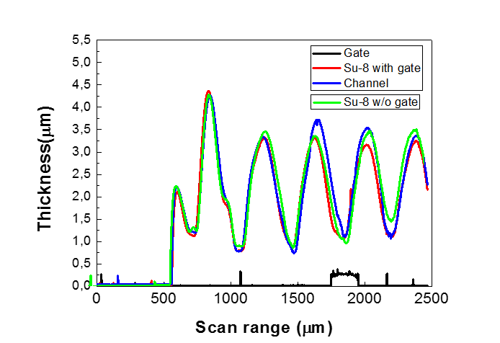
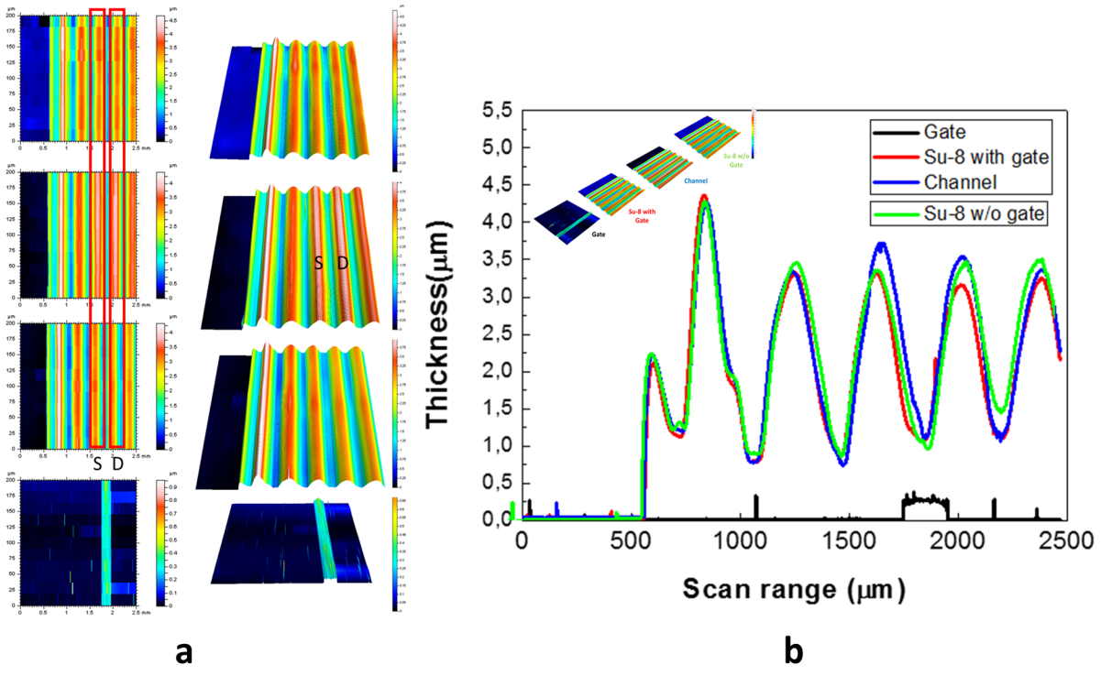
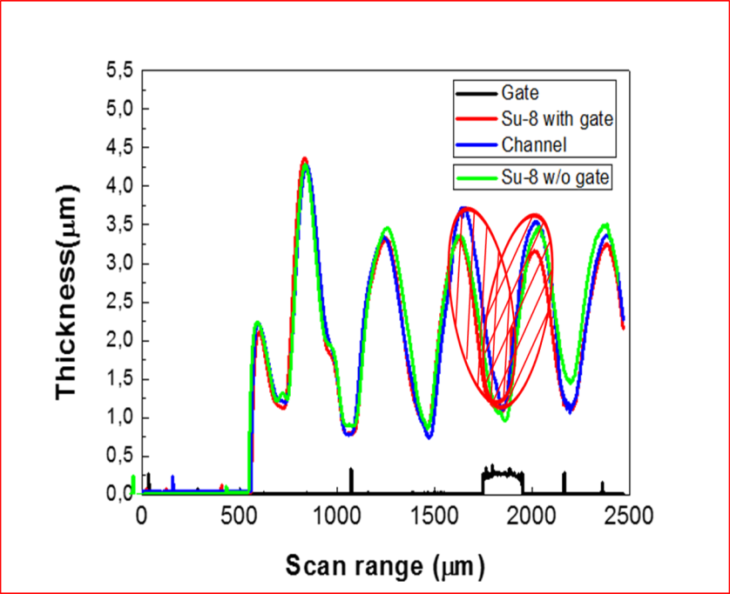
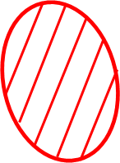
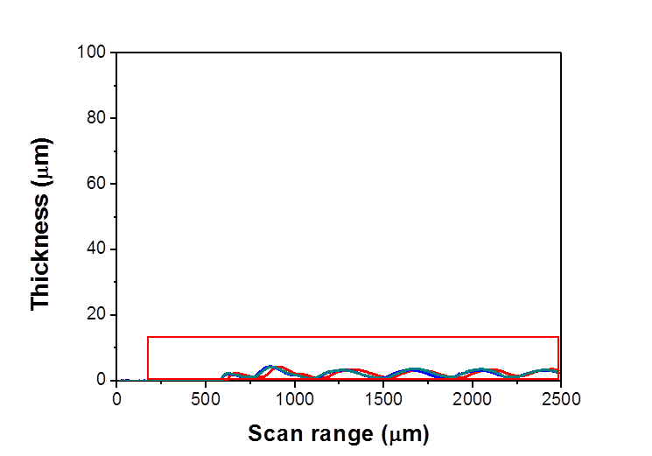
IETR
Hoseo Univ.
Morphological behavior
Overlap of the lines can lead to obtain a periodic wavy profile.
Source and drain were well defined even if there were printed on the peaks.
In this configuration, a channel is located on the valley.
(a)
(b)
Figure 5. (a) three dimensional profiles for each layers of fabricated OFET. (b) two dimensional profiles along the perpendicular of printing direction for fabricated OFET.

Slide 24
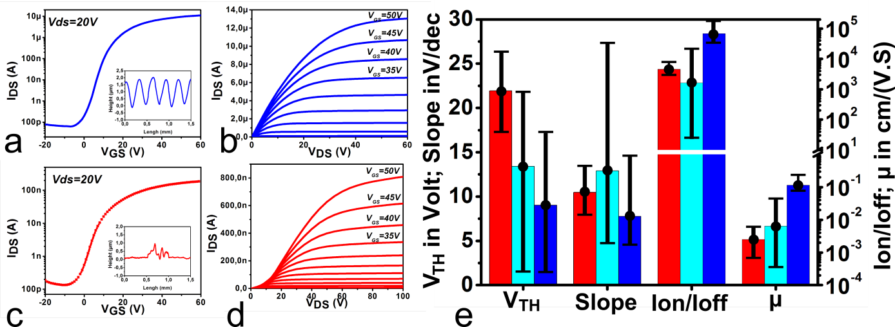
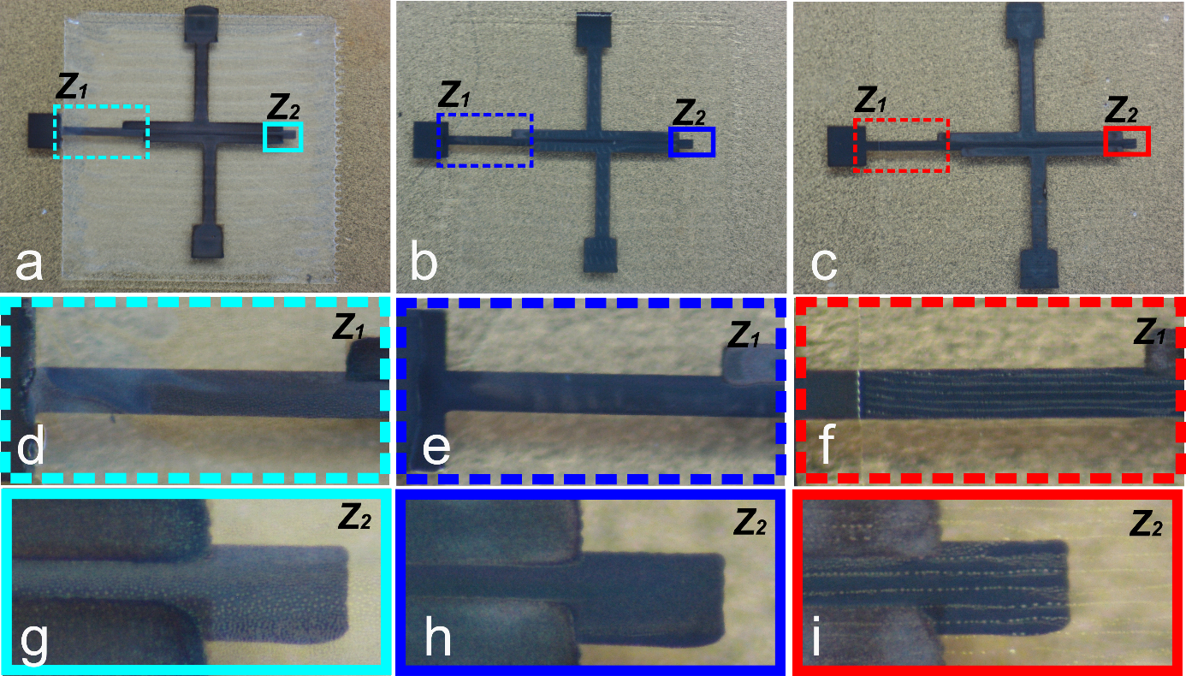
IETR
Hoseo Univ.
Bubble effect
multi printing method.
(High amount bubbles)
multi printing method.
(Low amount bubbles)
Mono printing method.
(High amount of bubbles)
Figure 5. OFET Electrical behaviors versus insulator morphology a) OFET fabricates using multi¹ printing method. High amount bubbles: multi, b) OFET fabricates using multi printing method. Low amount of bubbles: multi; c) OFET fabricates using mono printing method;
We can control the amount of bubble using purge shortly before printing.
As a result, it will benefit from this drawback in order to investigate pinholes effect on OFET electrical characteristics.

Slide 25
Spin coated SU-8 vs printed su-8
IETR
Hoseo Univ.
Su-8 dependence – thickness
IETR
Hoseo Univ.
(a)
Table. 1. Hysteresis characteristics of IJP OFET on the different thickness of Su-8
Hysteresis | V₁ | V₂ | △V (V₁-V₂)
700 ㎚ | 11.986 | 7.863 | 4.123
1 ㎛ | 6.76 | 1.252 | 5.508
1.5 ㎛ | 9.356 | 4.7 | 4.656
(b)
(c)
(d)
Fig. 16. Electrical characteristics of IJP OFET on the different thickness of Su-8 (a) I-V curve (b-d) output characteristics.

Slide 26

Spin coated SU-8 vs printed su-8
IETR
Hoseo Univ.
Spin coated Su-8 vs IJP(Inkjet pinted) Su-8
IETR
Hoseo Univ.
For the more definitely to confirm of main factor, we were tried to fabricate the OFET using IJP Ag gate and S/D with 2 different way of insulator.
Fig. 6. electrical characteristics of the IJP OFET using IJP Ag gate & S/D and insulator(spin coated vs IJP)
When we change the IJP Su-8 into spin coated Su-8, the characteristics of the OFET wasn`t change.
It seems to be the main problem of the fabrication is on the S/D electrode formation.
When we used the same epoxy based ink of Su-8 using different methods , there is not so big difference and no visible improvement.

Slide 27
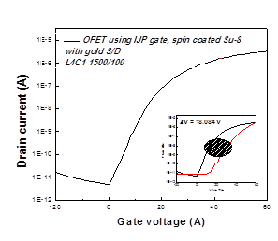
Spin coated SU-8 vs printed su-8
IETR
Hoseo Univ.
Spin coated Su-8 vs IJP(Inkjet pinted) Su-8
IETR
Hoseo Univ.
For the more definitely to confirm of main factor, we were tried to fabricate the OFET using IJP Ag gate and IJP Su-8 (1.5 ㎛) with gold S/D (50 nm).
Fig. 7. electrical characteristics of the IJP OFET using IJP Ag gate & IJP Su-8 gold S/D.
When we change the Ag S/D(200 nm) into Au S/D(50 nm), characteristics of the OFET was totally changed.
It seems to be the main problem of the fabrication is on the S/D electrode formation.
ven using the spin coated Su-8, the electrical characteristics were similar with IJP Su-8. and whole the OFETs have a uniform characteristics as shown in Fig. 10.
But, hysteresis characteristics was poor. It seems to be attributed to the interface between C₆₀ and Gold S/D.

Slide 28
Spin coated SU-8 vs printed su-8
IETR
Hoseo Univ.
Spin coated Su-8 vs IJP(Inkjet pinted) Su-8
IETR
Hoseo Univ.
For the stability, some functionalization method was used in the photolithography work as Malo Robin did. So, we tried to use the DABT for IJP OFET(Ag gate & spin Su-8) which the gold S/D electrode used.
Fig. 8. whole the transfer characteristics of the IJP OFET
using IJP Ag gate, spin coated Su-8 and gold S/D. (DABT)
Fig. 9. hysteresis characteristics of 4 OFET which selected arbitrary. (△V_{av} =4.75 V)
When we used the DABT functionalization on the IJP OFET, it can reduce the △V in the hysteresis curve as a photolithography with DABT.
But, even △V s were decreased, it`s higher than IJP OFET using Ag S/D. (△V_{DABT} = 4.75 V, △V_{Ags/d} = 1~1.5 V)

Slide 29
IETR
Hoseo Univ.
Shifting test (shifting gate & S/D or Su-8)

