Slide 1
ELECTROPLATING PART 1
HOSEO UNIVERSITY
Electro Device Laboratory
Yeong Jo Baek
Notes:
Hello. My name is Yeong Jo Baek
I’m fourth grade and member of electronic device laboratory
Let me tell you about electroplating

Slide 2
Index
What is Electroplating?
The need for plating
Plating process
Plating equipment
Purpose of research
Notes:
i prepared that sequence.
First we check about what is electroplating. simply
And then I explain about the need for plating, plating process , equipment and goal.

Slide 3
What is Electroplating?
Electroplating is a process that uses electric current to reduce dissolved metal cations so that they form a coherent metal coating on an electrode.
Notes:
that is a dictionary definition of electroplating
In short, Electroplating is a kind of plating and uses electric current.
For more information, I will explain more.

Slide 4
The need for plating
By the increasingly small size of the semiconductor devices, mechanical fabrication has limitation.
Sputtering compared to plating has very long process time and equipment is so expensive.
Notes:
In the past, plating is used for decoration and protection. also plating was assessed as hard job in Korea.
But now in making probe pin for testing semiconductor, because of increasingly small size of the semiconductor, mechanical fabrication has limitation. So we research making probe pin by electroplating.
Also we can use sputter instead of electroplating but sputter equipment is very expensive and it takes too long time.

Slide 5
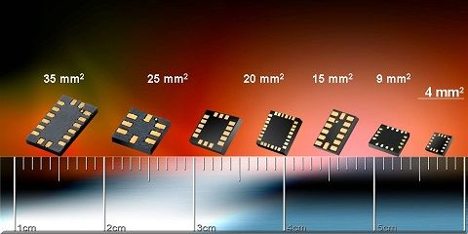
Chip size decreasing more and more!
Notes:
This picture shows the decrease of the chip size.
Over time, technology is evolving. The size of the device, get smaller and smaller.
Because testing probe is smaller then semiconductor, mechanical fabrication of the probe pin has limitation.
that is the reason why I research electroplating.

Slide 6
Plating process
Notes:
Let's investigation about plating process.
Electroplating process is largely divided into three sequence .
First. ' Pre-treatment ' to the surface of the base material before plating.
Second. ‘plating’.
Third. ‘Post processing’ to finish plating.

Slide 7
Pre-treatment
Electrode sputtering
Pre-treatment process
To clean the surface of the electrode sputtered.
Most of the defective goods caused by pre-treatment.
so pre-treatment is very important
Defatting
Soft(micro) etching
Help uniform contact of Cu particles
10% Sulfuric acid
prevent of pollution of plating solution and oxidation of Cu.
Remove oxidation, fingerprints, and oil
Notes:
At first we coat electrode, to coat electrodes on the substrate, we sputtered a Cr or Ti and.
This process is important. Because most of the problems occurred by bad pre-treatment process.
The pre-treatment have a direct impact on the quality of plating.
Pre-treatment is largely divided into three sequence .
First step is ‘defatted’ it is remove oxidation, fingerprints, and oil.
Second is ‘soft etching’ To increase adhesion of Cu.
Last step is dipping in 10% sulfuric acid for prevent of pollution of plating solution and oxidation of Cu

Slide 8



Plating process
-
+
Cathode
Anode
-
$${cu}^{2+}$$
$${cu}^{2+}$$
-
-
$${cu}^{2+}$$
-
$${cu}^{2+}$$
WAFER GLASS
$${cu}^{2+}$$
Cu
-
-ion
$${cu}^{2+}$$
Ti
Cu
Electrolyte solution
Notes:
I briefly explain the principles of electroplating.
The figure shows copper electroplating that we did.
Place the copper electrode to the anode and also place substrate to be plated to the cathode.
After that, flow the current , the copper of anode ionized into electrolyte and reduced on the cathode electrode.
Cu electroplating process is as follows.
First, we deposit the titanium by sputtering on the glass wafer and to increase the efficiency of the plating, a copper layer is deposited on it. Plating solution used in this experiment was copper sulfate.
It is source of copper ion and to increase the electrical conductivity. so serves to assist the flow of current.
We are researching about enhancing the quality of the plating by the addition of various additives.

Slide 9
Important Points
The type of electrode
What kind of metal used at electrode is important
Current density
Determine plating speed
Process time
High Temperature > Uneven plating thickness
Determine plating thickness
Temperature
Optimal temperature is important.
They are added to improve the quality
Concentration of solution
Reduced concentration > burning of high current area
Variety additives
Notes:
I will explain important points when plating we plate.
First. We have to choose what kind of metal we use for electrode.
Because of Some metal has good relation with Cupper and other some meter has bad relation with Cupper
Second. We have to consider current density and process time.
Plating speed and the thickness of plating are determined by them.
If you want to rapidly proceed, increasing the current density. But if too much, uniformity becomes poor. So to find optimal current density is important.
Next, we have to consider temperature. Because if temperature is too high, plating thickness becomes not uniform.
Also, we must check concentration of solution while plating. Because high current flow area can burn.
Last . We can add variety additives to improve the plating quality.

Slide 10
Post processing
Last process to finish plating
Chromate Coating or Sulfuric acid
Cleaing
dry
Remove the oxide layer and make gloss
Notes:
‘post processing’ is last process to finish plating.
First. To remove the oxide layer and make gloss, we can use ‘chromate coating’ or ‘sulfuric acid.
Second. We clean the wafer with DI water
And then we dry and finish the electroplating.

Slide 11
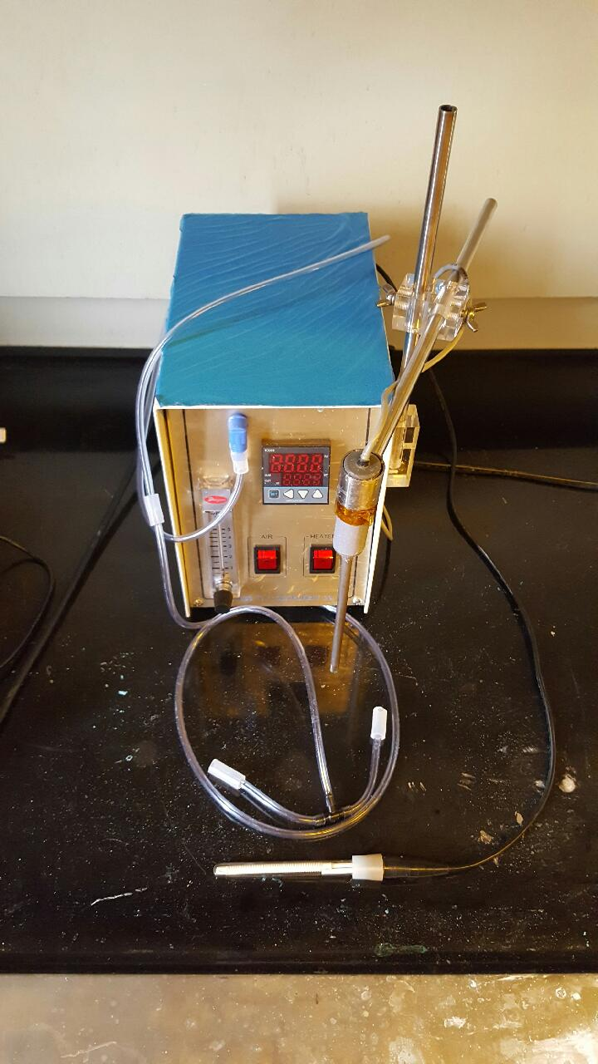
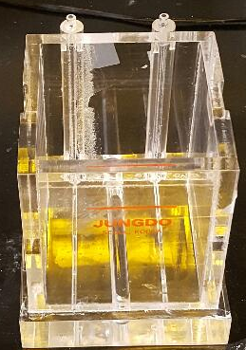
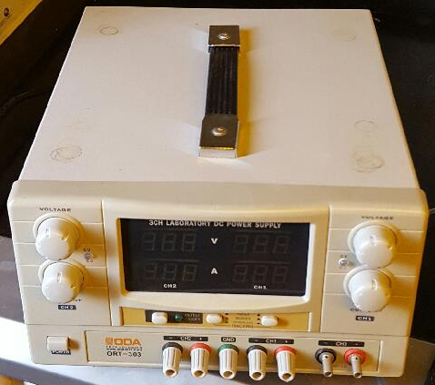
Plating equipment
Notes:
Those are some equipment that we are using for electroplating.
The left picture is power supply for fixed electric current.
In Middle picture, that equipment has two functions.
First it can make bubble for stirring
And it has thermometer and heater for temperature control.
The right picture is plating cell. We have two cells. One is 1L capacity and the other is 5L capacity.
also While there is no picture . We have filter for impurity removal.

Slide 12
Final goal
make fine semiconductor inspection probe pin by combining a plating process and a photo process.
Notes:
Lastly, I’d like to say the final goal of the research, it is to make fine semiconductor inspection probe pin by combining a plating process and a photo process.

Slide 13
ありがとうございます
Notes:
Thanks for listening
For more information about progress we had ,students Kim followed by presentation. Thank you.

