Slide 1
ELECTRO PLATING PART 2
HOSEO UNUVERSITY
ELECTRONIC DEVICE LABORATORY
KIM DONG GYU
Notes:
Hello everyone my name is donggyu kim.
I will be talking (→ talk) about the recent 2weeks of plating process that our team and I have been doing.

Slide 2
Table of Contents
1. Process
2. Results
3. Goal of Research
Notes:
The Contents will be
First, the process
Second, the results
And Last, the final Goal of the research

Slide 3
Process
Pre-treatment
Remove of organic, inorganic contaminants
Prevention of defect
Electroplating
Copper plating
Use of Plating equipment, Plating solution and Deposited wafer
Post Treatment
To improve the quality
Test
Confirm quality
Notes:
First the electroplating process.
The electroplating is divided into four processes, which is Pre-treatment, Electroplating, Post treatment and test
The effects of Pre-treatment process is first, it removes organic, inorganic contaminants and second, prevents defects
in the electroplating process, we use plating equipment, plating solution, copper plate and deposited wafer with chrome, titanium, copper
The effects of Post treatment is that it improves the quality of the uniformity and gloss.
Finally, we test it to check the quality of the samples uniformity, thickness and adhesion.

Slide 4
Pre-treatment
Acetone
Remove Organic
Sulfuric Acid(10%)
Prevent of pollution, oxidation
Dry
Remove Solution
Notes:
Next the Pre-treatment process
First, after removing organic contaminants with acetone
Second, we use sulfuric acid for a minute to prevent oxidation and pollution (→ oxide and contaminants)
Finally, After rinse with DI water, dry it with nitrogen gun

Slide 5
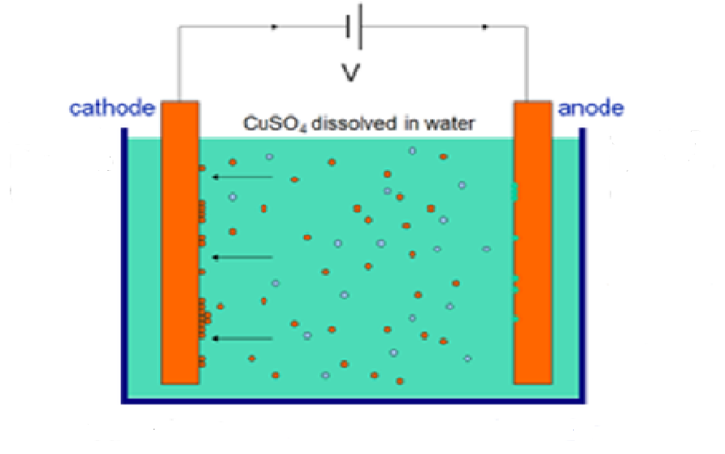
Electroplating
Power supply
Voltage apply
Copper plate
Add to Copper ion
Deposited wafer
Plate target
Deposited with Chrome
Deposited with Titanium, Copper
Plating solution
DI water
CuSO4
- Copper Ion source
- Electro conductance
(3) HCl
- Plating uniformity
Plating equipment
Agitation
Temperature maintenance
Notes:
Next Electroplating process
After filling the tank with plating solution
We connected the wafer to the cathode and the copper plate to the anode. Then we used the power supply to flow the current to accomplish electroplating.
We are using both Chrome deposited wafer and Copper on Titanium deposited wafer.
The plating solution is made up with mixture of Di water and copper sulfate which is the source of supply of copper ion, and also a small quantity of hydrochloric acid which increase the uniformity.
We controlled the temperature and used bubble (→ bubbled the plating solution) for uniform plating.

Slide 6
Post treatment
DI Water
Clean
Sulfuric Acid(10%)
Remove oxide layer and make gloss
Dry
Remove Solution
Notes:
Next Post treatment process
After cleaning the wafer with Di water, it is taken out from the tank
We build a gloss removing the oxide film by dipping it into the 10% sulfate acid solution
Finally, to remove the remaining solution we use nitrogen gun after DI rinse.

Slide 7
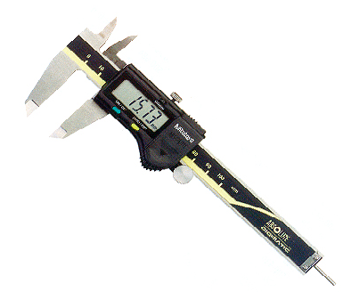
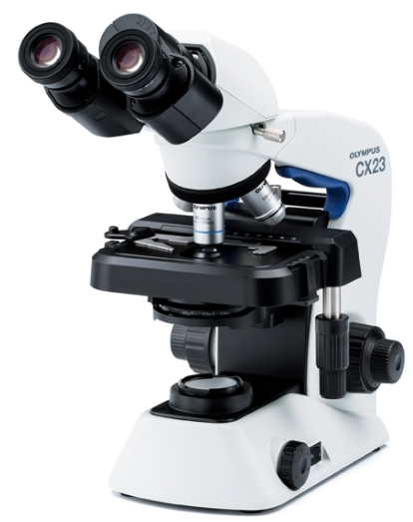
Test
Adhesion
Use of Tape
Plating area thickness
Vernier Calipers
Surface morphology
Microscope
Notes:
Next Test process
To confirm(→ check ) the adhesion we use tape on the plated wafer.(→ we did tape test)
And we used the Vernier calipers to measure the thickness of the plating area and also we confirm(→ observed) the surface morphology using the microscope

Slide 8
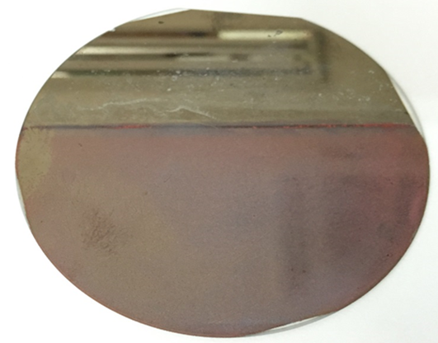
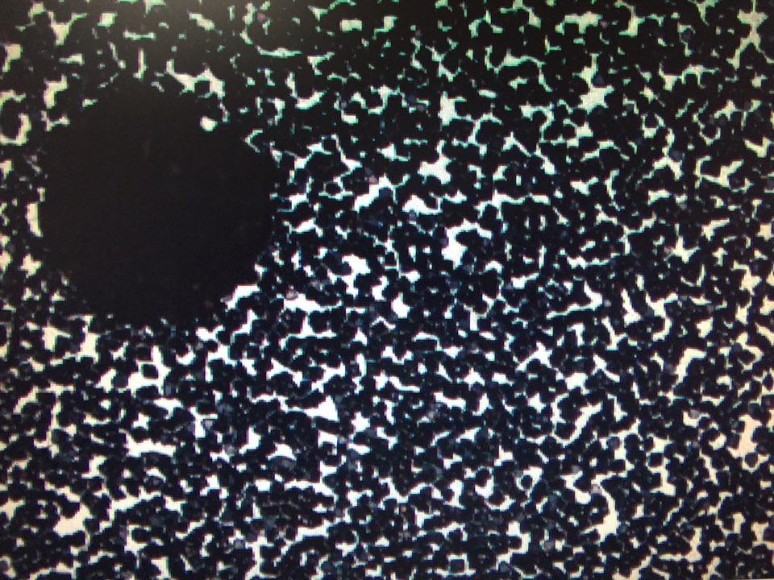
Results
Wafer | Cr 1125Å |  | Conclusion
Solution | DI water 1L + CuSO4 60g |  | Low plating uniformity Low adhesion to copper Rough surface
Condition | Voltage | 1.2 V
 | Current | 0.1 A
 | Time | 1hour
 | Temp | 32 ℃
Notes:
Process results.
These are the pictures and results for the wafer that is deposited by chrome with these conditions.
In this process we could find out that the uniformity of the plating bad and the adhesion of the copper isn’t good and also surface is ruff.
The picture below is a microscope picture of a wafer that is plated.

Slide 9
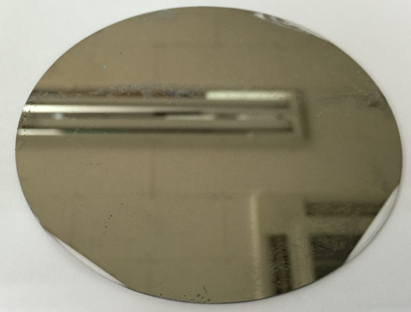

Results
Wafer | Cr 1125Å |  | Conclusion
Solution | DI water 1L + CuSO4 60g + HCl 10mL |  | Not plating Chrome etched
Condition | Voltage | 1.7 V
 | Current | 0.1 A
 | Time | 1hour
 | Temp | 32 ℃
Notes:
In this process we changed the plating solutions.
We can find out that plating did not progress because there was too much of hydrochloric acid.
Also, there was a phenomenon of chrome getting etched.

Slide 10
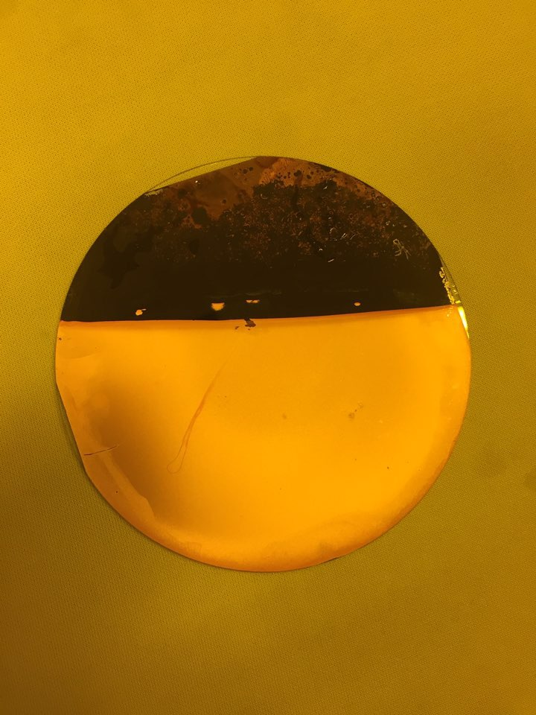
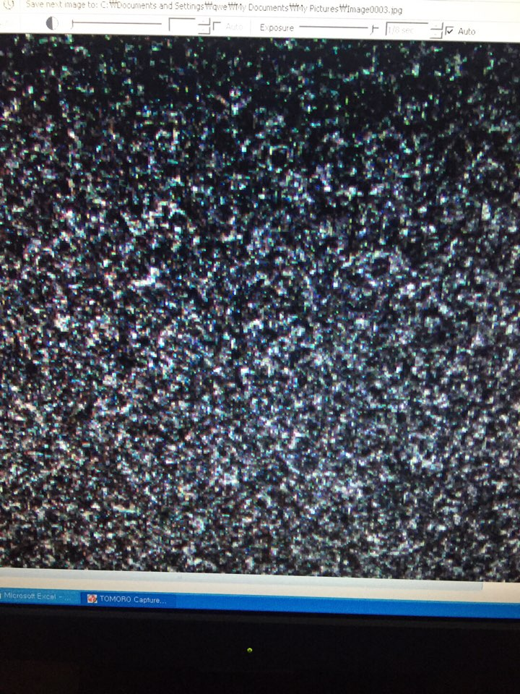
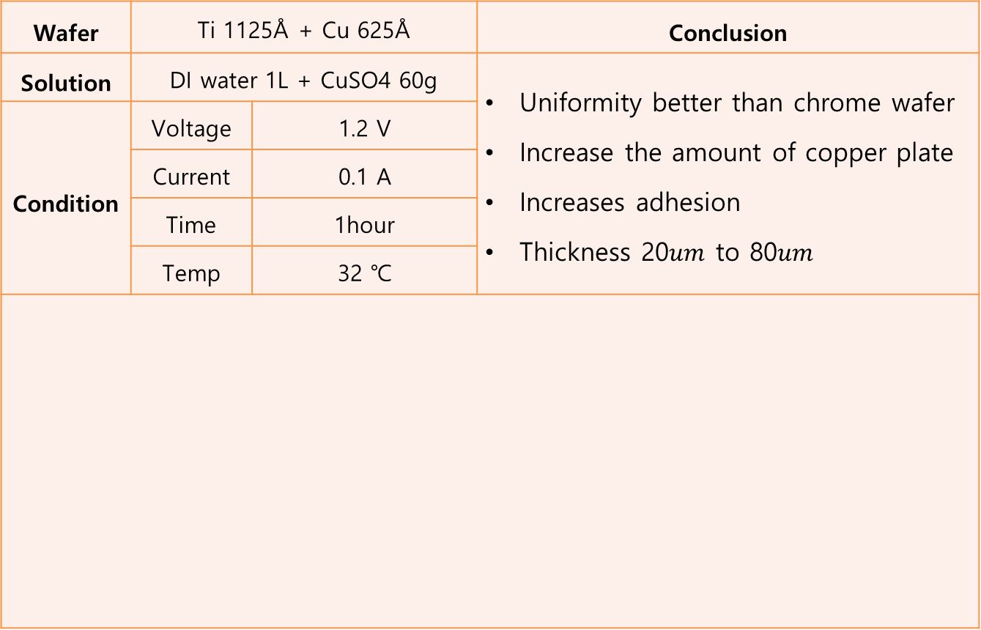
Results
Wafer | Ti 1125Å + Cu 625Å |  | Conclusion
Solution | DI water 1L + CuSO4 60g |  | Uniformity better than chrome wafer Increase the amount of copper plate Increases adhesion Thickness 20$um$ to 80$um$
Condition | Voltage | 1.2 V
 | Current | 0.1 A
 | Time | 1hour
 | Temp | 32 ℃
Notes:
This is a process of a wafer deposited copper on Titanium.
The plated copper thickness and adhesive increased more than Chrome wafer. The thickness was 20 ~ 80 micrometers and the uniformity was not so good.

Slide 11
Results
Current density gives influence to the uniformity
Plating doesn’t form with copper and chrome hardness differences
An insulating film builds if we put in too much hydrochloric acid
Notes:
We can find out 3 problems from the process results
First, current density gives influence to particle size.
We found out that particles gather where it has high current density
Second, plating is bad with on chrome due to hardness difference with Copper.
Plating forms well when the metal has similar hardness
Last, an insulating film builds if we put in too much hydrochloric acid and this disturbs current flow so it doesn’t progress plating

Slide 12
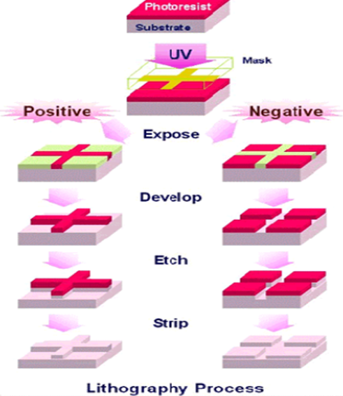

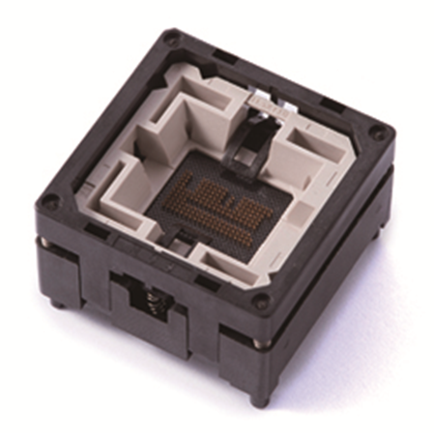
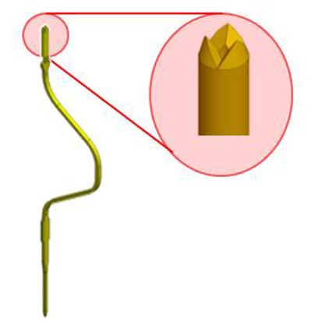
Goal of Research
Combine
Notes:
Goal of research
The final goal is to combine photolithography and electroplating and produce a 20$um$ probe that goes in a semiconductor testing equipment.

Slide 13
Thanks
Notes:
That’s all for my presentation. Thanks for listening

